Slide 1




Slide 2

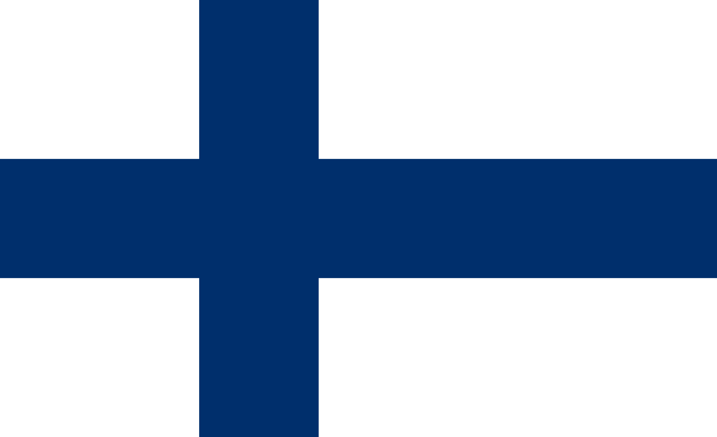
PRAYING FOR
FINLAND

Slide 3
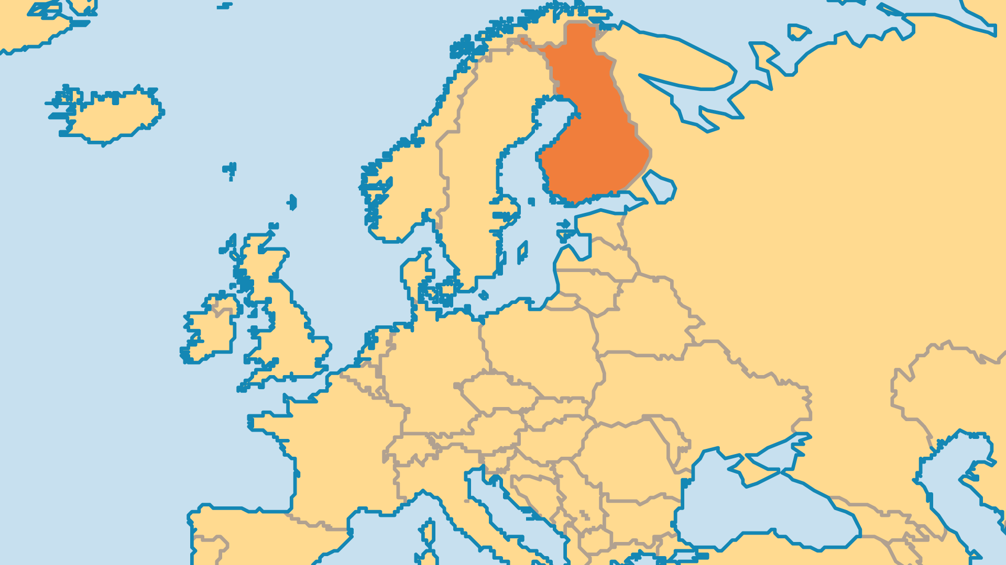
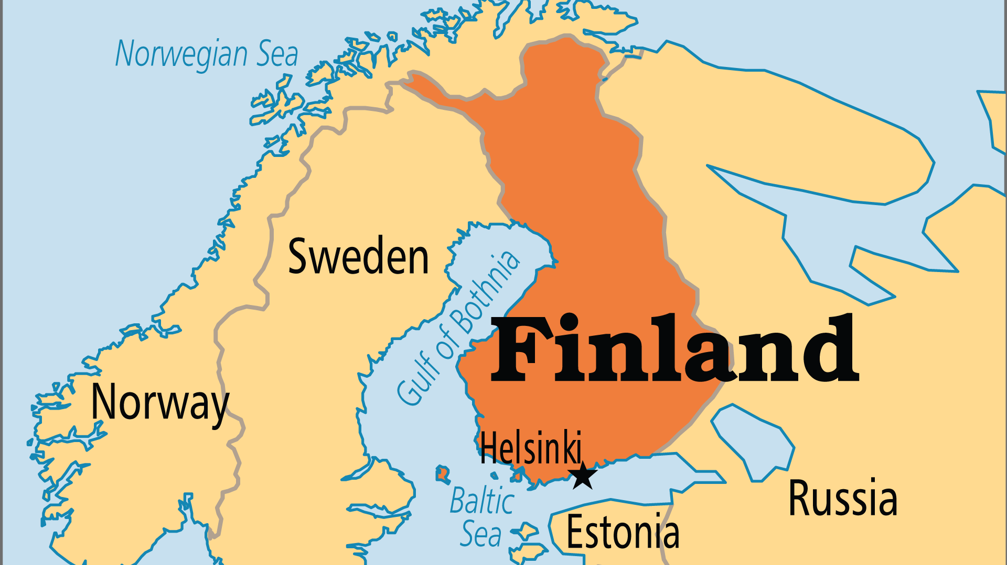
KEY STATS
Capital: | Helsinki
Population: | 5,623,330
% Urban: | 86.0 %
Pop Under 15 Yrs: | 16 %
Official Language: | Finnish, Swedish, Saami, sign language
Literacy Rate: | 100 %
HDI Ranking: | 11/193
% Christian: | 65.2 %
% Evangelical: | 12.1 %
% Unevangelized: | 2 %

Slide 4

FOR PRAYER
Finland has a largely secular society, even though Christians number around two-thirds of the population. 90% look with favour on the Church’s social work, but only 8% consistently attend any kind of religious service. The last revival came in the 1960s. Strong belief in the power of human reason, and rejection of supernatural things, now dominates the society. An ultra-modern country like Finland probably needs both reformation in the existing Church and also new expressions of faith. Pray for a spiritual breakthrough that will cause people to seek the Lord.
Want to know more? Go to www.operationworld.org

