Slide 1




Slide 2


PRAYING FOR
FIJI

Slide 3
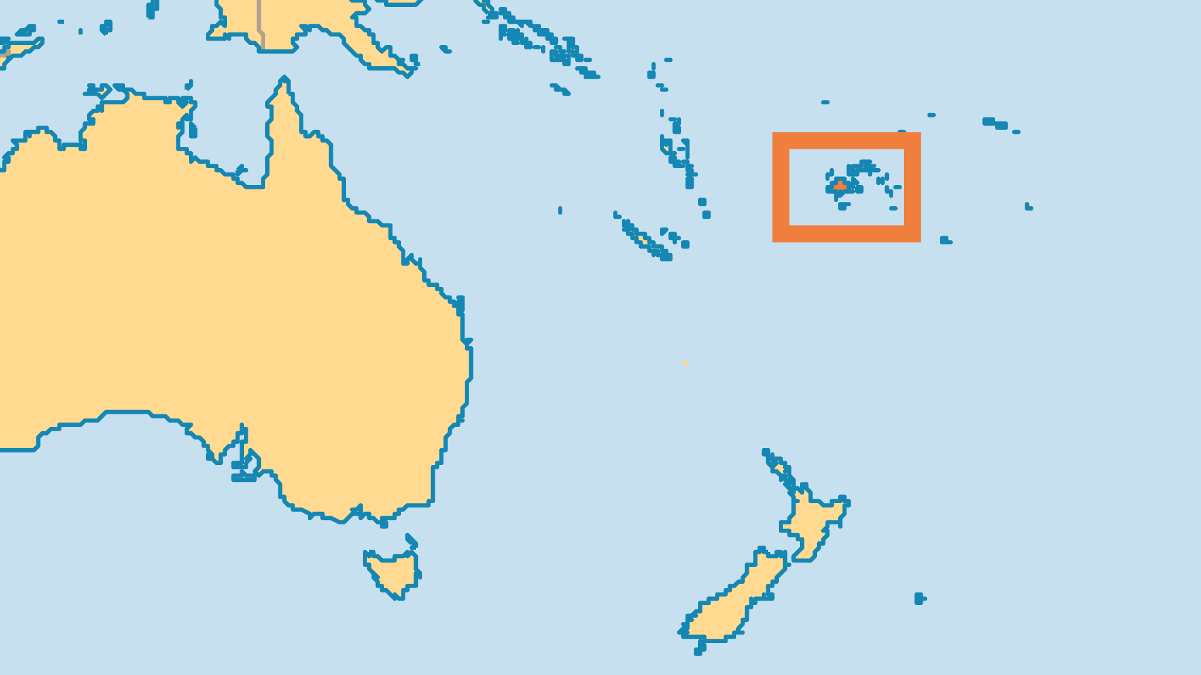
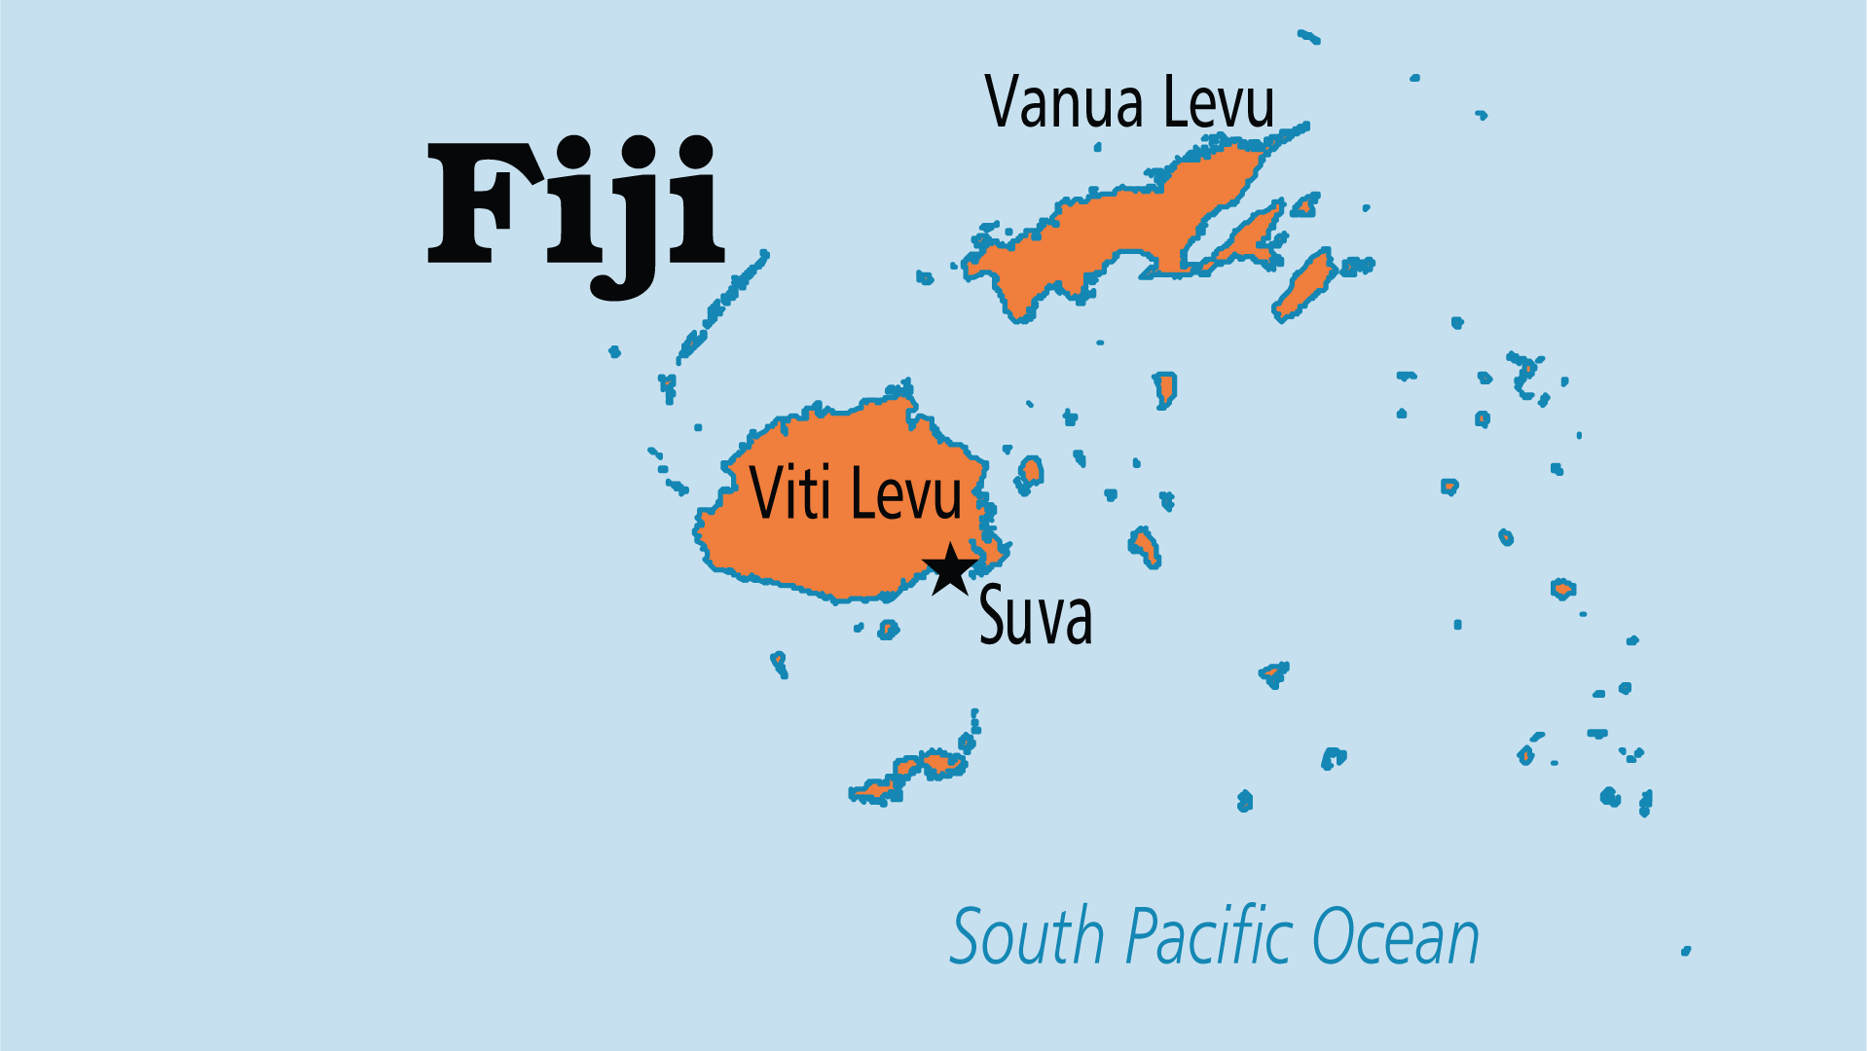
KEY STATS
Capital: | Suva
Population: | 933,155
Official Language: | English, iTaukei, Fiji Hindi
Languages: | 21
HDI Ranking: | 99/193
% Christian: | 65.1 %
% Evangelical: | 25.2 %
People Groups: | 33
Least Reached People Groups: | 1
% Unevangelized: | 13 %

Slide 4

FOR PRAYER
British colonial practices on Fijian plantations first saw the importation of slaves, and then the use of indentured labourers from India, who have since grown and thrived as communities. However, racial division between native Fijians and Indo-Fijians persists, and common ground between these two groups has not been easy to find. Native Fijians feel their values and social structures are under threat from government policy. Indo-Fijians still feel trauma from the events surrounding recent coups. Both groups want to be able to get on with their lives. Pray that native Fijians may be able to thrive in their own land while Indo-Fijians and others can still enjoy fair treatment and opportunity.

