Slide 1




Slide 2

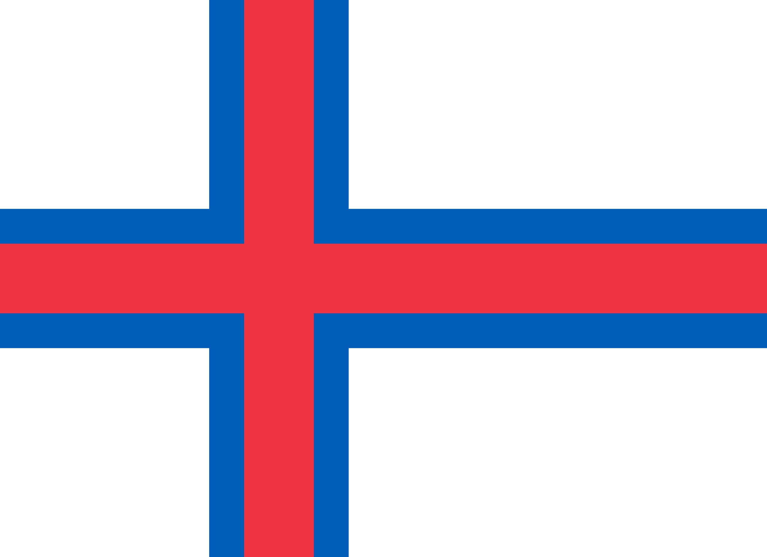
PRAYING FOR
FAROE ISLANDS

Slide 3
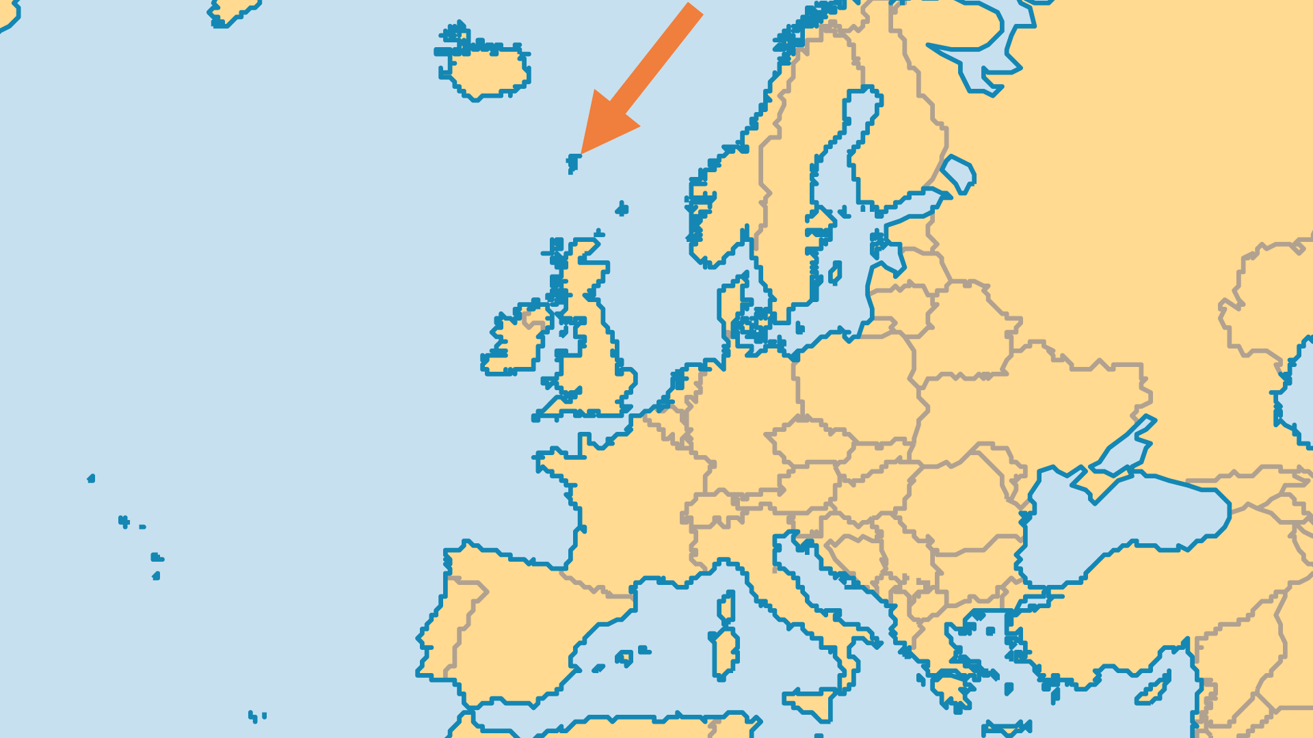
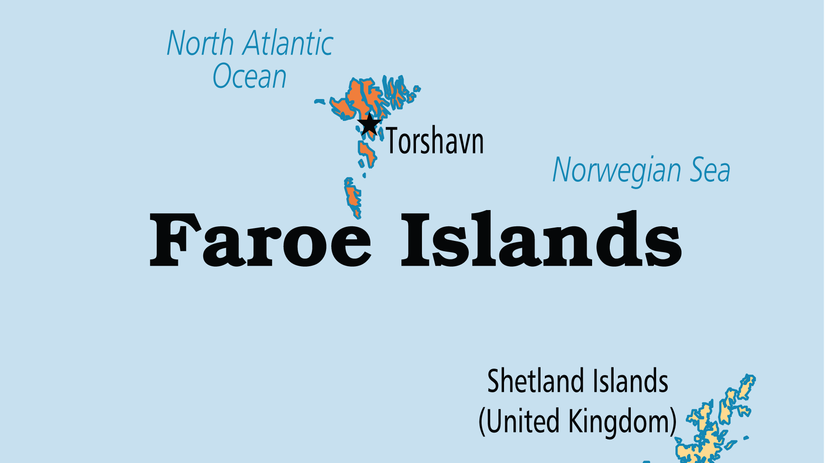
KEY STATS
Capital: | Torshavn
Population: | 56,002
% Urban: | 43.4 %
Official Language: | Faroese, Danish
% Christian: | 90.6 %
% Evangelical: | 28.8 %
Largest Religion: | Christian
People Groups: | 3
% Unevangelized: | 1 %

Slide 4

FOR PRAYER
The Faroese need revival. From the Lutheran Church (with many nominals as well as a solid evangelical contingent) to the Pentecostals and charismatics, local Christian leaders all agree that these islands are starting to see a fresh move of the Holy Spirit. The Lutheran Church has declined, but its recent independence from Danish Lutheranism sees an emerging evangelicalism, such as the growing Pietist Home Mission with 35 prayer houses and up to 5,000 affiliates. Pray for the Spirit to make the Faroes truly Christian - and not just in name only.
Want to know more? Go to www.operationworld.org

