Slide 1




Slide 2

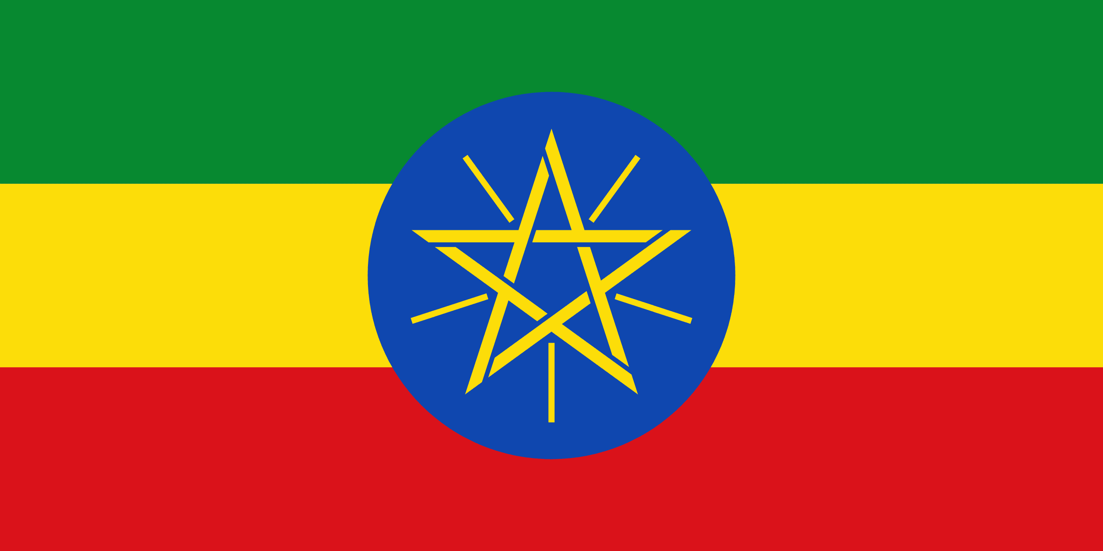
PRAYING FOR
ETHIOPIA

Slide 3
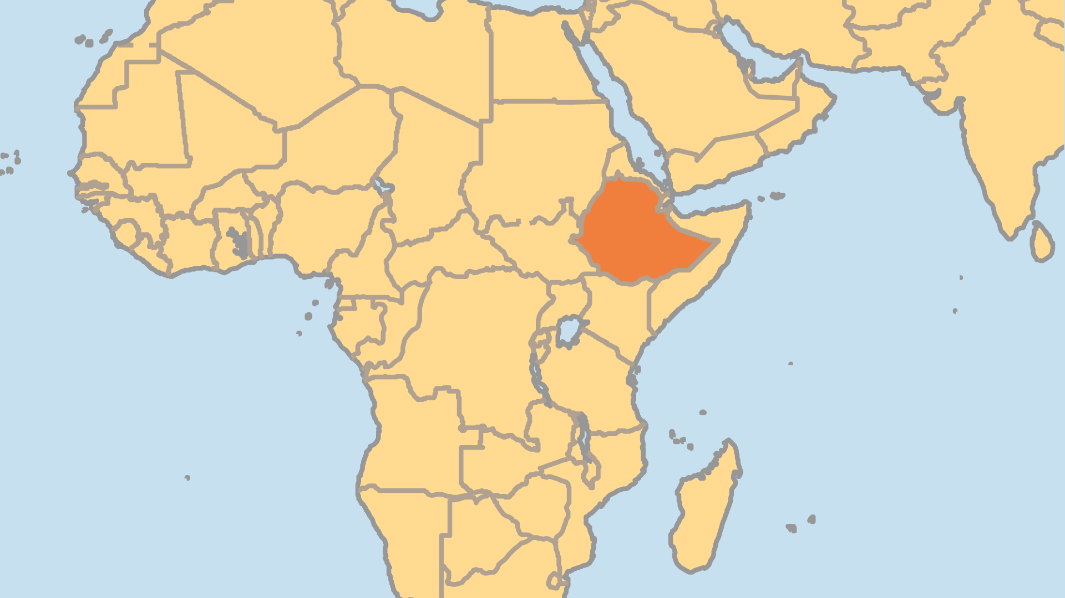
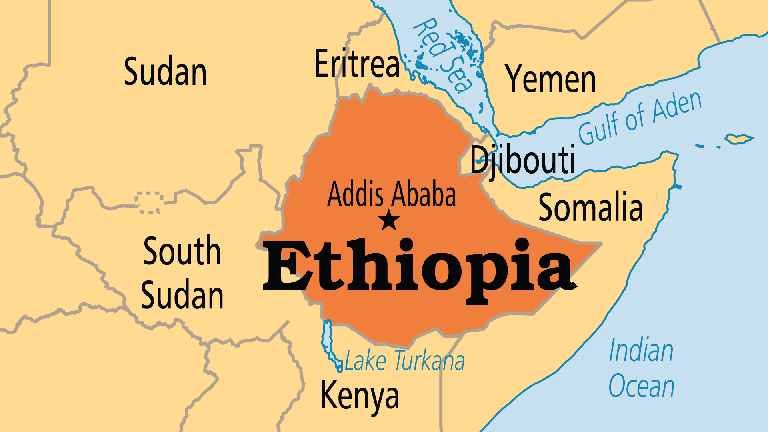
KEY STATS
Capital: | Addis Ababa
Population: | 135,472,051
Official Language: | Amharic; English widely taught.
Languages: | 88
Literacy Rate: | 49 %
HDI Ranking: | 175/193
% Christian: | 60.7 %
% Evangelical: | 19.6 %
% Unevangelized: | 15 %
Persecution Ranking: | 33/50

Slide 4

FOR PRAYER
Ethiopia's major ethnic groups (Amhara, Tigrinya, Oromo, Somali, Afar) divide themselves largely by geographic region, which gives each more independence at the expense of national unity. As a result, Ethiopia's stability and power balances are precarious. A wide gap now exists between the few who are rich and the many who are poor. From 2020, civil conflict - along ethnic lines - erased much of the recent economic progress. Tigrayans describe it as genocide. The violence has abated somewhat, but the humanitarian crisis affects 20 million people. Pray for an end to the terrible violence, and a peace that offers esteem to every region and ethnic group while also enabling a genuine national unity.

Slide 5
FOR PRAYER
The Ethiopian Orthodox Church is enduring a time of immense change. Centuries of isolation from the rest of the Christian world - as a Christian island in a sea of Islam - helped form its unique culture, theology and traditions. The Orthodox Church is being challenged by the growth of both Islam and contemporary Christian movements, but its roots run deep. Pray for God to bring new vibrancy to this ancient faith.
Want to know more? Go to www.operationworld.org

