Slide 1




Slide 2


PRAYING FOR
ESTONIA

Slide 3
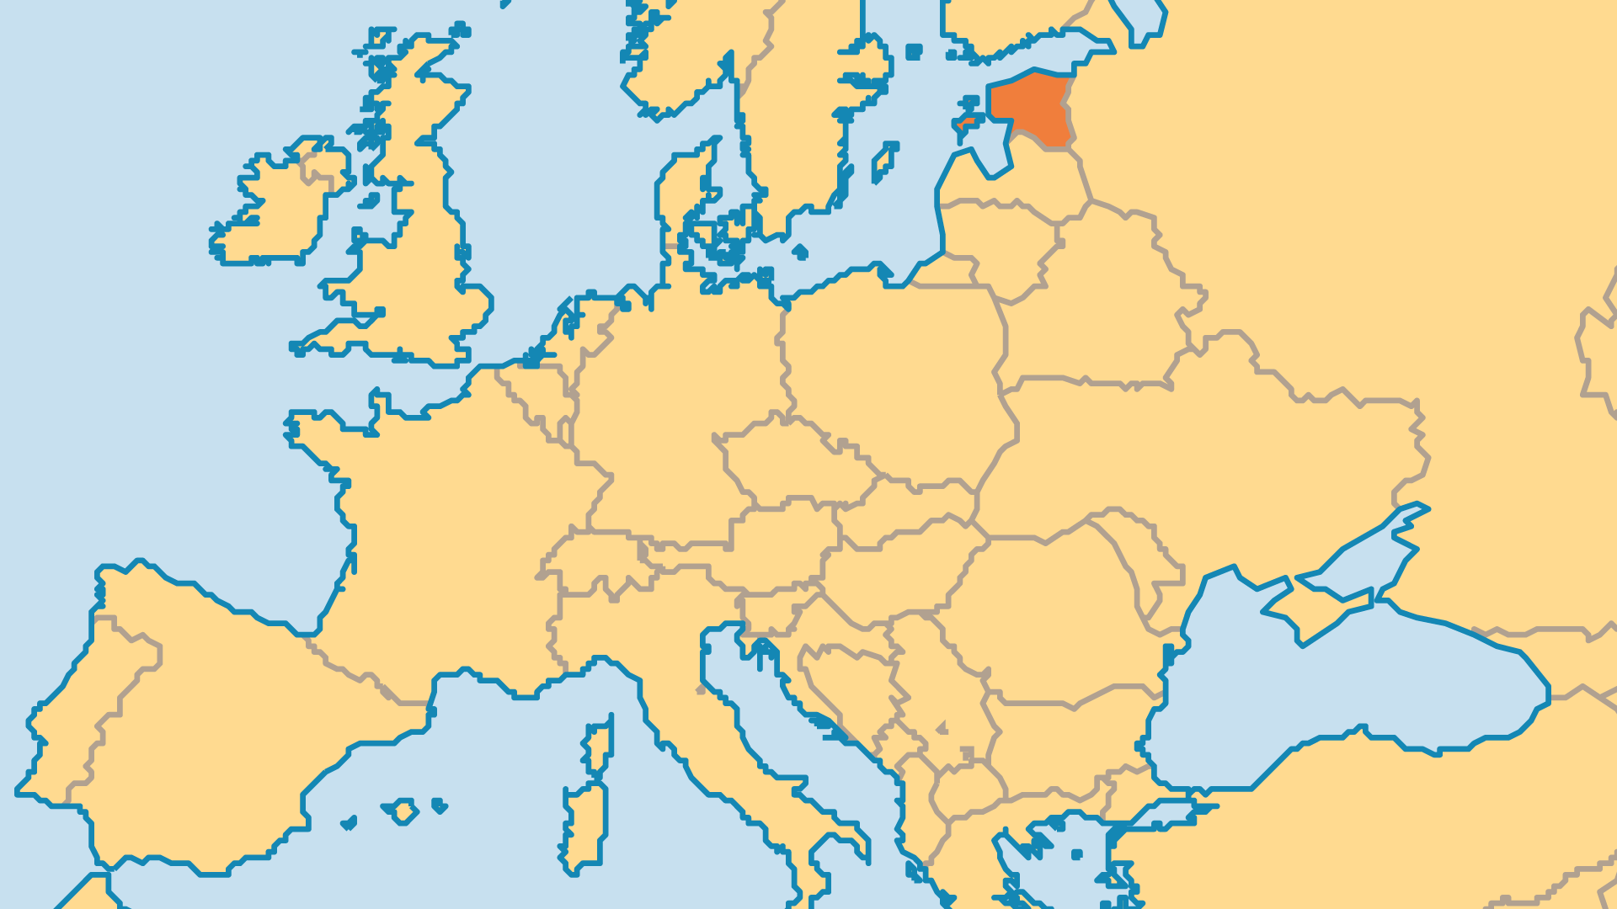
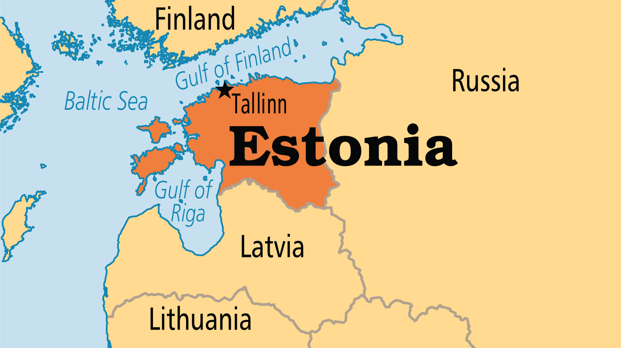
KEY STATS
Continent: | Europe
Capital: | Tallinn
Population: | 1,344,232
Pop Under 15 Yrs: | 16.5 %
Official Language: | Estonian; Russian is still common
Literacy Rate: | 99 %
% Christian: | 45.3 %
% Evangelical: | 4.9 %
Largest Religion: | Non-religious
% Largest Religion: | 54 %
% Unevangelized: | 4 %

Slide 4

FOR PRAYER
Estonia found political and economic success after the time of Soviet domination (1940-1988). Poverty remains a problem, and greed for material possessions grows as the economy grows. Estonia faces a crisis of values as the people become more and more secular in their attitudes. Pray for a wise and upright government to model righteousness and biblical values.
Want to know more? Go to www.operationworld.org

