Slide 1




Slide 2


PRAYING FOR
ERITREA

Slide 3
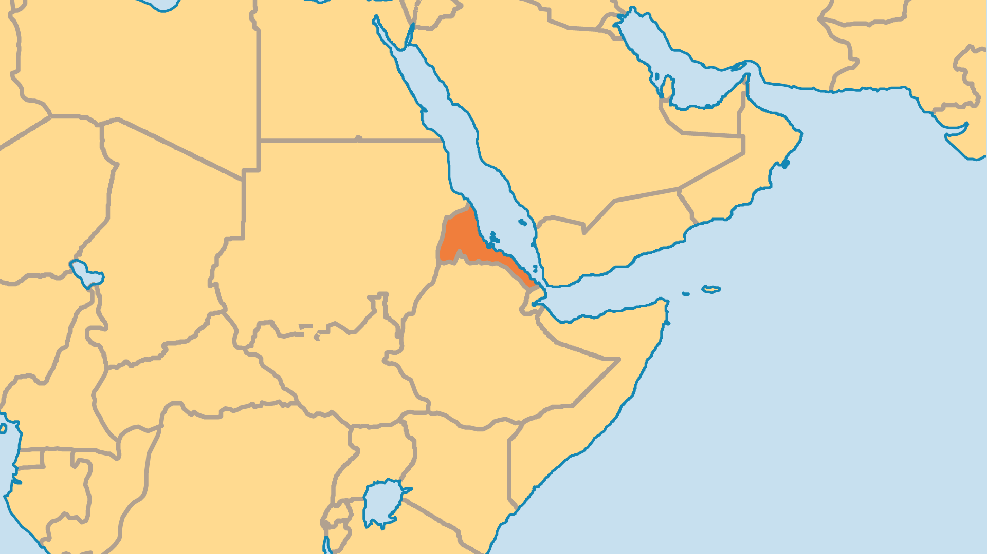
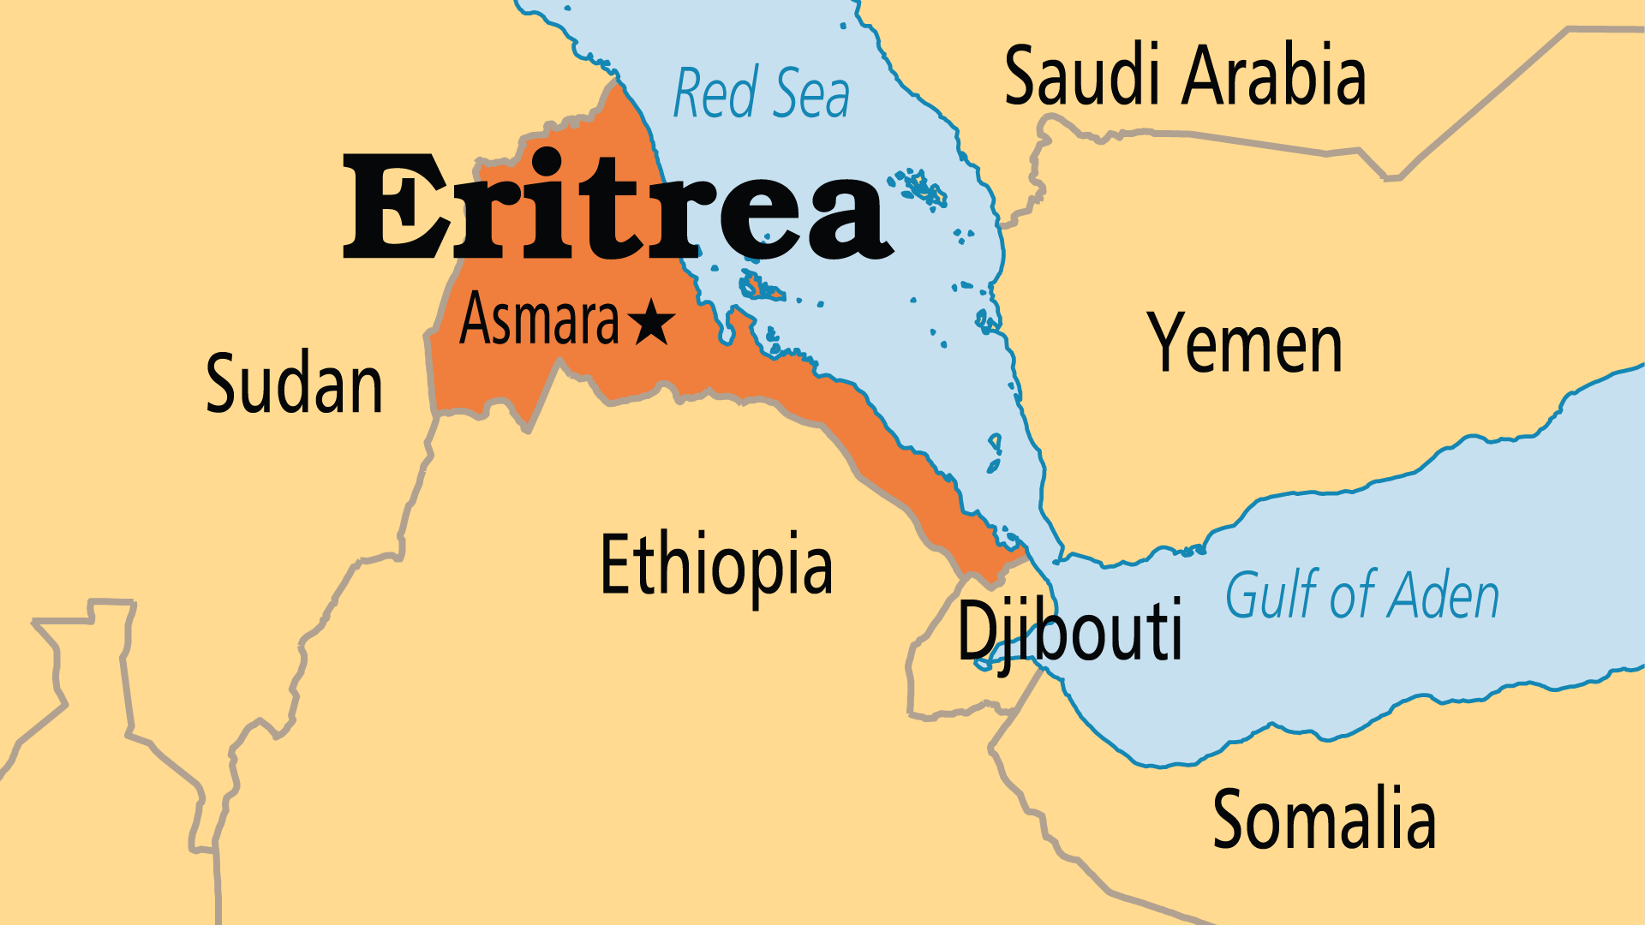
KEY STATS
Capital: | Asmara
Population: | 3,607,003
Official Language: | Tigrinya. Tigre, Arabic and English
Languages: | 18
HDI Ranking: | 176/193
% Christian: | 47.3 %
% Evangelical: | 2.1 %
Largest Religion: | Muslim
% Unevangelized: | 29 %
Persecution Ranking: | 6/50

Slide 4

FOR PRAYER
Eritrea is located in a region fraught with conflict and crises. Many face extreme poverty with no relief ahead as drought and food shortages are serious challenges in this one-party state. Mandatory military service limits the size of the workforce. Many emigrate to escape the military, and the money sent home by those who live abroad provides a vital source of income for the country. Eritrea's relations with its neighbour and former enemy, Ethiopia, have significantly improved of late. Pray for the government to focus on caring and providing for its own people - it has a terrible record on human rights and press freedoms, accompanied by an obsession with military power and control.

Slide 5
FOR PRAYER
Religious freedom remains a major issue. A 2002 government ruling banned all religious groups from meeting together and practicing their faith without official recognition, and it granted recognition only to Sunni Islam, Eritrean Orthodox, Roman Catholic and Evangelical Lutheran groups. The effects of this on all Eritreans are significant, especially so on Christians within non-approved groups. Some posit this as a reaction against the evangelical growth within the Orthodox Church and during the long war with Ethiopia. Pray for government acceptance of religious groups and for restoration of basic human rights and religious freedom to all Eritreans.

