Slide 1




Slide 2


PRAYING FOR
EQUATORIAL GUINEA

Slide 3
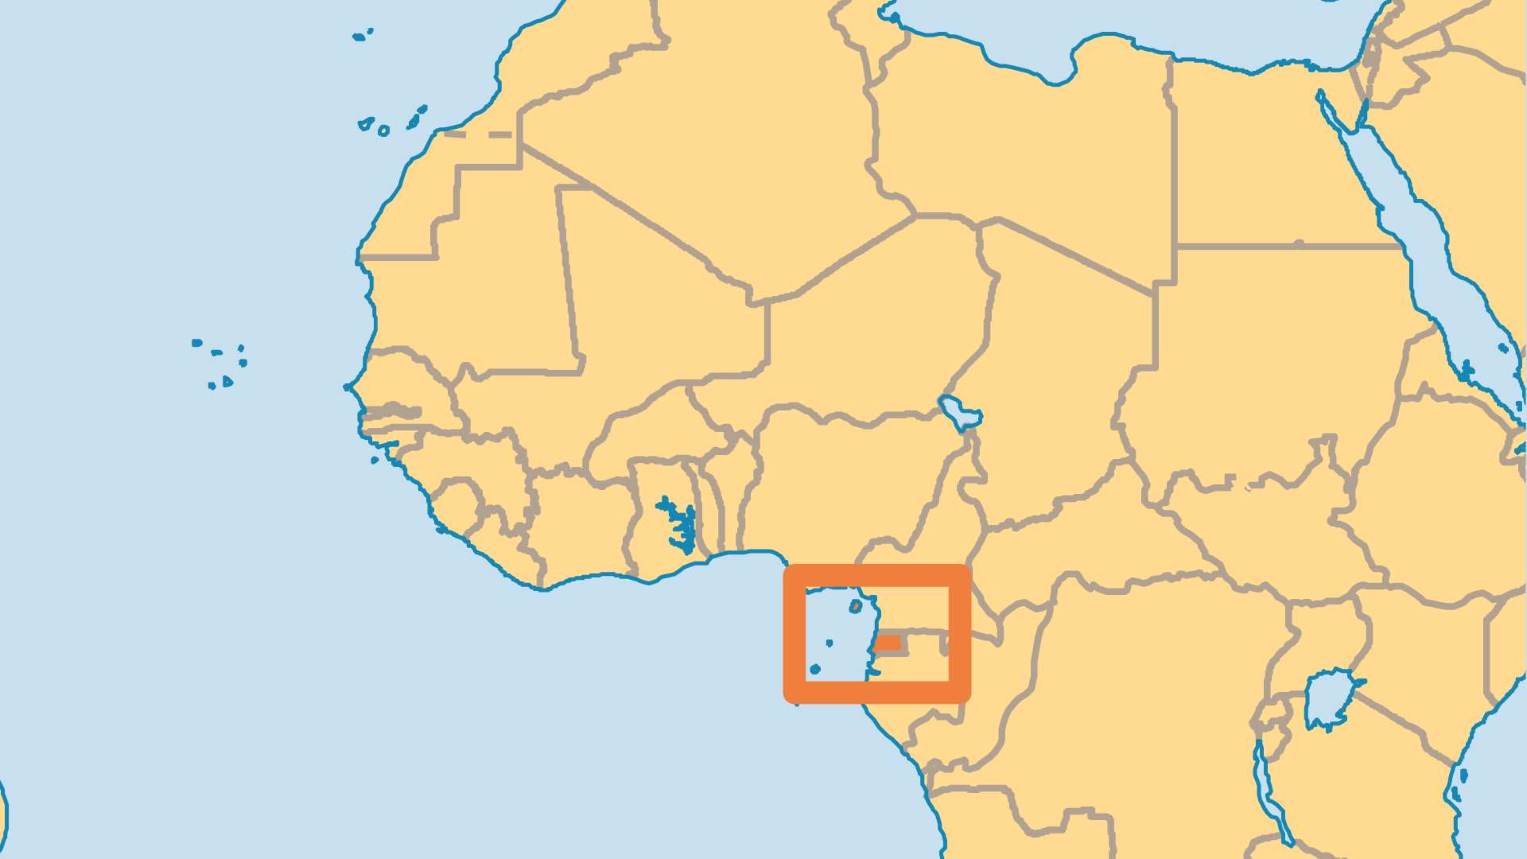
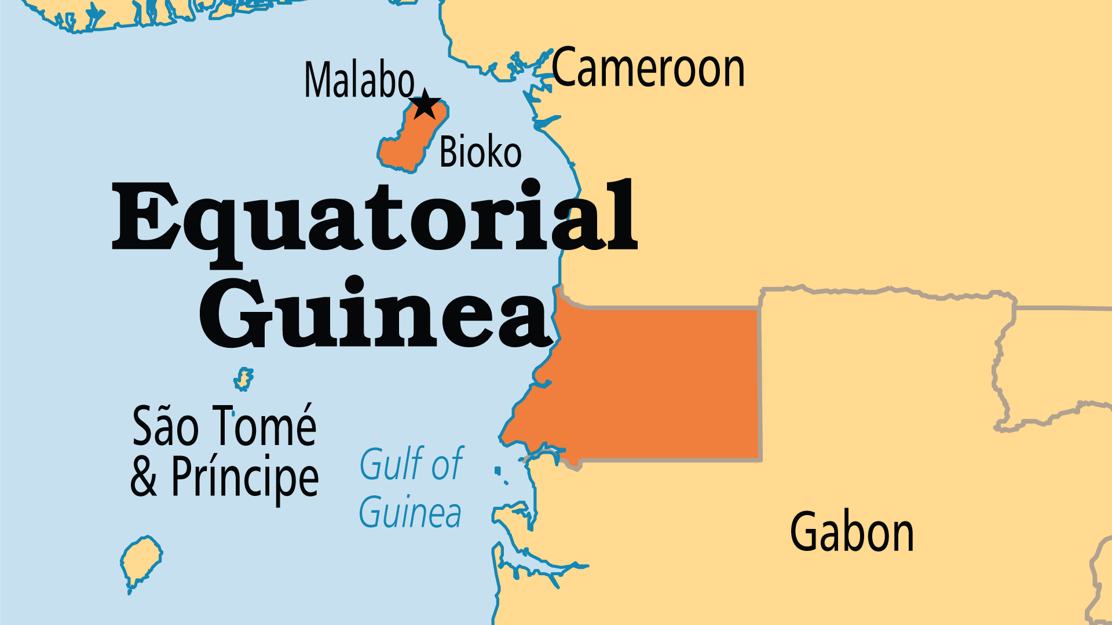
KEY STATS
Capital: | Malabo
Population: | 1,938,431
Official Language: | Spanish; French; Portuguese
Languages: | 14
Literacy Rate: | 88 %
Life Expectancy: | 60.6 yrs (217th/236)
HDI Ranking: | 145/193
% Christian: | 90 %
% Evangelical: | 4.4 %
% Unevangelized: | 1 %

Slide 4

FOR PRAYER
Equatorial Guinea faces an unusual political and economic situation. Large oil reserves made a small minority very rich. Western oil companies work with a regime whose human rights record is poor in order to increase profits. Corruption means that most people do not benefit from such wealth. Pray for economic justice and wise stewardship. The oil boom brings in foreigners, both Christian and Muslim. Pray that expat believers might engage with the spiritual and physical needs of the nation. Pray that foreign companies do business in ways that benefit the local people. What will be left to show when the oil money ends?
Want to know more? Go to www.operationworld.org

