Slide 1




Slide 2

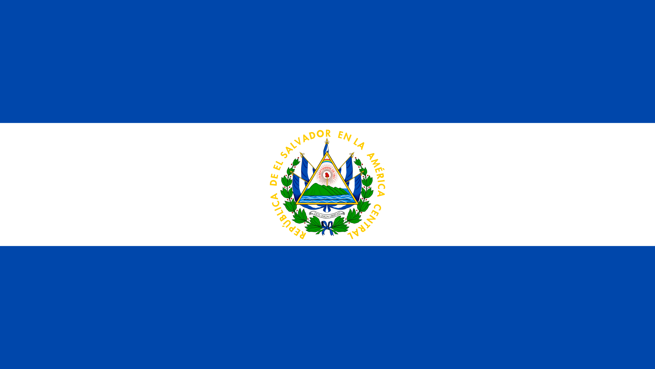
PRAYING FOR
EL SALVADOR

Slide 3
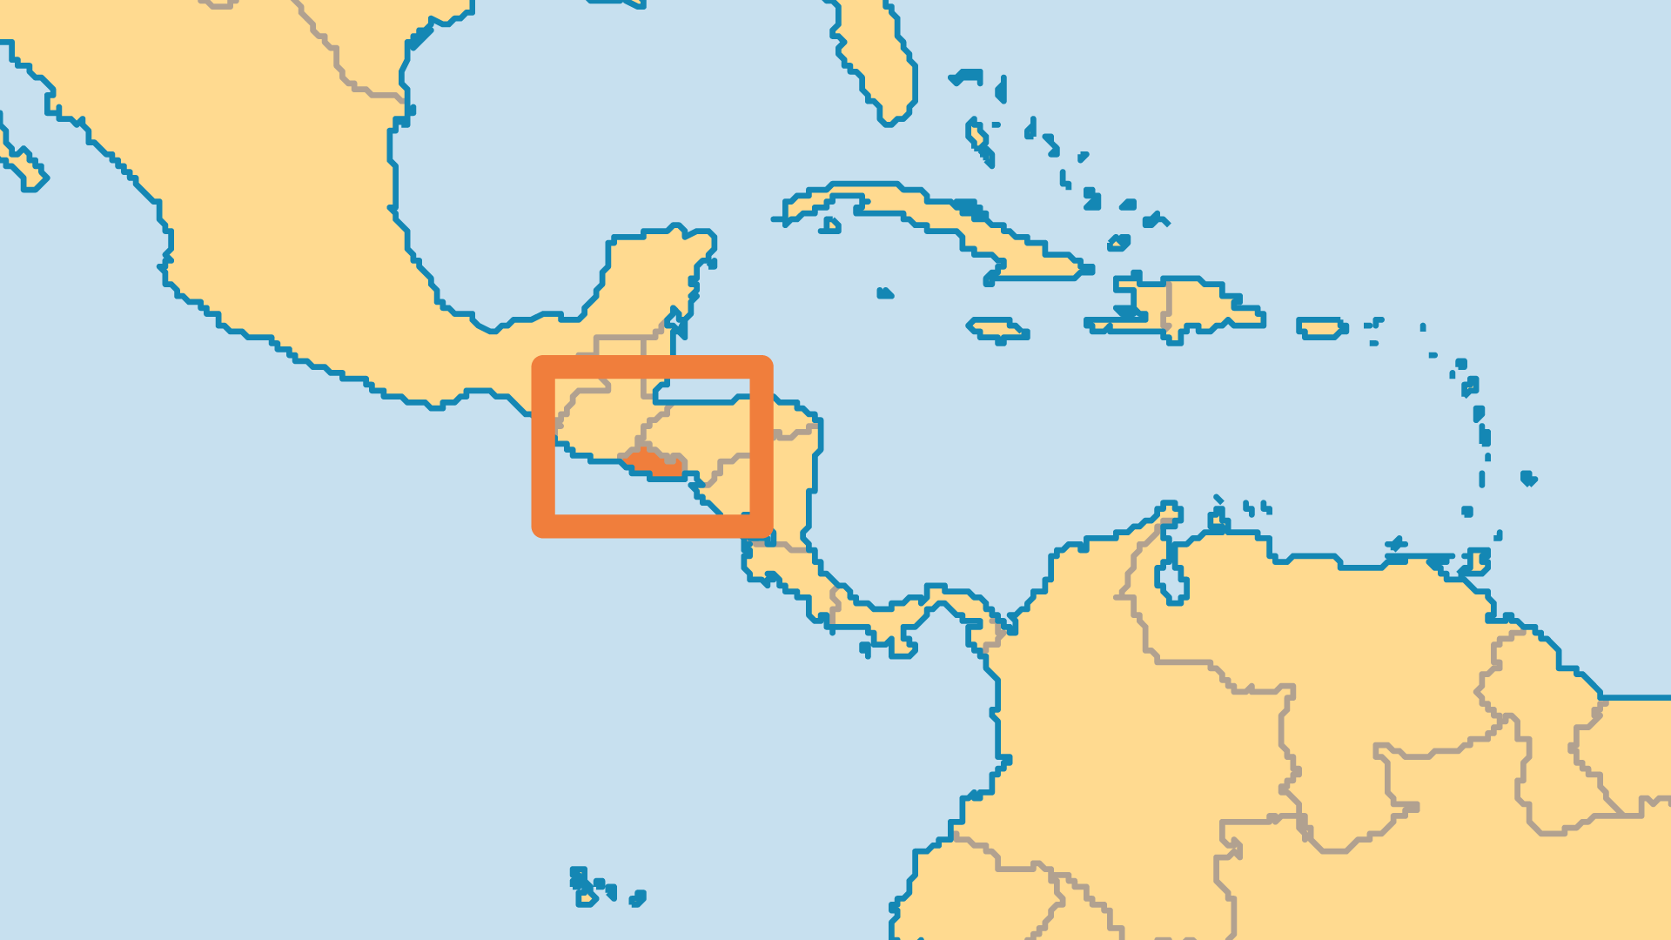
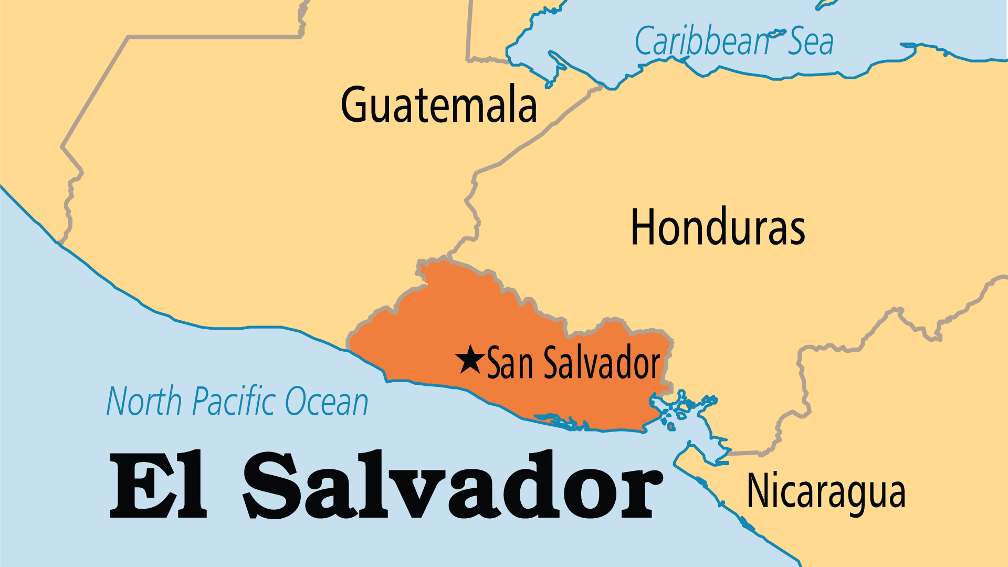
KEY STATS
Capital: | San Salvador
Population: | 6,365,503
% Urban: | 76.6 %
Pop Under 15 Yrs: | 26.9 %
Official Language: | Spanish
Languages: | 7
Literacy Rate: | 87 %
HDI Ranking: | 125/193
% Christian: | 94.6 %
% Evangelical: | 31.6 %
% Unevangelized: | 1 %

Slide 4

FOR PRAYER
Praise God for peace since the civil war ended in 1992. Corruption in politics has been a big problem in El Salvador, but multiple free elections have occurred. Now El Salvador largely struggles with poverty and gang violence. Nearly 23% of the country lives below the poverty line. Money sent home from Salvadorans working abroad is the largest part of the economy. Violent criminal gangs known as "maras" keep the nation among the global leaders for murder rates and juvenile delinquency. Overcoming these two giants will take more than just good social and economic policy. El Salvador needs a spiritual awakening that transforms the nation!
Want to know more? Go to www.operationworld.org

