Slide 1




Slide 2


PRAYING FOR
EGYPT

Slide 3
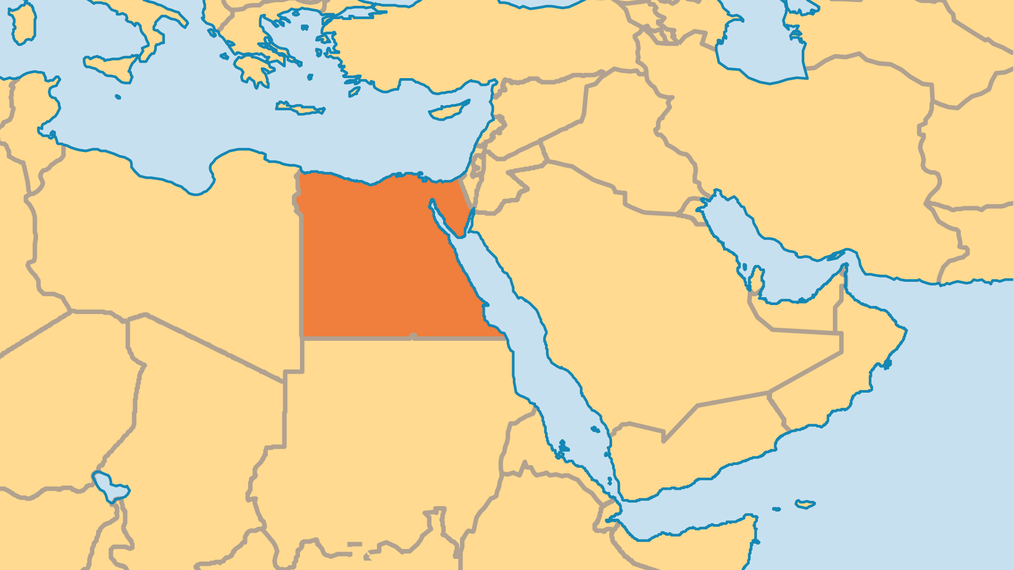
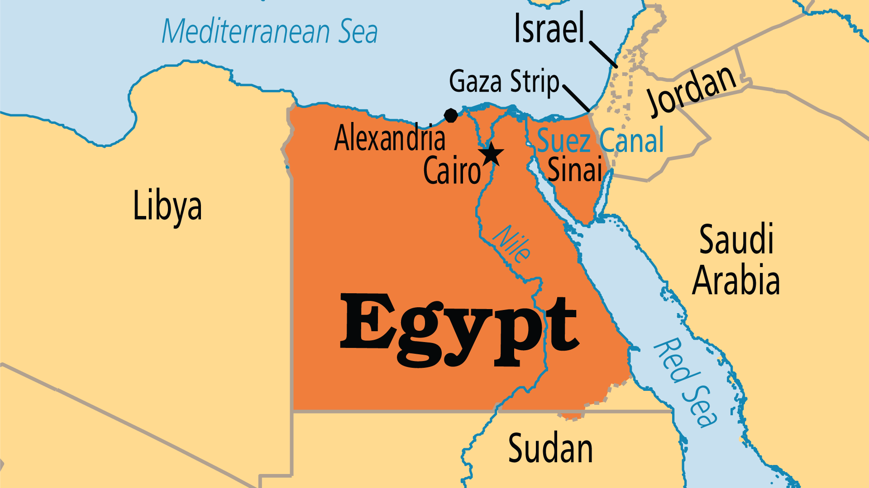
KEY STATS
Continent: | Africa
Capital: | Cairo
Population: | 118,365,995
Official Language: | Arabic
% Christian: | 12.8 %
% Evangelical: | 3.9 %
Largest Religion: | Muslim
% Largest Religion: | 86.7 %
% Unevangelized: | 38 %
Persecution Ranking: | 40/50

Slide 4

FOR PRAYER
More than a decade since the Arab Spring upheaval, some of the change protestors hoped for has arrived, but much remains the same as before 2011. President Sisi appears to be instilling authoritarian rule once again, but many - including Christians - feel this is necessary to curb Islamist movements from regaining control. Christians still live in a precarious situation regarding religious freedom and persecution. Many Muslims would prefer Egypt did not have such a large Christian population. Pray for a government that serves God's purposes - to restrain evil, punish crime, and enable peaceful and quiet lives among the citizenry.

Slide 5
FOR PRAYER
For over 1,000 years, Egypt was a majority-Christian country, even after the Arab Muslim conquest in AD 640. Egypt gave to the Christian world some of its greatest theologians and the monastic movement. Egyptian Christians may be more clearly linked to the original Egyptian civilization that pre-dates the coming of Islam. Some try to minimize Egypt's great Christian heritage, to downplay the size of the Church and to marginalize its contribution to society. Pray for recognition of the Church's history and role within Egypt and for an even greater role in the future.
Want to know more? Go to www.operationworld.org

