Slide 1




Slide 2

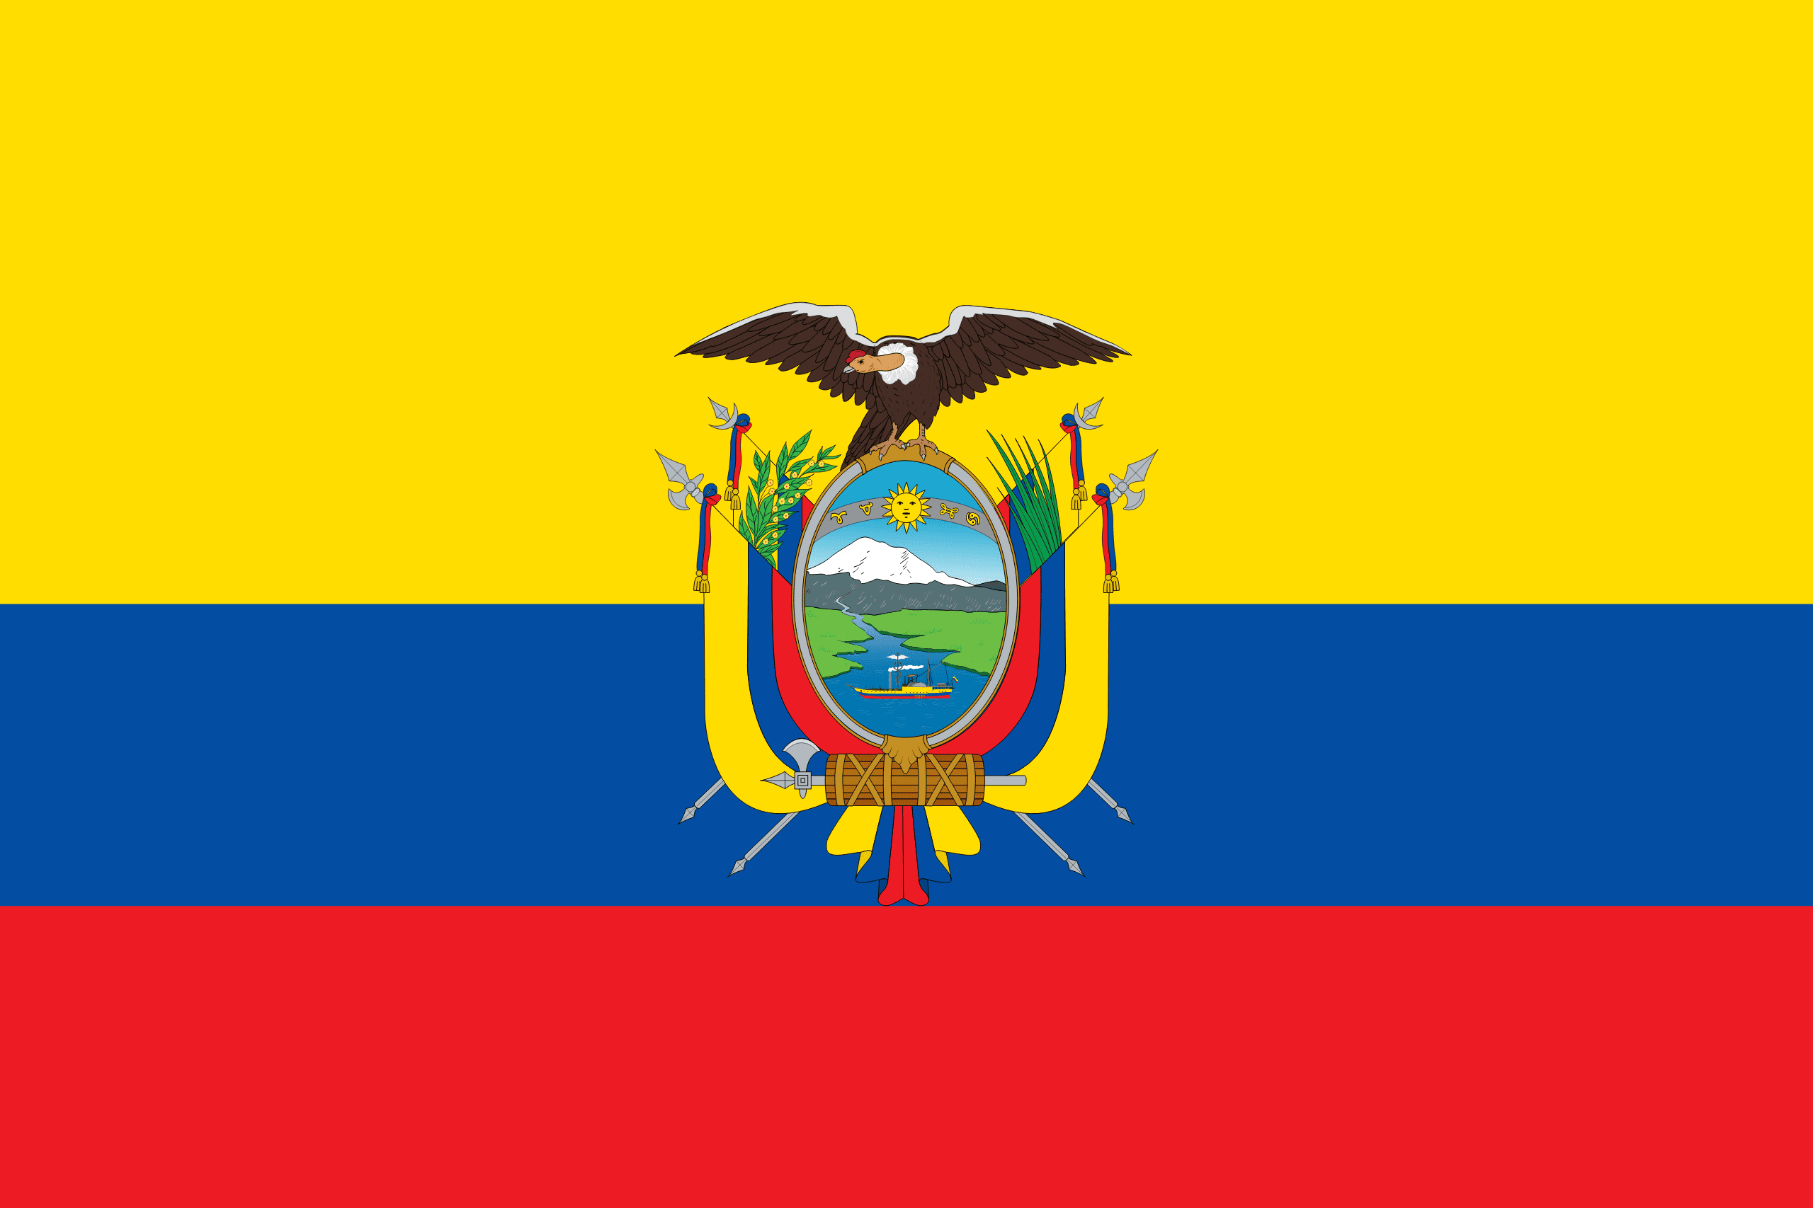
PRAYING FOR
ECUADOR

Slide 3
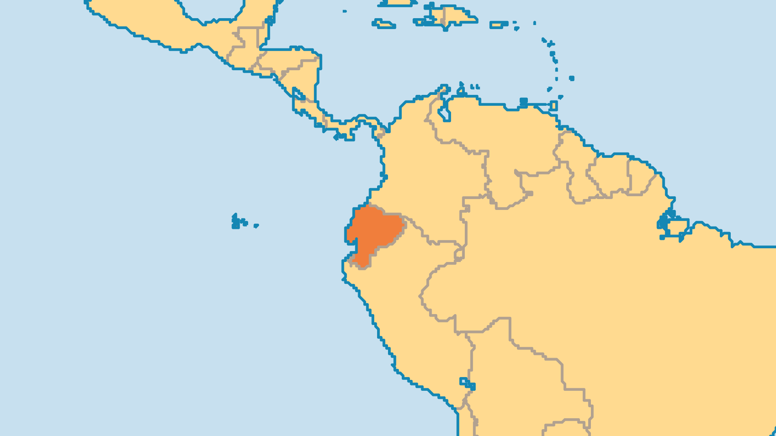
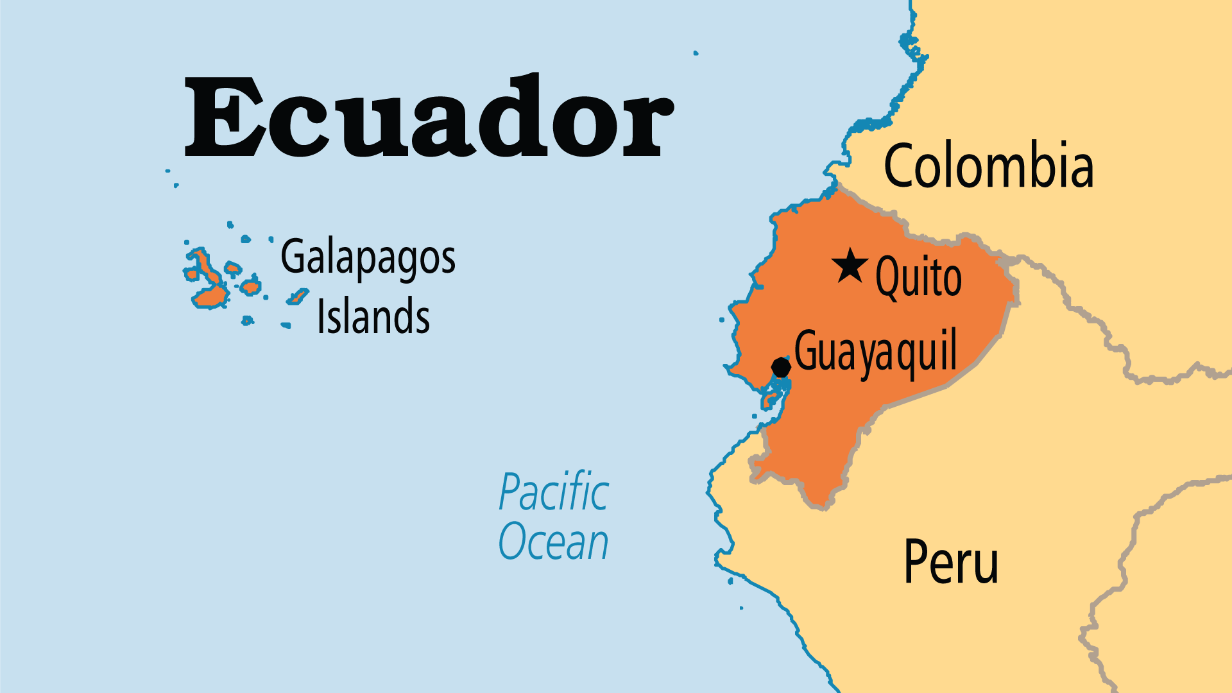
KEY STATS
Capital: | Quito
Population: | 18,289,896
Official Language: | Spanish
Languages: | 25
HDI Ranking: | 95/193
% Christian: | 94.5 %
% Evangelical: | 8.5 %
People Groups: | 36
Least Reached People Groups: | 1
% Unevangelized: | 1 %

Slide 4

FOR PRAYER
The gospel impact on the Quichua is a true miracle. In 1967, only 120 out of 3 million people followed Christ. Today some Quichua areas are over 50% evangelical! Over 240,000 people go to churches planted through Avant Ministries which worked among the Quichua for over 100 years. Following worldwide attention in 1956 when the Waorani (Auca) killed 5 young foreign missionaries, now almost all these tribes have churches and the Scriptures through the work of missionaries. The first of great mission broadcasters, HCJB Radio began in Ecuador in 1931. Today the ministry blesses Ecuador and the whole world.
Want to know more? Go to www.operationworld.org

