Slide 1




Slide 2

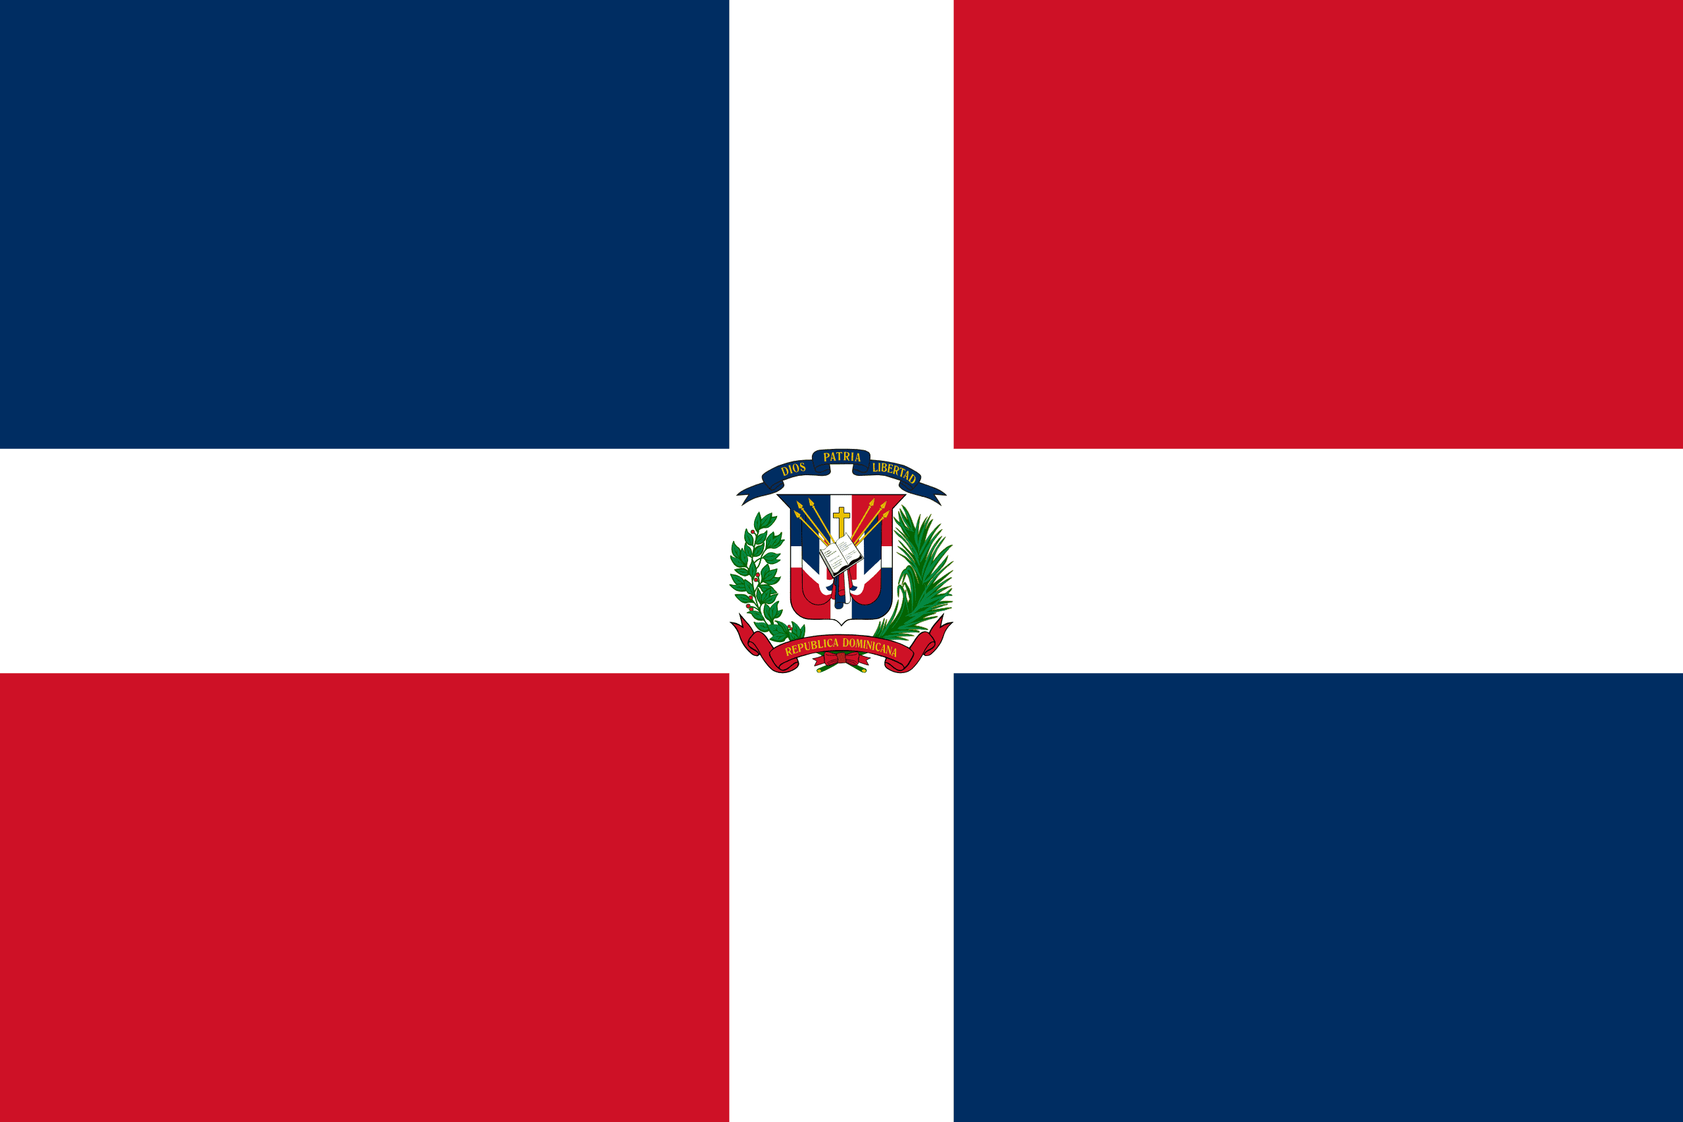
PRAYING FOR
DOMINICAN REPUBLIC

Slide 3
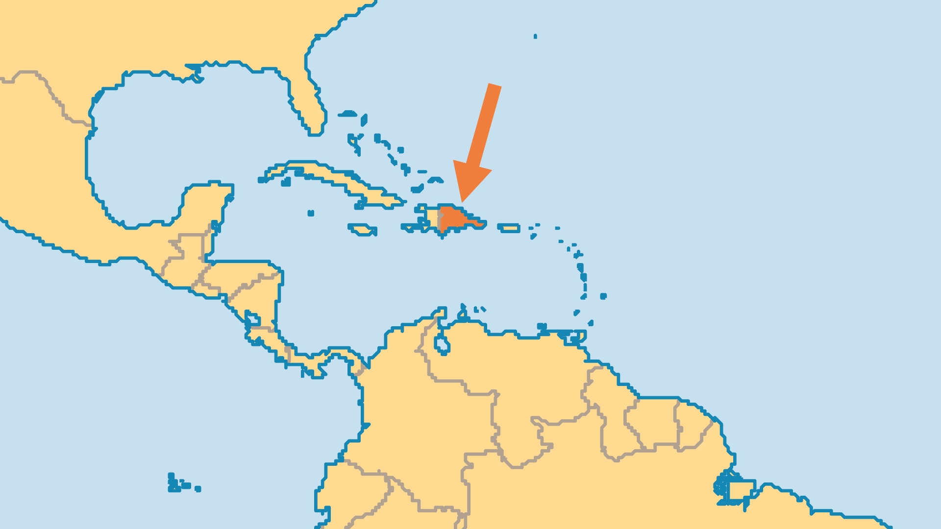
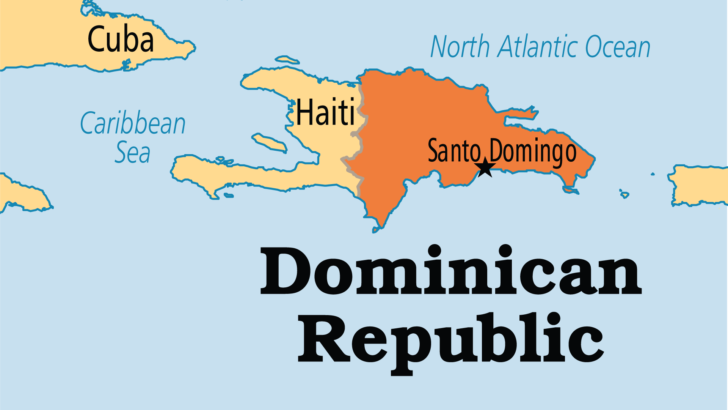
KEY STATS
Capital: | Santo Domingo
Population: | 11,520,487
% Urban: | 85.5 %
Pop Under 15 Yrs: | 27.7 %
Official Language: | Spanish
Literacy Rate: | 91 %
HDI Ranking: | 80/193
% Christian: | 94.4 %
% Evangelical: | 9.1 %
% Unevangelized: | 1 %

Slide 4

FOR PRAYER
The Dominican Republic has suffered 500 years of turmoil. First, one million indigenous Arawak Taino people died from foreign diseases and Spanish rule. Sugar cane plantation owners later imported African slaves. Both European colonial powers and later Dominican governments exploited the land and people. Pray for economic and political justice to visit this nation that has suffered for so long.
Want to know more? Go to www.operationworld.org

