Slide 1




Slide 2

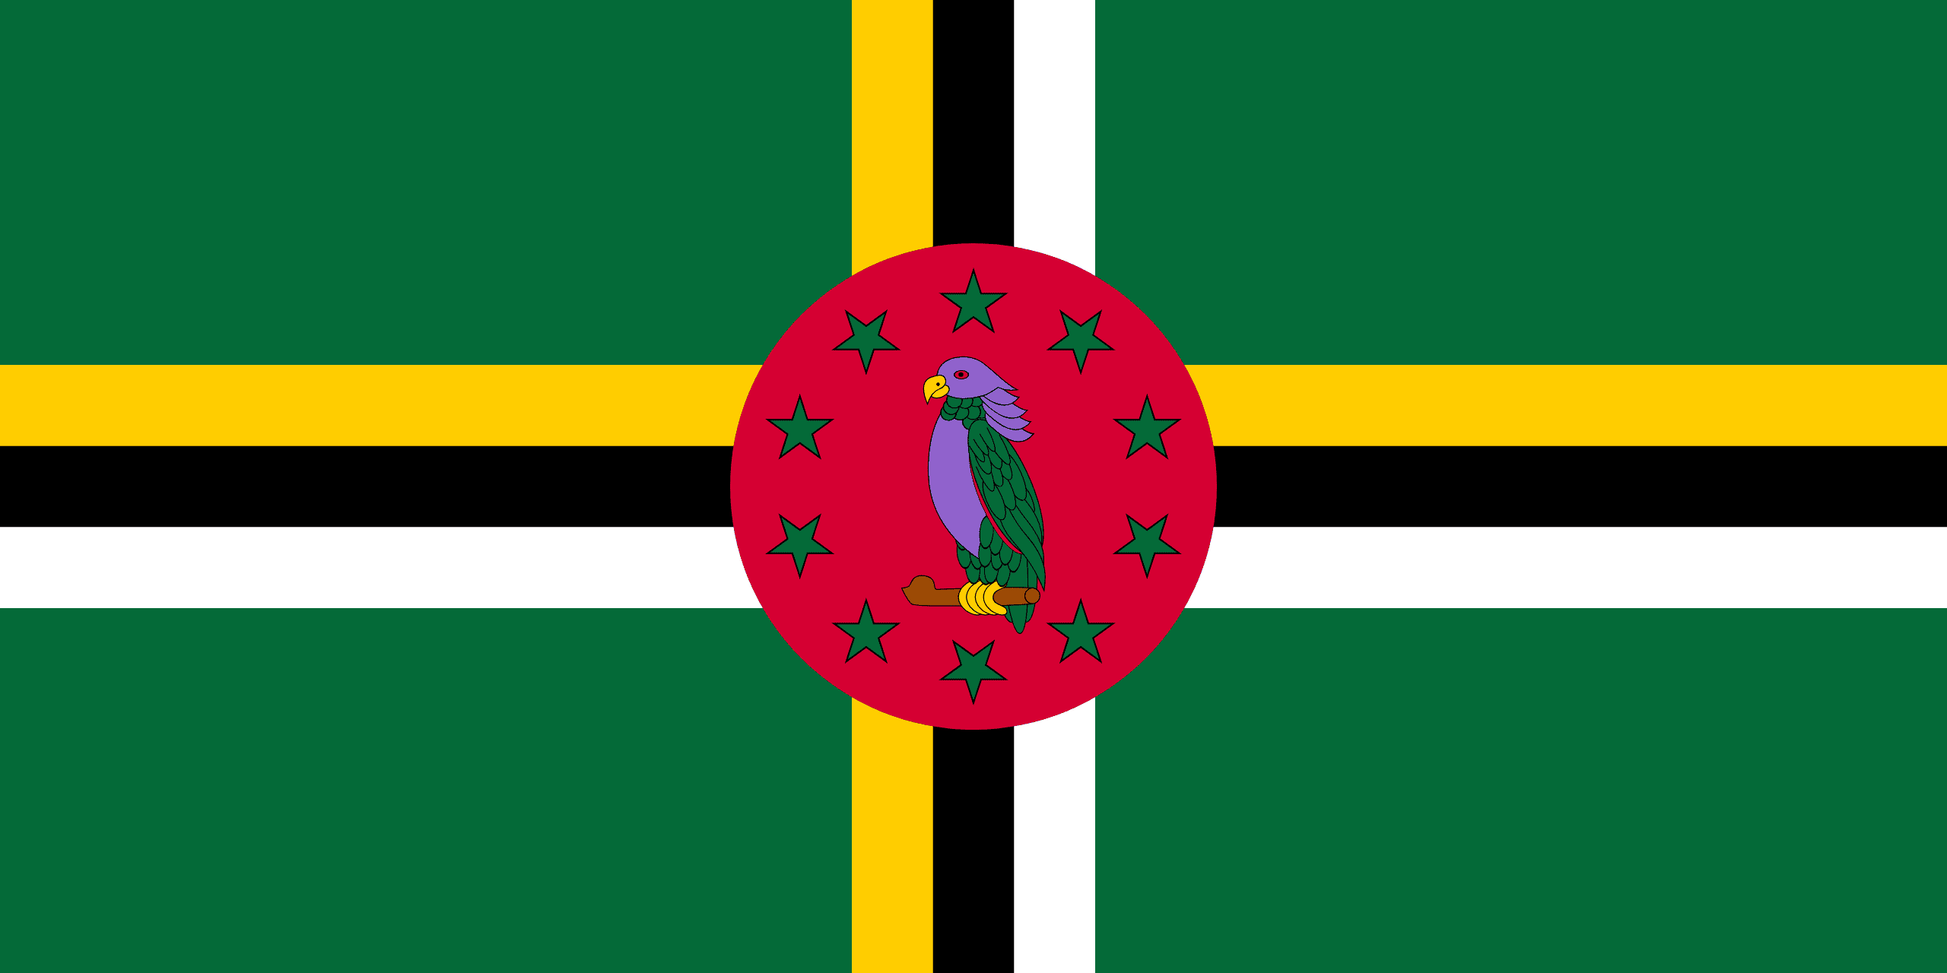
PRAYING FOR
DOMINICA

Slide 3
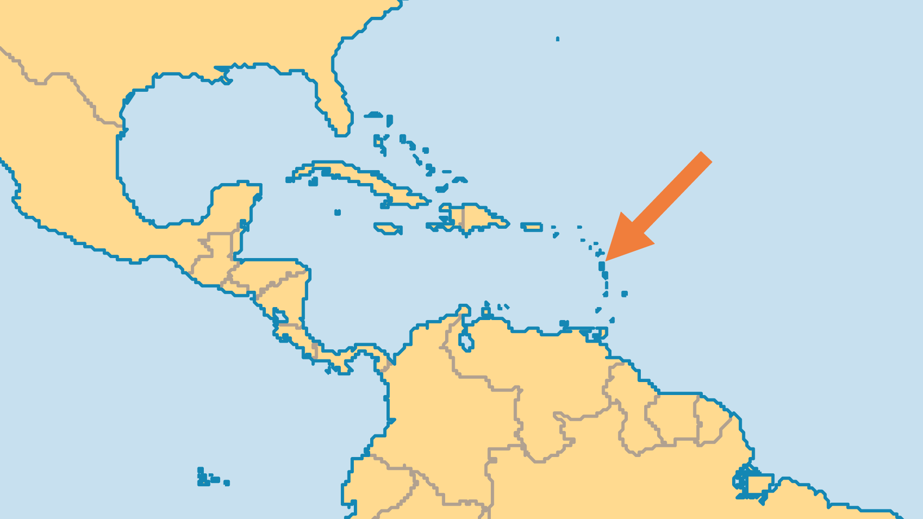
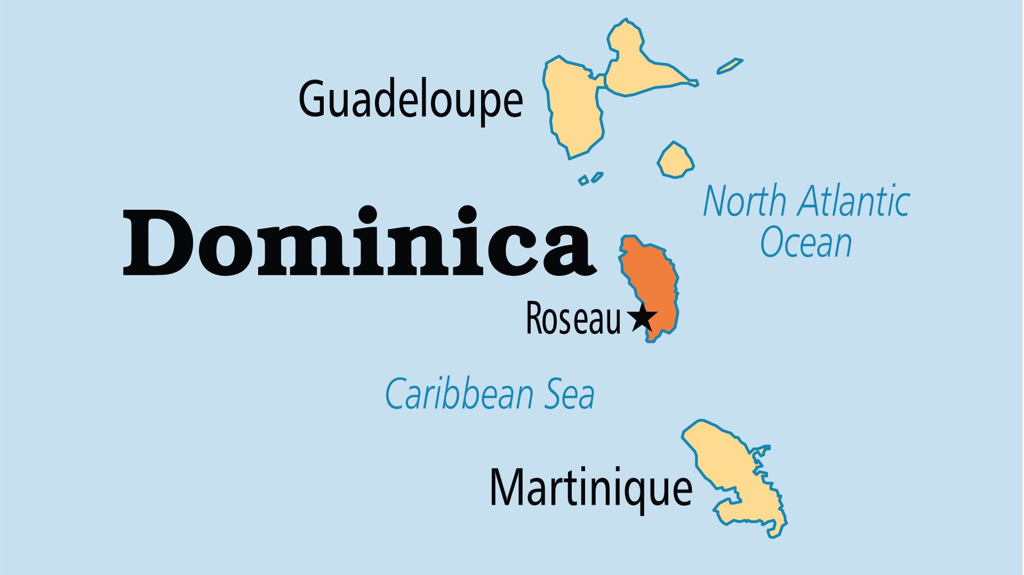
KEY STATS
Capital: | Roseau
Population: | 65,872
% Urban: | 72.6 %
Official Language: | English, but as many as 80% speak a French Creole
Languages: | 3
Literacy Rate: | 94 %
% Christian: | 91.8 %
% Evangelical: | 16.8 %
% Unevangelized: | 1 %

Slide 4

FOR PRAYER
Practicing Catholics have substantially decreased in recent years, indicating a high degree of nominalism. Pray for those who still adhere to Catholicism and those who have disaffiliated themselves, that the Holy Spirit might speak to their hearts about the reality of the gospel.
Want to know more? Go to www.operationworld.org

