Slide 1




Slide 2


PRAYING FOR
DJIBOUTI

Slide 3
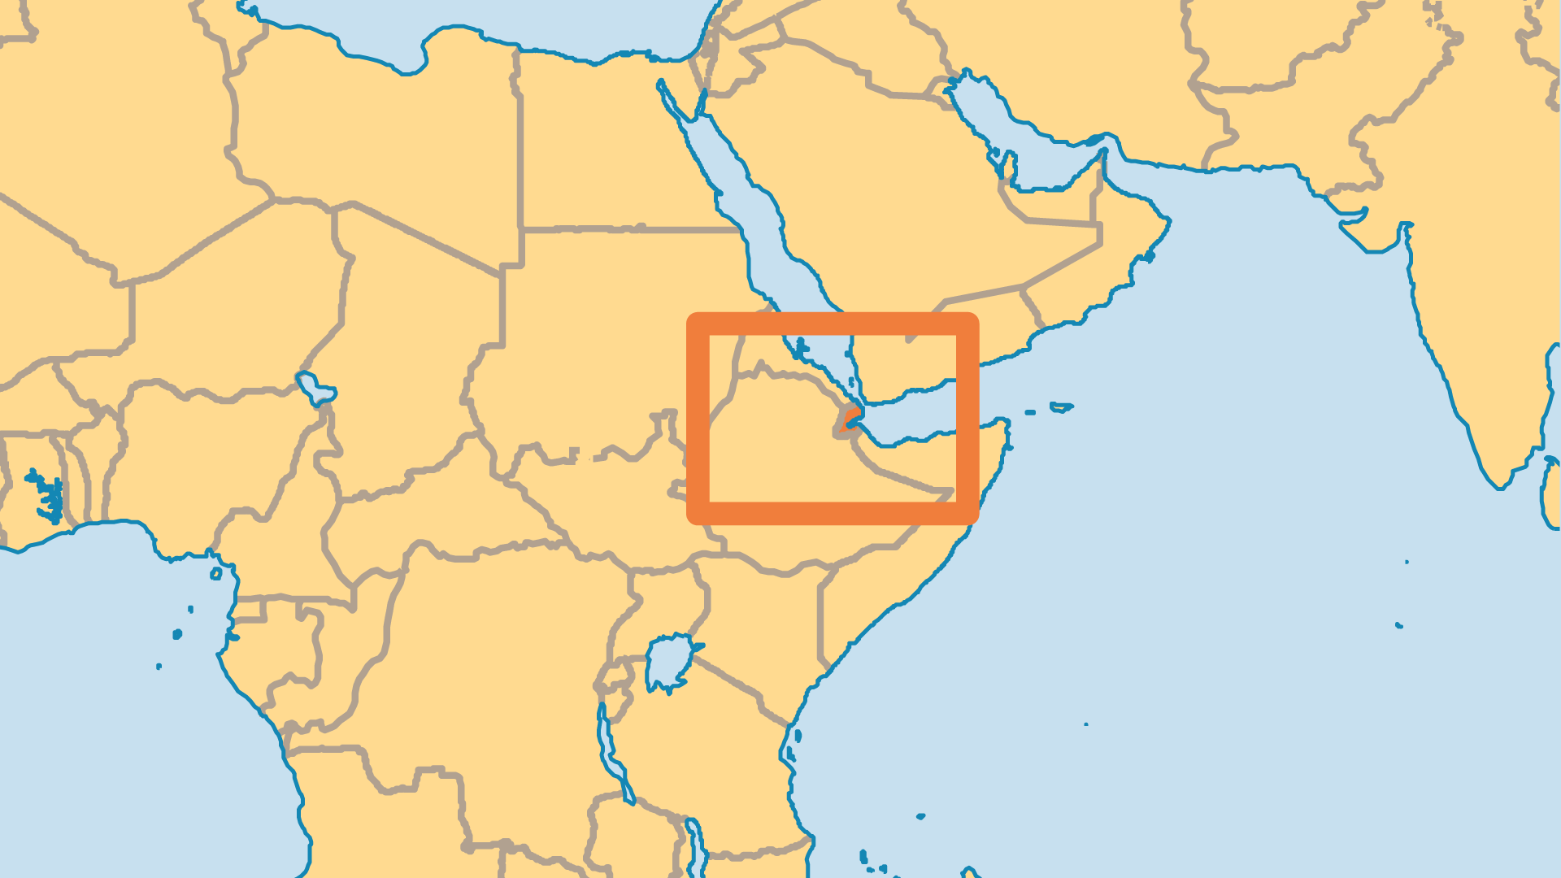
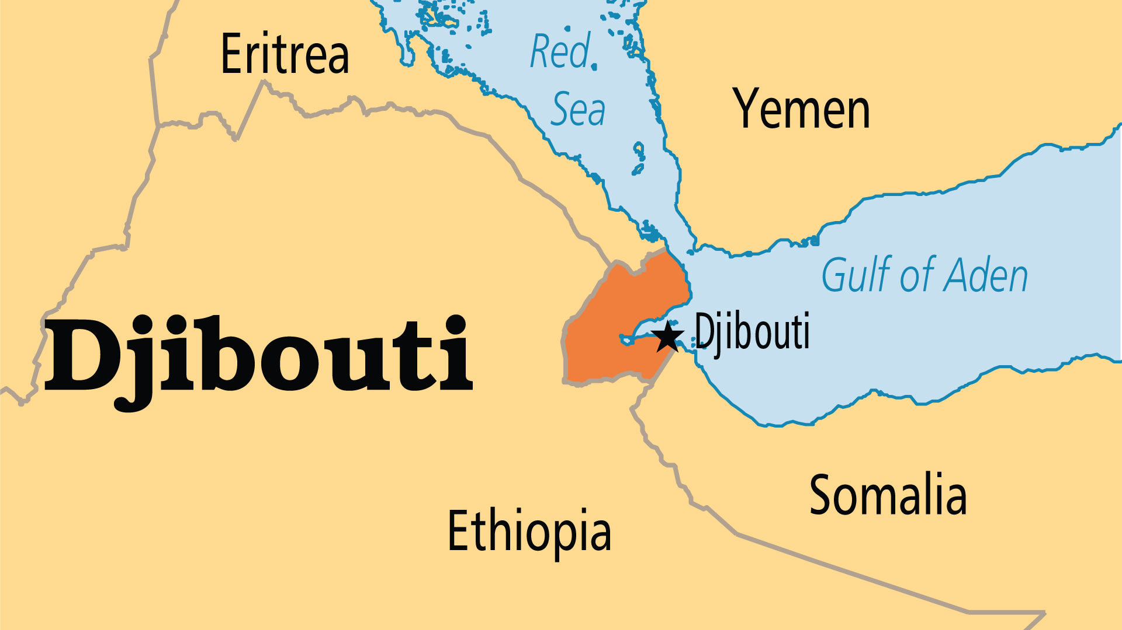
KEY STATS
Continent: | Africa
Capital: | Djibouti
Population: | 1,184,077
Pop Under 15 Yrs: | 29.2 %
Official Language: | French & Arabic. Somali, Afar
Life Expectancy: | 62.3 yrs (205th/236)
HDI Ranking: | 171/193
% Christian: | 1.8 %
% Evangelical: | 0.1 %
Largest Religion: | Muslim

Slide 4

FOR PRAYER
Djibouti enjoys peace, but suffers under serious social and economic problems. Western military presence helps create an atmosphere of calm and safety. Pray that the Islamist voice that seeks to make Djibouti conform to its own values will not destroy current freedoms. Serious national problems include widespread famine, extreme unemployment, human trafficking, prostitution, and drug abuse.
Want to know more? Go to www.operationworld.org

