Slide 1




Slide 2


PRAYING FOR
DENMARK

Slide 3
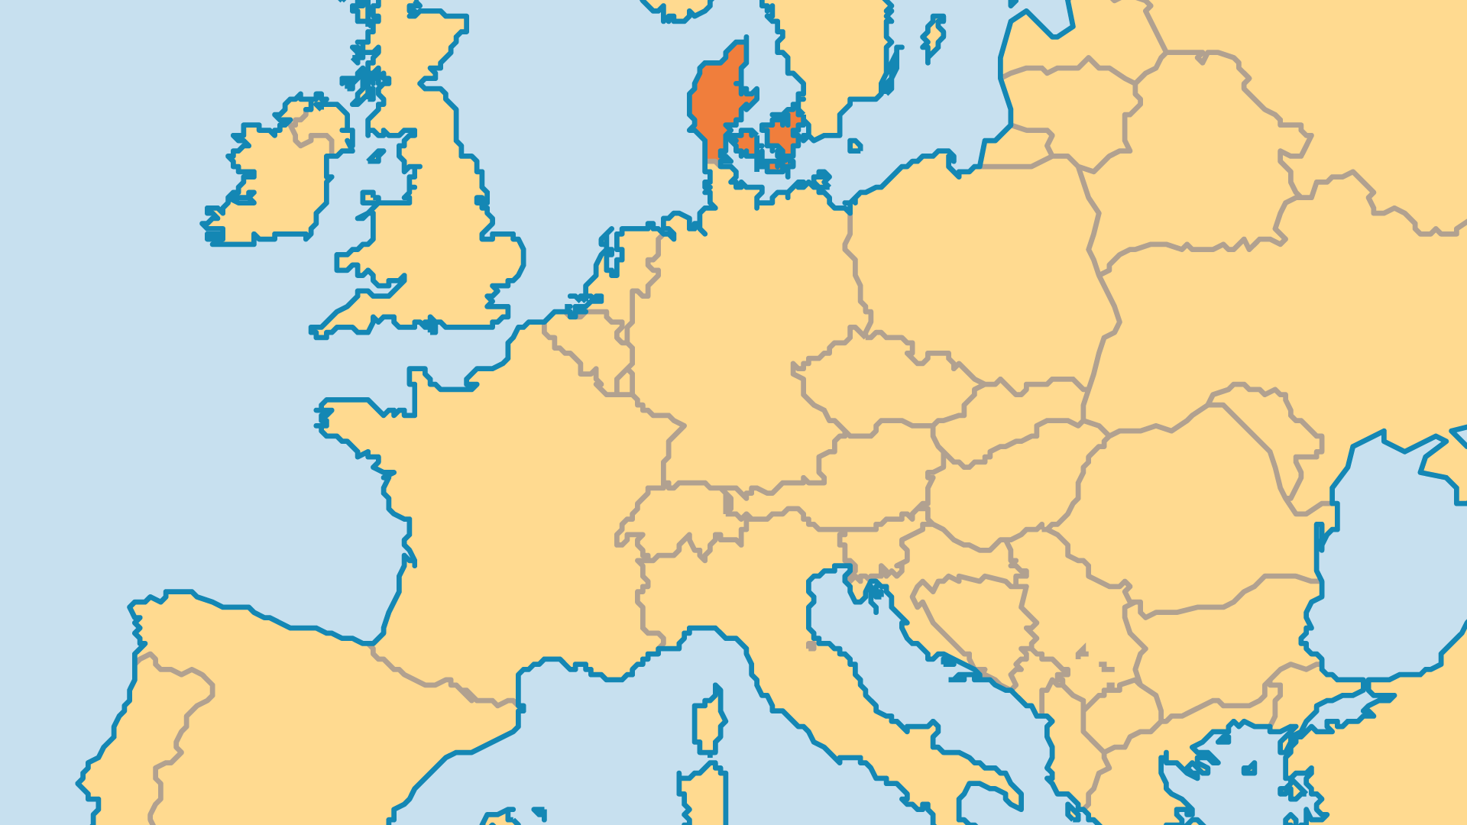
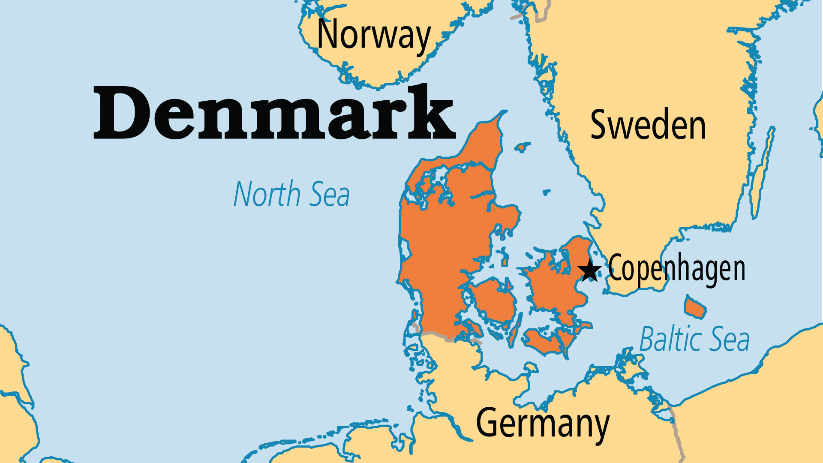
KEY STATS
Capital: | Copenhagen
Population: | 6,002,507
% Urban: | 88.8 %
Pop Under 15 Yrs: | 16.4 %
Official Language: | Danish
Languages: | 13
Literacy Rate: | 99 %
HDI Ranking: | 6/193
% Christian: | 85.3 %
% Evangelical: | 3.5 %
% Unevangelized: | 4 %

Slide 4

FOR PRAYER
Denmark retains a core of Christian traditions and values in its social laws and values. And Danes began to show more openness to spiritual things in recent years. But over half the population is agnostic or atheist by some reports. And many people's spiritual search does not lead them to Christian faith and the Church. Pray that more Danes will rediscover the faith that shaped so much of the nation's history and society.
Want to know more? Go to www.operationworld.org

