Slide 1




Slide 2

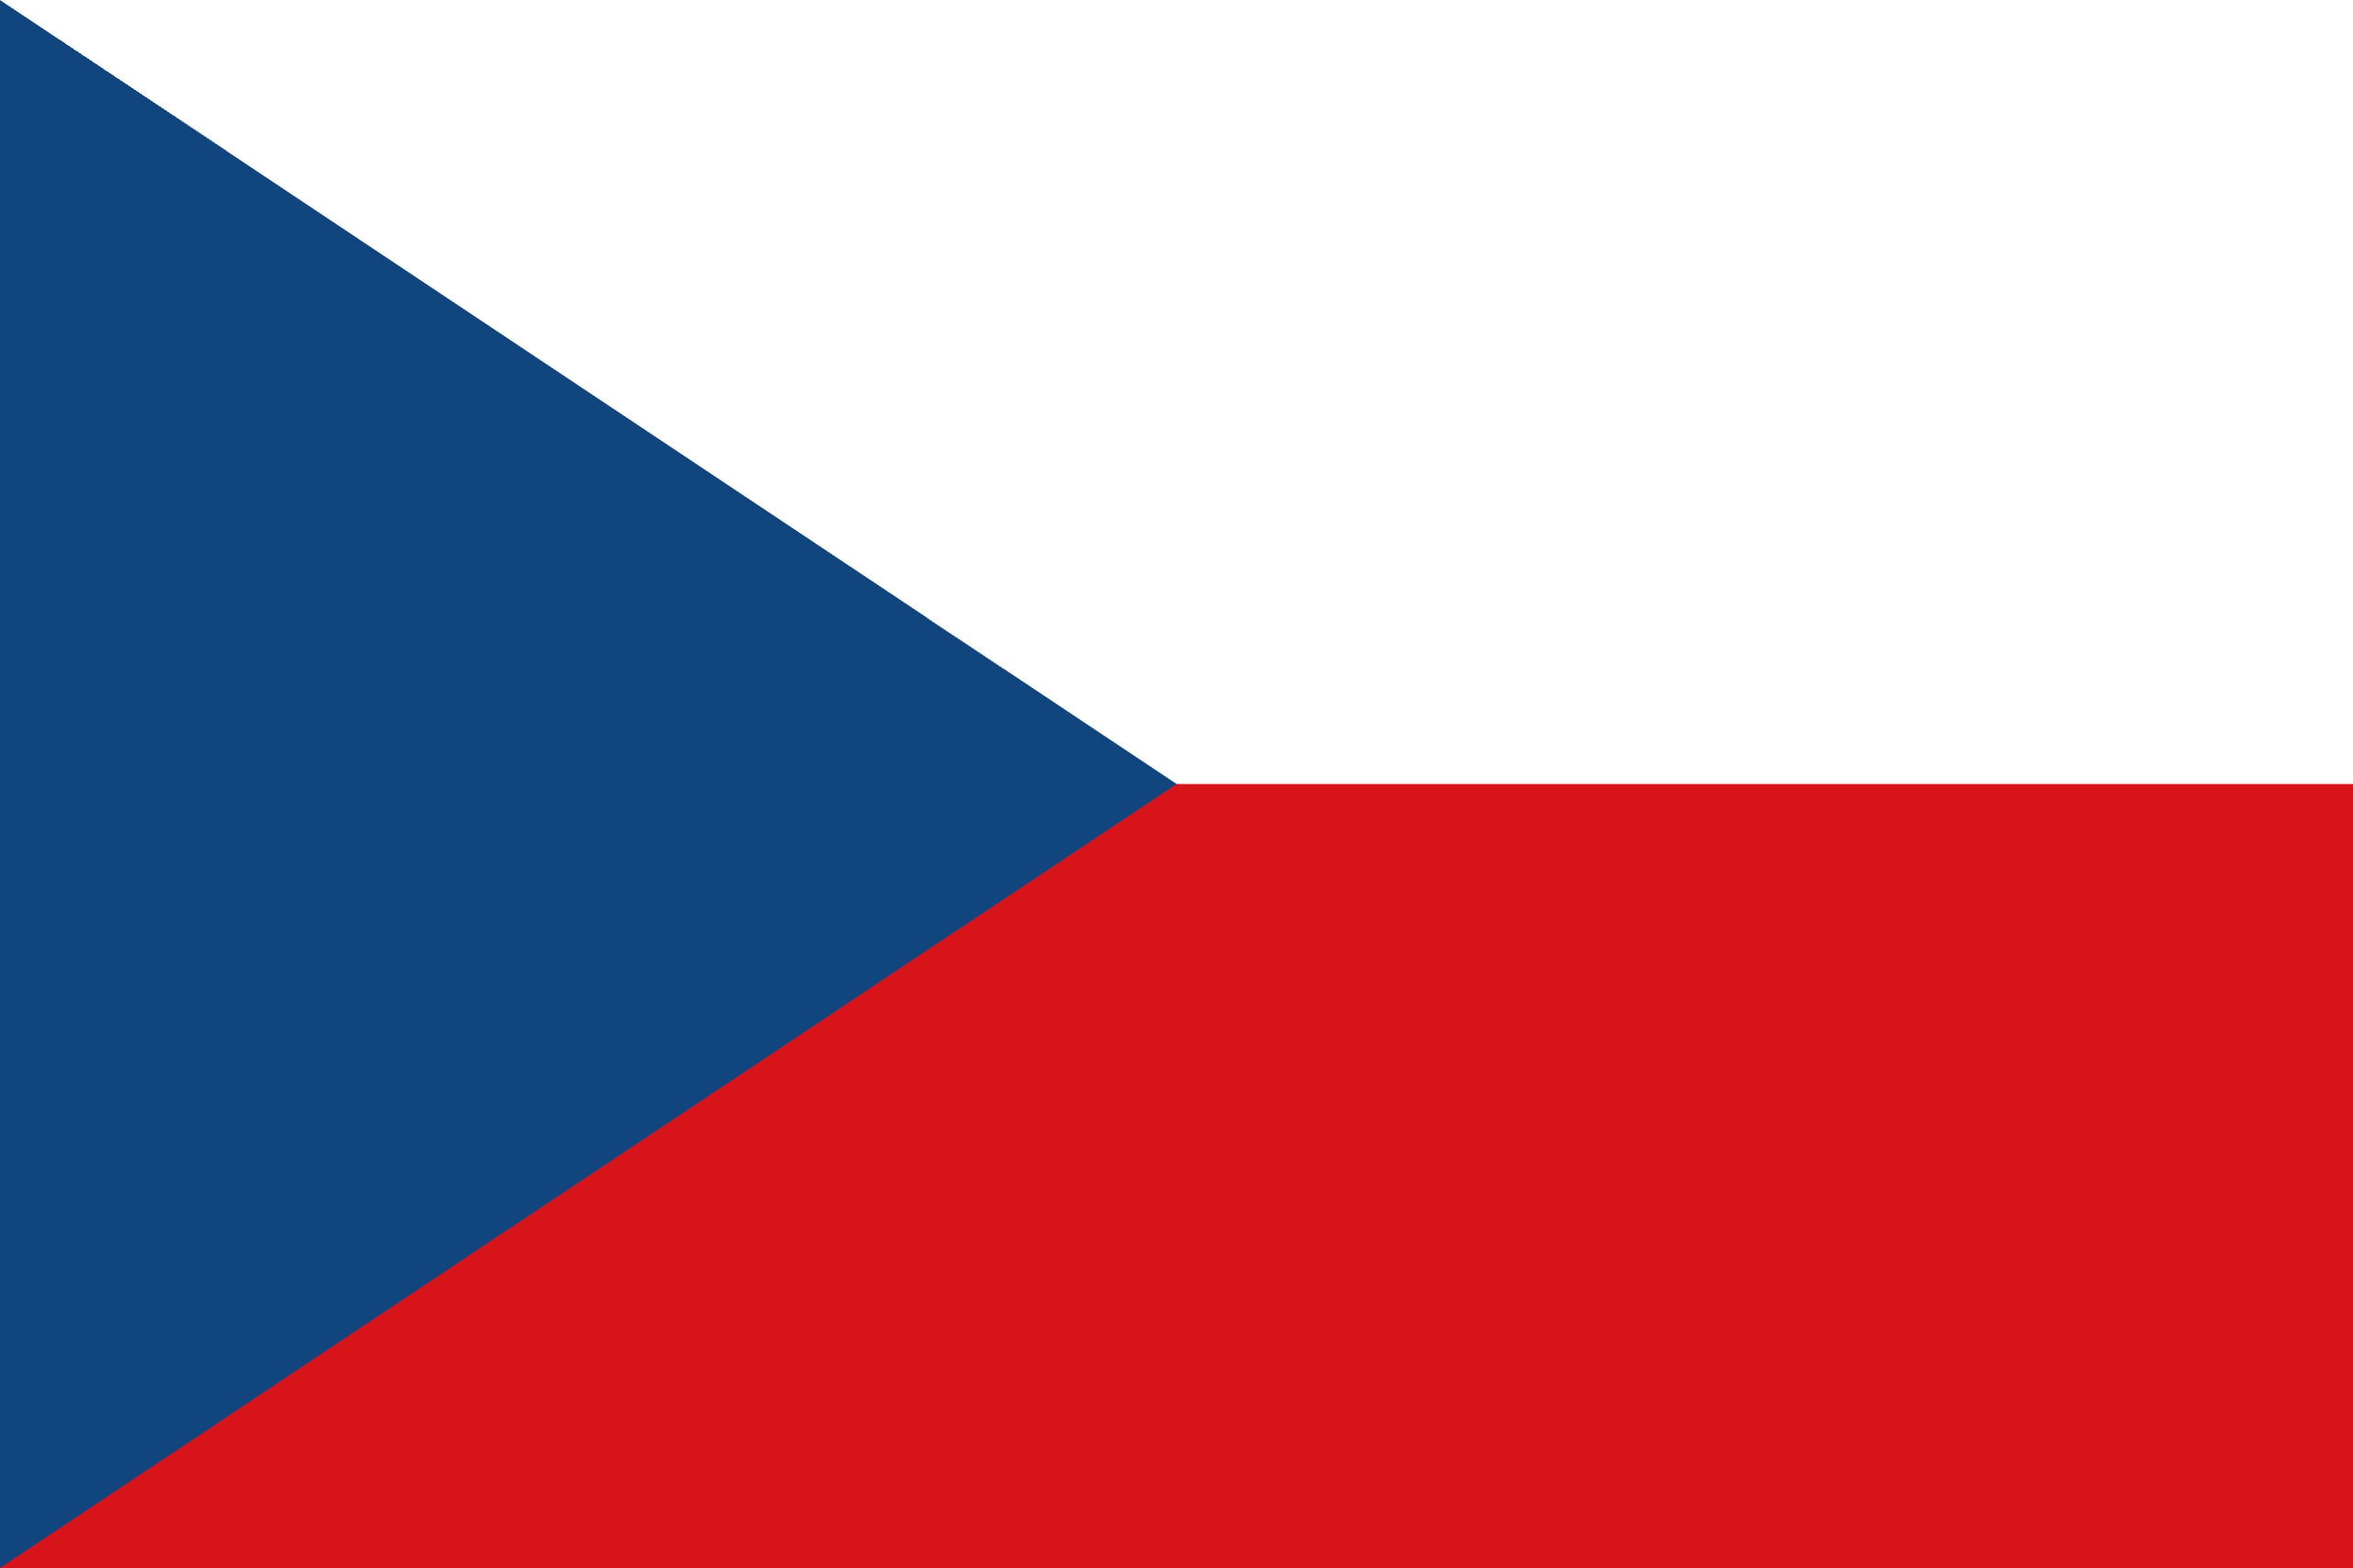
PRAYING FOR
CZECHIA

Slide 3
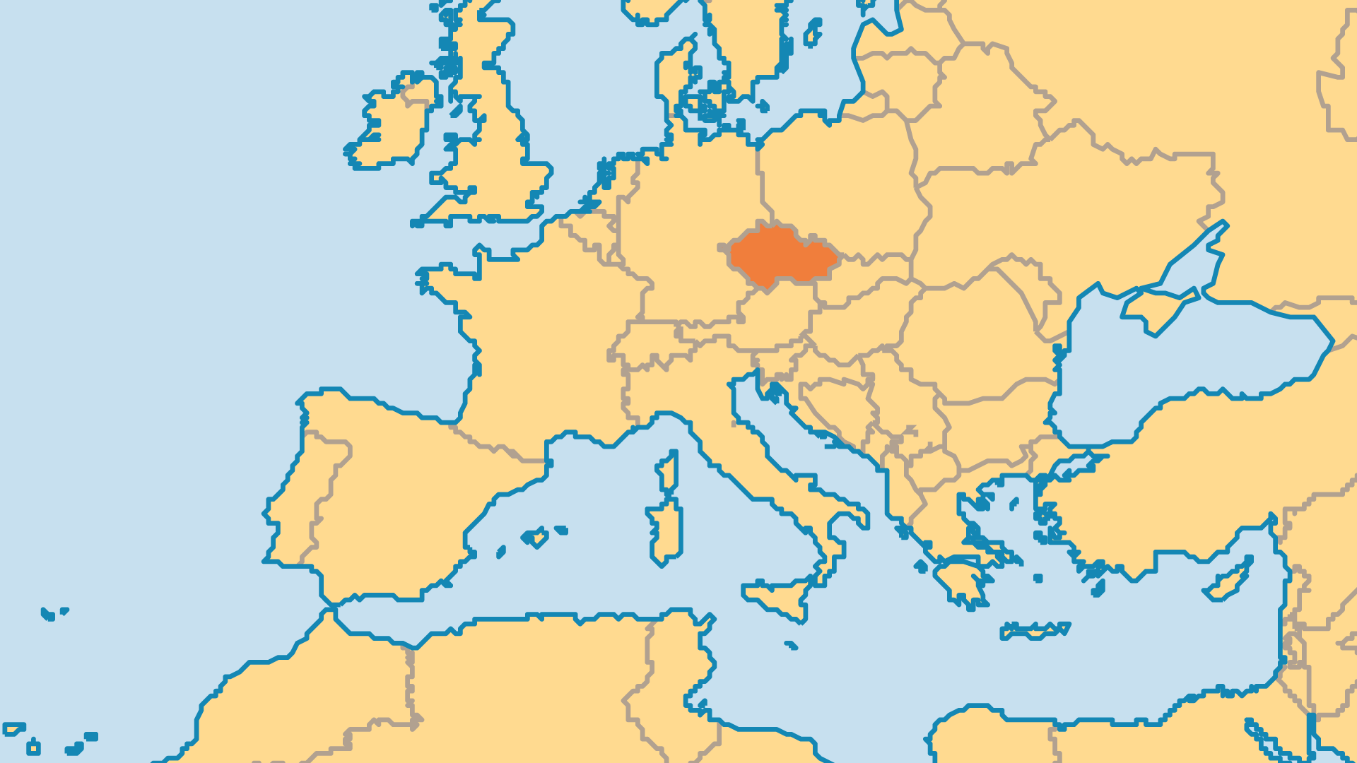
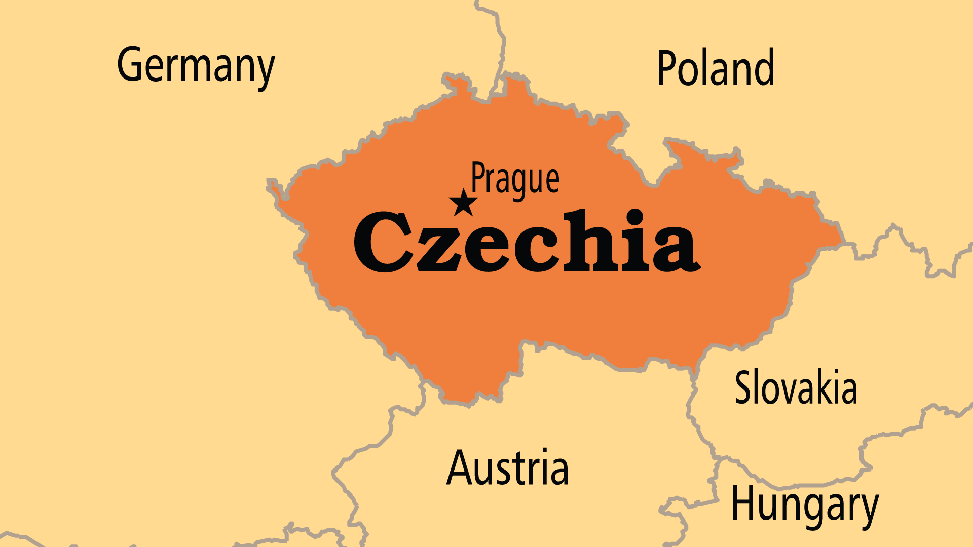
KEY STATS
Capital: | Prague
Population: | 10,609,240
Pop Under 15 Yrs: | 15.7 %
Official Language: | Czech
Life Expectancy: | 77.7 yrs (61st/236)
% Christian: | 25.9 %
% Evangelical: | 0.7 %
Largest Religion: | Non-religious
% Largest Religion: | 71.4 %
% Unevangelized: | 1 %

Slide 4

FOR PRAYER
Over 70% of the population consider themselves non-religious, though many use horoscopes and mix spiritual ideas. The successful transition to a market economy was a positive change, but it put economic stress on the most vulnerable people. Crime, sexual immorality, substance abuse, depression, and suicide all have higher rates today than they did during Communist times. Ask God to lift the spiritual heaviness from over Czechia. Social changes create new opportunities for ministry. The ageing population and new immigrants (especially Russian speakers, East and Southeast Asians) need loving outreach.
Want to know more? Go to www.operationworld.org

