Slide 1




Slide 2


PRAYING FOR
CYPRUS

Slide 3
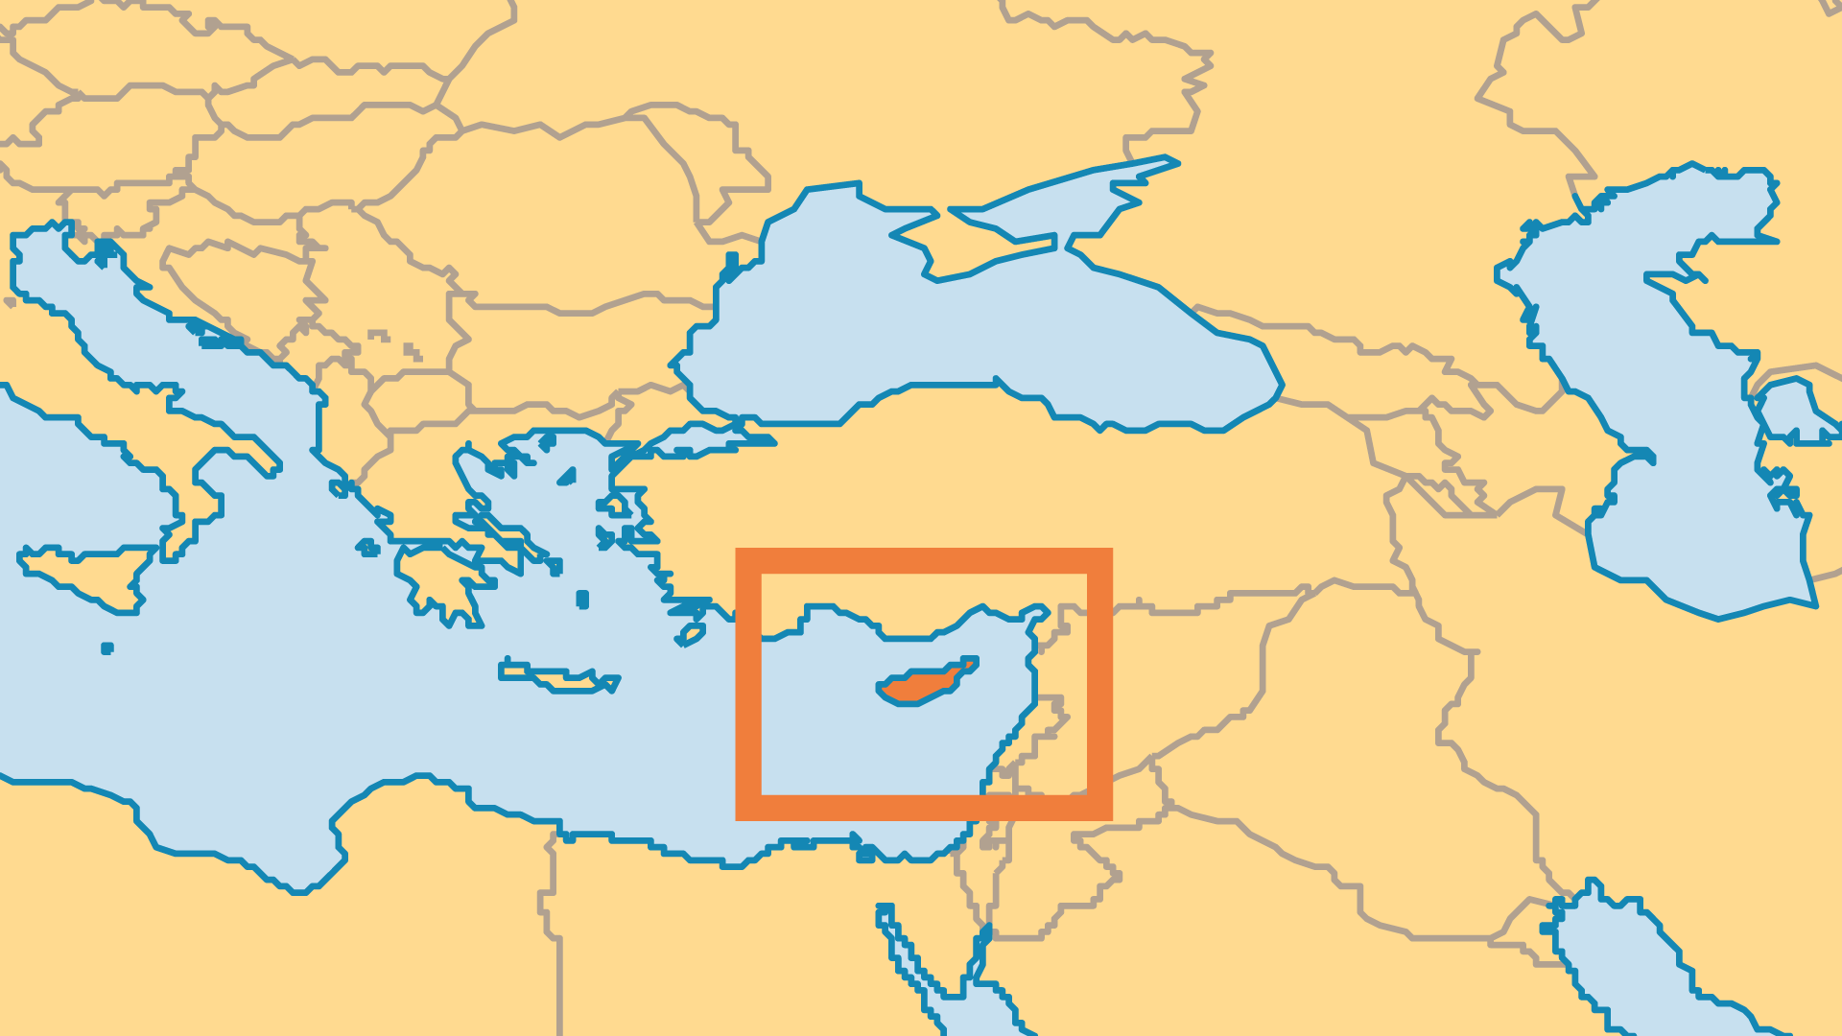
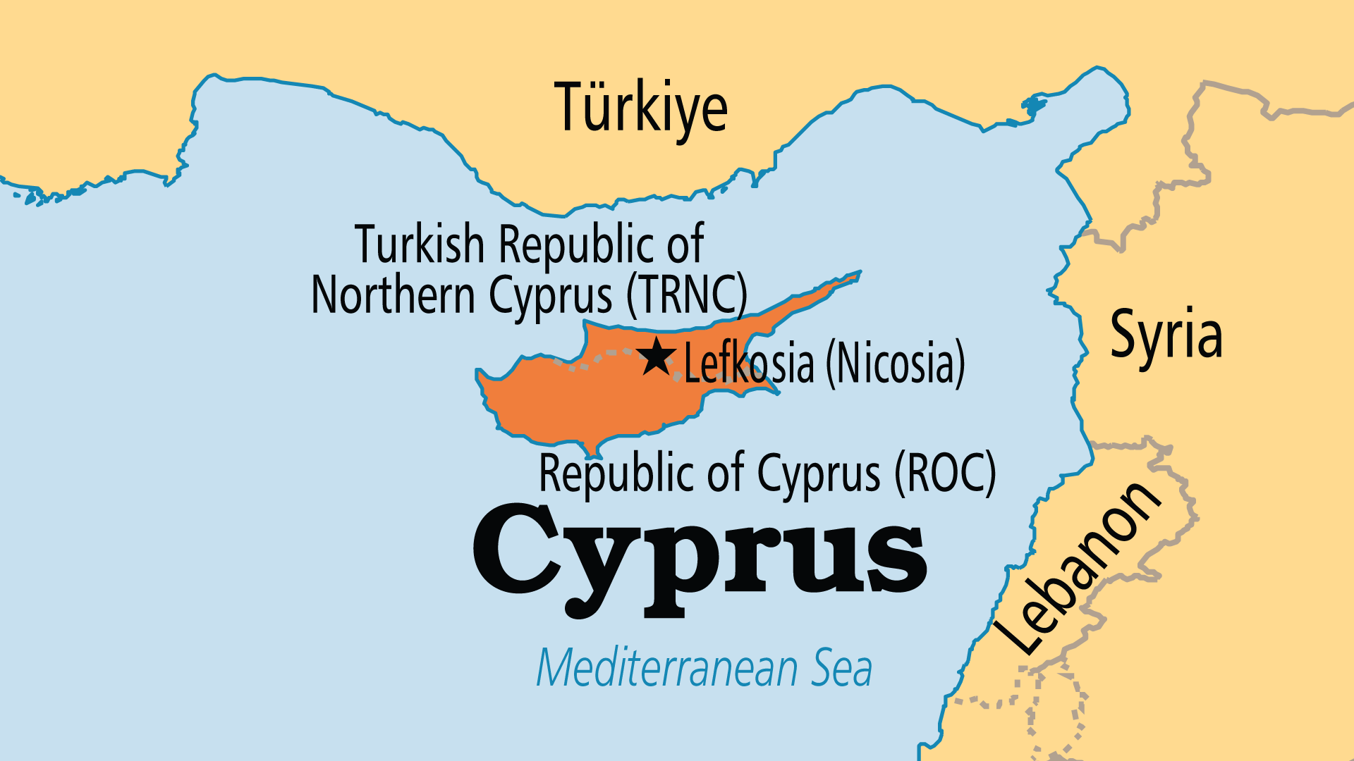
KEY STATS
Capital: | Lefkosia (Nicosia)
Population: | 1,370,754
% Urban: | 67.2 %
Pop Under 15 Yrs: | 16.7 %
Official Language: | Greek; Turkish
Literacy Rate: | 99 %
Life Expectancy: | 81.2 yrs (30th/236)
HDI Ranking: | 29/193
% Christian: | 72.4 %
% Evangelical: | 0.8 %
% Unevangelized: | 12 %

Slide 4

FOR PRAYER
The 50-year conflict between the two communities (Greeks and Turks), fuelled by the involvement of foreign powers, has gone on too long. Political intransigence by a few hampers the reunification seemingly favoured by the majority. Pray that old grievances might be overcome by forgiveness. Pray that external meddling would stop and that Cypriots might move into a unified future. Since 2004, Cypriot and EU citizens have been free to cross the dividing line. Increased interaction between the communities has shown that, for most, it is possible to live together in peace.
Want to know more? Go to www.operationworld.org

