Slide 1




Slide 2

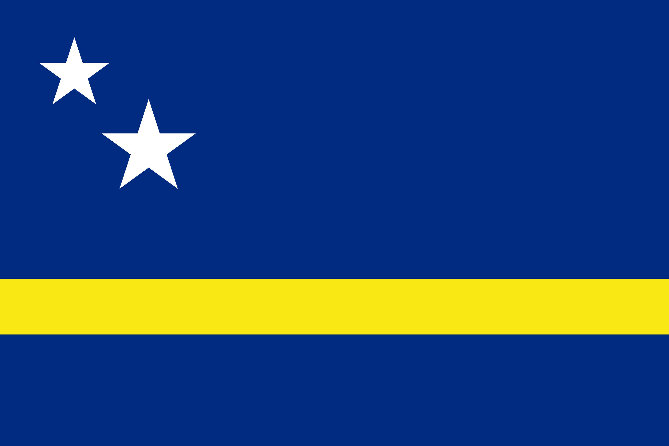
PRAYING FOR
CURAÇAO

Slide 3
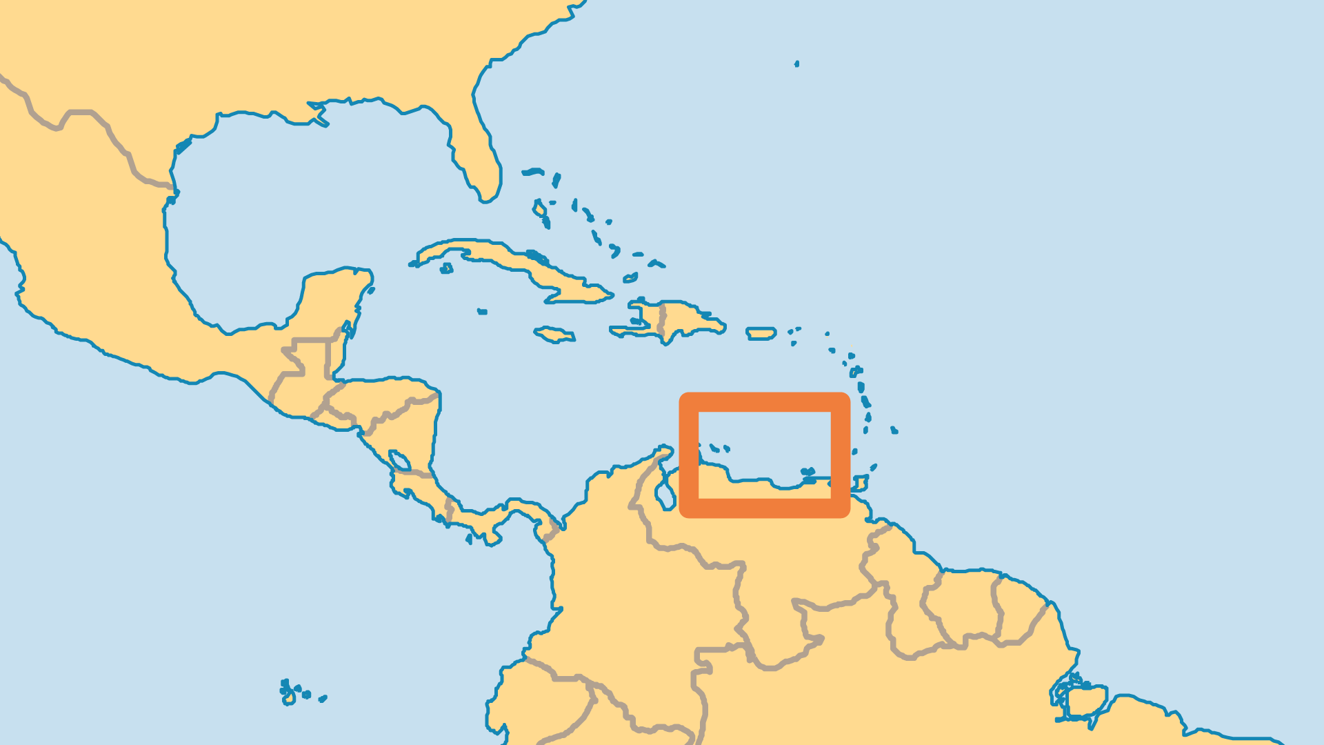
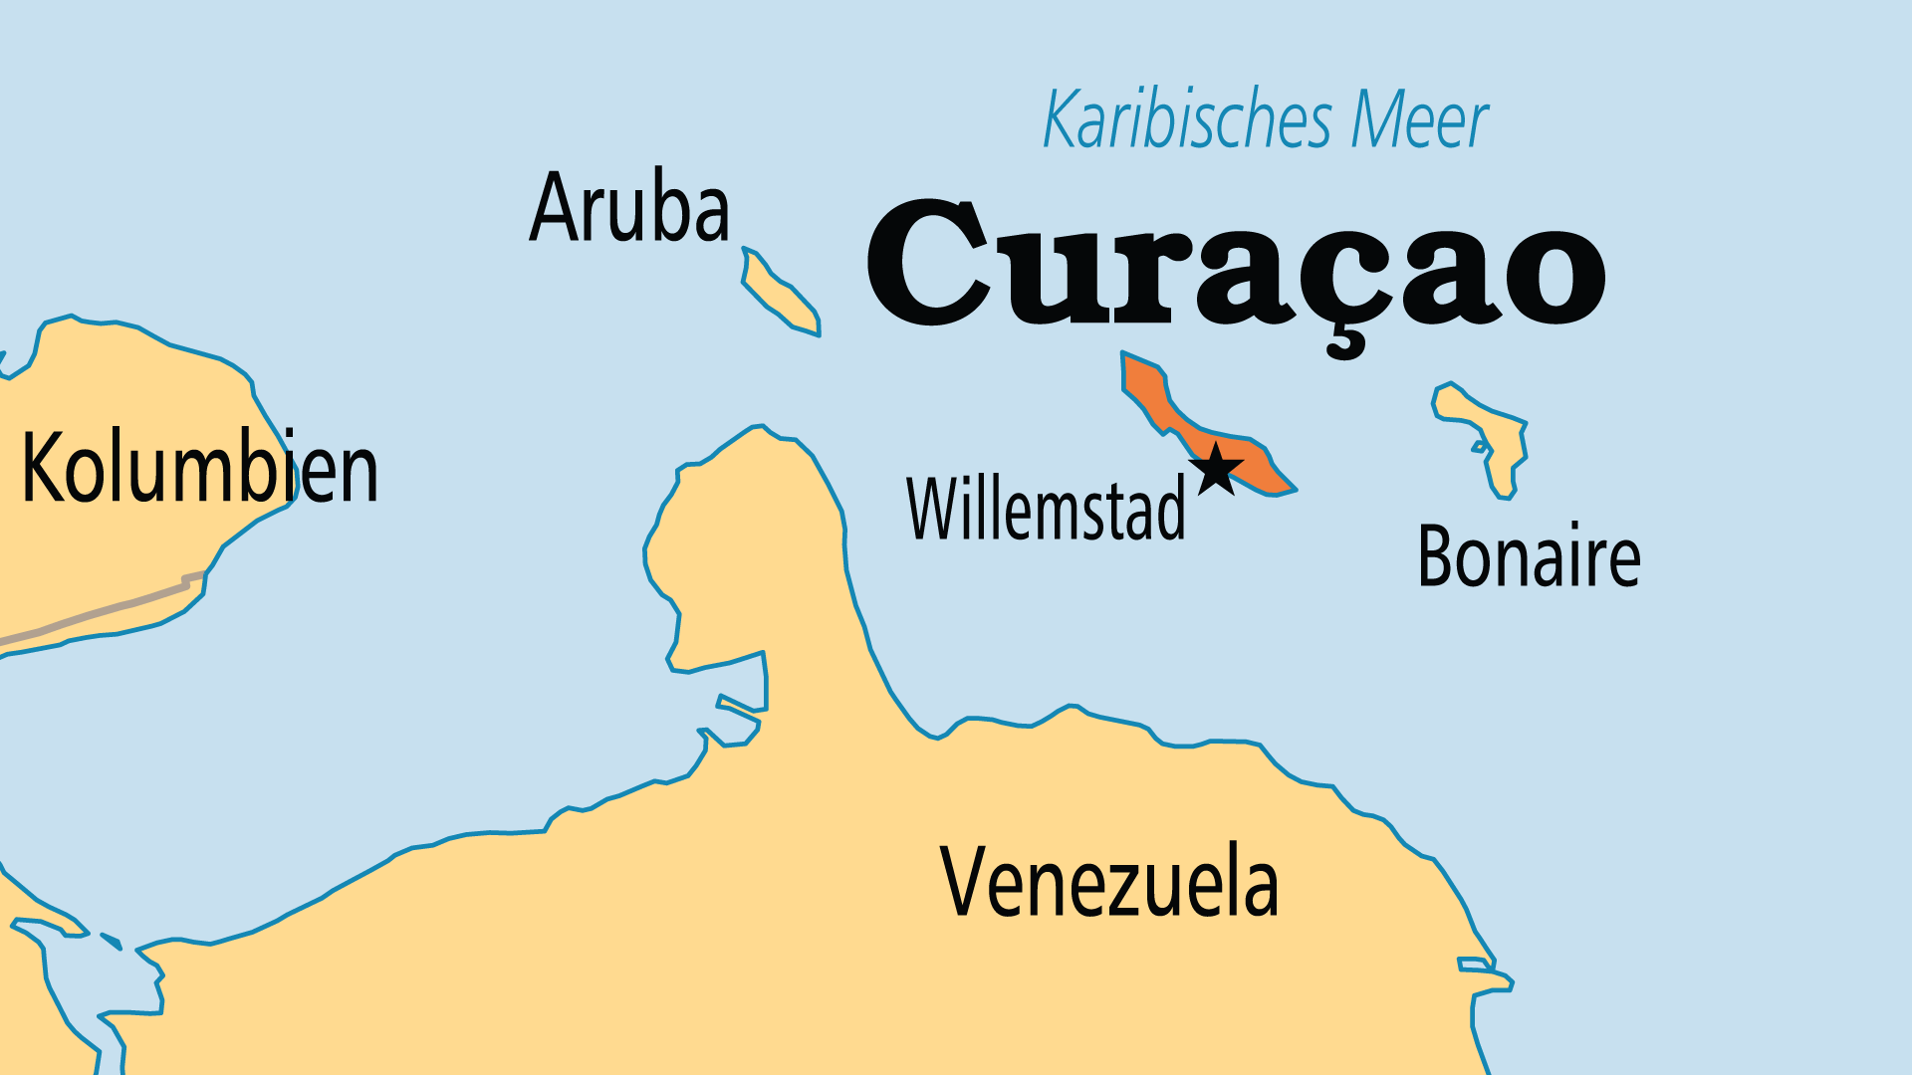
KEY STATS
Capital: | Willemstad
Population: | 185,487
Official Language: | Dutch, English, Papiamento
Languages: | 5
Life Expectancy: | 75.4 yrs (83rd/236)
% Christian: | 89.6 %
% Evangelical: | 7.7 %
People Groups: | 16
Least Reached People Groups: | 2

Slide 4

FOR PRAYER
The Papiamento Bible was most recently translated in 2013 (Dutch and English are available as well). It is available in hard copy and online. Pray for impact on Papiamento speakers - a majority in Curaçao, but also found in Aruba and the Caribbean Netherlands. Pray also for literacy programmes and more Christian literature in the language. There is a Christian bookstore on Curaçao. Biblical literacy will go a great distance in discipling and renewing the Christian population.
Want to know more? Go to www.operationworld.org

