Slide 1




Slide 2

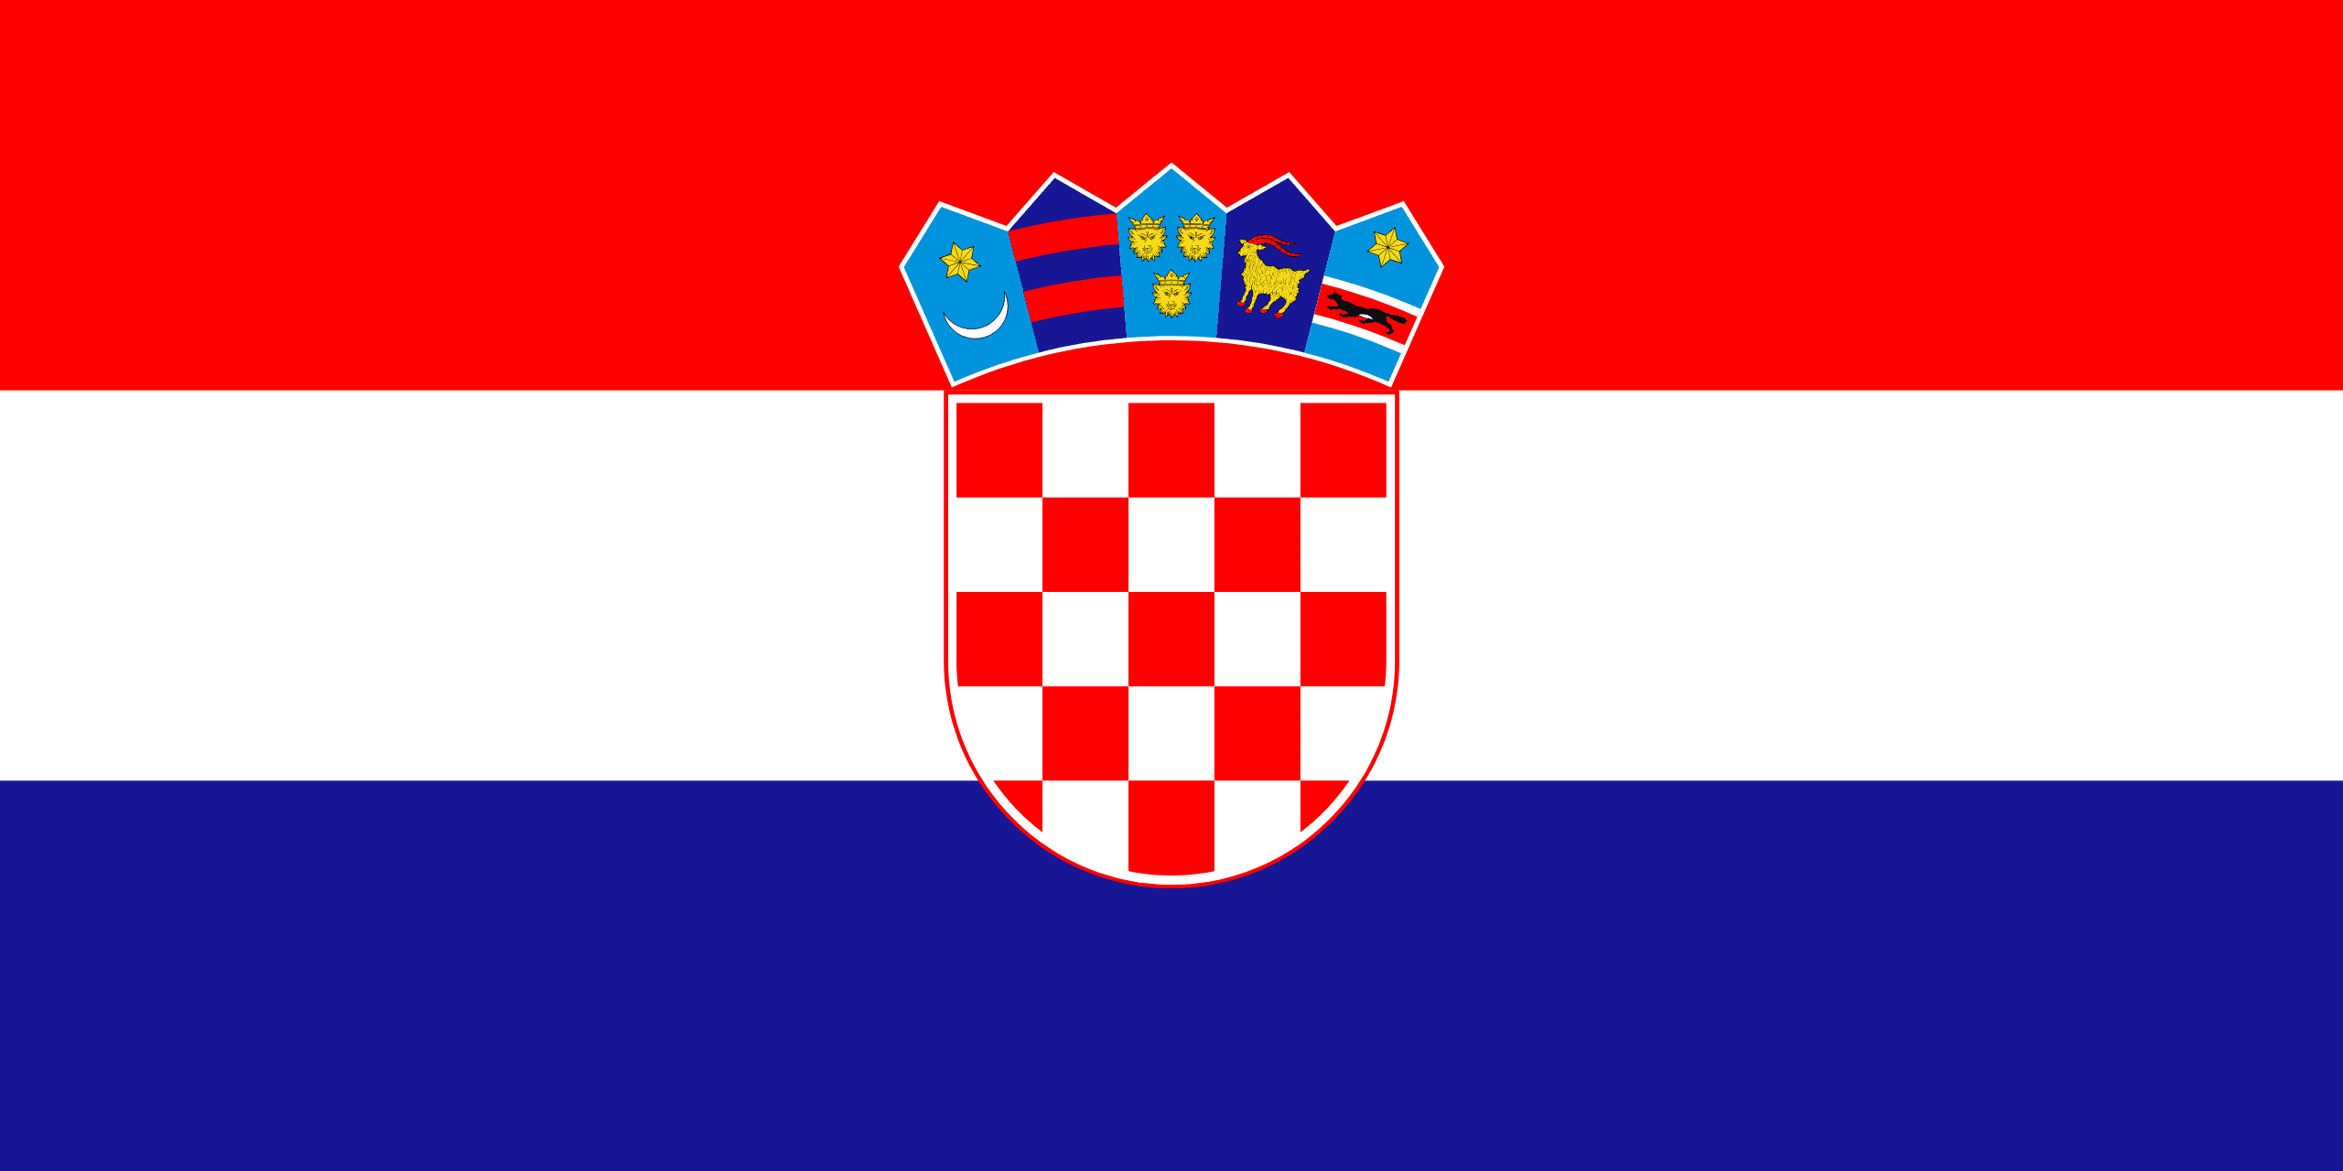
PRAYING FOR
CROATIA

Slide 3
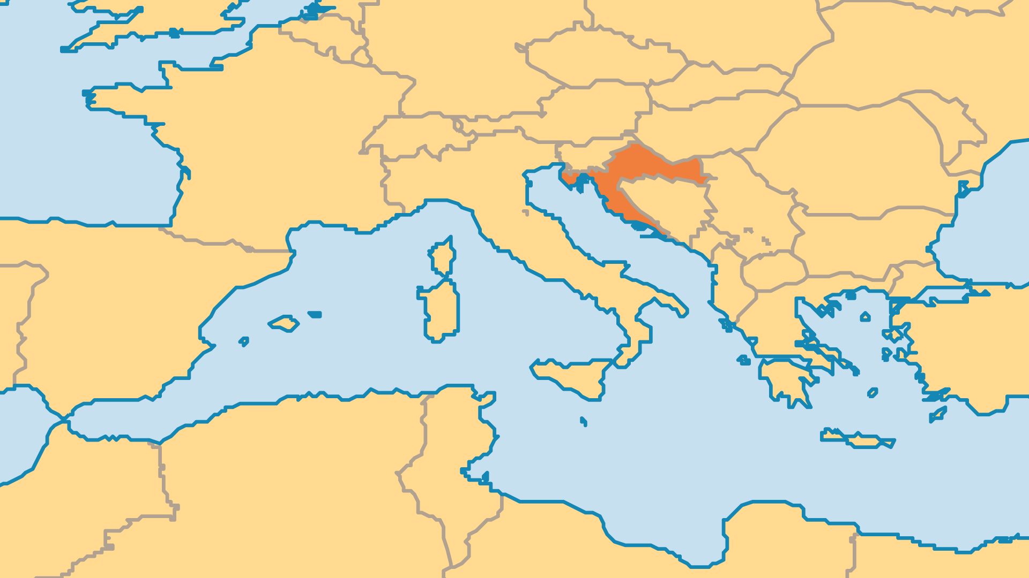
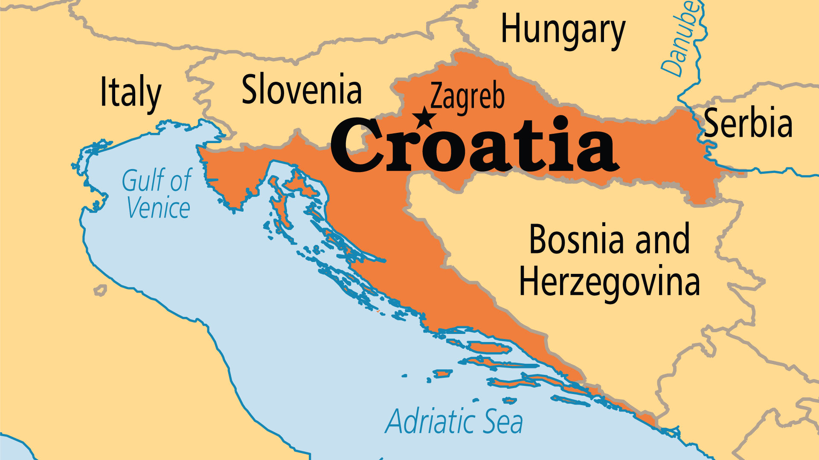
KEY STATS
Capital: | Zagreb
Population: | 3,848,160
% Urban: | 59.3 %
Official Language: | Croatian
Languages: | 22
Literacy Rate: | 99 %
Life Expectancy: | 77.6 yrs (63rd/236)
HDI Ranking: | 40/193
% Christian: | 92 %
% Evangelical: | 0.4 %
% Unevangelized: | 1 %

Slide 4

FOR PRAYER
The deep impact of historic and recent hatred among Croat, Serb, and Bosnian may hurt the nation for generations to come. Pray for true reconciliation, and for God to break these religious and ethnic bondages through the power of Christ! The Catholic Church holds much influence in society, and some Catholic leaders work towards reconciliation. Many people still suffer psychological and emotional trauma from the conflicts, and churches could have a great impact in this area where few others currently work.
Want to know more? Go to www.operationworld.org

