Slide 1




Slide 2

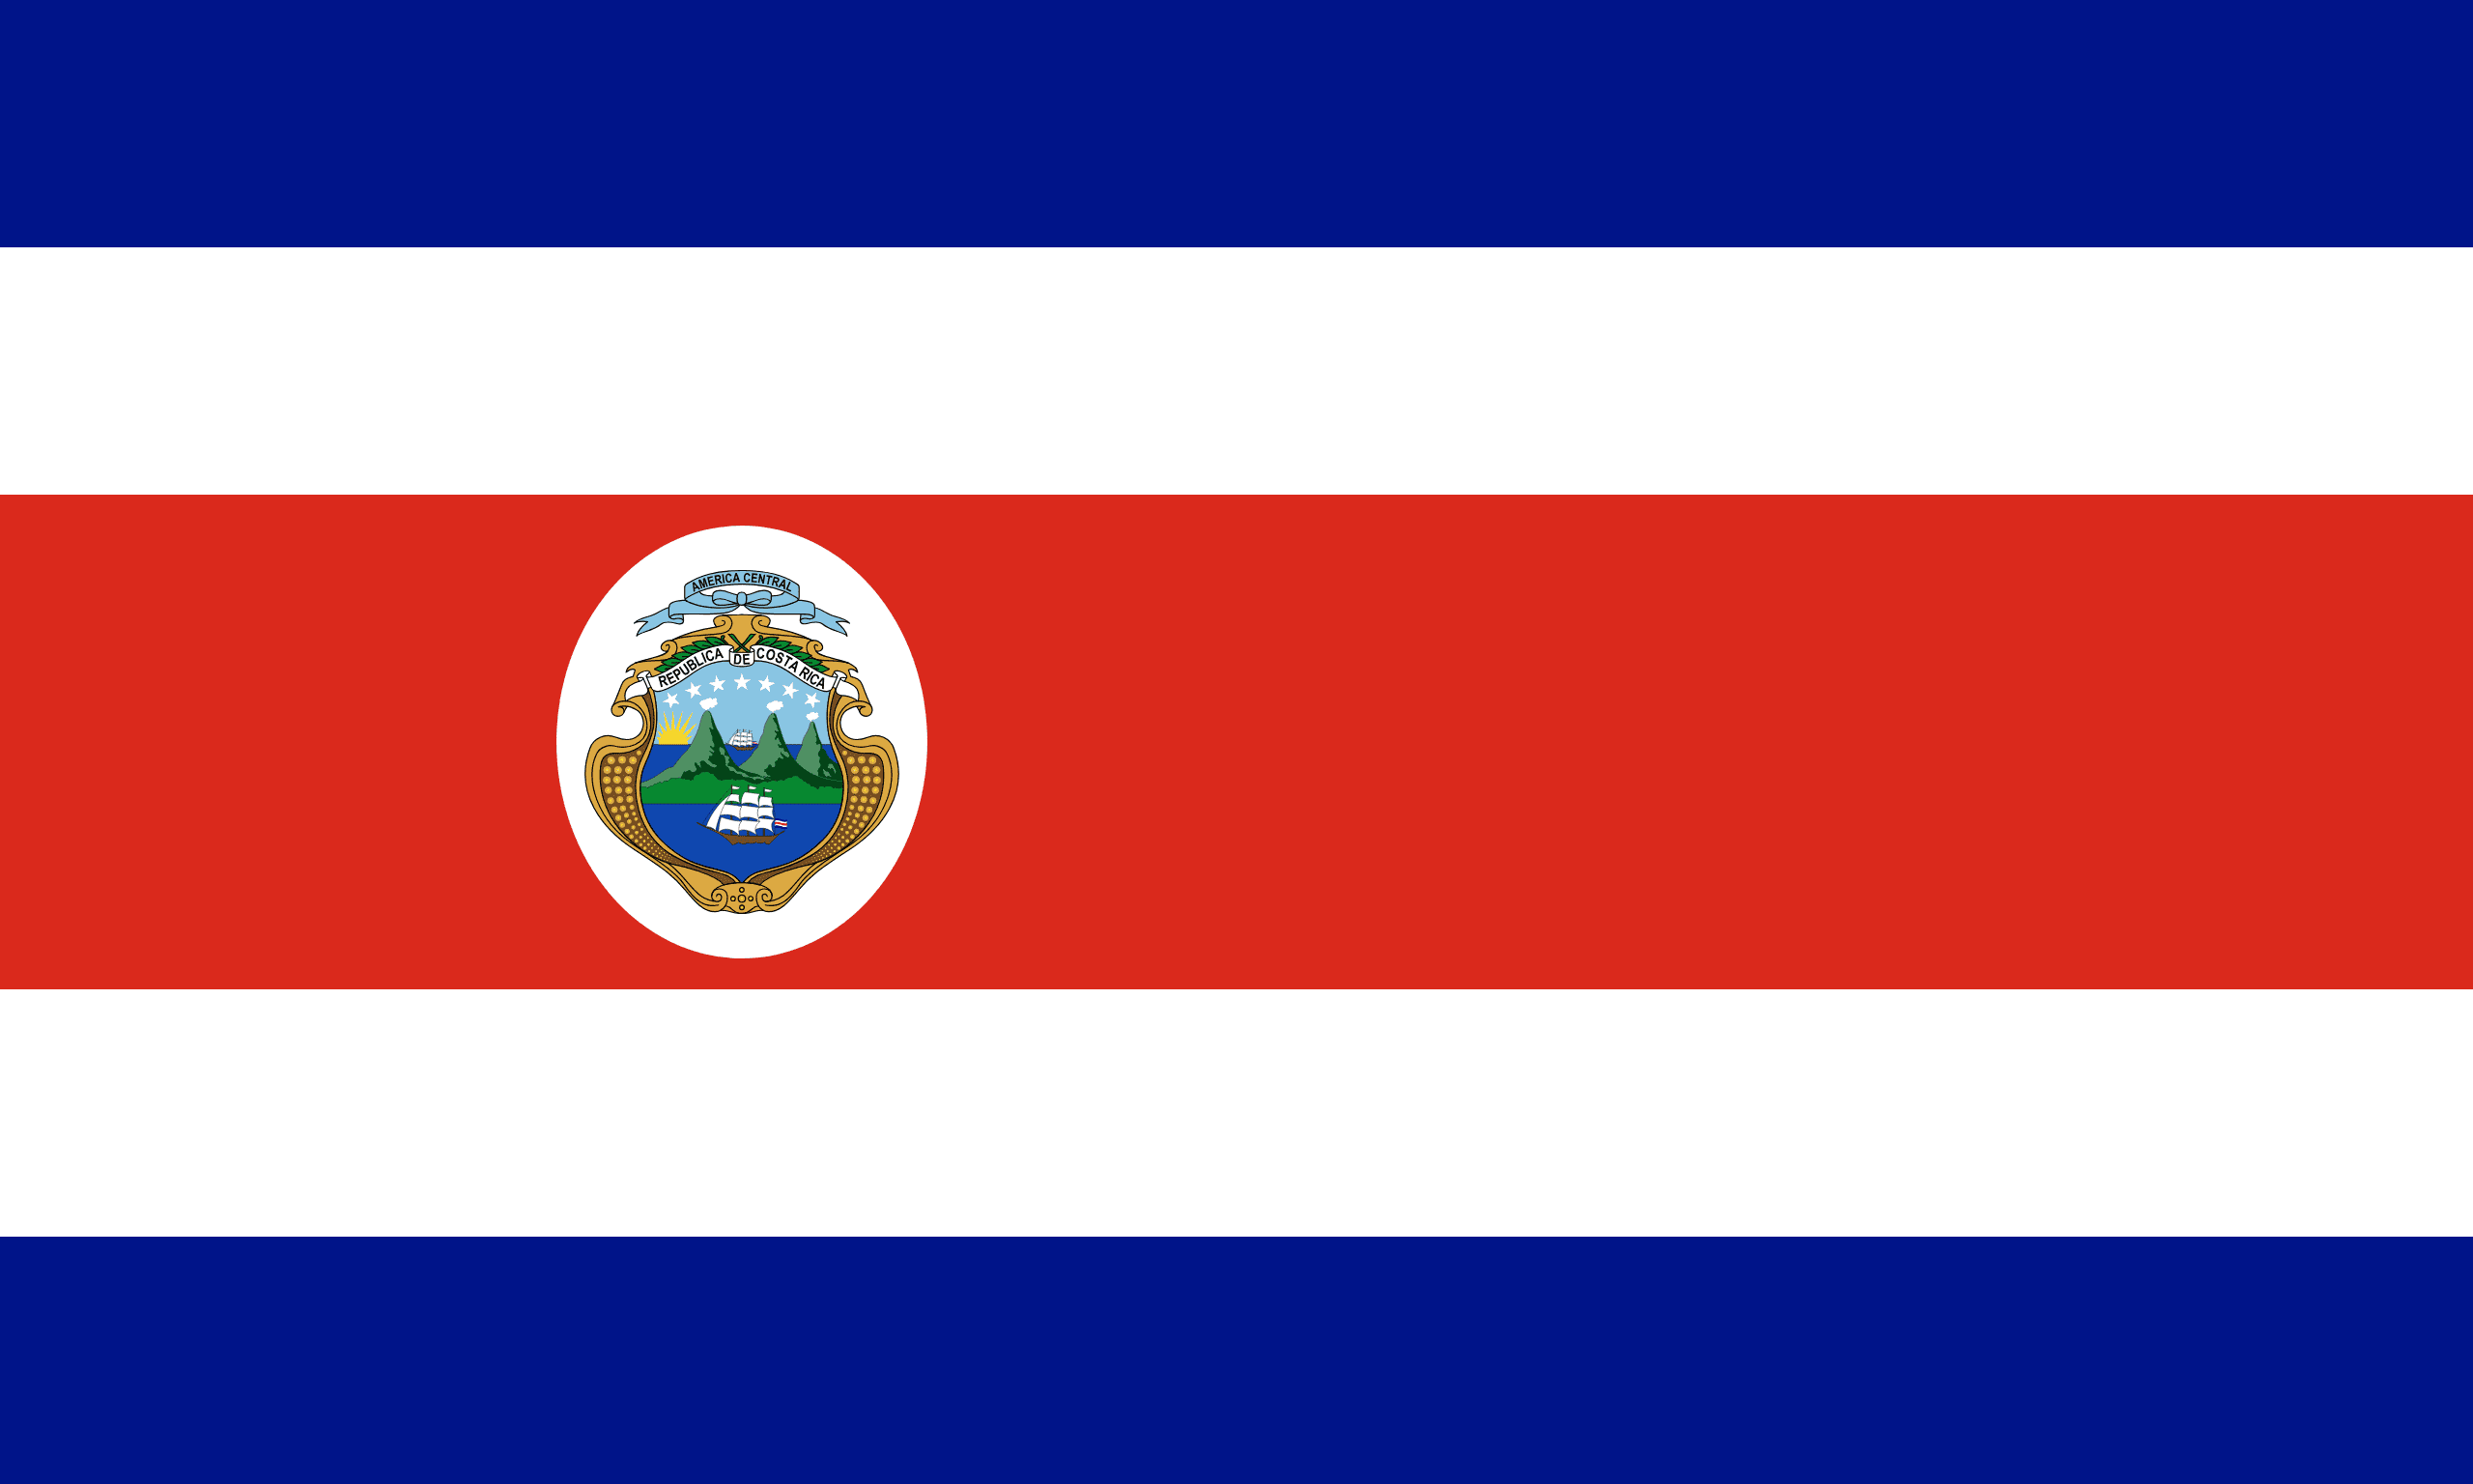
PRAYING FOR
COSTA RICA

Slide 3
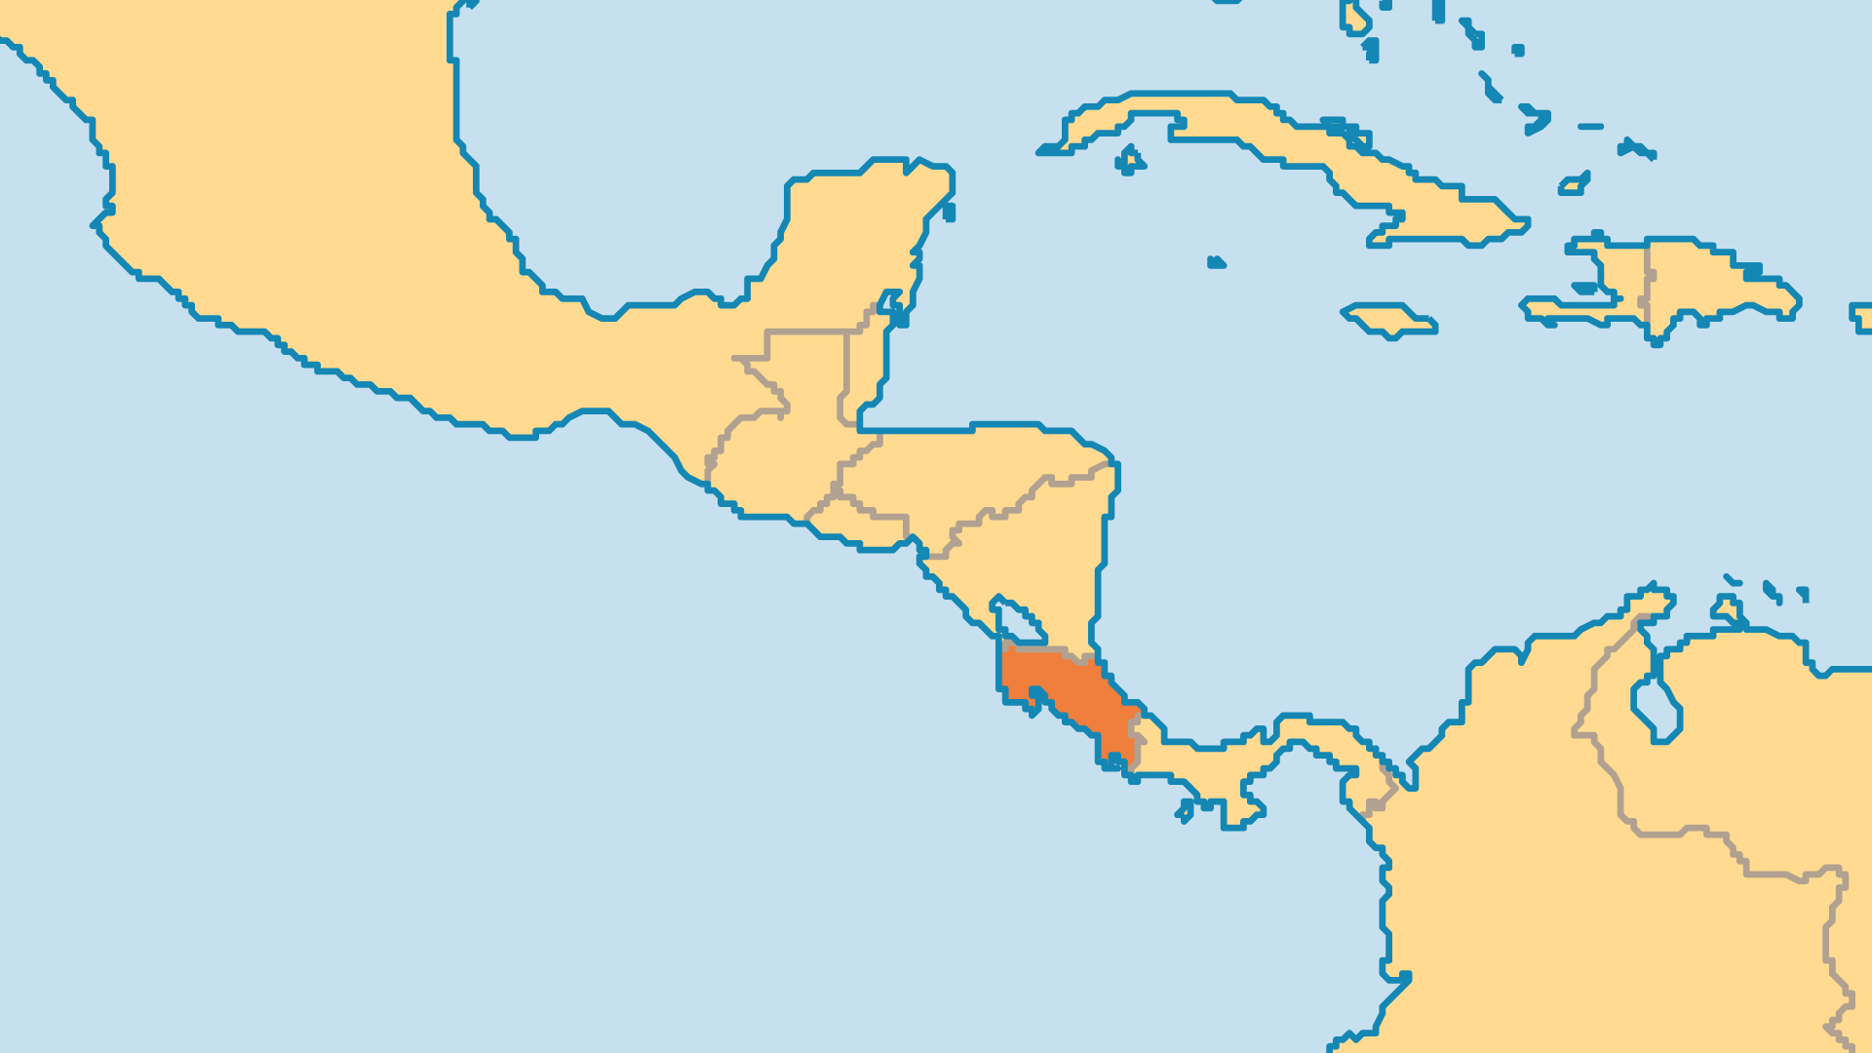
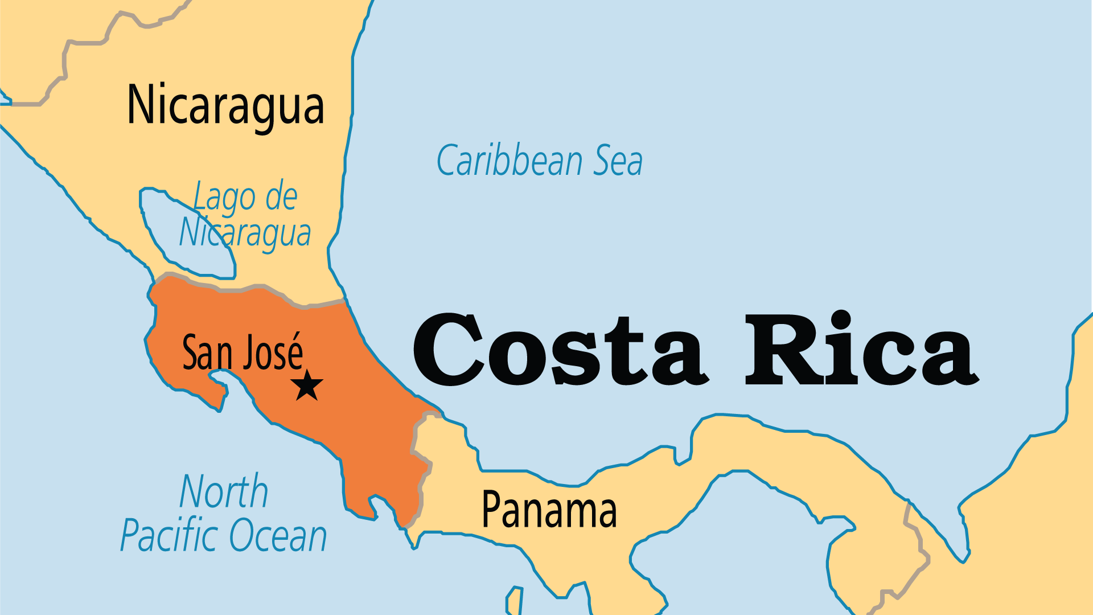
KEY STATS
Capital: | San José
Population: | 5,152,950
Official Language: | Spanish. English and Mekitelyu
Literacy Rate: | 94 %
Life Expectancy: | 77 yrs (68th/236)
HDI Ranking: | 58/193
% Christian: | 93.9 %
% Evangelical: | 14.8 %
Least Reached People Groups: | 1
% Unevangelized: | 1 %

Slide 4

FOR PRAYER
Evangelicals in Costa Rica grew to 15% of the population, and established one of Latin America's most effective mission movements. But the Church needs prayer. Most Costa Rican churches are good at winning "converts", but they fail to disciple them well. Pastors survive on minimal incomes and have little help, so they struggle to provide consistent pastoral care. Christians often fall away in difficult times or move to different churches. Pray for effective and sustainable models of doing church and making disciples in Costa Rica.
Want to know more? Go to www.operationworld.org

