Slide 1




Slide 2

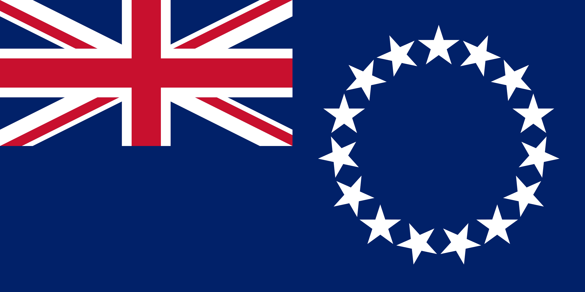
PRAYING FOR
COOK ISLANDS

Slide 3
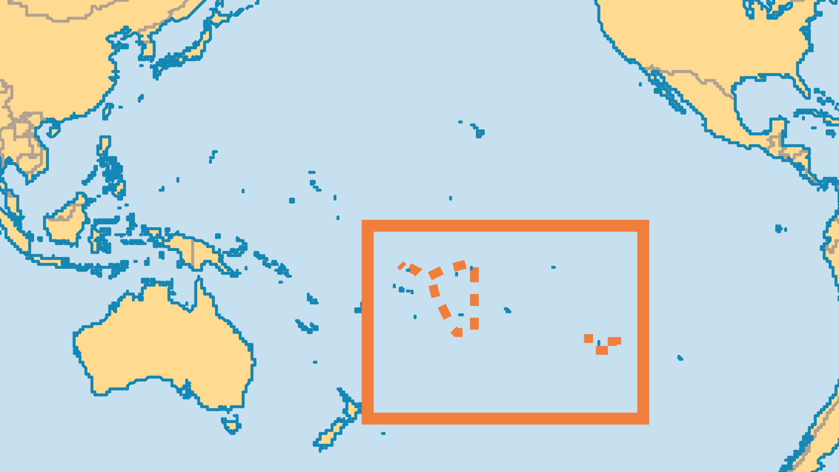
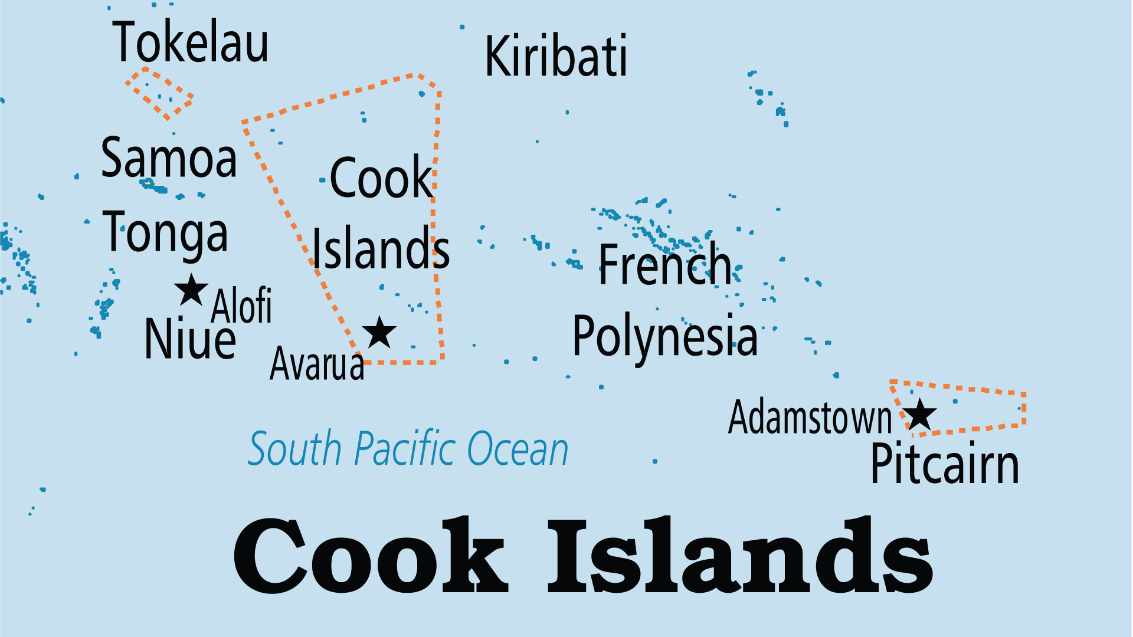
KEY STATS
Capital: | Avarua
Population: | 13,263
Official Language: | English, Cook Island Maori
Literacy Rate: | 95 %
Life Expectancy: | 74.8 yrs (94th/236)
% Christian: | 96.2 %
% Evangelical: | 12.6 %
People Groups: | 7
% Unevangelized: | 0 %

Slide 4

FOR PRAYER
The strong Christian legacy of over 150 years - bordering on theocracy on some islands - is fading rapidly. Increasing numbers are nominal or even non-religious, and Mormons and Jehovah's Witnesses are the fastest growing groups. Pray for reversal of these trends and for new life to come to the mainline Churches.
Want to know more? Go to www.operationworld.org

