Slide 1




Slide 2

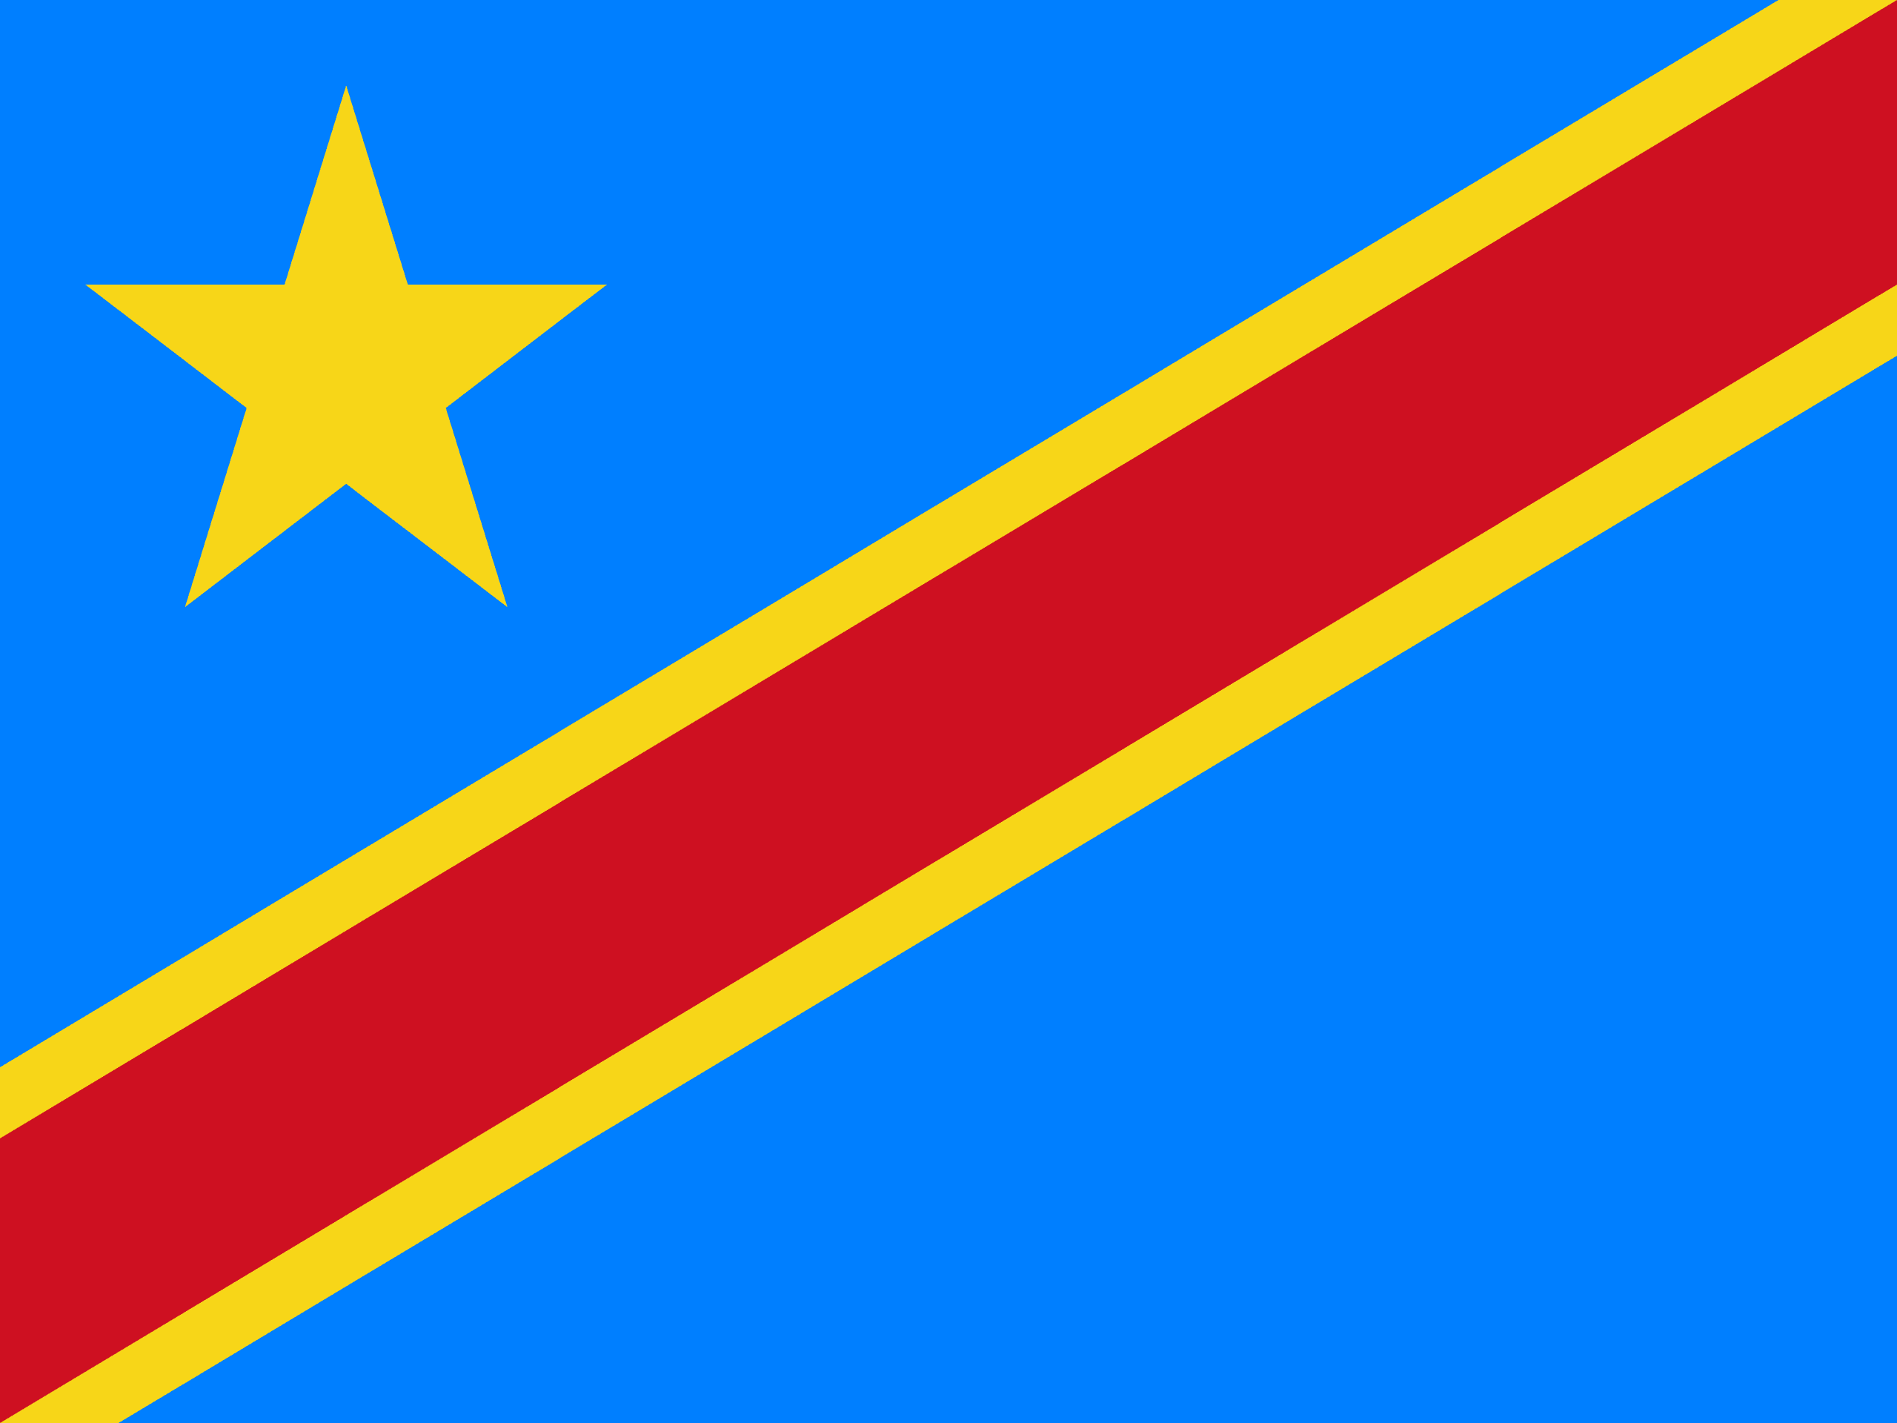
PRAYING FOR
DEMOCRATIC REPUBLIC OF CONGO (DRC)

Slide 3
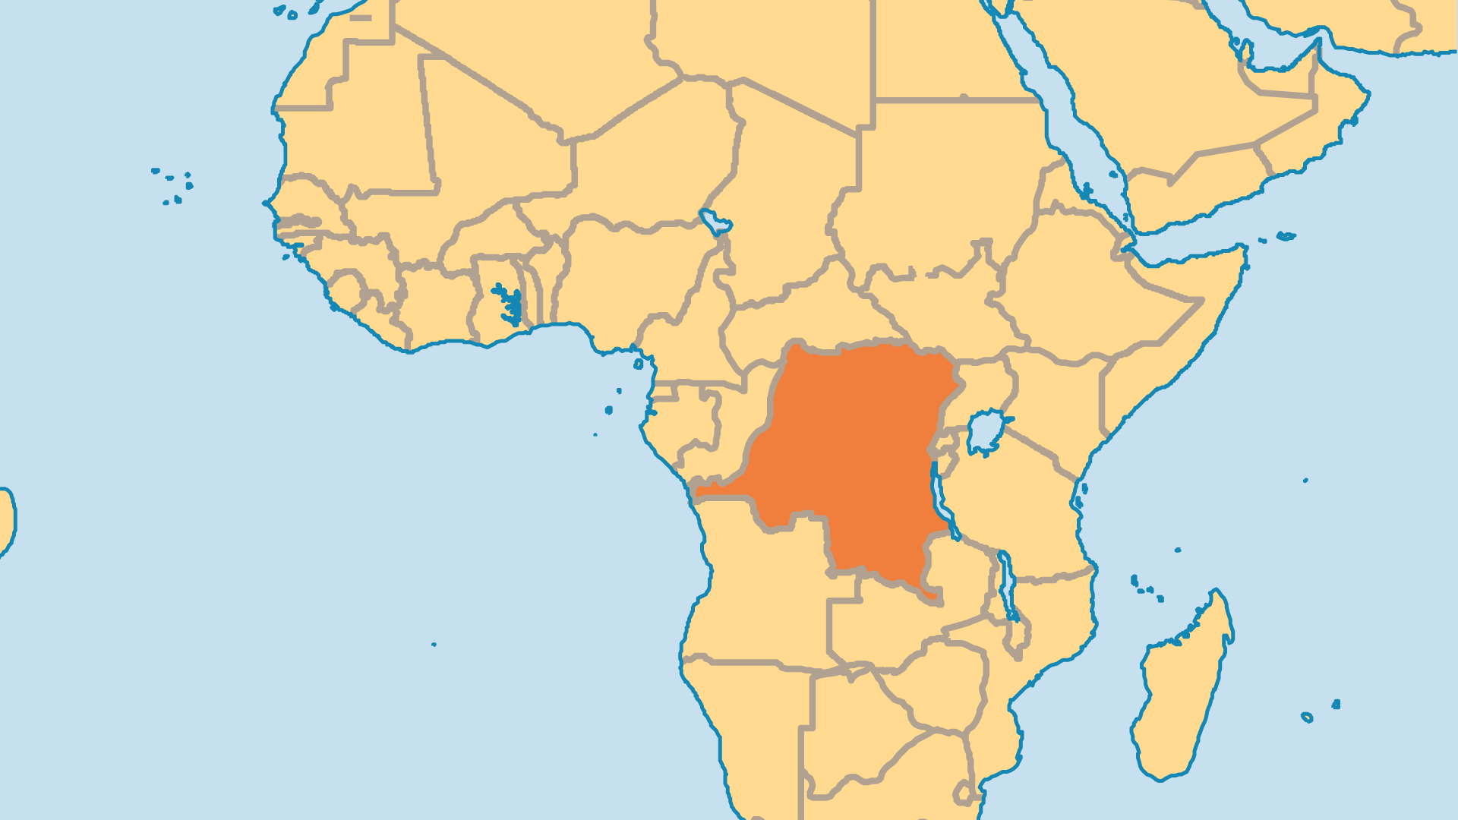
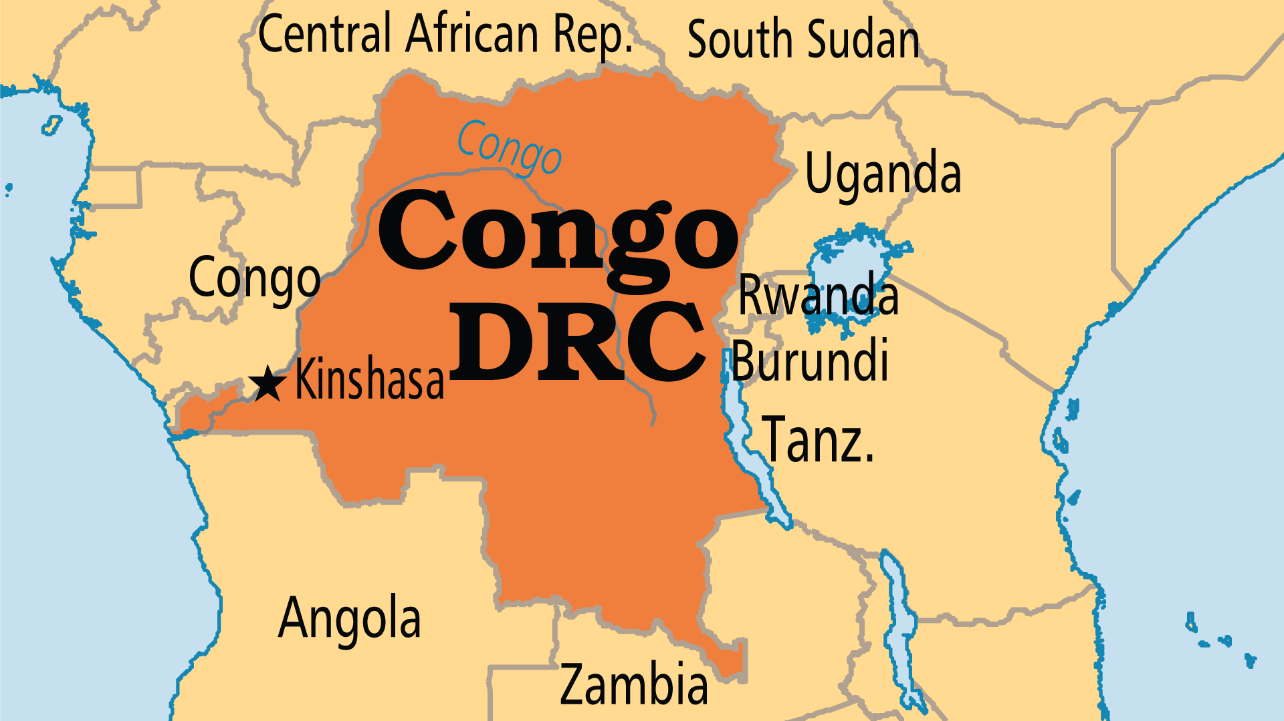
KEY STATS
Capital: | Kinshasa
Population: | 112,832,473
Pop Under 15 Yrs: | 46 %
Official Language: | French. Lingala/Bangala, Swahili, Tshiluba, Kikongo/Tuba
HDI Ranking: | 179/193
% Christian: | 92.2 %
% Evangelical: | 18.7 %
% Unevangelized: | 1 %
Persecution Ranking: | 35/50

Slide 4

FOR PRAYER
Congo has endured intense suffering for centuries. The Arab slave trade was followed by a brutal colonial occupation by Belgium, and then by corrupt leadership post-independence (Mobutu). Rebel groups, militias, foreign armed forces, and Congo's army now clash in eastern Congo. Millions of lives were lost from similar conflicts in 1996-2003. Ruthless foreign interests exploit the poverty and chaos to plunder Congo’s rich natural resources, including minerals. These evils and injustices, past and present, must be brought to light and things must be put right for this nation and its people. No modern tragedy has been so enduring and yet so ignored by the global media and the global Church. Pray for God's mercy for the nation!

Slide 5
FOR PRAYER
The powerful spiritual evil that influences much of this land shows itself in deeper ways than wars, killings, greed, and corruption. Wicked men committed widespread rape, unspeakable brutality, cannibalism, and witchcraft against adults and children. The DRC is the worst country in the world regarding sexual violence against women. How could these horrors spread throughout a land with over 90% who profess Christianity? This moves our hearts, and calls us to spiritual warfare. Cry out for God to deliver this land, and to bind the spirits that have such power over a suffering people.

