Slide 1




Slide 2

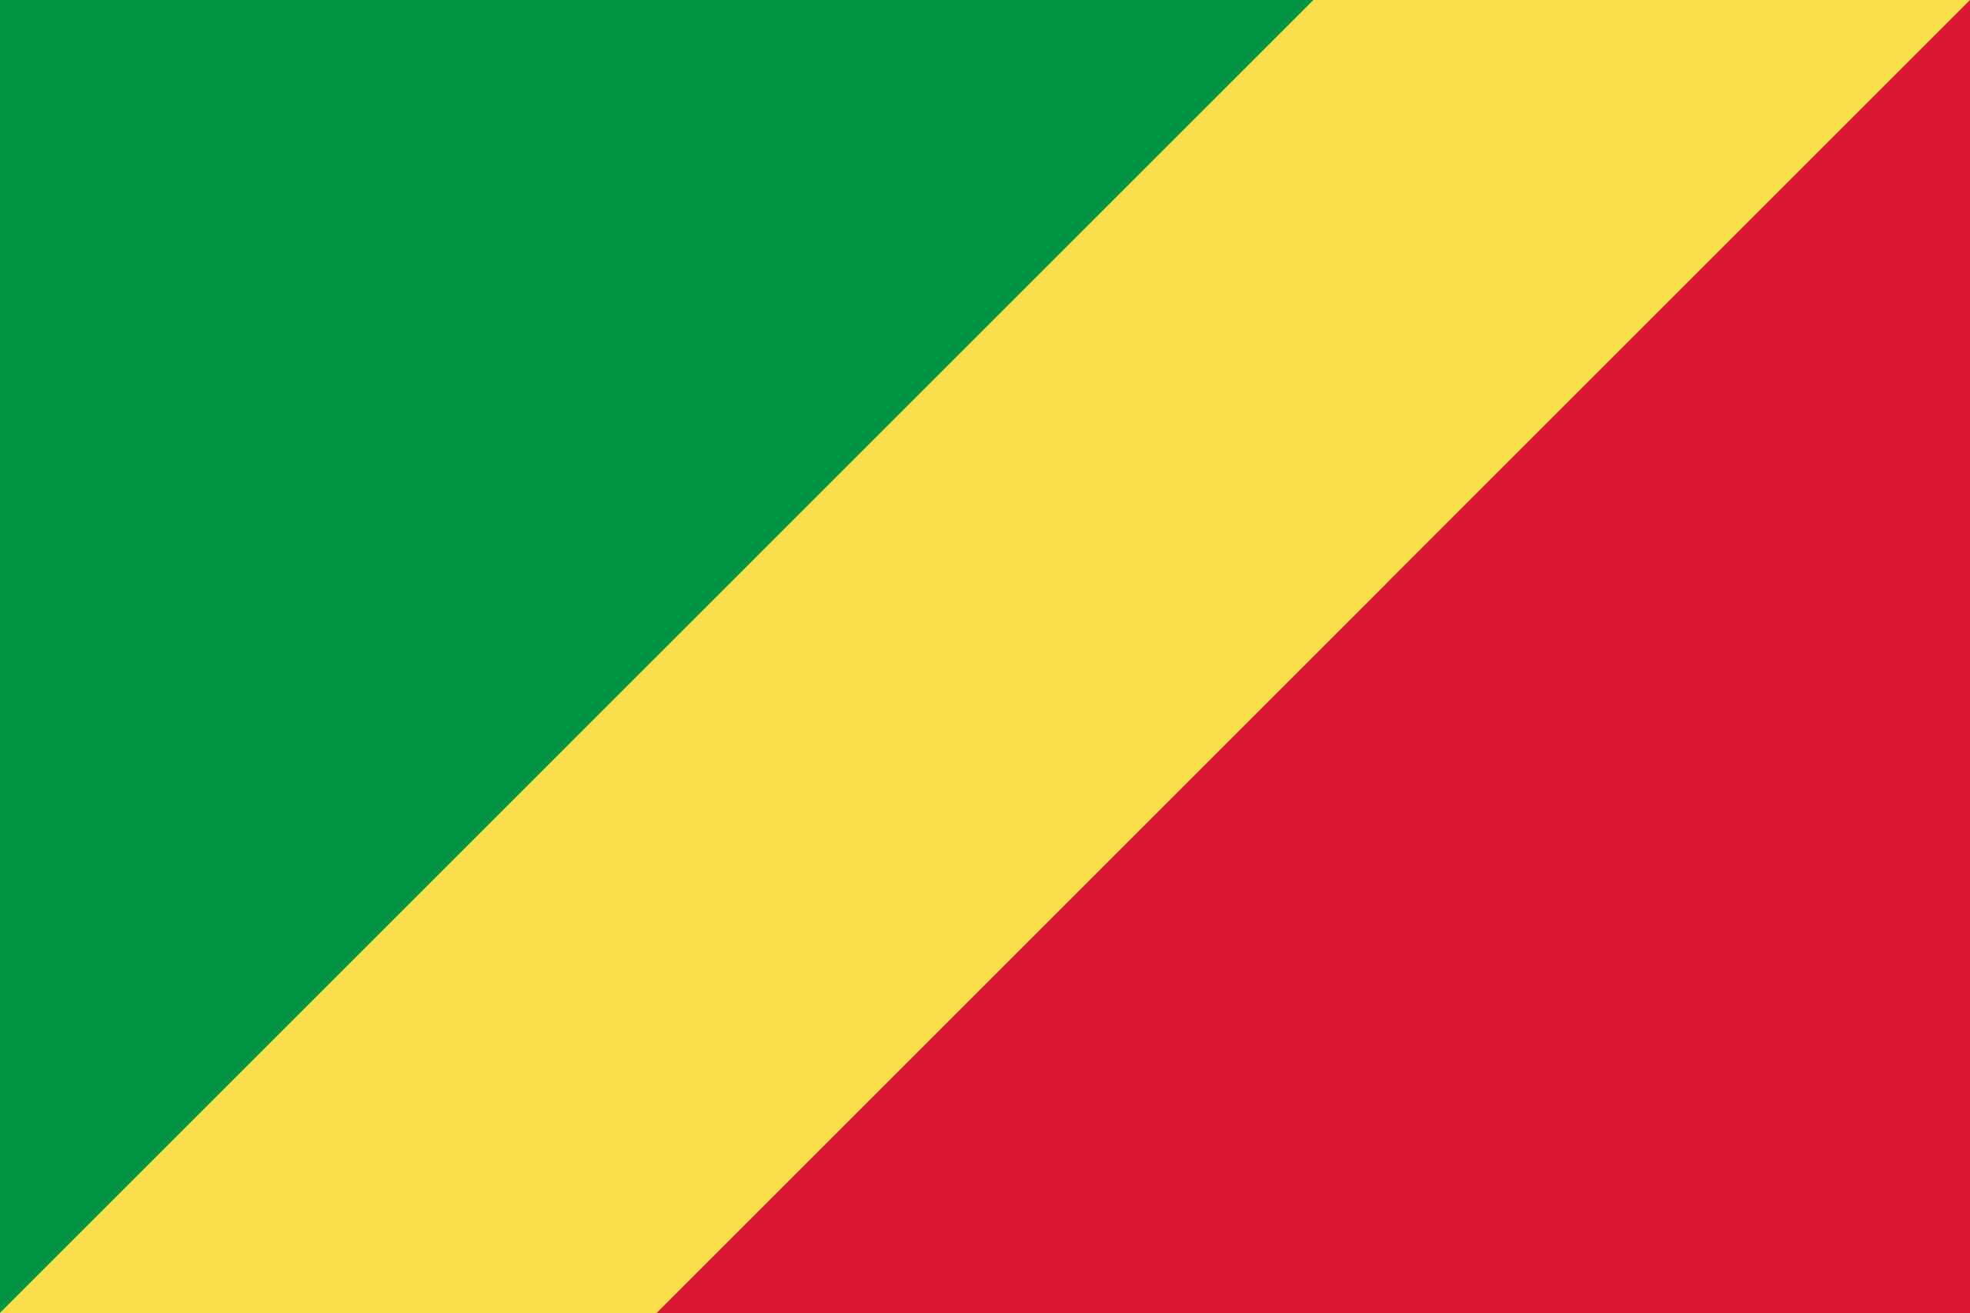
PRAYING FOR
REPUBLIC OF CONGO (ROC)

Slide 3
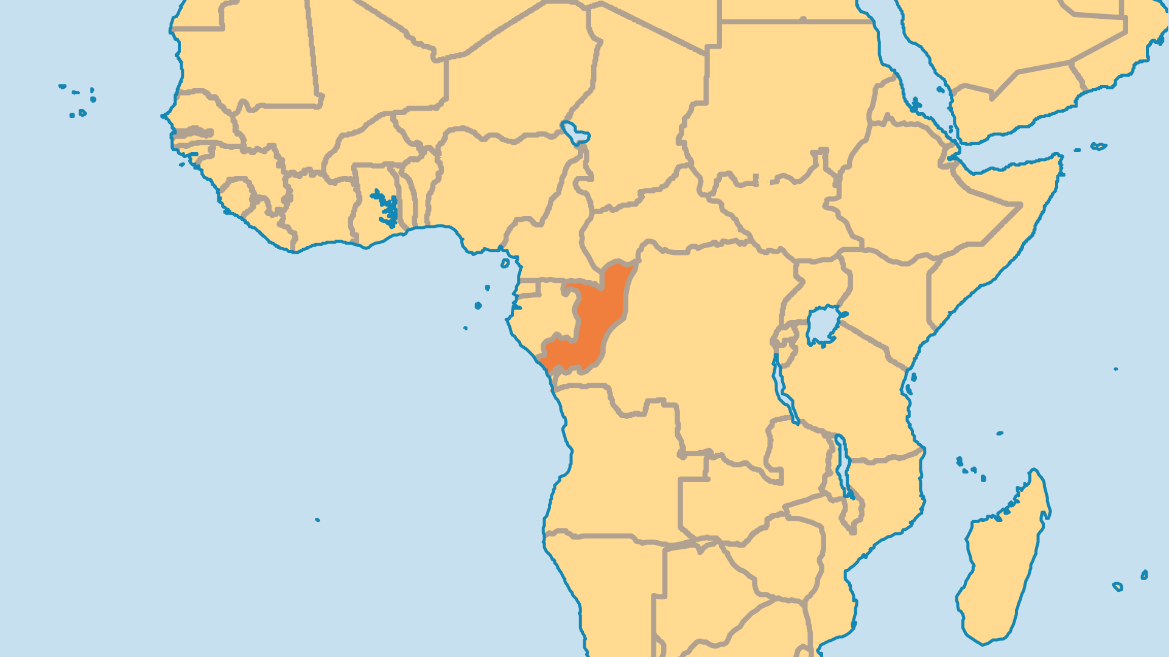
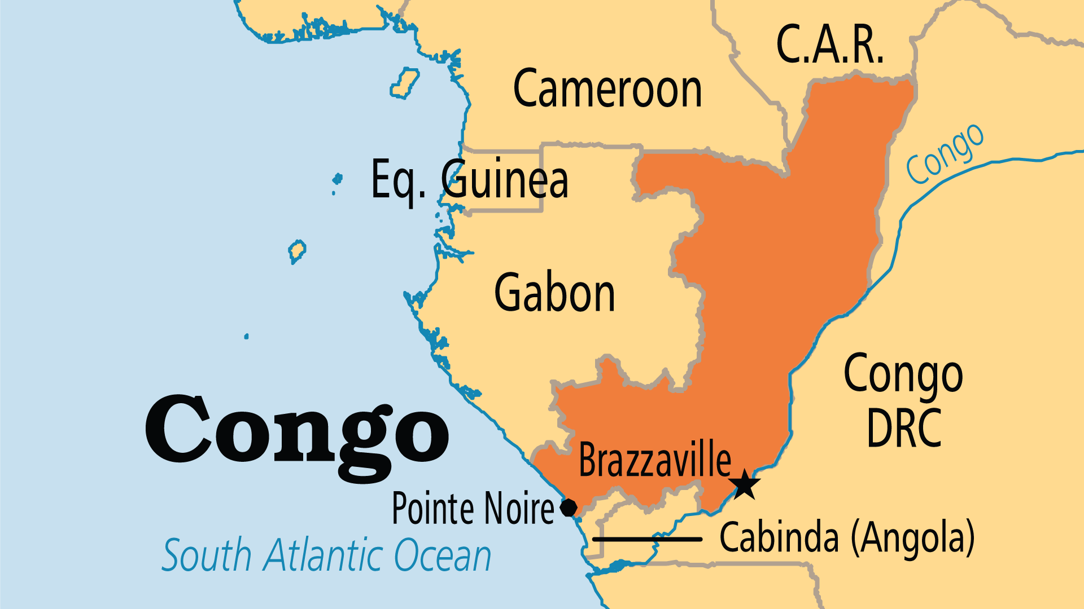
KEY STATS
Capital: | Brazzaville
Population: | 6,484,437
Official Language: | French. Trade languages Lingala, Munukutuba (Kongo Creole)
Languages: | 66
Life Expectancy: | 63.5 yrs (200th/236)
HDI Ranking: | 153/193
% Christian: | 89.7 %
% Evangelical: | 15.9 %
% Unevangelized: | 1 %

Slide 4

FOR PRAYER
The Congo has past troubles, but future potential. After two decades of Communism, the past dictator eventually became president of the new democracy. But in the years between he provoked a civil war that devastated the land, killed thousands, and displaced over 300,000 people. Currently, this nation's troubles pale in contrast to some of its neighbours. Pray for good government, for wise economic policies, for good stewardship of natural resources, and for justice to rule in society.
Want to know more? Go to www.operationworld.org

