Slide 1




Slide 2

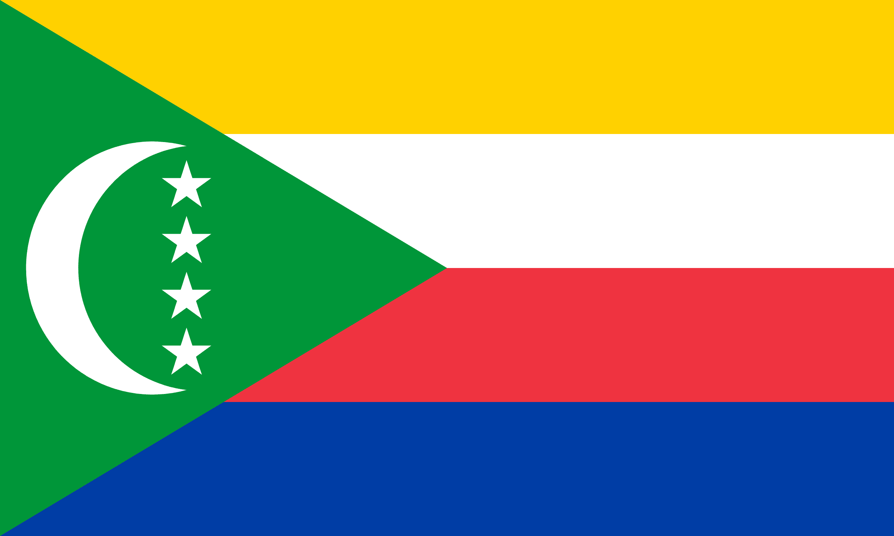
PRAYING FOR
COMOROS

Slide 3
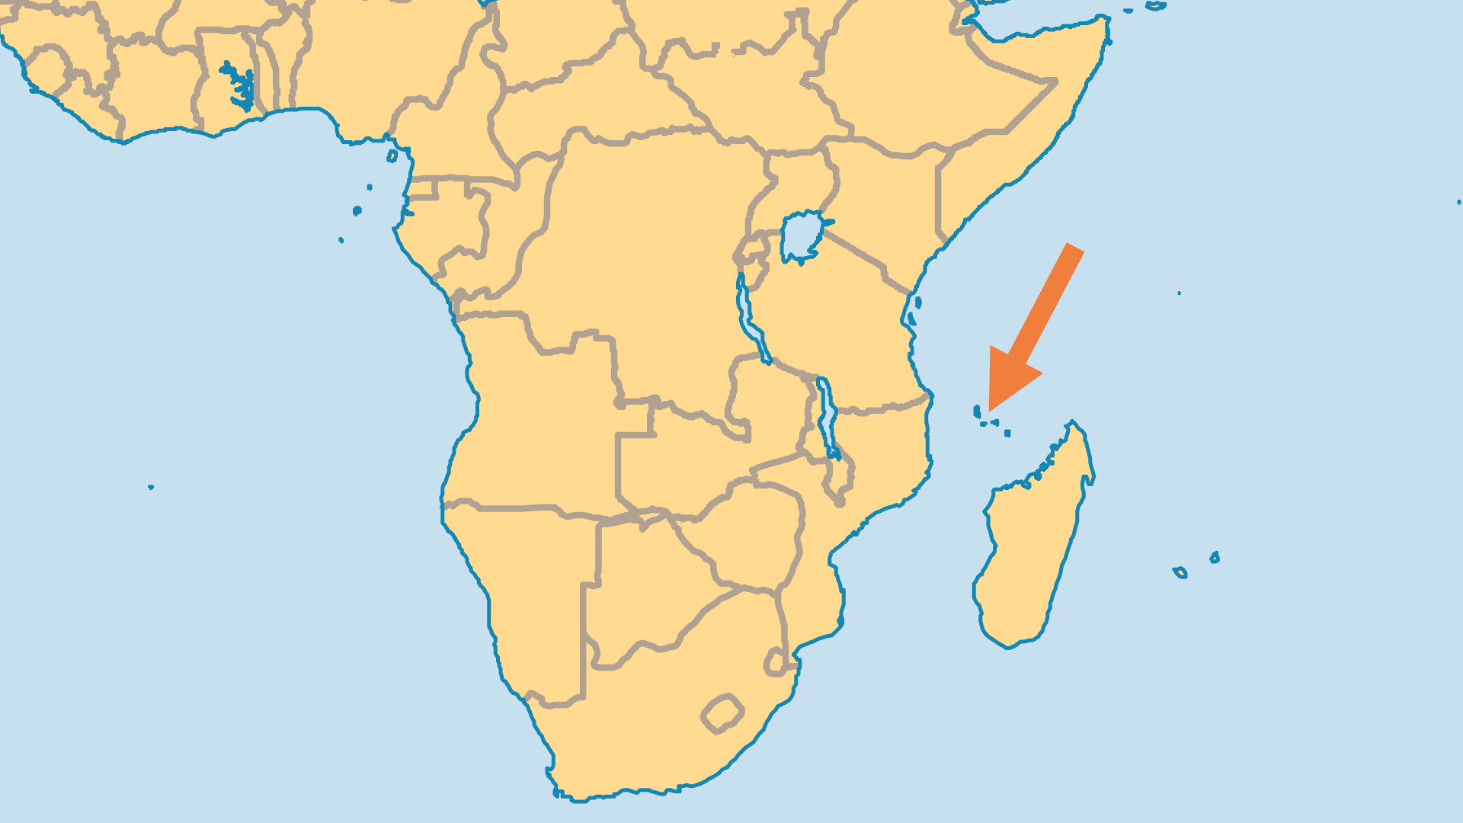
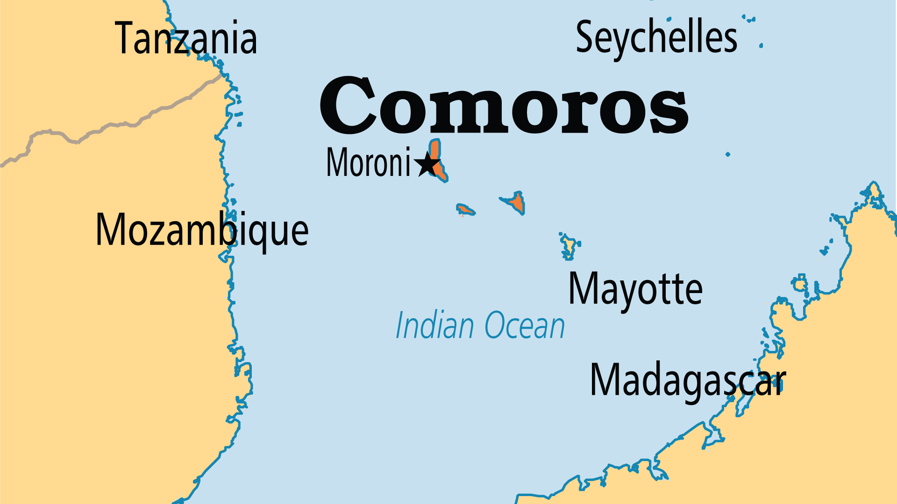
KEY STATS
Capital: | Moroni
Population: | 882,848
Official Language: | Arabic, French, Comorian
Literacy Rate: | 76 %
Life Expectancy: | 63.4 yrs (201st/236)
% Christian: | 0.9 %
% Evangelical: | 0.2 %
Largest Religion: | Muslim
% Unevangelized: | 66 %
Persecution Ranking: | 42/50

Slide 4

FOR PRAYER
The vast majority of the population are Muslim. They were almost completely unevangelized before 1973. Islamic fundamentalism is on the rise. However, most are involved in occult practices through witchcraft, curses and spirit possession. Many young people - disillusioned with life in this society that offers so little hope - attempt to find solace in drugs, sex or the opportunity to leave the islands. Pray that they might have opportunities to hear the gospel of life that offers hope to all.
Want to know more? Go to www.operationworld.org

