Slide 1




Slide 2

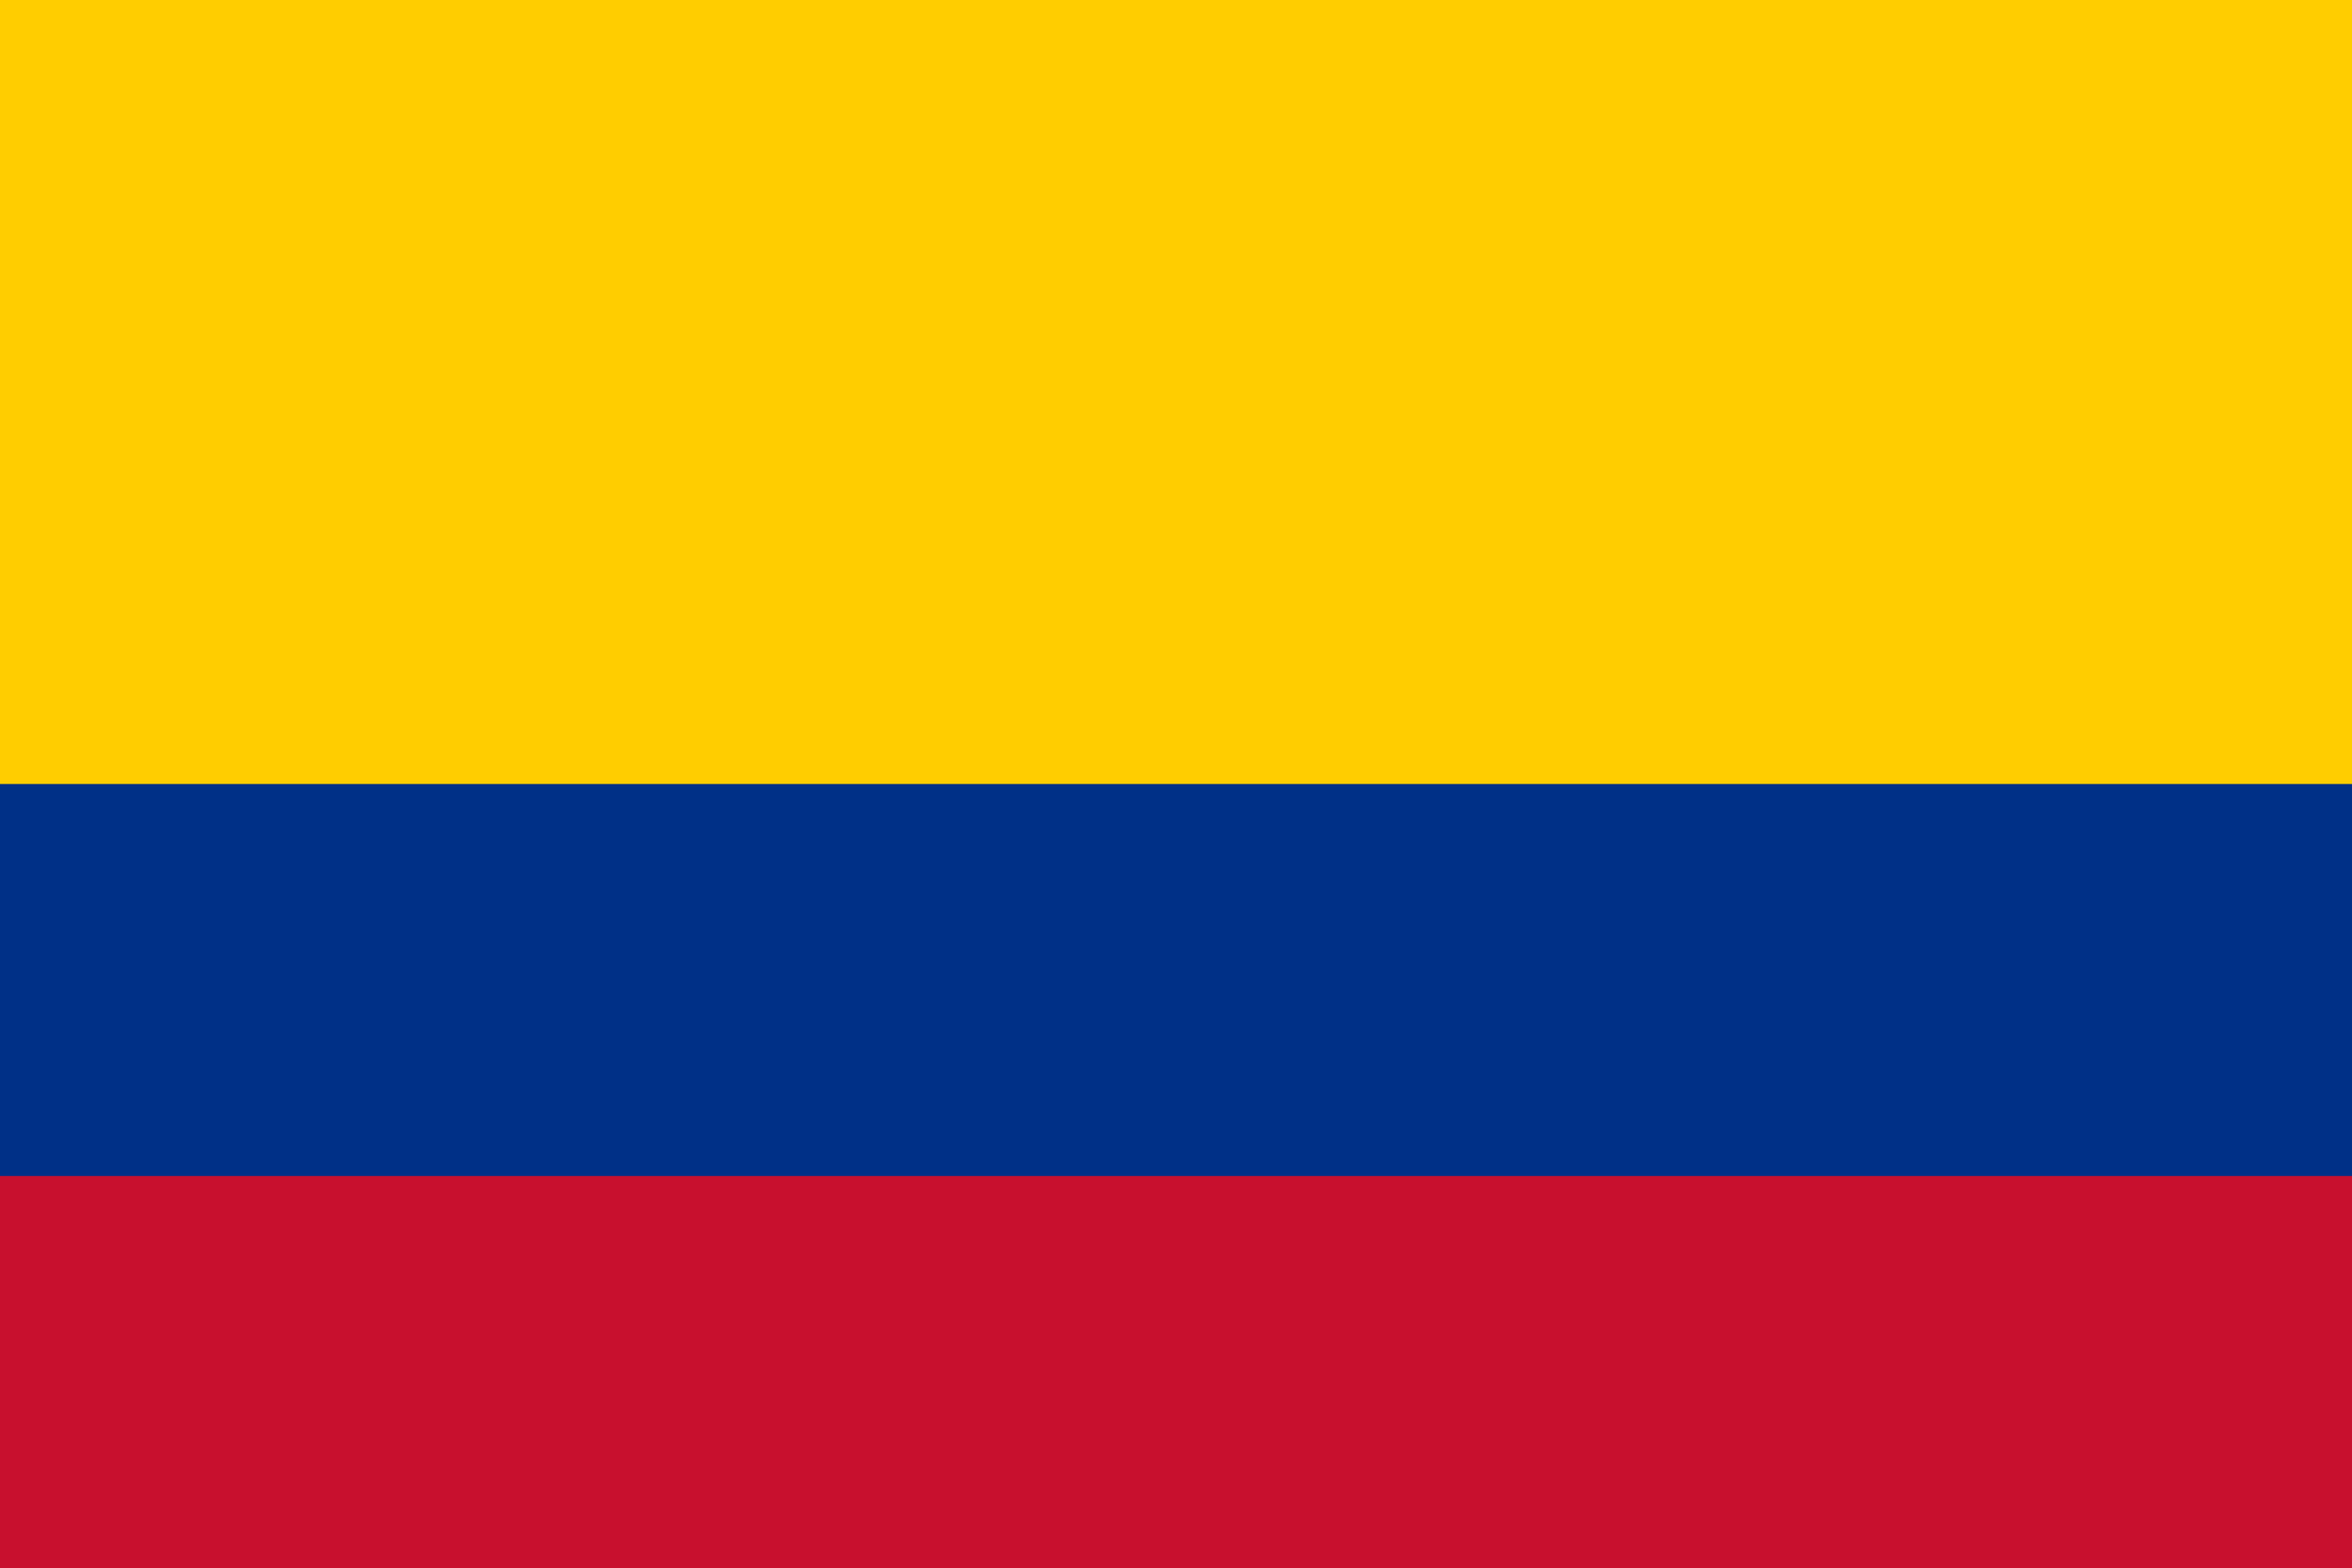
PRAYING FOR
COLOMBIA

Slide 3
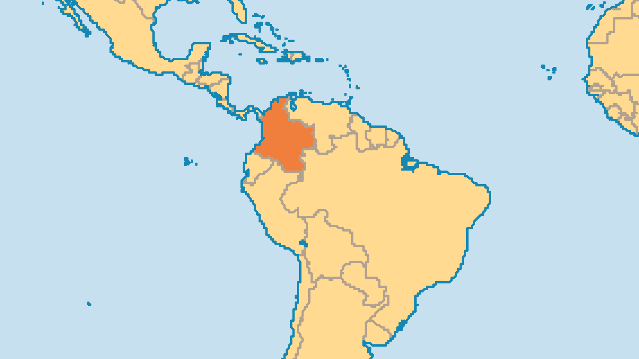
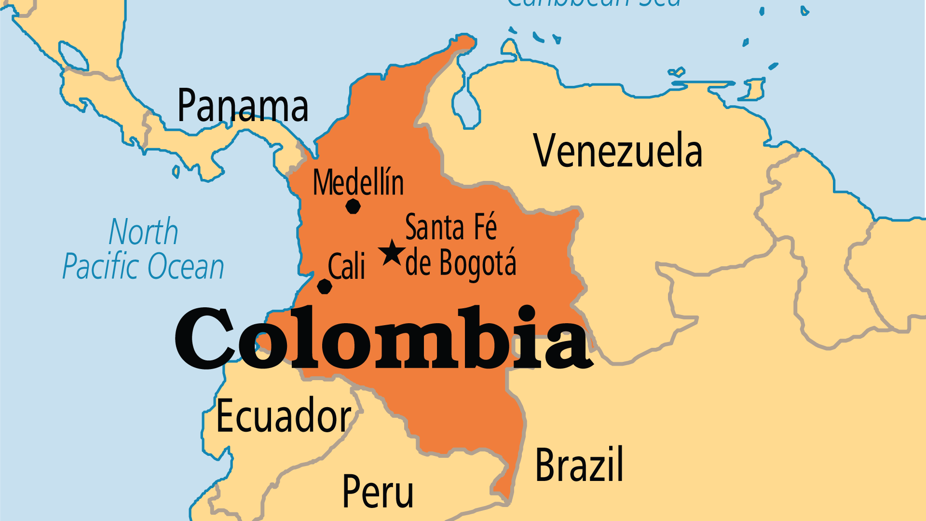
KEY STATS
Capital: | Bogota
Population: | 53,425,636
% Urban: | 82.9 %
Official Language: | Spanish
Languages: | 83
Life Expectancy: | 72.8 yrs (122nd/236)
HDI Ranking: | 88/193
% Christian: | 94.4 %
% Evangelical: | 7.5 %
Persecution Ranking: | 46/50

Slide 4

FOR PRAYER
Pray that peace might hold in this nation so troubled by violence in the past. A long-lasting armed conflict included the government, left-wing guerrillas, right-wing paramilitaries, foreign multi-national corporations, and drug cartels. There is now an effort to bring justice to those victimized during the conflict, and to those who committed human rights violations or broke international law. Meanwhile, Venezuela's meltdown has brought up to 4 million Venezuelans into Colombia. Pray that believers in Colombia might be peacemakers amidst continuing tensions and violence. Pray also for the Church to love their neighbours - including the millions of Venezuelans who find themselves in such desperate need.

Slide 5
FOR PRAYER
Amerindians suffer oppression and discrimination. Colombians often disregard their contribution to culture and society. Most are poor, less educated, and vulnerable to violent conflict and land abuses. Some of the 94 tribes have strong, well-led churches that work together and even send out missionaries. 37 Amerindian languages have no New Testament; 25 have no Scripture at all. Violent groups kidnapped or killed some Bible translators. Some Amerindian Christians are pressured/forced to return to their former religious practices. 15 of these 94 tribes remain isolated and unevangelized. Pray for each of these precious groups to find the gospel before they disappear forever.

