Slide 1




Slide 2


PRAYING FOR
TAIWAN - REPUBLIC OF CHINA

Slide 3
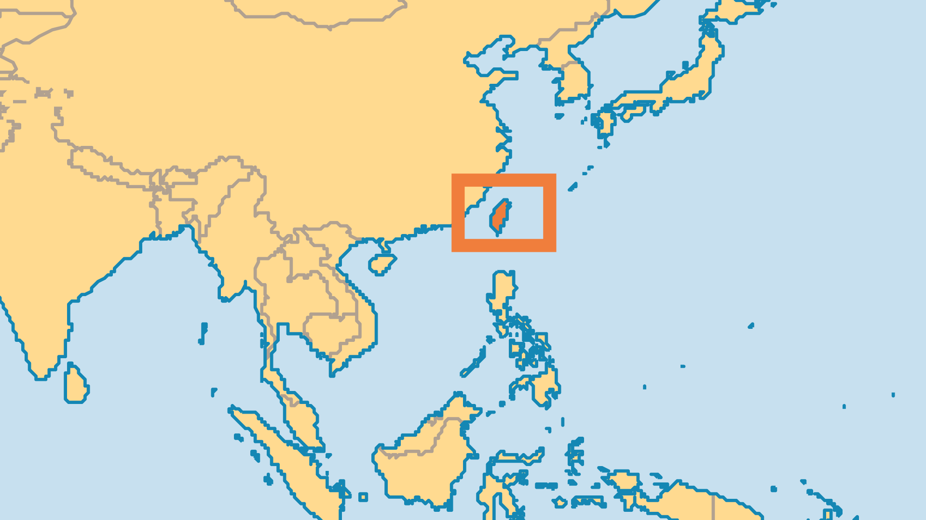
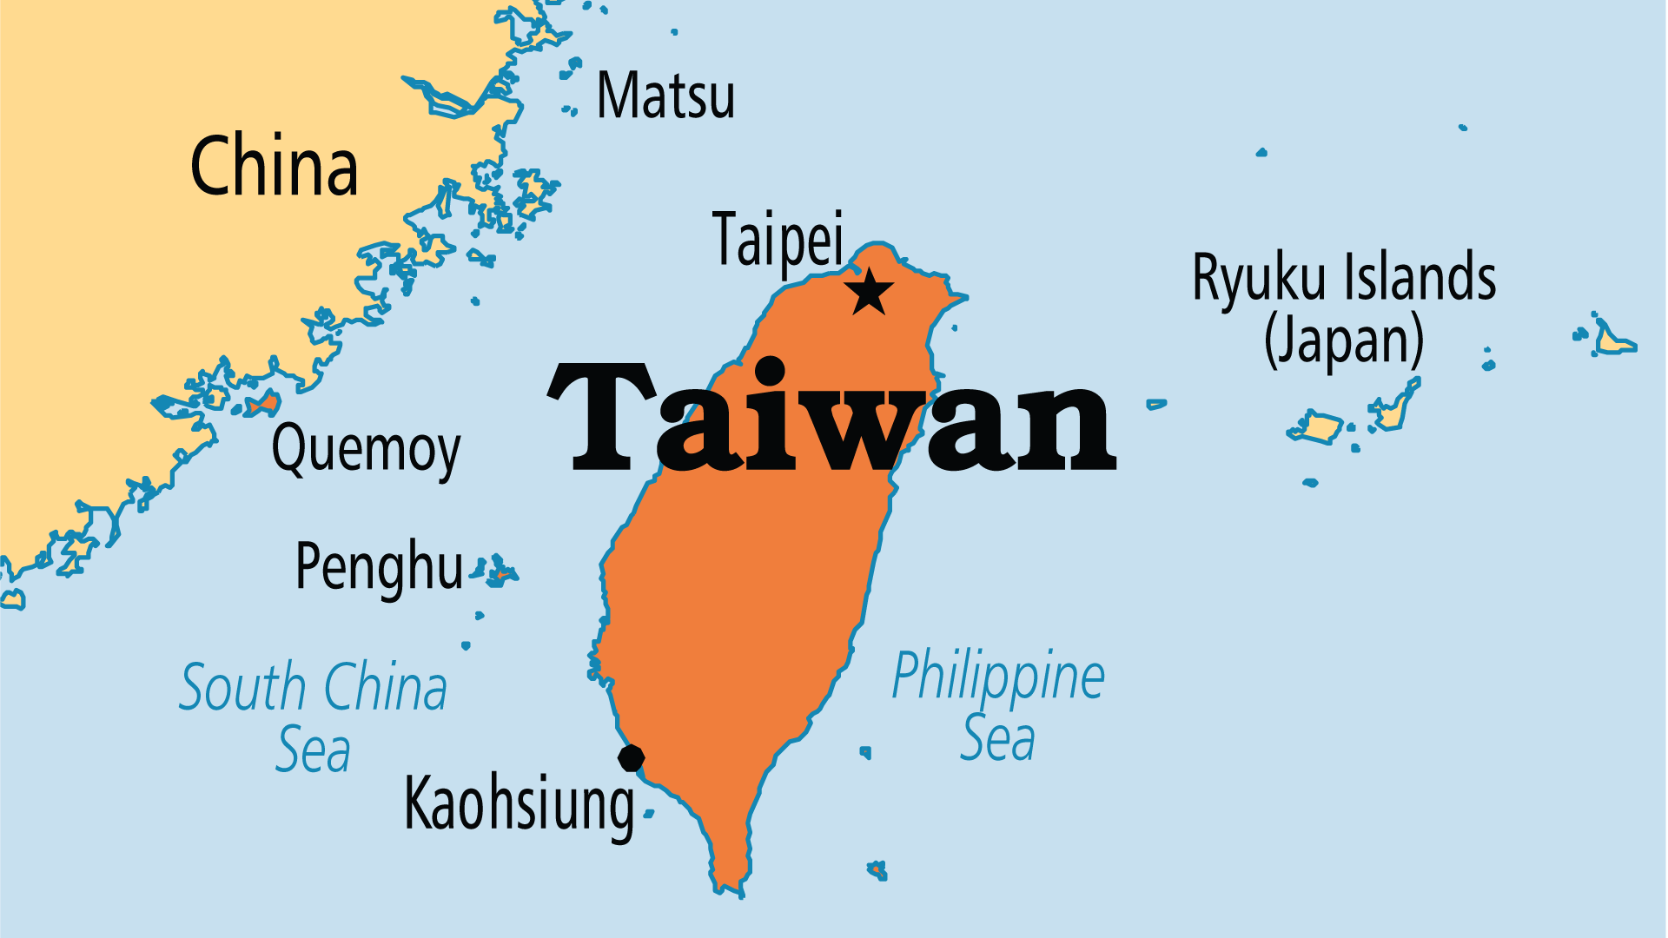
KEY STATS
Capital: | Taipei
Population: | 23,112,793
Official Language: | Mandarin. Hoklo and Hakka are widely spoken
Languages: | 28
Literacy Rate: | 99 %
% Christian: | 5.8 %
% Evangelical: | 2.8 %
Largest Religion: | Chinese
% Unevangelized: | 34 %

Slide 4

FOR PRAYER
Taiwan’s controversial political status causes problems both within China and internationally. Taiwan functions as an independent state but is claimed by China as one of its provinces. If Taiwan declared full independence, it could result in a hostile military response from China. Even without such a declaration, China's expanding ambitions and increasingly aggressive tone and actions cast a long shadow over this beautiful island. Pray for wisdom for the leaders involved, and for good relations for the long term. Pray that violence would be averted, and that peace would prevail.

Slide 5
FOR PRAYER
Taiwan remains a stronghold of Buddhism and Taiwanese folk religion. Over 90% of Taiwanese follow some combination of Buddhism, Confucianism, Daoism, and traditional religions. Buddhism now grows strongly among educated professionals. Most traditional folk religions have many gods, and people pay offerings to ghosts or seek advice from the spirit world. Taiwan remains the only major Han Chinese population in the world without a significant spiritual breakthrough. Visitors from mainland China often comment on the spiritual darkness here.
Want to know more? Go to www.operationworld.org

