Slide 1




Slide 2


PRAYING FOR
MACAU

Slide 3
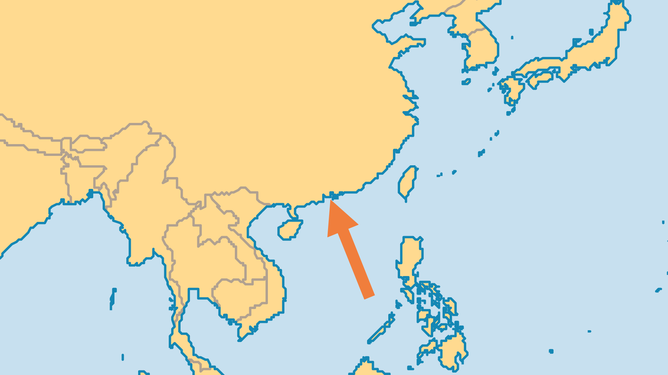
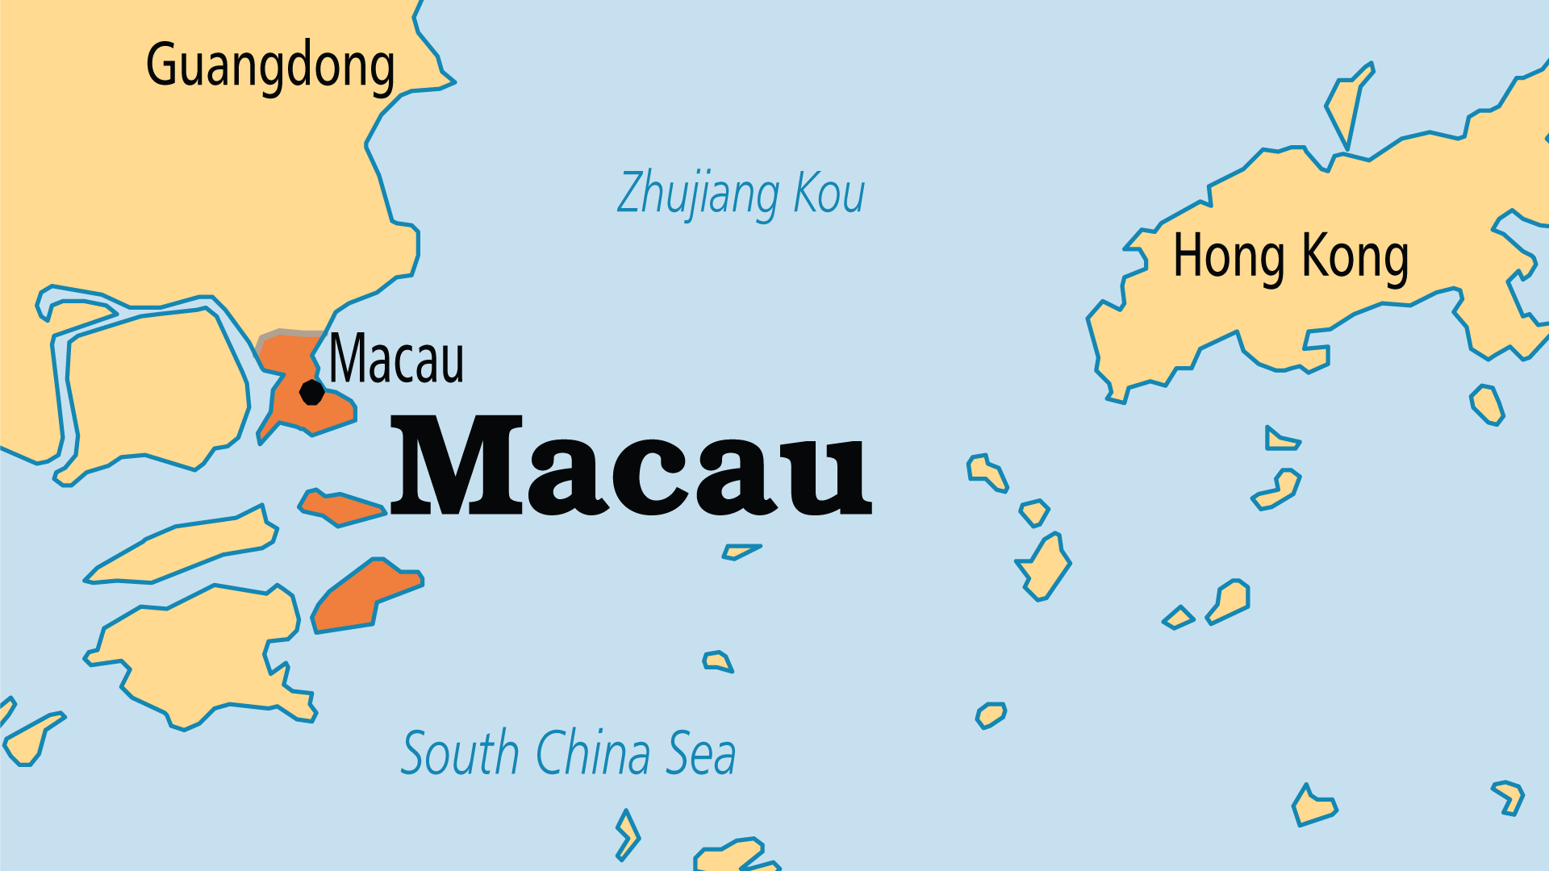
KEY STATS
Capital: | Macau
Population: | 722,007
Official Language: | Chinese and Portuguese.
Life Expectancy: | 85.4 yrs (3rd/236)
% Christian: | 5.4 %
% Evangelical: | 1.6 %
Largest Religion: | Chinese
People Groups: | 12
Least Reached People Groups: | 5
% Unevangelized: | 28 %

Slide 4

FOR PRAYER
Macau is the first Christian territory in Asia to become non-Christian since the Muslim conquest in West Asia over 600 years ago. 95% of the population were Catholic in 1600; fewer than 5% are Christian today. Protestant missions to China started in Macau. Here, missionaries baptized the first Chinese convert and translated the first Chinese Bible. Many now follow Buddhism, Daoism, or traditional Chinese religions. The gambling industry, fear of the local god "A-Ma", and high turnover of church leaders, hinder the spread of the gospel. Pray for believers to win back Macau for the Saviour.
Want to know more? Go to www.operationworld.org

