Slide 1




Slide 2


PRAYING FOR
HONG KONG

Slide 3
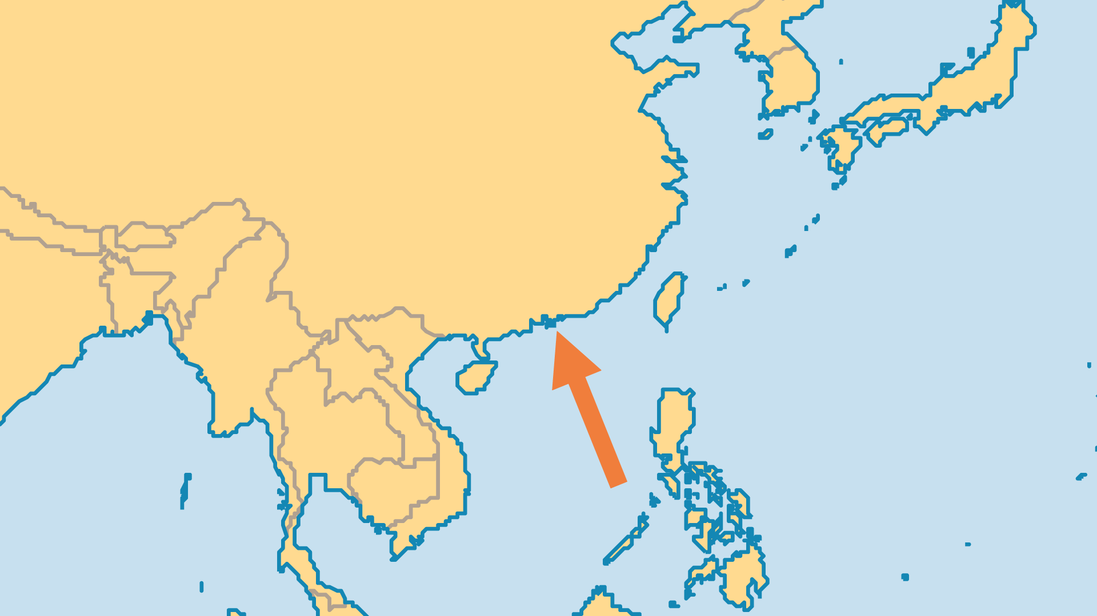
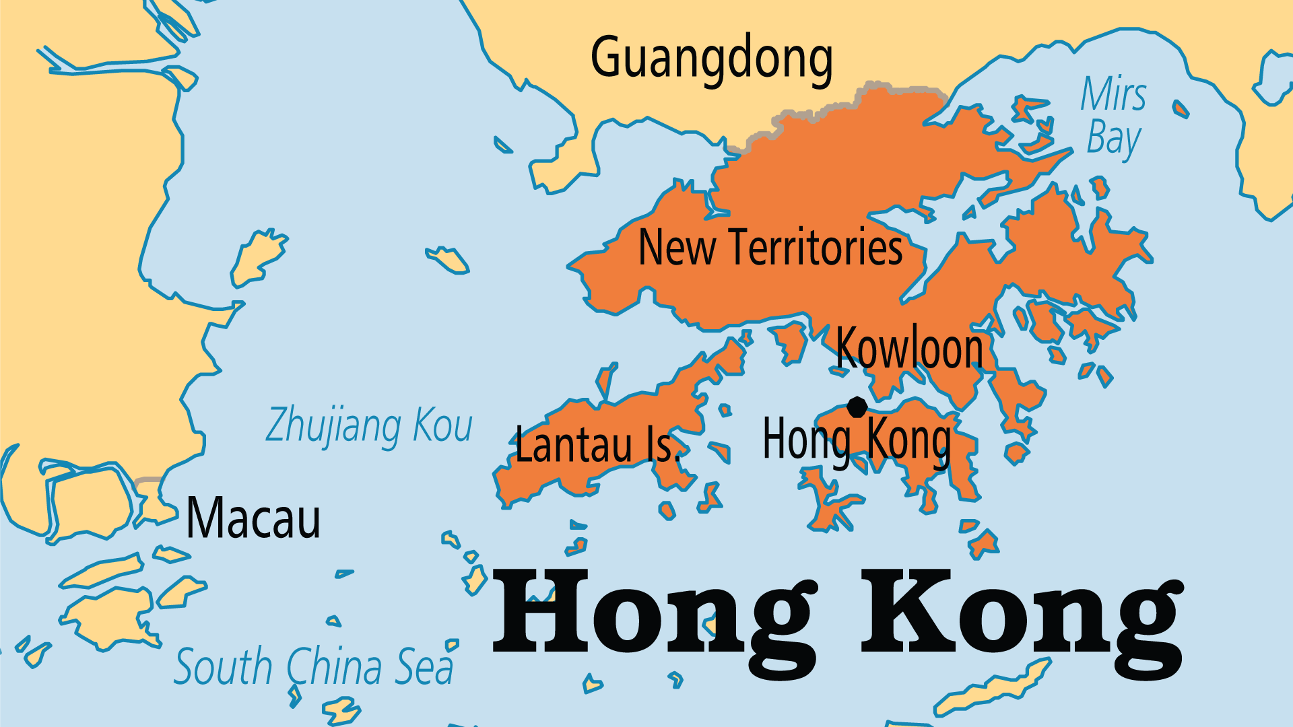
KEY STATS
Population: | 7,396,076
% Urban: | 100 %
Pop Under 15 Yrs: | 12.3 %
Official Language: | Chinese (Cantonese, Putonghua) and English
Life Expectancy: | 85.5 yrs (2nd/236)
HDI Ranking: | 4/193
% Christian: | 12.4 %
% Evangelical: | 6.1 %
Largest Religion: | Chinese

Slide 4

FOR PRAYER
The political and government changes since 2020, the failure of protests to achieve liberties sought by many young people, and the fast-track migration programmes of countries like the UK and Canada together have generated conditions for Hong Kong to undergo yet another historic mass exodus. The educated and wealthy will be able to thrive elsewhere, but millions more are “stuck” in a context ever more under the PRC’s direct control. While the choice to migrate is understandable, pray that many believers will stay to continue Kingdom work and to be a witness to Jesus.
Want to know more? Go to www.operationworld.org

