Slide 1




Slide 2


PRAYING FOR
PEOPLE'S REPUBLIC OF CHINA

Slide 3
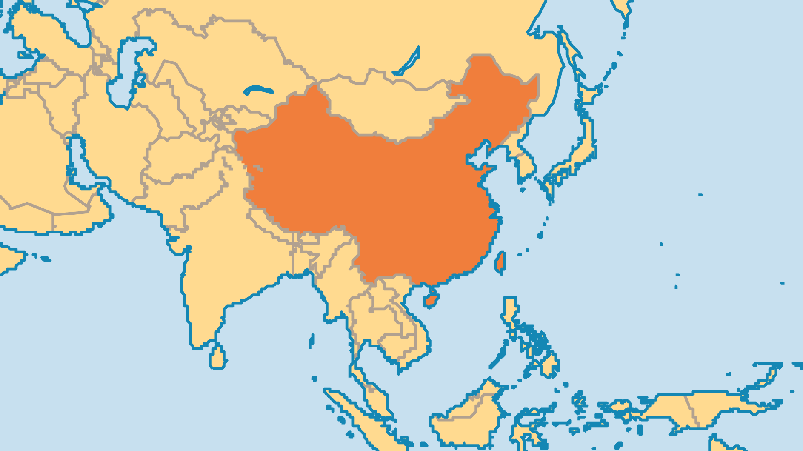
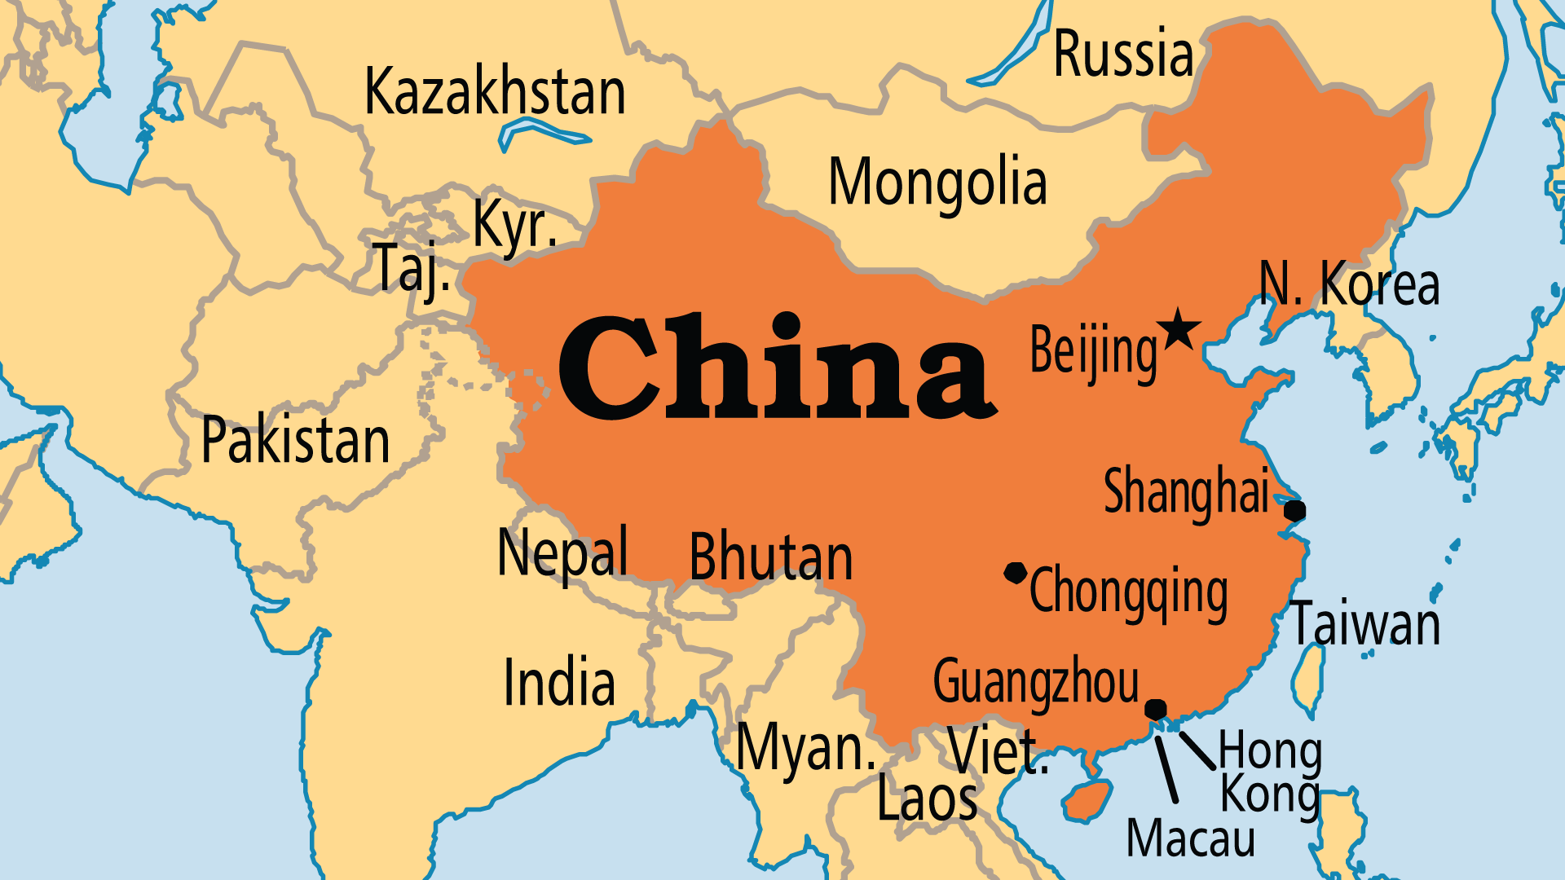
KEY STATS
Capital: | Beijing
Population: | 1,416,096,094
Pop Under 15 Yrs: | 17.8 %
Official Language: | Mandarin
Languages: | 296
Life Expectancy: | 78.2 yrs
% Christian: | 7.9 %
% Evangelical: | 5.7 %
Largest Religion: | Non-religious
% Unevangelized: | 33 %
Persecution Ranking: | 15/50

Slide 4
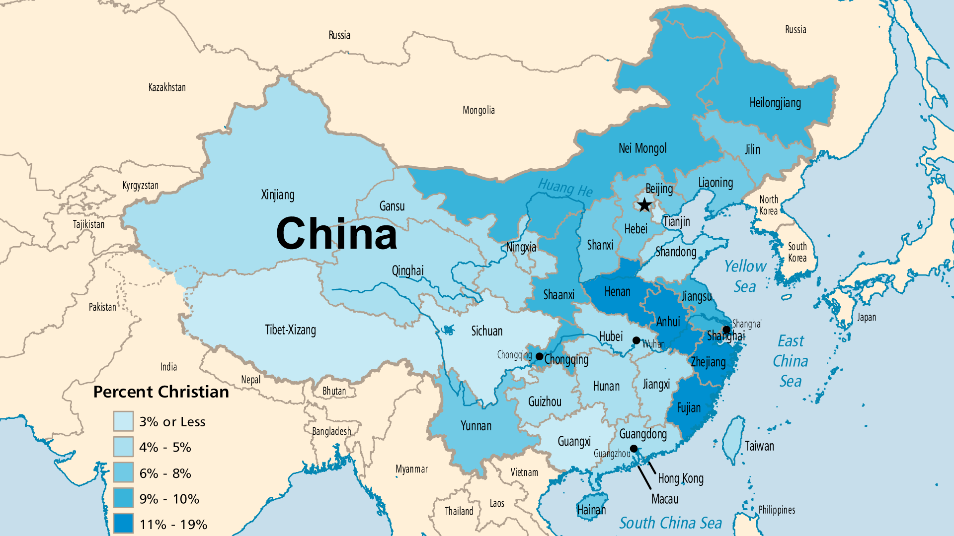

Slide 5

FOR PRAYER
Some call this the "Chinese Century" because of China's rising role on the world stage. Until 2023, it had more people than any other country, and exerts massive influence on world economics and politics. China invests billions of dollars in Africa, Asia, and Latin America to develop trade, but also to gain influence. But it also remains politically oppressive and corrupt. It has a poor human rights record imposing harsh laws and punishments. The cult of personality surrounding President Xi, the increasingly bellicose tone of China's foreign policy, and the accelerating oppression of minorities and dissidents should compel us to prayer! Pray for God to do a mighty work in and through the Chinese government.

Slide 6
FOR PRAYER
The biggest human migration in history has been happening in China. In just a couple of generations, hundreds of millions of rural dwellers relocated to China's urban centres. Many millions cannot support their families through farming. Migrants to cities can end up without basic social services or educational opportunities, which creates overcrowding and unemployment. Migrants without proper housing become vulnerable and problematic. These problems were exacerbated in 2020 by the lockdown and economic consequences of Covid-19's emergence in China. Pray for Christians in the cities to reach out with compassion to these millions of desperate people.

Slide 7
FOR PRAYER
From 1970 to 2015 China had a "one-child policy" to control population size. Many families desired a healthy son and aborted, abandoned, or trafficked female or disabled babies. But now, China has a birthrate crisis. In the near future, the Chinese population will have many more elderly than young people, with severe economic, health care, and ethical implications. China's labour pool has shrunk. There are opportunities to share a hope in Christ to the increasing elderly population, the over-burdened carers, and the frustrated men unable to find wives. Pray that the Church might rise up to be a blessing to these vulnerable groups.

Slide 8
FOR PRAYER
The survival and growth of the Church in China are awesome events in our generation! The atheist government strictly controls religious groups. Christians started underground house-church networks designed to survive the persecution. Through radio ministries, Christian workers, and believers devoted to outreach, the Church did more than survive; it grew! The government re-allowed registered churches in 1978 as a way to regain control over Christianity. But unregistered churches just continued to grow. There is no growth story like it in all of church history. 2.7 million evangelicals in 1975 grew to over 75 million in just 35 years!

Slide 9
FOR PRAYER
The traditional house-church networks formed the core of the Chinese Church for many decades. Preachers travelled far and wide across China. The intense persecution isolated them from the global Church, and forced them to adopt indigenous ways. They focus strongly on prayer, revival, simple living, and on Christ! Most house-church Christians love their country, but their first loyalty is to God. They do not want to register with the government. Their illegal status leads to persecution. Pray that the strong commitment to God’s Word, the power of the Holy Spirit, and the boldness to spread the gospel will all continue to shape this growing, changing movement.

Slide 10
FOR PRAYER
Missions vision is strong, and the Chinese Church sends out workers to both unreached minorities within China and unevangelized nations beyond. Some house-church networks have supported missions outreach to other provinces and to ethnic minorities for a long time. The Back to Jerusalem vision aims to send up to 100,000 missionaries from China throughout the unevangelized world. Some think China may become the greatest sending nation of the 21st century! Pray for good preparation to equip Christians and churches for this cross-cultural task. Pray for sensitivity and humility, especially for the dominant Han Chinese.

Slide 11
FOR PRAYER
The "lost generation" are those who came of age during the Cultural Revolution of 1966-1976. The Cultural Revolution was Mao Zedong's final policy, and it caused great suffering. Millions died in those years, and education was crippled. The economic growth in China since then largely left the "lost generation" behind, and the current obsession with economic issues will leave them even more abandoned. Pray that this generation might find hope and peace in Christ.
Want to know more? Go to www.operationworld.org

Slide 12
FOR PRAYER
Islam is an officially recognized religion in China, but conflict with some ethnic minority groups makes it a sensitive matter. Almost all Chinese Muslims come from the indigenous Uyghur, Kazak, Uzbek, Kyrgyz, Tajik, Tatar, Salar, Dongxiang, and Hui groups. Recently, Muslim minorities have suffered terrible treatment, including but by no means limited to the internment of over 1 million Uyghurs in "re-education camps". Few Christians in China live and work among Muslim peoples, and work among them becomes increasingly difficult due to government policies. Ask God to call more workers to serve these often isolated and sometimes oppressed minorities.

Slide 13
FOR PRAYER
Northeast China: Heilongjiang, Jilin, Liaoning provinces. Over 120 million people. Around 8% of them are Christian. This region (near North Korea and Russia) was the homeland of the Manchu people (Manchuria), who conquered and ruled all of China from 1644-1911. The Church here grew rapidly, with both locals and foreigners (Korean) active in ministry and church planting. Pray for this region where the drama and danger of North Korean escapees unfolds, that God would draw many North Koreans, ethnically Korean Chinese, and Manchu and Han Chinese to Himself.

Slide 14
FOR PRAYER
North Central China: Hebei, Shaanxi, Shanxi, 2 Municipalities (Beijing, Tianjin). Over 176 million people live in North Central China, with about 8% of them Christian. China is ruled from Beijing. The Communist Party's grip over this vast population - and the information they are exposed to - appears to be getting tighter and tighter. Pray for the nation's leaders to seek the good of the people. The wealth and influence of Beijing attracts millions of rural migrants, as well as people from business and academic communities throughout China and the world.
Want to know more? Go to www.operationworld.org

Slide 15
FOR PRAYER
Northwest China: Gansu, Qinghai, 2 Autonomous Regions (Ningxia Hui and Xinjiang) Over 40 million people live in this region. Around 5% are Christian. Qinghai Province is a unique region where the Tibetan, Han, Mongol, Hui, and Turkic worlds meet. Qinghai has the highest ethnic-minority population of any full province in China. In the 1940s, only a few hundred Christians lived here. Growth has been significant mostly among the Han Chinese. Many thousands of prisoners endure great hardship in the labour/prison camps in this province. Pray for the believers who suffer in prison, that their faith in God might grow and bless those around them.

Slide 16
FOR PRAYER
East China: Anhui, Fujian, Jiangsu, Jiangxi, Shandong, Zhejiang, 1 Municipality (Shanghai) Over 400 million people live here. Over 10% are Christian. Christian growth in East China has been amazing for several decades now! Two of China's largest house-church networks started in Anhui, where the Church keeps growing despite strong persecution. 20% of Zhejiang is Christian, the highest of any province (likely more born-again believers live here than in any European country!), with churches full of vision for missions. Nanjing (in Jiangsu) is a key city for Christianity in China. The national seminary for the TSPM and the Amity Press (the biggest printer of Bibles) are both here.

Slide 17
FOR PRAYER
Central China: Henan, Hubei, Hunan, 1 Municipality (Chongqing) Pray for the 250 million people of Central China. Around 10% are Christians. Henan is the powerhouse of church growth in China! Fangcheng county was known as the "Jesus Nest". The state declared Henan an "Atheistic Zone" in the 1960s. Revival began during the Cultural Revolution with mass conversions, miracles, and vision for evangelism. Henan now has the largest church populations. Outreach from Henan is one of the great stories of the expansion of Christianity! Church-planting teams (often young women) went out from Henan, followed by Bible teachers. Praise God for this massive, nation-changing growth.

Slide 18
FOR PRAYER
South & Southwest China: Guangdong, Guizhou, Hainan, Sichuan, Yunnan, 2 Autonomous Regions (Guangxi Zhuang and Chongqing) Over 350 million people live here. Only around 4.5% are Christian. There are hundreds of unreached peoples here, each with different cultures and languages, comprised of tens of millions of individuals. Difficult geography and poor transportation keep many villages isolated from the gospel. The Holy Spirit worked powerfully among some tribal groups of Yunnan in the last century (Lisu, Hmong, Wa, Jingpo, Nu). Other peoples have a large number of Christians, but it remains only a small beginning.

Slide 19
FOR PRAYER
The Three Outer Autonomous Regions: Inner Mongolia (Nei Mongol), Tibet-Xizang, Xinjiang Uyghur. Over 48 million people live here. Only around 6.6% are Christian. Tibet was briefly an independent Buddhist state until 1950, when China invaded. Tibetan Buddhism has a powerful hold on the people. The high places of the Tibetan plateau are known to be a spiritual stronghold, highly resistant to the gospel. The ancient religion (Bon) still has demonic and occult influence. 1,800 monasteries and 46,000 Buddhist monks remain in spite of Communist persecution. After centuries of failed attempts and very little fruit, perhaps just over 3,000 Christians exist among the 5 million ethnic Tibetans in the world.

