Slide 1




Slide 2

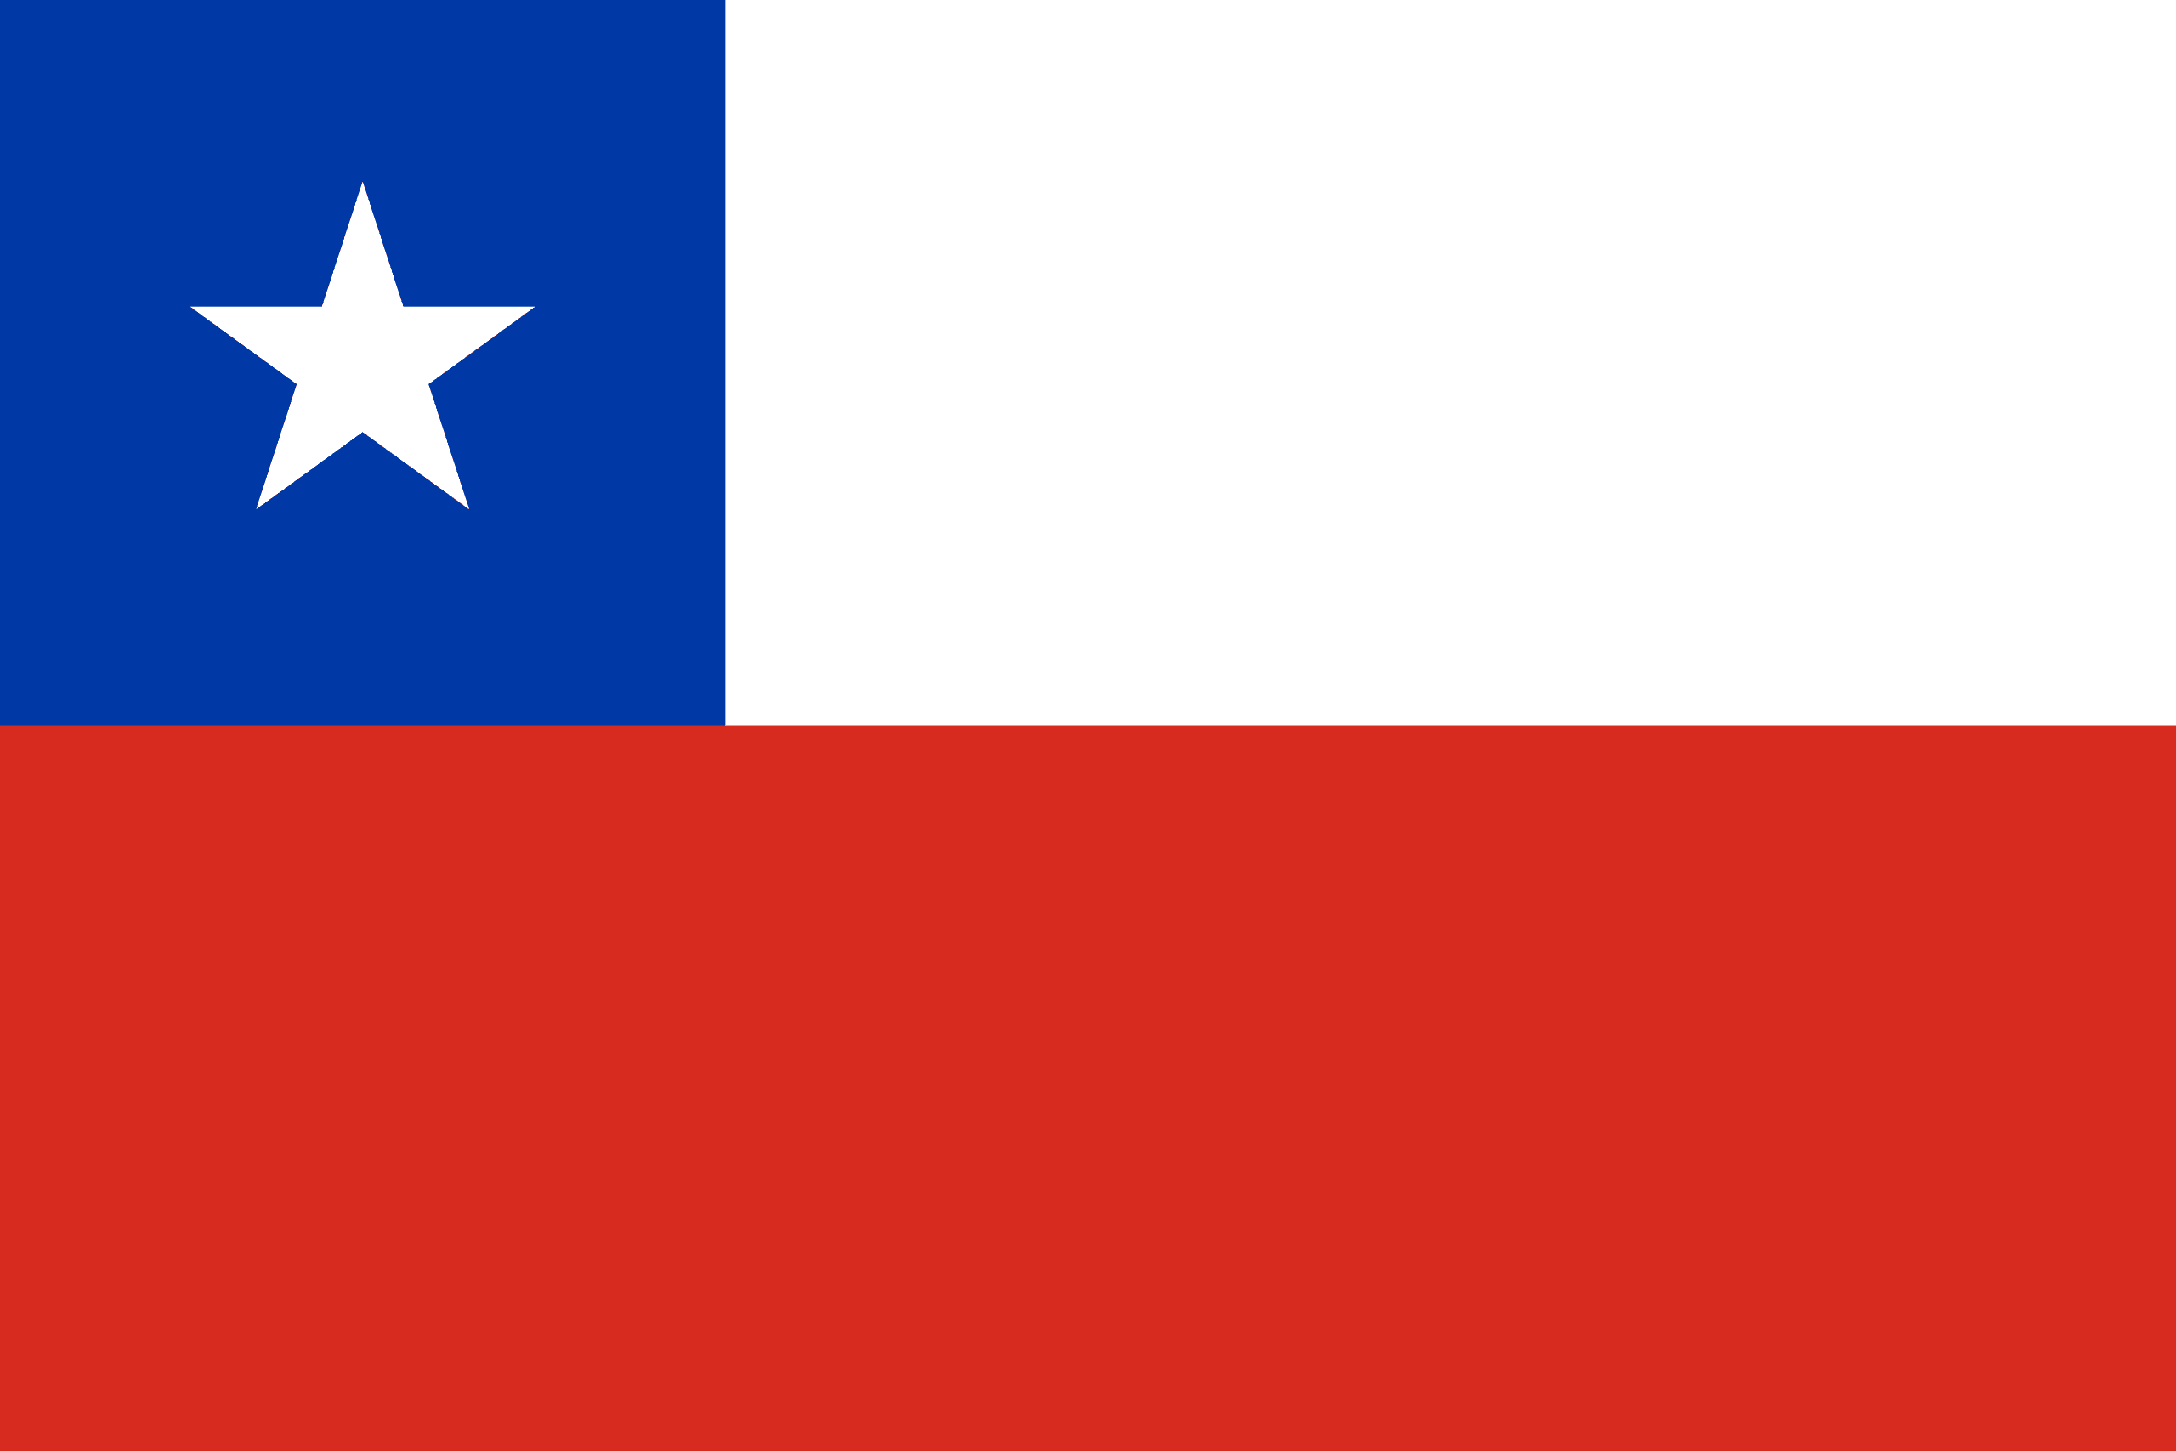
PRAYING FOR
CHILE

Slide 3
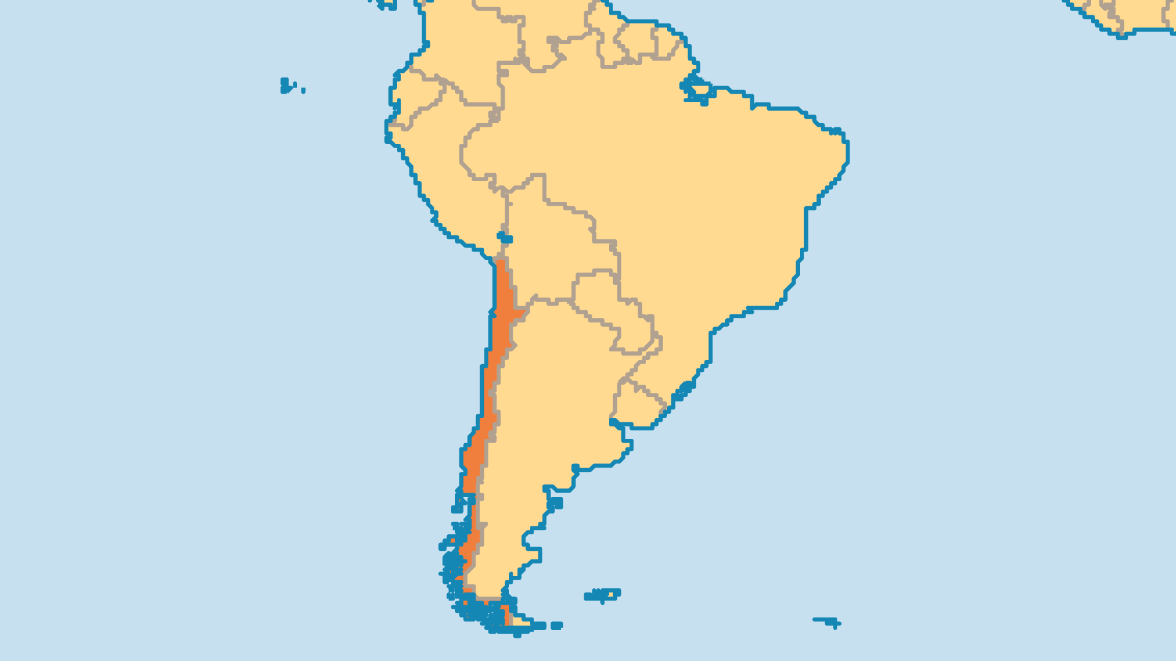
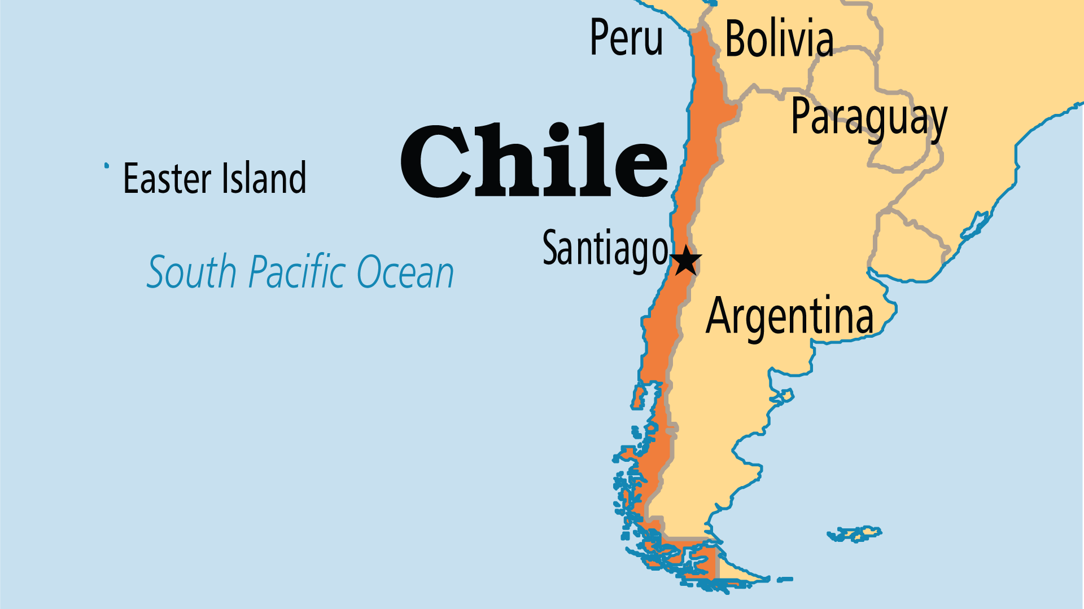
KEY STATS
Capital: | Santiago
Population: | 19,859,921
% Urban: | 88.2 %
Pop Under 15 Yrs: | 19.5 %
Official Language: | Spanish
Literacy Rate: | 99 %
% Christian: | 87.2 %
% Evangelical: | 18.4 %
People Groups: | 29
Least Reached People Groups: | 3
% Unevangelized: | 1 %

Slide 4

FOR PRAYER
Social changes in Chile reflect shifts in life and belief in this traditionally conservative nation. Liberalization yields both positive and negative effects. Divorce was only recently legalized; before that, the number of marriages performed fell by 45%, and 60% of children were born out of wedlock. One out of seven Chilean women is a mother by age 14. Crime, drug abuse and materialism are on the rise. Many are parting with traditional religion, with many leaving both Catholicism and Pentecostalism. Pray that the positive aspects of traditional social structures would be affirmed and strengthened.
Want to know more? Go to www.operationworld.org

