Slide 1




Slide 2


PRAYING FOR
CHAD

Slide 3
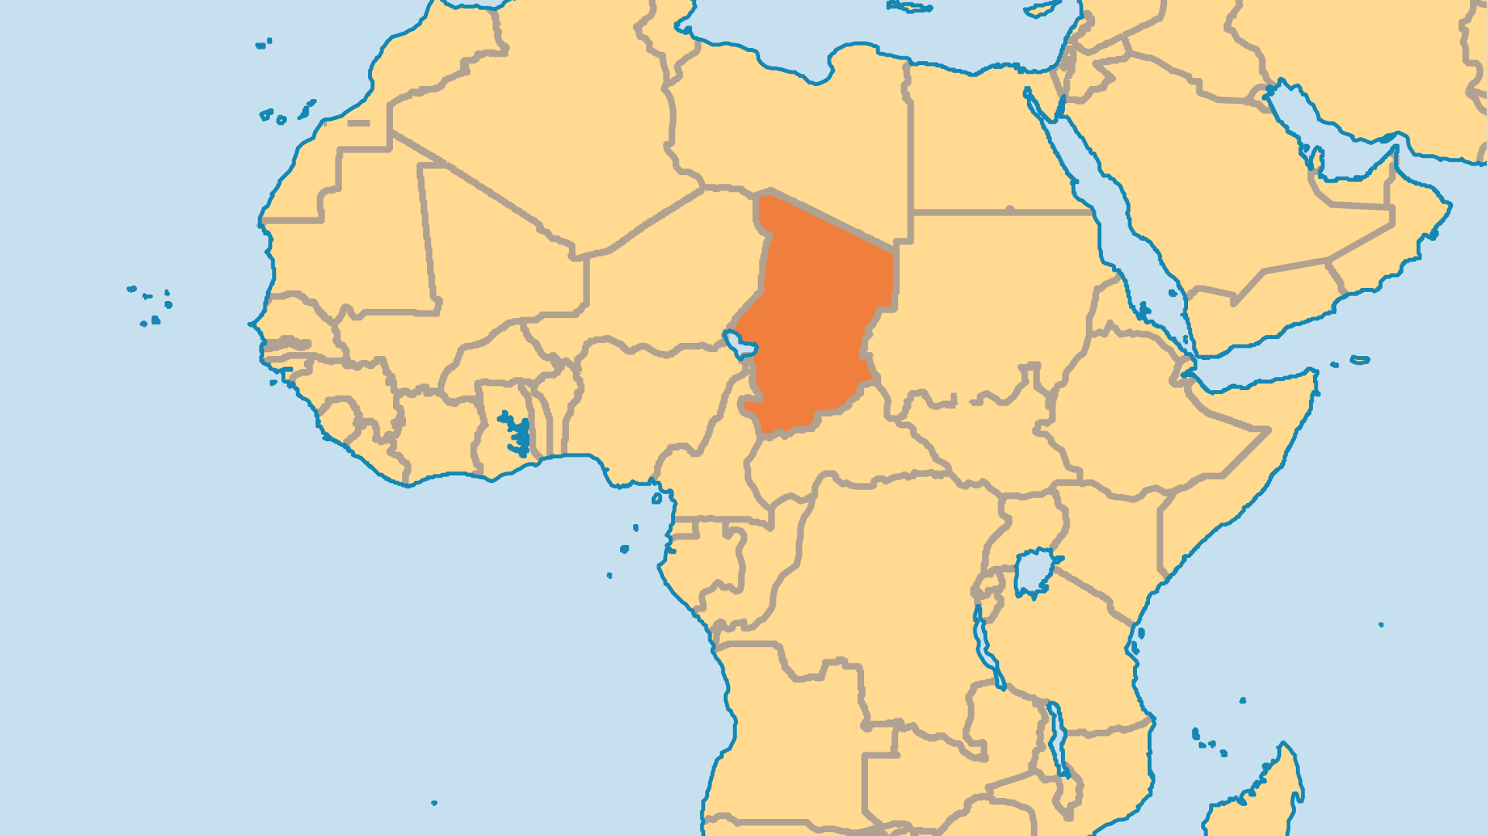
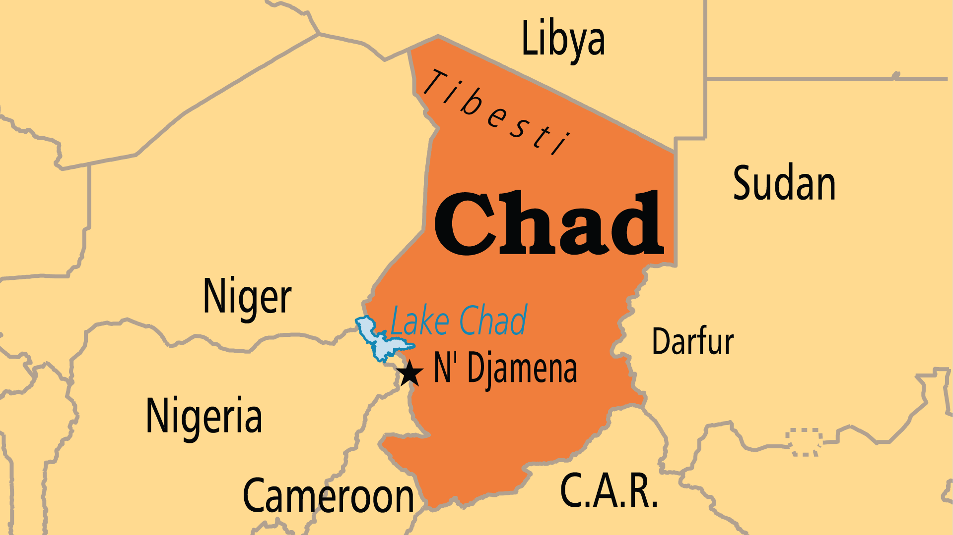
KEY STATS
Capital: | N'Djamena
Population: | 21,003,705
Official Language: | French, Arabic
Languages: | 133
Literacy Rate: | 26 %
Life Expectancy: | 52.5 yrs (236th/236)
HDI Ranking: | 190/193
% Christian: | 38.5 %
% Evangelical: | 10.1 %
Largest Religion: | Muslim
% Unevangelized: | 45 %

Slide 4

FOR PRAYER
Chad's government was dissolved and the head of the military is now an "interim President". Rebels and bandits plague the nation from inside Chad but also from Darfur, C.A.R., Nigeria, and Cameroon. Economic growth, human development, and Christian ministry are all held back by these factors, and Chad remains one of the world’s poorest nations. More than half lack basic water services and acute hunger is widespread. The massive influx of refugees fleeing Sudan's civil war intensifies every challenge that Chad faces.Pray for a new government that will lead with integrity, transparency, justice, and balanced concern for all of Chad’s regions and peoples.

Slide 5
FOR PRAYER
Many Muslims have heard the good news! New groups of believers from Muslim backgrounds have emerged. Bible storytelling and Chadian Arabic Christian radio help spread the gospel in culturally relevant ways. Violence in nearby Darfur at the hands of other Muslims caused some to question Islam, and left them open to the loving ministry and witness of Christians. Still, Islam grows in numbers, and in financial and social influence. Pray that Christians will learn to reach out to the Muslims around them.
Want to know more? Go to www.operationworld.org

