Slide 1




Slide 2


PRAYING FOR
CENTRAL AFRICAN REPUBLIC

Slide 3
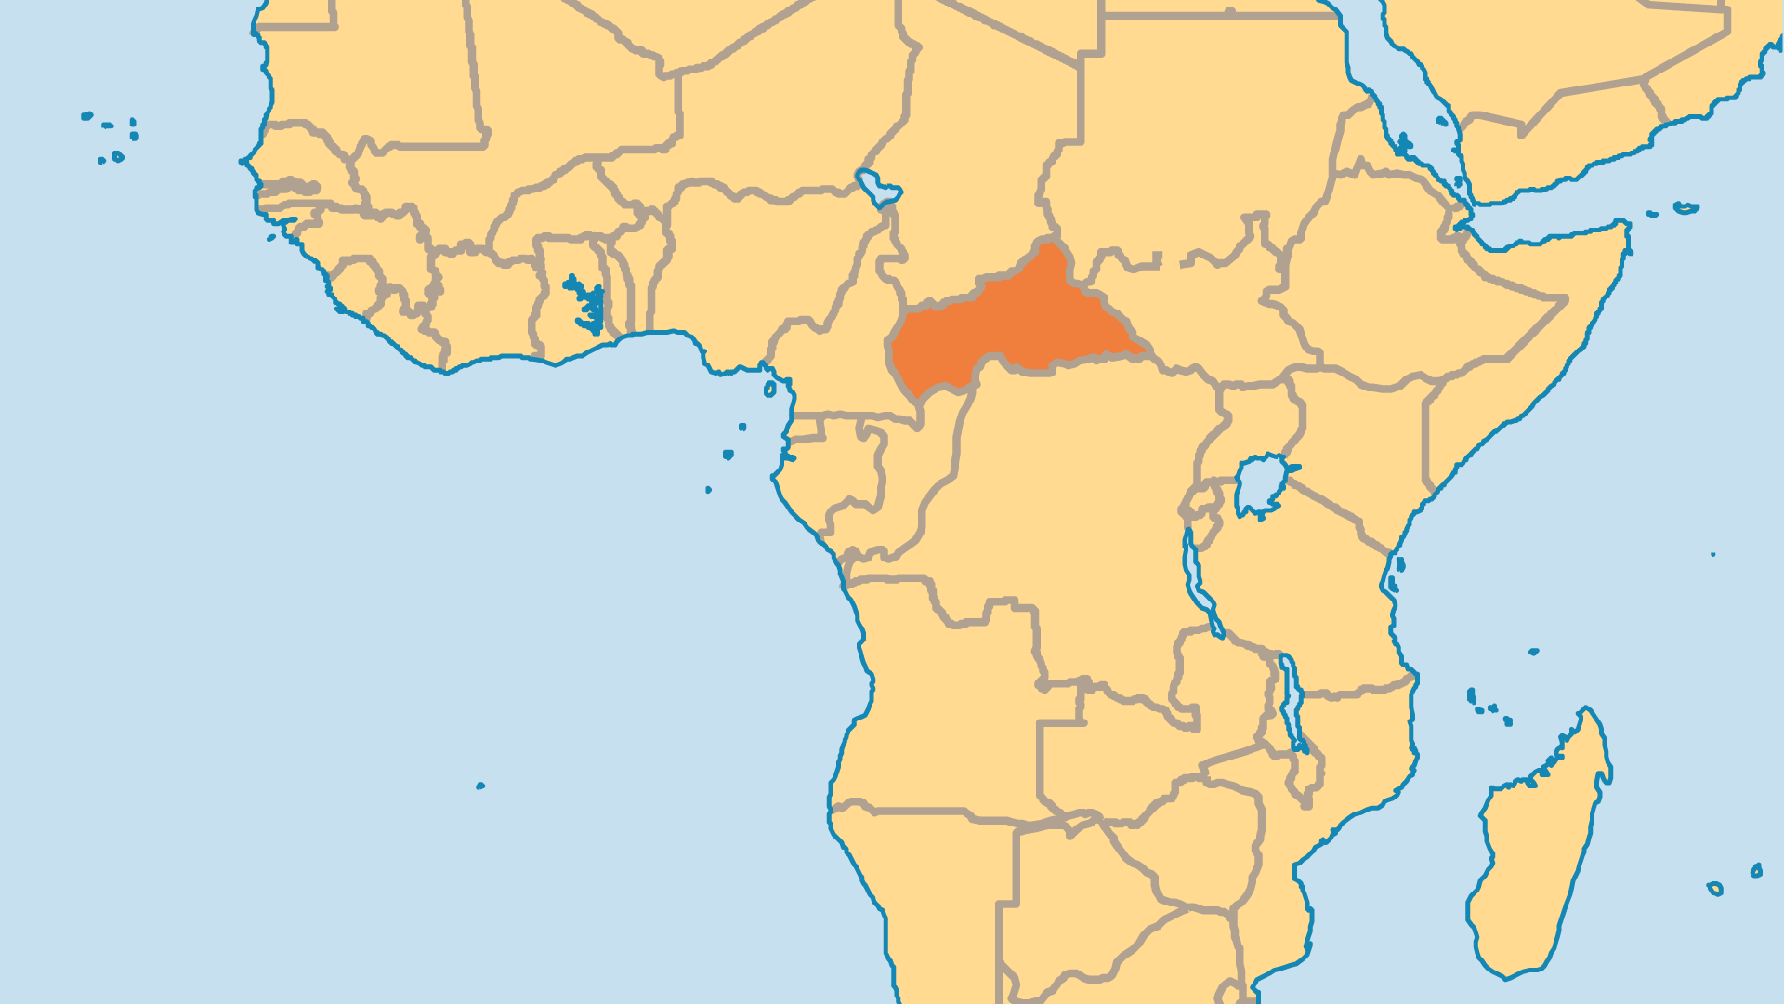
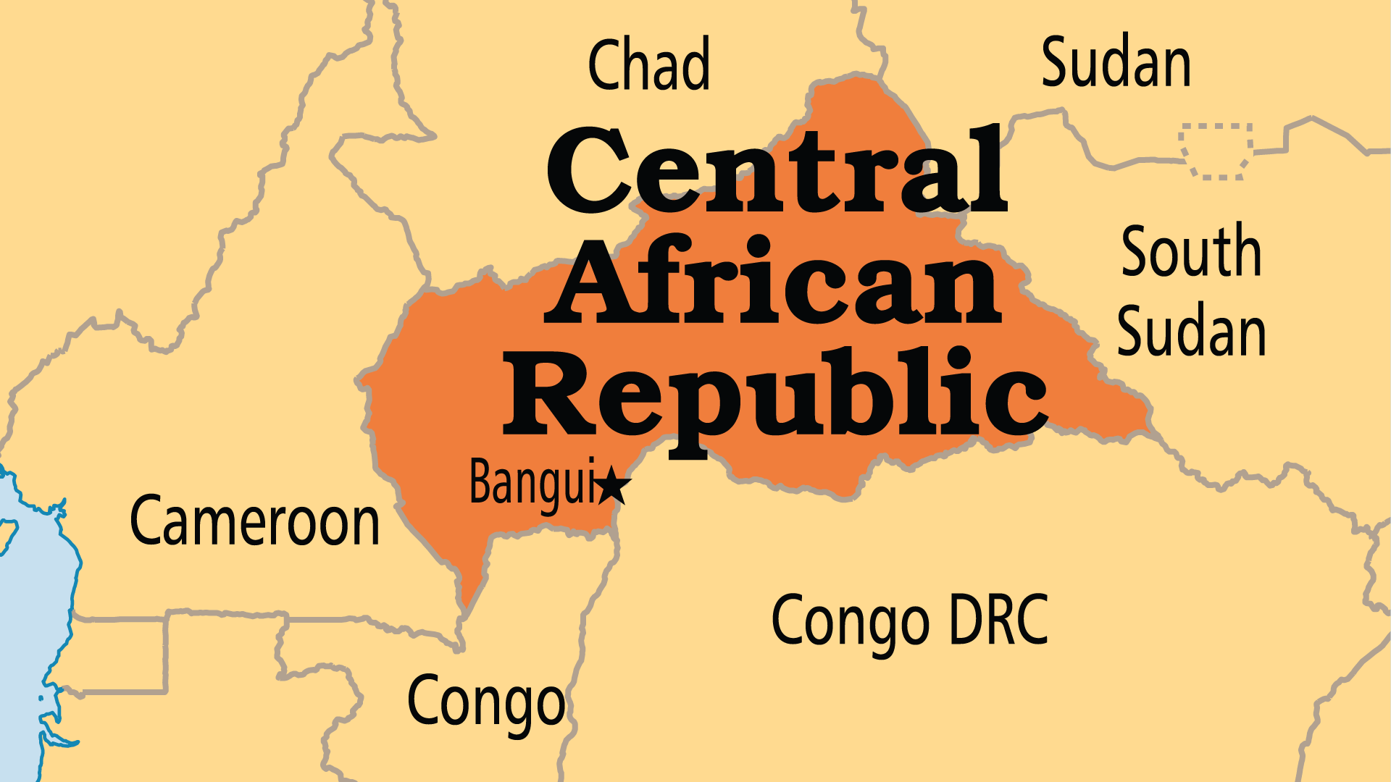
KEY STATS
Capital: | Bangui
Population: | 5,513,282
Official Language: | French and Sango
Literacy Rate: | 57 %
Life Expectancy: | 53.9 yrs (233/236)
HDI Ranking: | 188/193
% Christian: | 76.4 %
% Evangelical: | 32.2 %
% Unevangelized: | 11 %
Persecution Ranking: | 27/50

Slide 4

FOR PRAYER
The Central African Republic (CAR) is one of the world's poorest countries and faces immense physical human needs. A long series of coups, counter-coups, and civil conflicts devastated the economy and infrastructure. Muslim rebel groups (Séléka) and mostly Christian militias (anti-balaka) fought with government forces and each other. Hundreds of thousands were displaced. Although two successful elections have been held since then, rebels still hold significant swathes of the countryside. Pray for God to establish peace throughout the country.
Want to know more? Go to www.operationworld.org

Slide 5
FOR PRAYER
The CAR was one of the world's most evangelized nations, but the upheavals here and in nearby Chad and Sudan mean the progress in some regions has reversed. Pray for all CAR denominations to send students for missionary training. Pray that the trained would resist the draw to serve in the city and go to serve the unreached. Pray for the northern region, for the Runga (90% Muslim), the Sara Kaba (50% Animist), and the Gula/Kara (65% Muslim). Muslims grew rapidly in influence, especially in the cities. Few Christians feel equipped to reach out to them.
Want to know more? Go to www.operationworld.org

