Slide 1




Slide 2


PRAYING FOR
CAYMAN ISLANDS

Slide 3
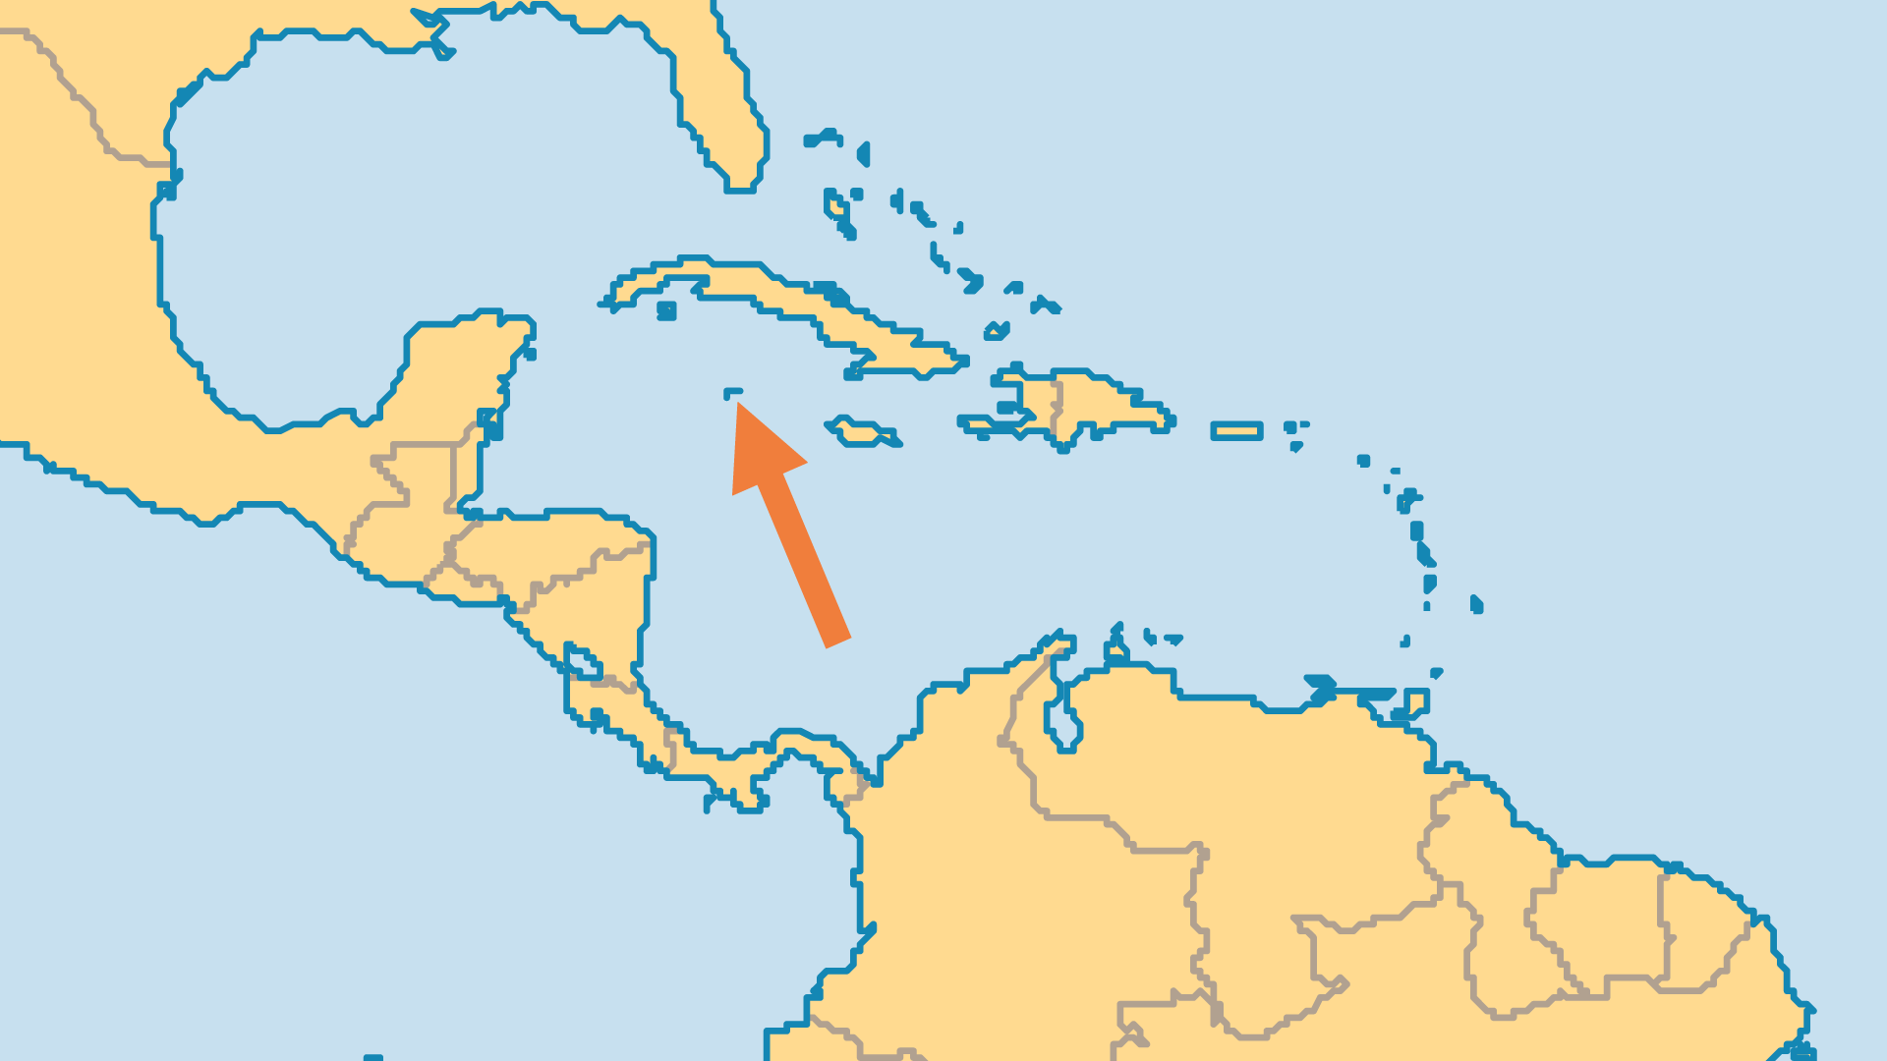
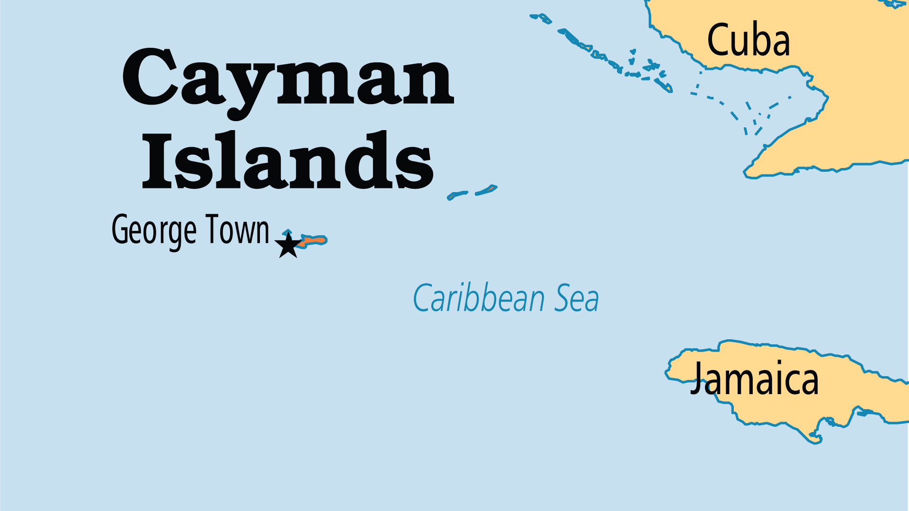
KEY STATS
Capital: | Georgetown
Population: | 75,844
% Urban: | 100 %
Official Language: | English
Languages: | 3
Literacy Rate: | 99 %
% Christian: | 77.1 %
% Evangelical: | 21.3 %
People Groups: | 10
% Unevangelized: | 2 %

Slide 4

FOR PRAYER
Christianity is numerically strong. There are more than 90 churches, many of them evangelical. With one church for approximately every 500 people, Christian faith and values should (and do) have a significant influence on society. Pray that this might continue amid the materialism and hedonism. The nation's flag bears part of Psalm 24, "He hath founded it upon the seas." The new constitution acknowledges the Christian heritage of the Cayman Islands. Pray that God's sovereign power would not only be noted in documents but lived out with joy!
Want to know more? Go to www.operationworld.org

