Slide 1




Slide 2


PRAYING FOR
CABO VERDE

Slide 3
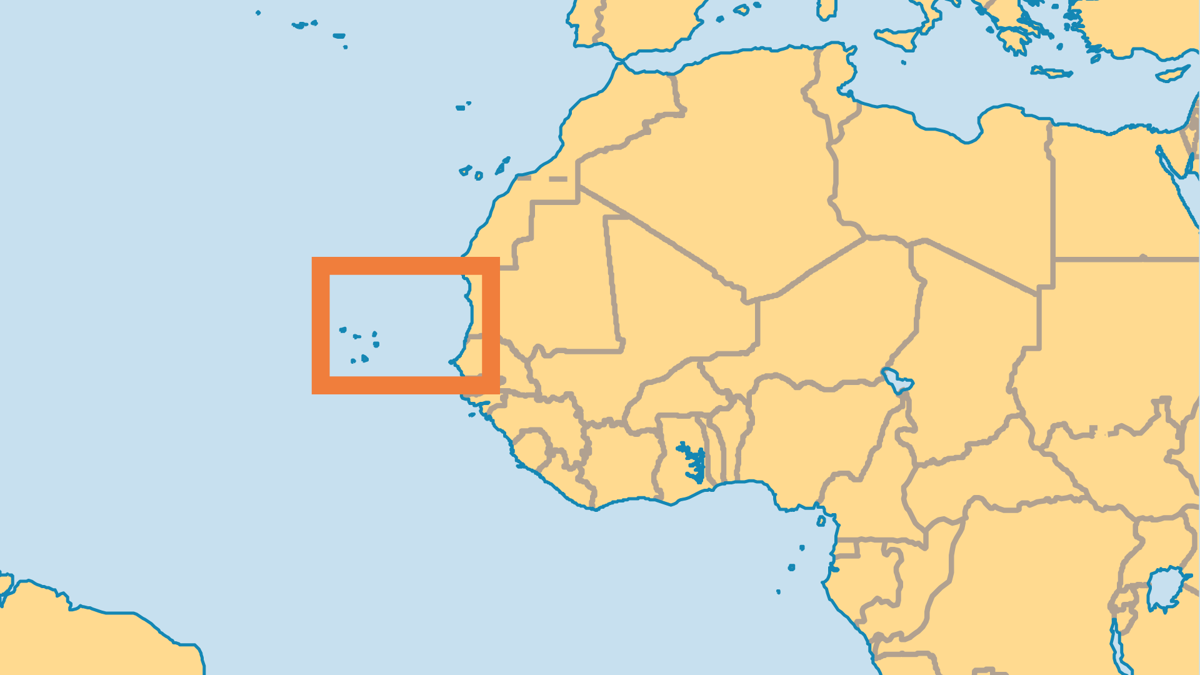
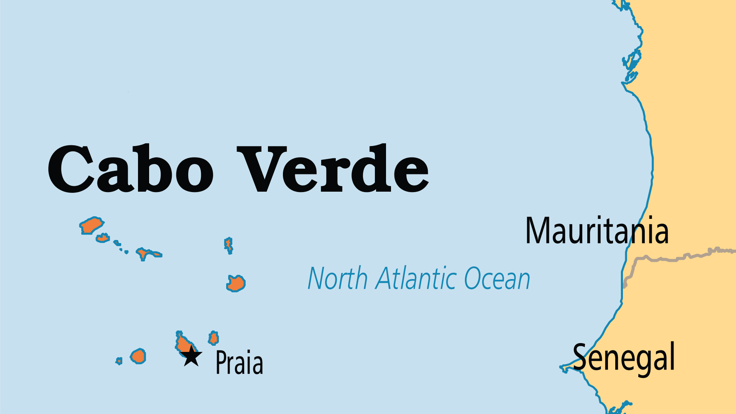
KEY STATS
Capital: | Praia
Population: | 527,326
% Urban: | 68.8 %
Pop Under 15 Yrs: | 28.4 %
Official Language: | Portuguese
Languages: | 2
Literacy Rate: | 87 %
Life Expectancy: | 74.1 yrs (105th/236)
HDI Ranking: | 128/193
% Christian: | 94.6 %
% Evangelical: | 6.6 %

Slide 4

FOR PRAYER
Economic and ecological problems must be wisely addressed. The arid islands lack adequate fresh water and arable land. Scant resources were poorly managed in the past, intensifying Cabo Verde's poverty. Pray for government leaders who will make good decisions and develop the economy for the betterment of the whole nation.
Want to know more? Go to www.operationworld.org

