Slide 1




Slide 2

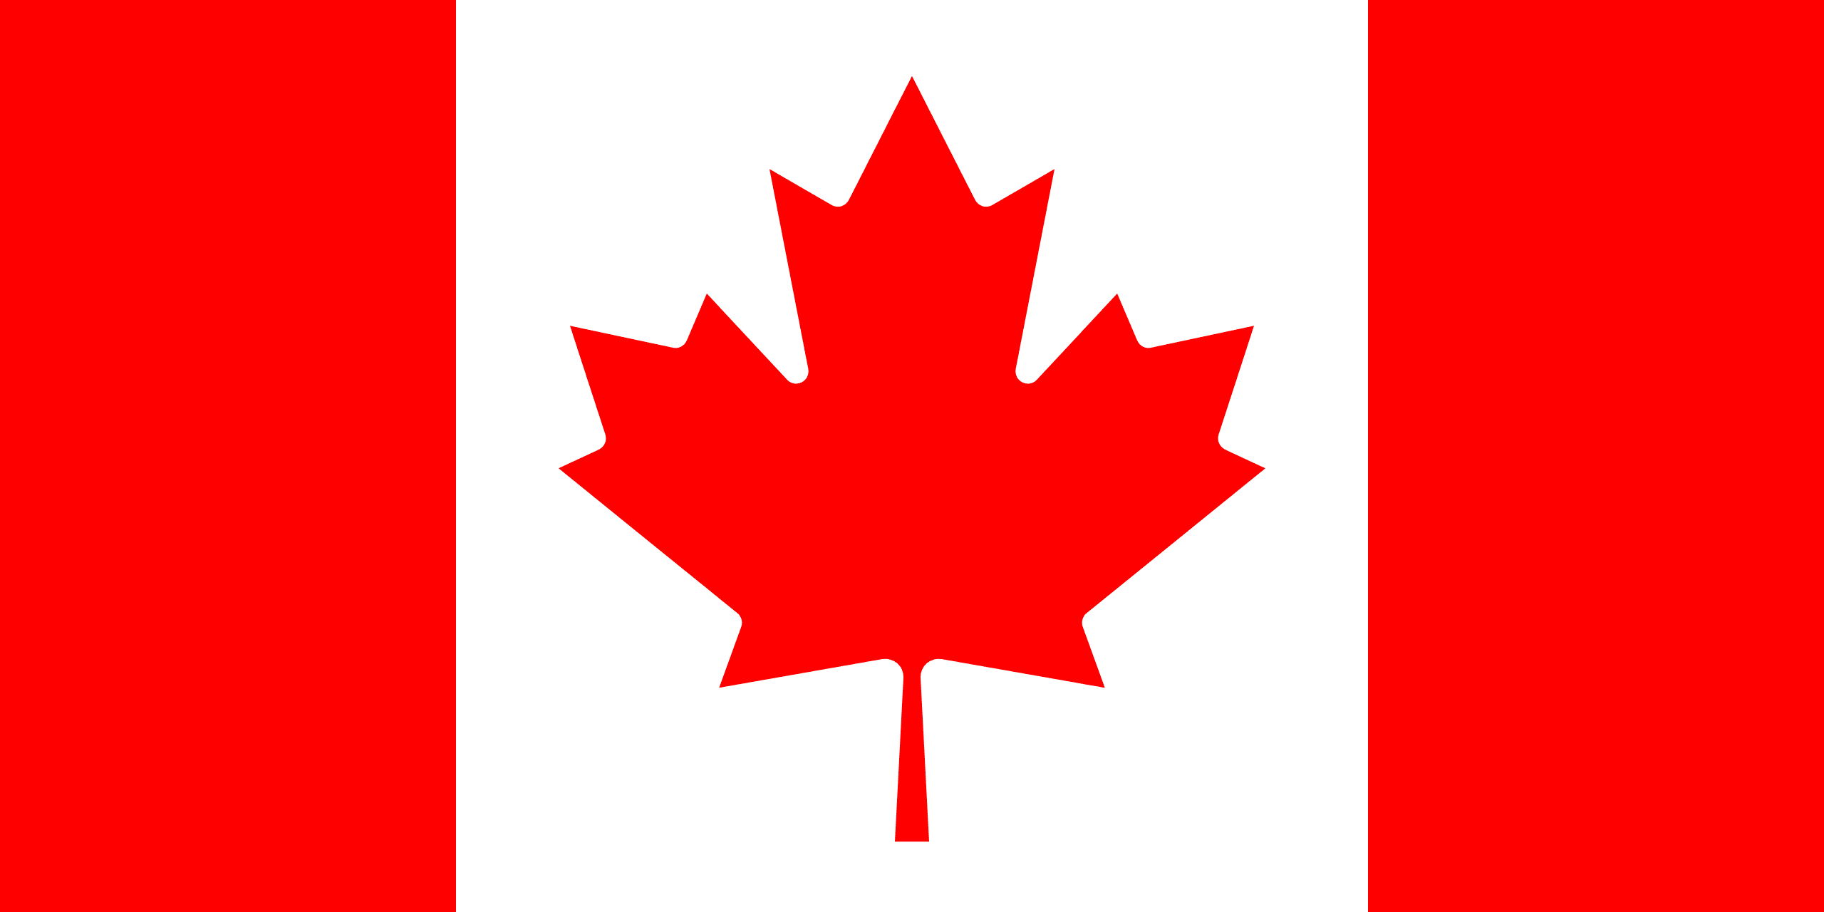
PRAYING FOR
CANADA

Slide 3
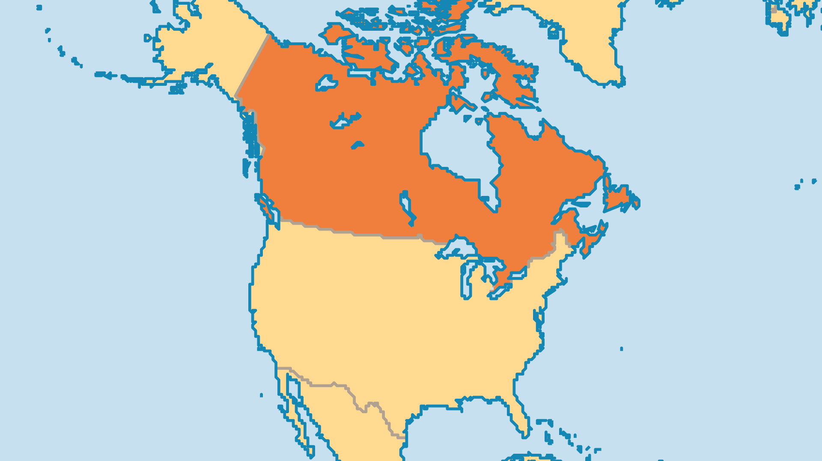
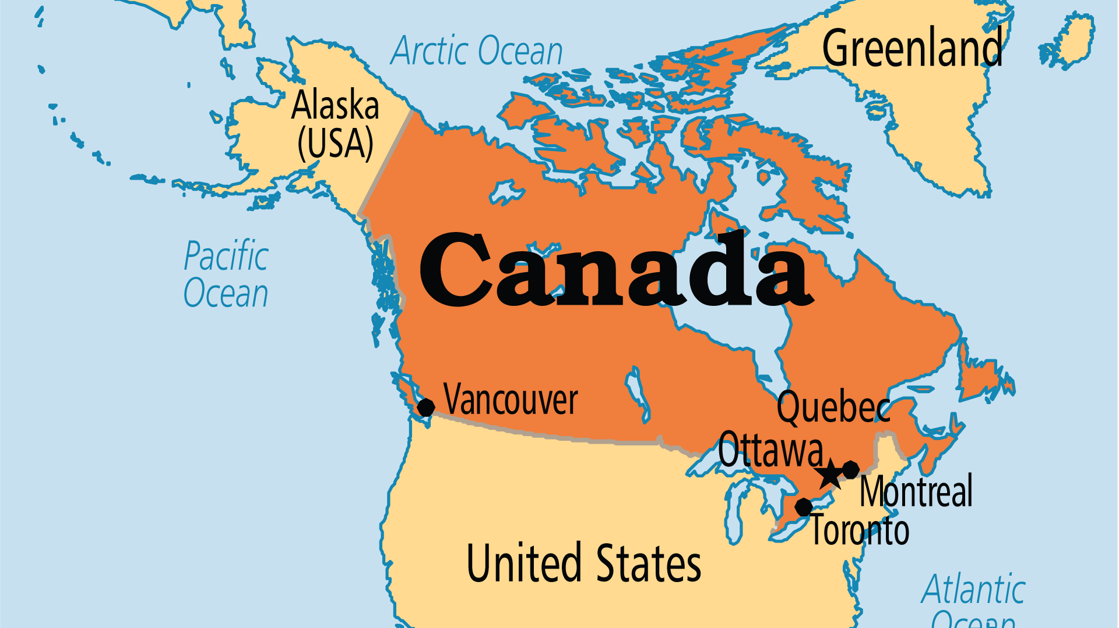
KEY STATS
Capital: | Ottawa
Population: | 40,126,723
% Urban: | 82.1 %
Official Language: | English; French
Literacy Rate: | 99 %
Life Expectancy: | 82.7 yrs (15th/236)
HDI Ranking: | 15/193
% Christian: | 72.1 %
% Evangelical: | 7.7 %
People Groups: | 297
% Unevangelized: | 4 %

Slide 4

FOR PRAYER
Christian influence on Canadian society weakened in the last century. The non-religious population grew the most as Christians left the Church; other religions grew through high birthrates and immigration. Mainline churches, following more liberal beliefs about God and the Bible, also declined in numbers. Pray for a new, vibrant move of God in declining denominations and for fresh expressions of faith in Jesus. Pray that Christians would be more concerned with being loving witnesses to the Gospel than with political agendas and culture wars.
Want to know more? Go to www.operationworld.org

Slide 5
FOR PRAYER
Canadian indigenous peoples suffered shameful treatment in the past. Both the government and the Church (mostly European-background) abused these peoples in painful ways. Pray for appropriate repentance and forgiveness - both are necessary for true reconciliation. First Nations peoples have 600 reserves in Canada, all with small populations. Large numbers live in poverty and struggle with substance abuse. Many Canadian indigenous people are called Christian, but do not practise their faith. Pray for First Nations peoples to form and multiply churches that resonate with and reflect their culture.

