Slide 1




Slide 2

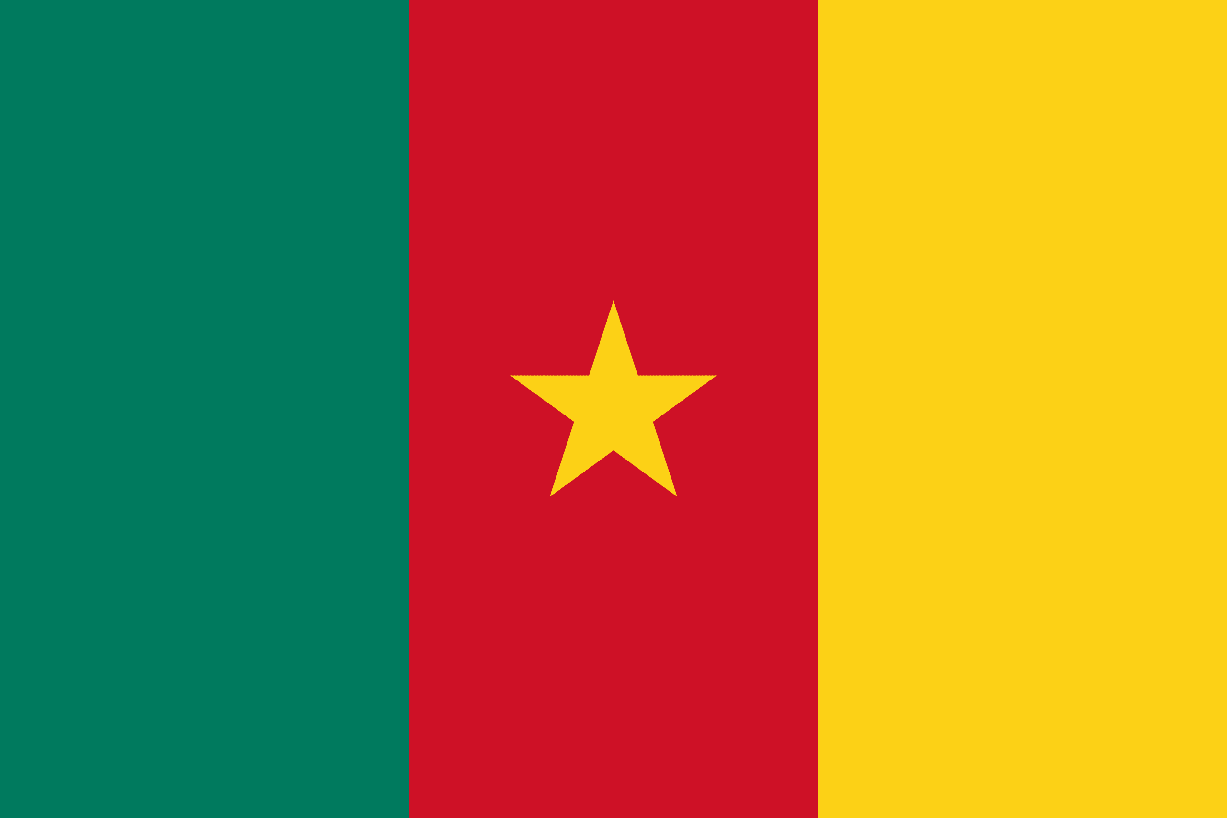
PRAYING FOR
CAMEROON

Slide 3
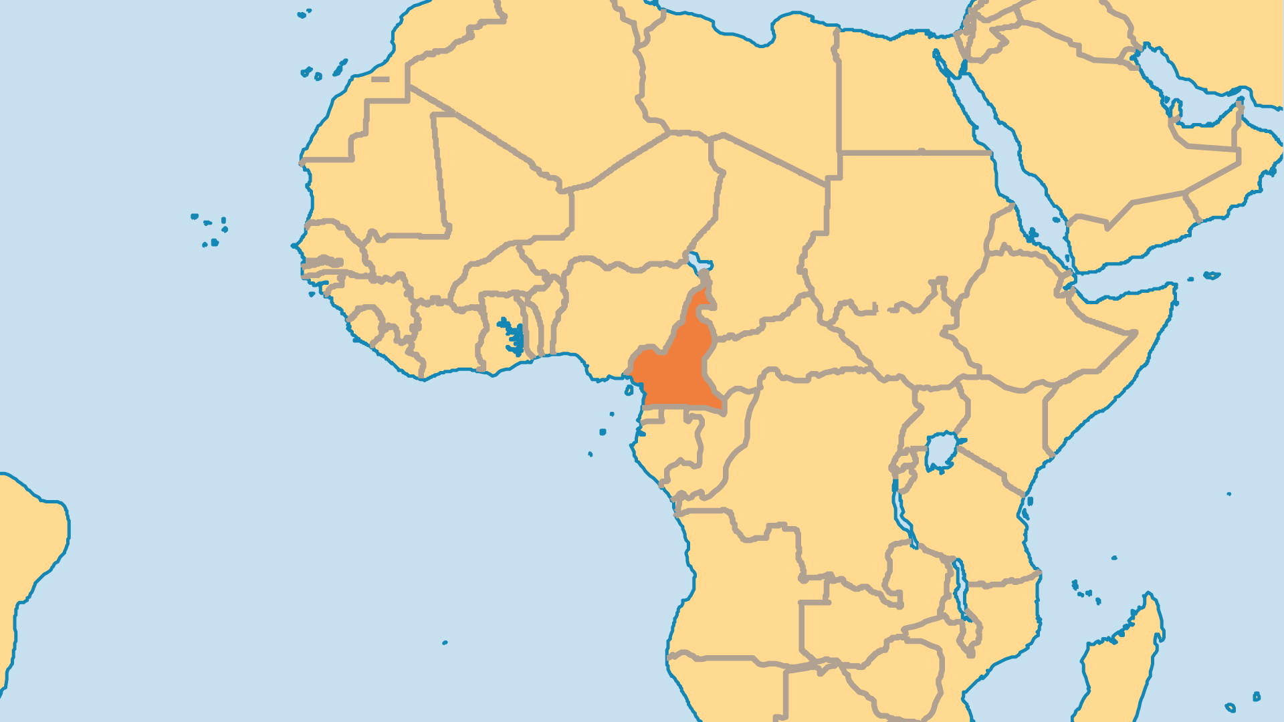
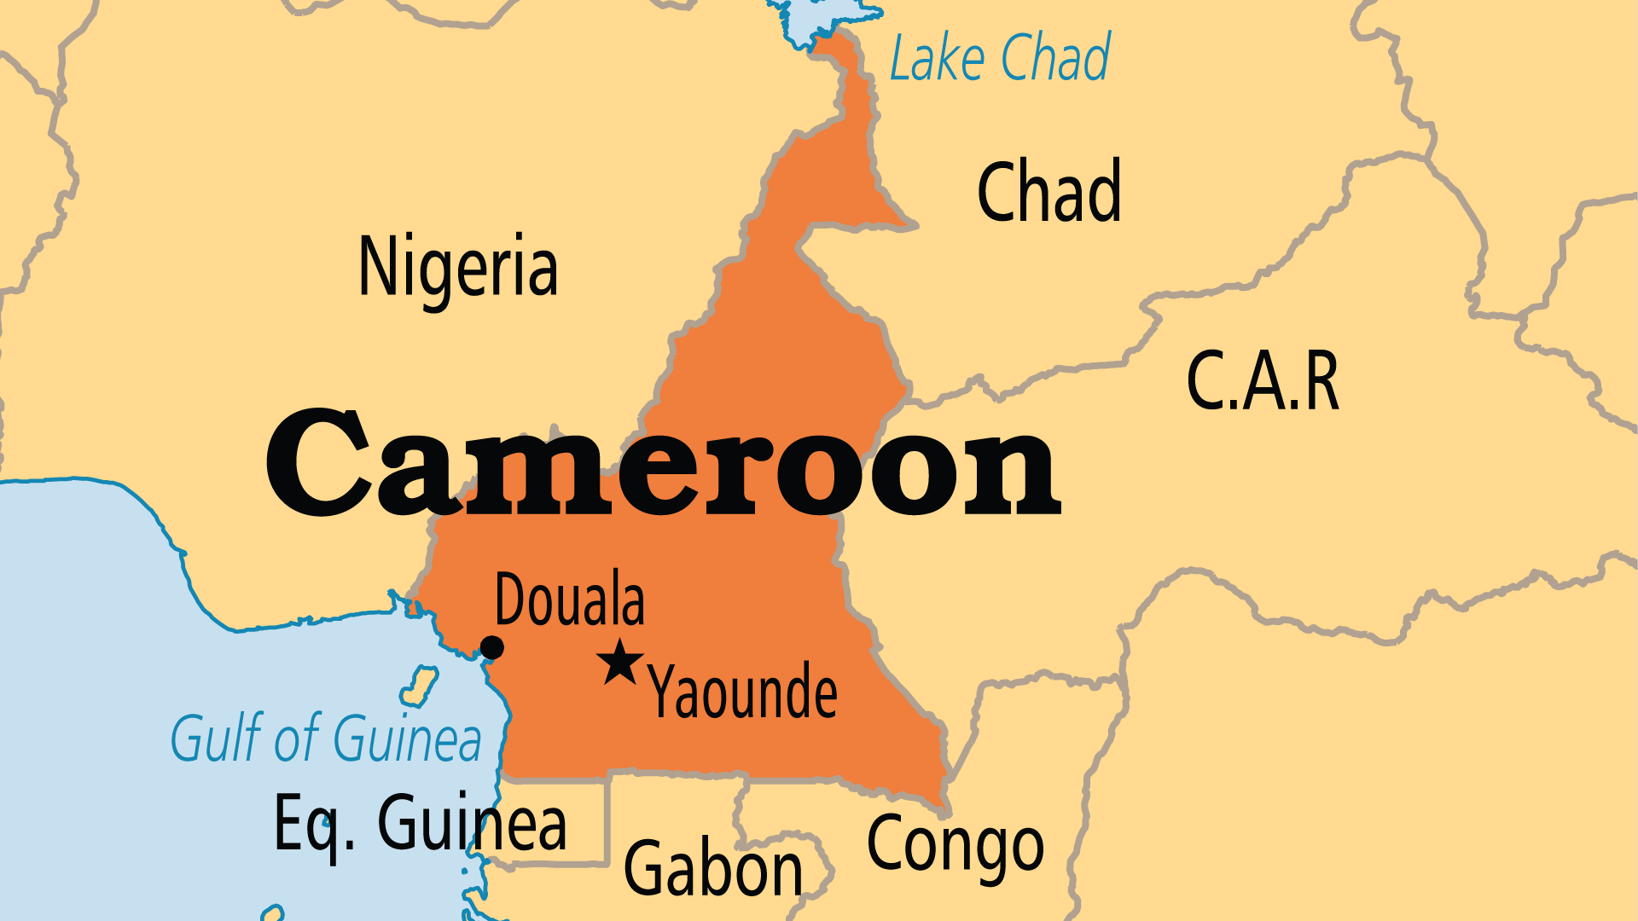
KEY STATS
Capital: | Yaounde
Population: | 29,879,337
Pop Under 15 Yrs: | 42.4 %
Official Language: | French; English
Languages: | 279
Life Expectancy: | 60.3 yrs (218th/236)
% Christian: | 53.8 %
% Evangelical: | 9 %
Largest Religion: | Christian
Persecution Ranking: | 43/50

Slide 4

FOR PRAYER
God has blessed Cameroon with material resources, relative stability, and a diversity of peoples. Many significant leaders (professional, military, police, political) now follow Christ! This gives hope for change in a society infamous for corruption. Pray that those who steal from the nation would change their ways - or be caught and prevented from doing it any longer - and that people will no longer tolerate corruption, but rather will work together to eradicate it. The best solution to corruption is a transformation of hearts.
Want to know more? Go to www.operationworld.org

Slide 5
FOR PRAYER
Deep divisions of language, faith, and politics lead to tension and violence. Cameroon divides between French and English regions. It also divides between Christian, Muslim, and traditional religions, and between those who hold political power and the opposition. Since 2017, separatist insurgents from the Anglophone regions have been combatting government troops. The increasing activity of Islamist groups in the north further threatens peace. Pray for God to raise up reconcilers and peacemakers in this divided land.
Want to know more? Go to www.operationworld.org

