Slide 1




Slide 2

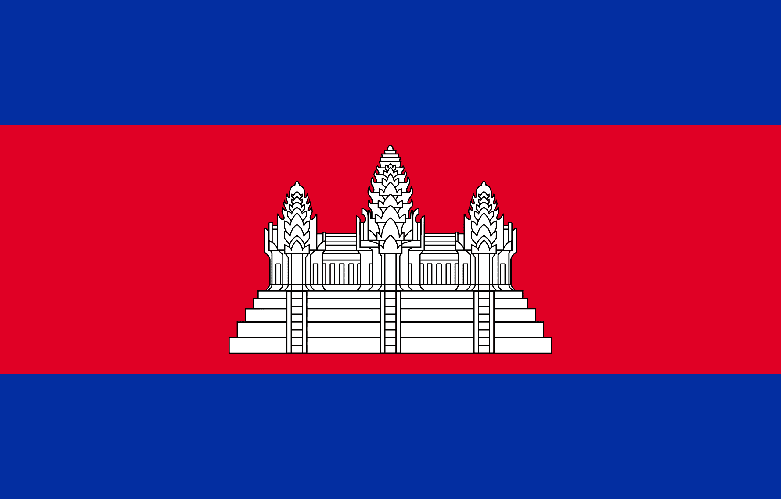
PRAYING FOR
CAMBODIA

Slide 3
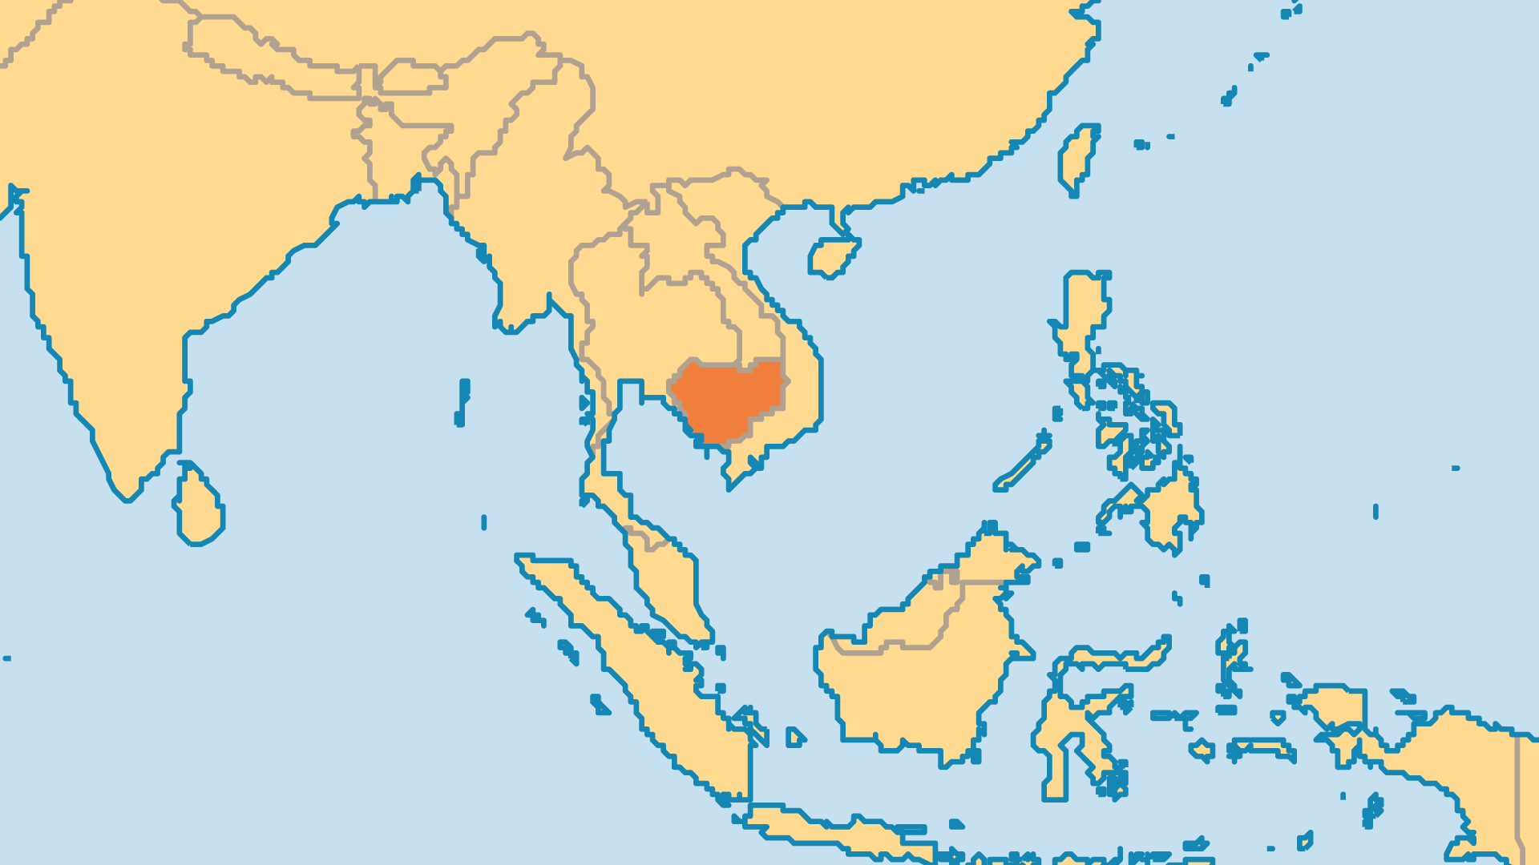
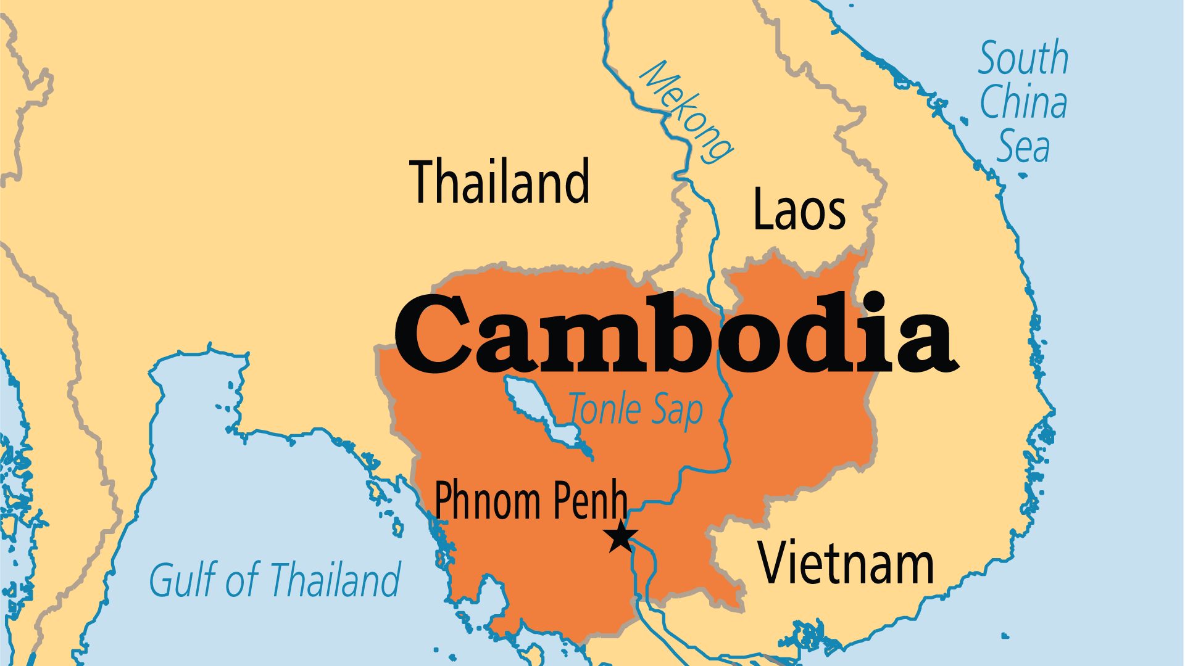
KEY STATS
Capital: | Phnom Penh
Population: | 17,847,982
Official Language: | Khmer
Languages: | 25
Literacy Rate: | 77 %
% Christian: | 3.1 %
% Evangelical: | 1.6 %
Largest Religion: | Buddhist
% Largest Religion: | 83.3 %
% Unevangelized: | 47 %

Slide 4

FOR PRAYER
Spiritual darkness covers Cambodia, from the many spirit shrines, the grip of Buddhism and the widespread loss of morals. Only prayer will lift it. The enemy of souls makes people suffer terrible abuses and cruel poverty. The drug and sex trades tyrannize many people. Criminals exploit unprotected children and youth. The wealthy and friends of the ruling party plunder the nation's resources and restrict freedoms. Pray that gospel light shines on individuals and social and political structures. Christians can positively influence healthcare, rehabilitation, orphanages, development and justice. Progress is also needed in agriculture, fisheries, water management, and education.

Slide 5
FOR PRAYER
Cambodian people need freedom and deliverance from past sin, hatred, suffering, and abuse. This comes through the blood of Jesus. The violent Khmer Rouge regime (1975-1979) destroyed millions of its own people. Ask God to heal deep psychological wounds through the Holy Spirit and counselling ministry. Many of the former Khmer Rouge who took part in genocide now follow Jesus. Pray for them to live in the fullness of God's forgiveness for past crimes. Christians can bring peace and reconciliation. Churches can teach children and young people how to live in a healthy family.
Want to know more? Go to www.operationworld.org

