Slide 1




Slide 2


PRAYING FOR
BURUNDI

Slide 3
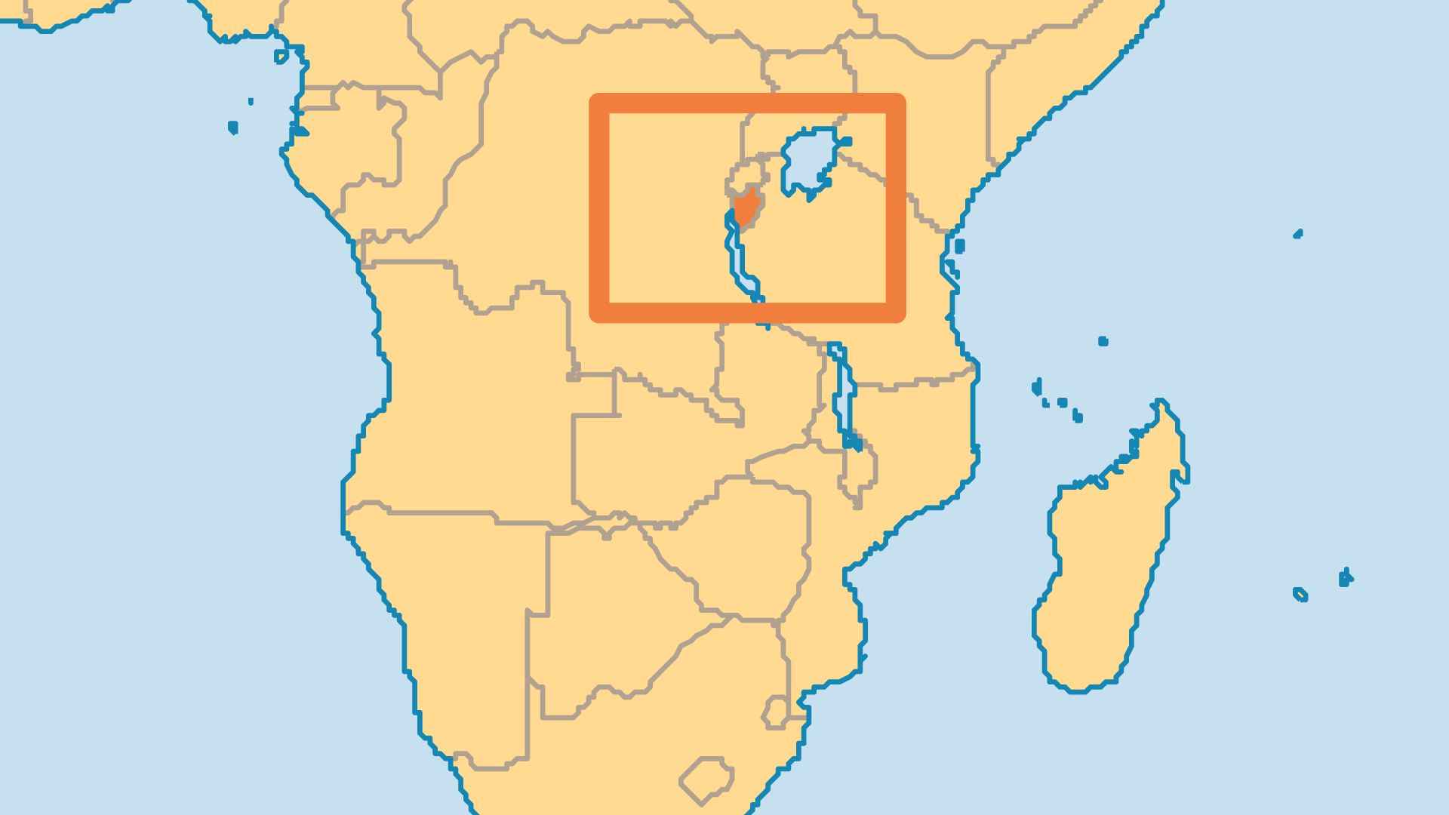
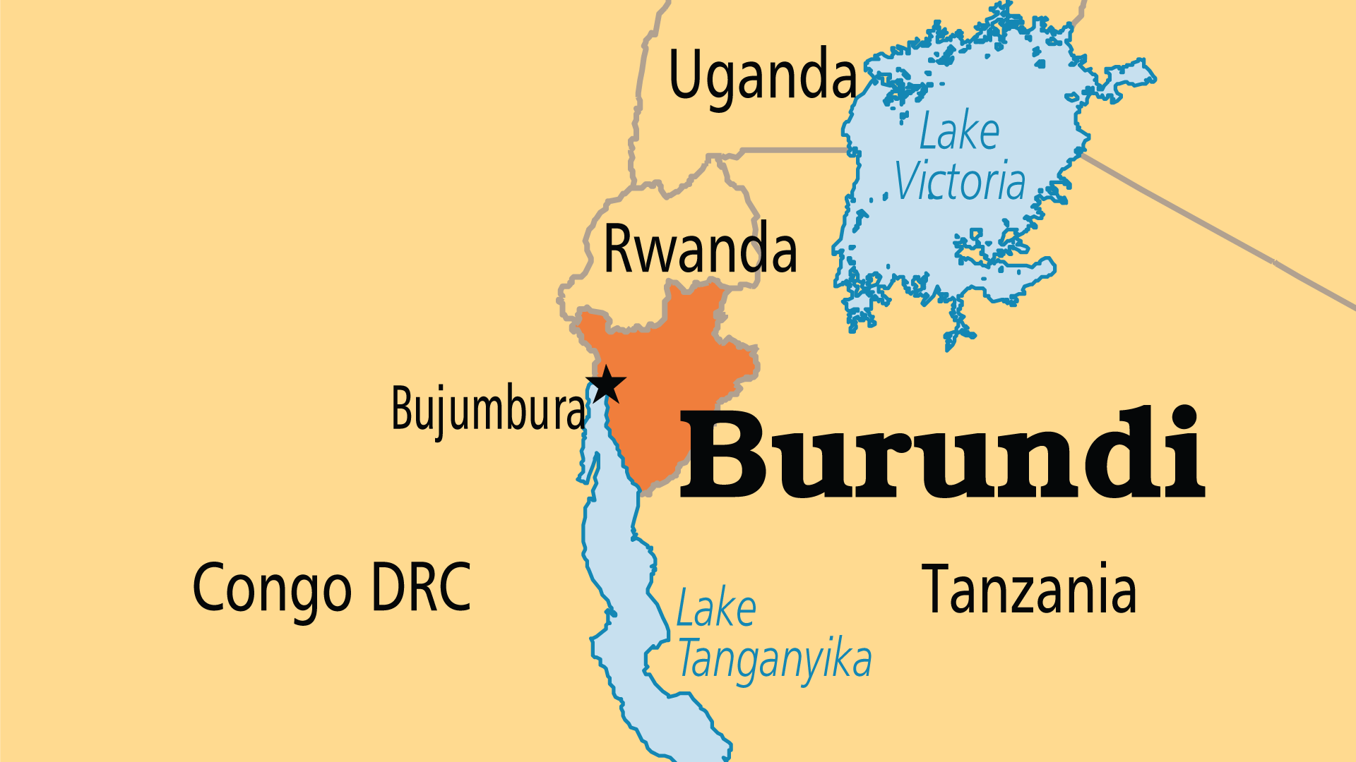
KEY STATS
Capital: | Bujumbura
Population: | 14,390,003
Pop Under 15 Yrs: | 45.4 %
Official Language: | Kirundi, French, English
HDI Ranking: | 187/193
% Christian: | 90.5 %
% Evangelical: | 27 %
People Groups: | 12
Least Reached People Groups: | 3
% Unevangelized: | 1 %

Slide 4

FOR PRAYER
Praise God for relative stability in Burundi after the violent terrors of the 1990s and of 2015. The government now includes both major ethnic groups (Hutu and Tutsi). The 2020 election saw a largely peaceful and successful transition of presidential power - not to be taken for granted! Pray for the parliament elected in 2025 and for respect and cooperation between Hutu and Tutsi as they build Burundi’s future together. Past violence and the scars of atrocities are not easily or quickly overcome. Poverty, regional instability and corruption challenge Burundi. Pray the gospel brings lasting change.
Want to know more? Go to www.operationworld.org

