Slide 1




Slide 2

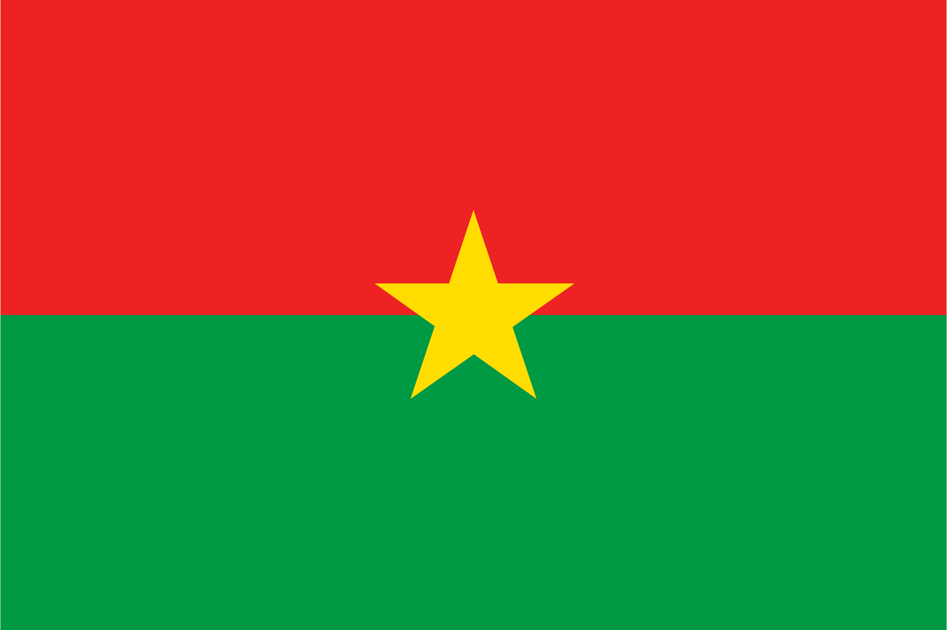
PRAYING FOR
BURKINA FASO

Slide 3
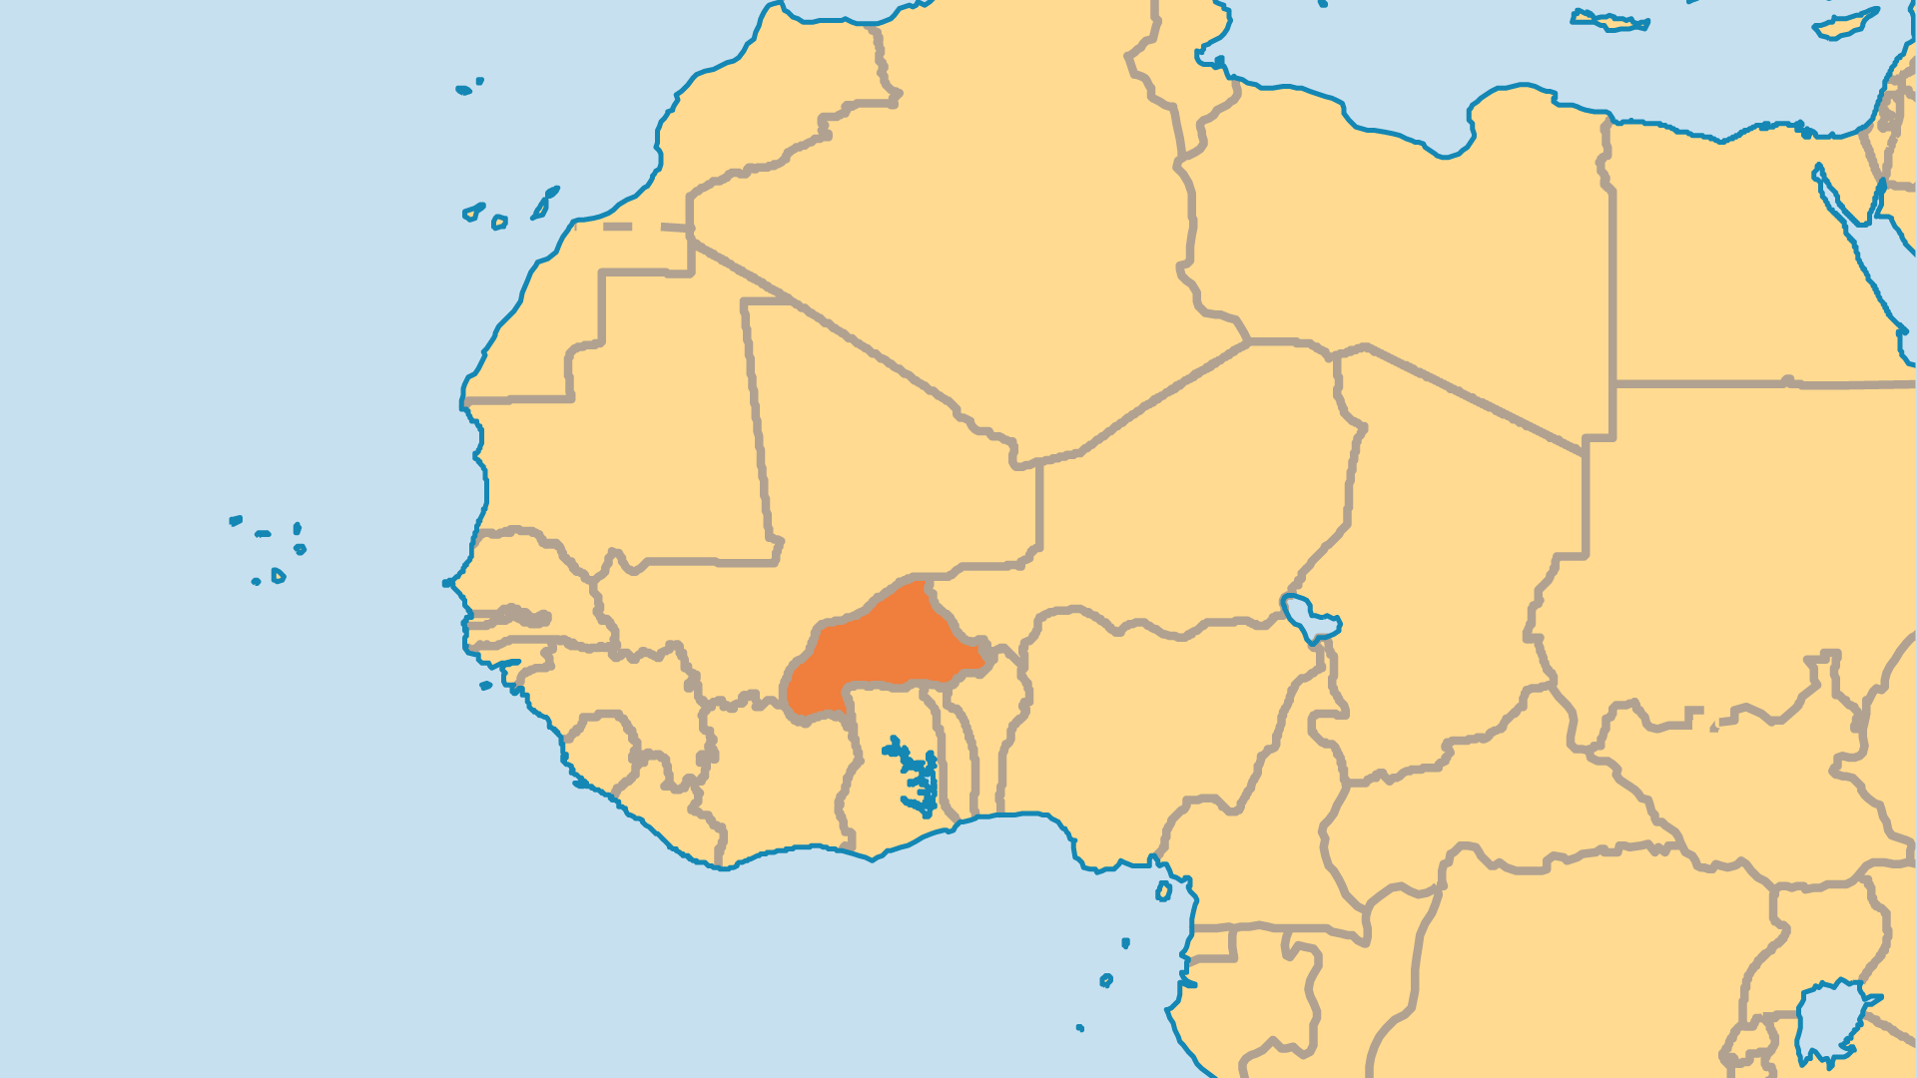
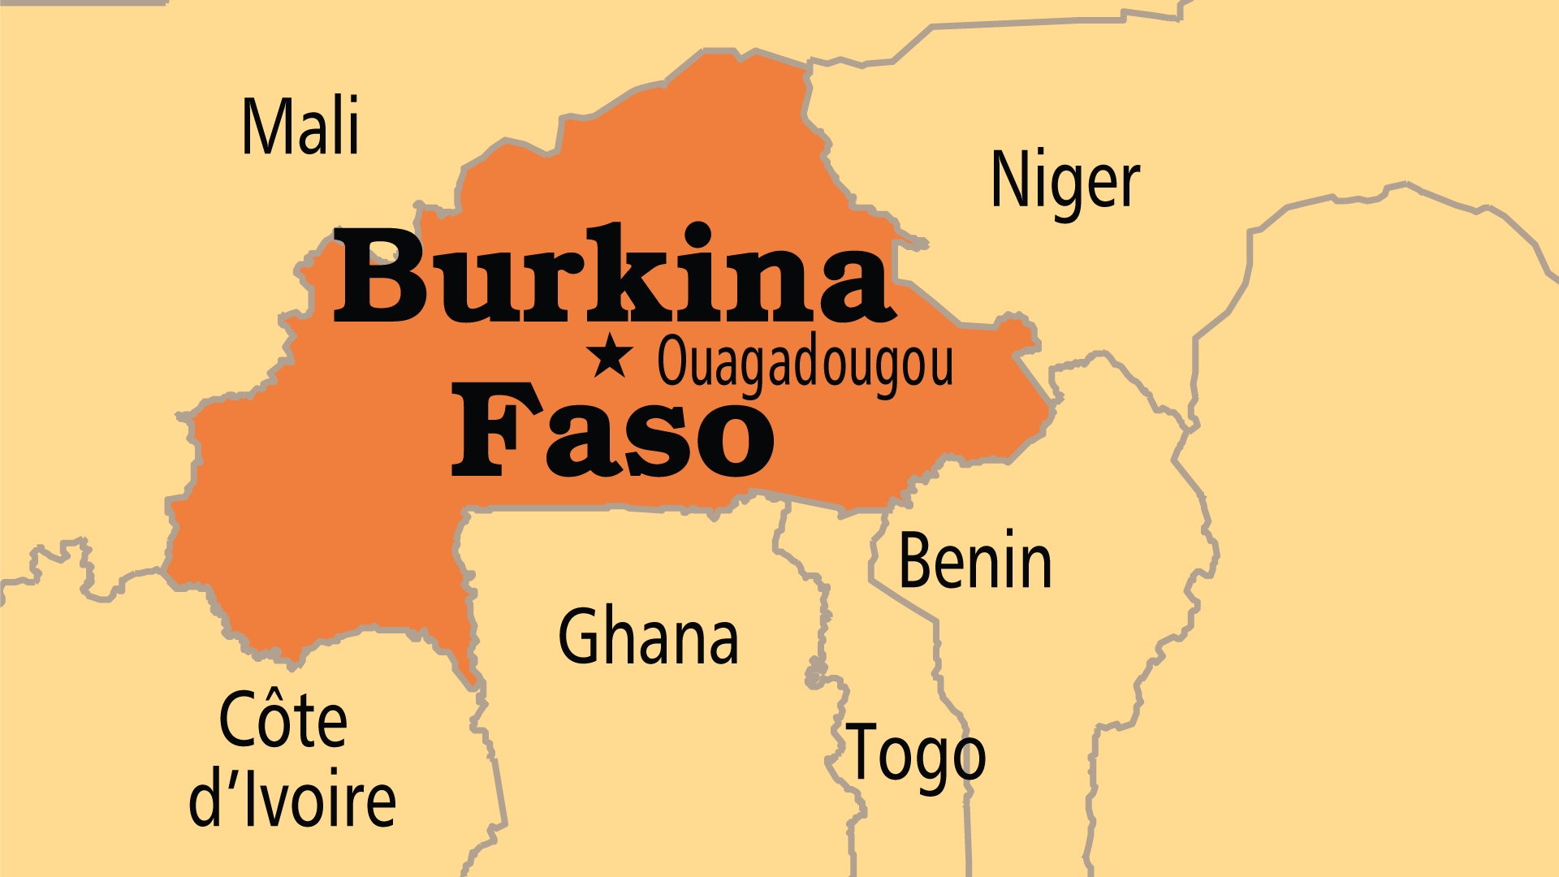
KEY STATS
Capital: | Ouagadougou
Population: | 24,074,580
Pop Under 15 Yrs: | 44.7 %
Official Language: | French, Moore, Jula
Languages: | 70
Literacy Rate: | 36 %
HDI Ranking: | 184/193
% Christian: | 20.7 %
% Evangelical: | 8.9 %
Largest Religion: | Muslim
Persecution Ranking: | 20/50

Slide 4

FOR PRAYER
The rise – or arrival from elsewhere – of radical jihadist Muslim groups has brought death and great turmoil to Burkina Faso. Over 10,000 people were killed and at least 2 million displaced. These attacks, combined with existing ethnic tensions, rebel groups, and political instability, led to two military coups in 2022. In December 2024, the military ruler dissolved the entire government. Burkina Faso is seen as a strategic key in the region. Violence here could easily spill over into the whole Sahel region. Pray for God to restrain those with wicked ambitions and intentions. Pray for wisdom and courage for the nation’s leaders, and for faith and fearless love for Christians in this land.

Slide 5
FOR PRAYER
The power of the spirit world has not been broken. Some people say that the population is "50% Muslim, 20% Christian, and 100% animist"! Idols, charms, and secret societies have more control in Burkina Faso than in most West African countries. The occult shows its power even in some churches. The strongest animist groups live in the west and southwest. Pray for the risen Christ to demonstrate His power and set many free. Pray for Christians to demonstrate the power and authority of the name of Jesus and to live out holy, blameless lives in His name.
Want to know more? Go to www.operationworld.org

