Slide 1




Slide 2

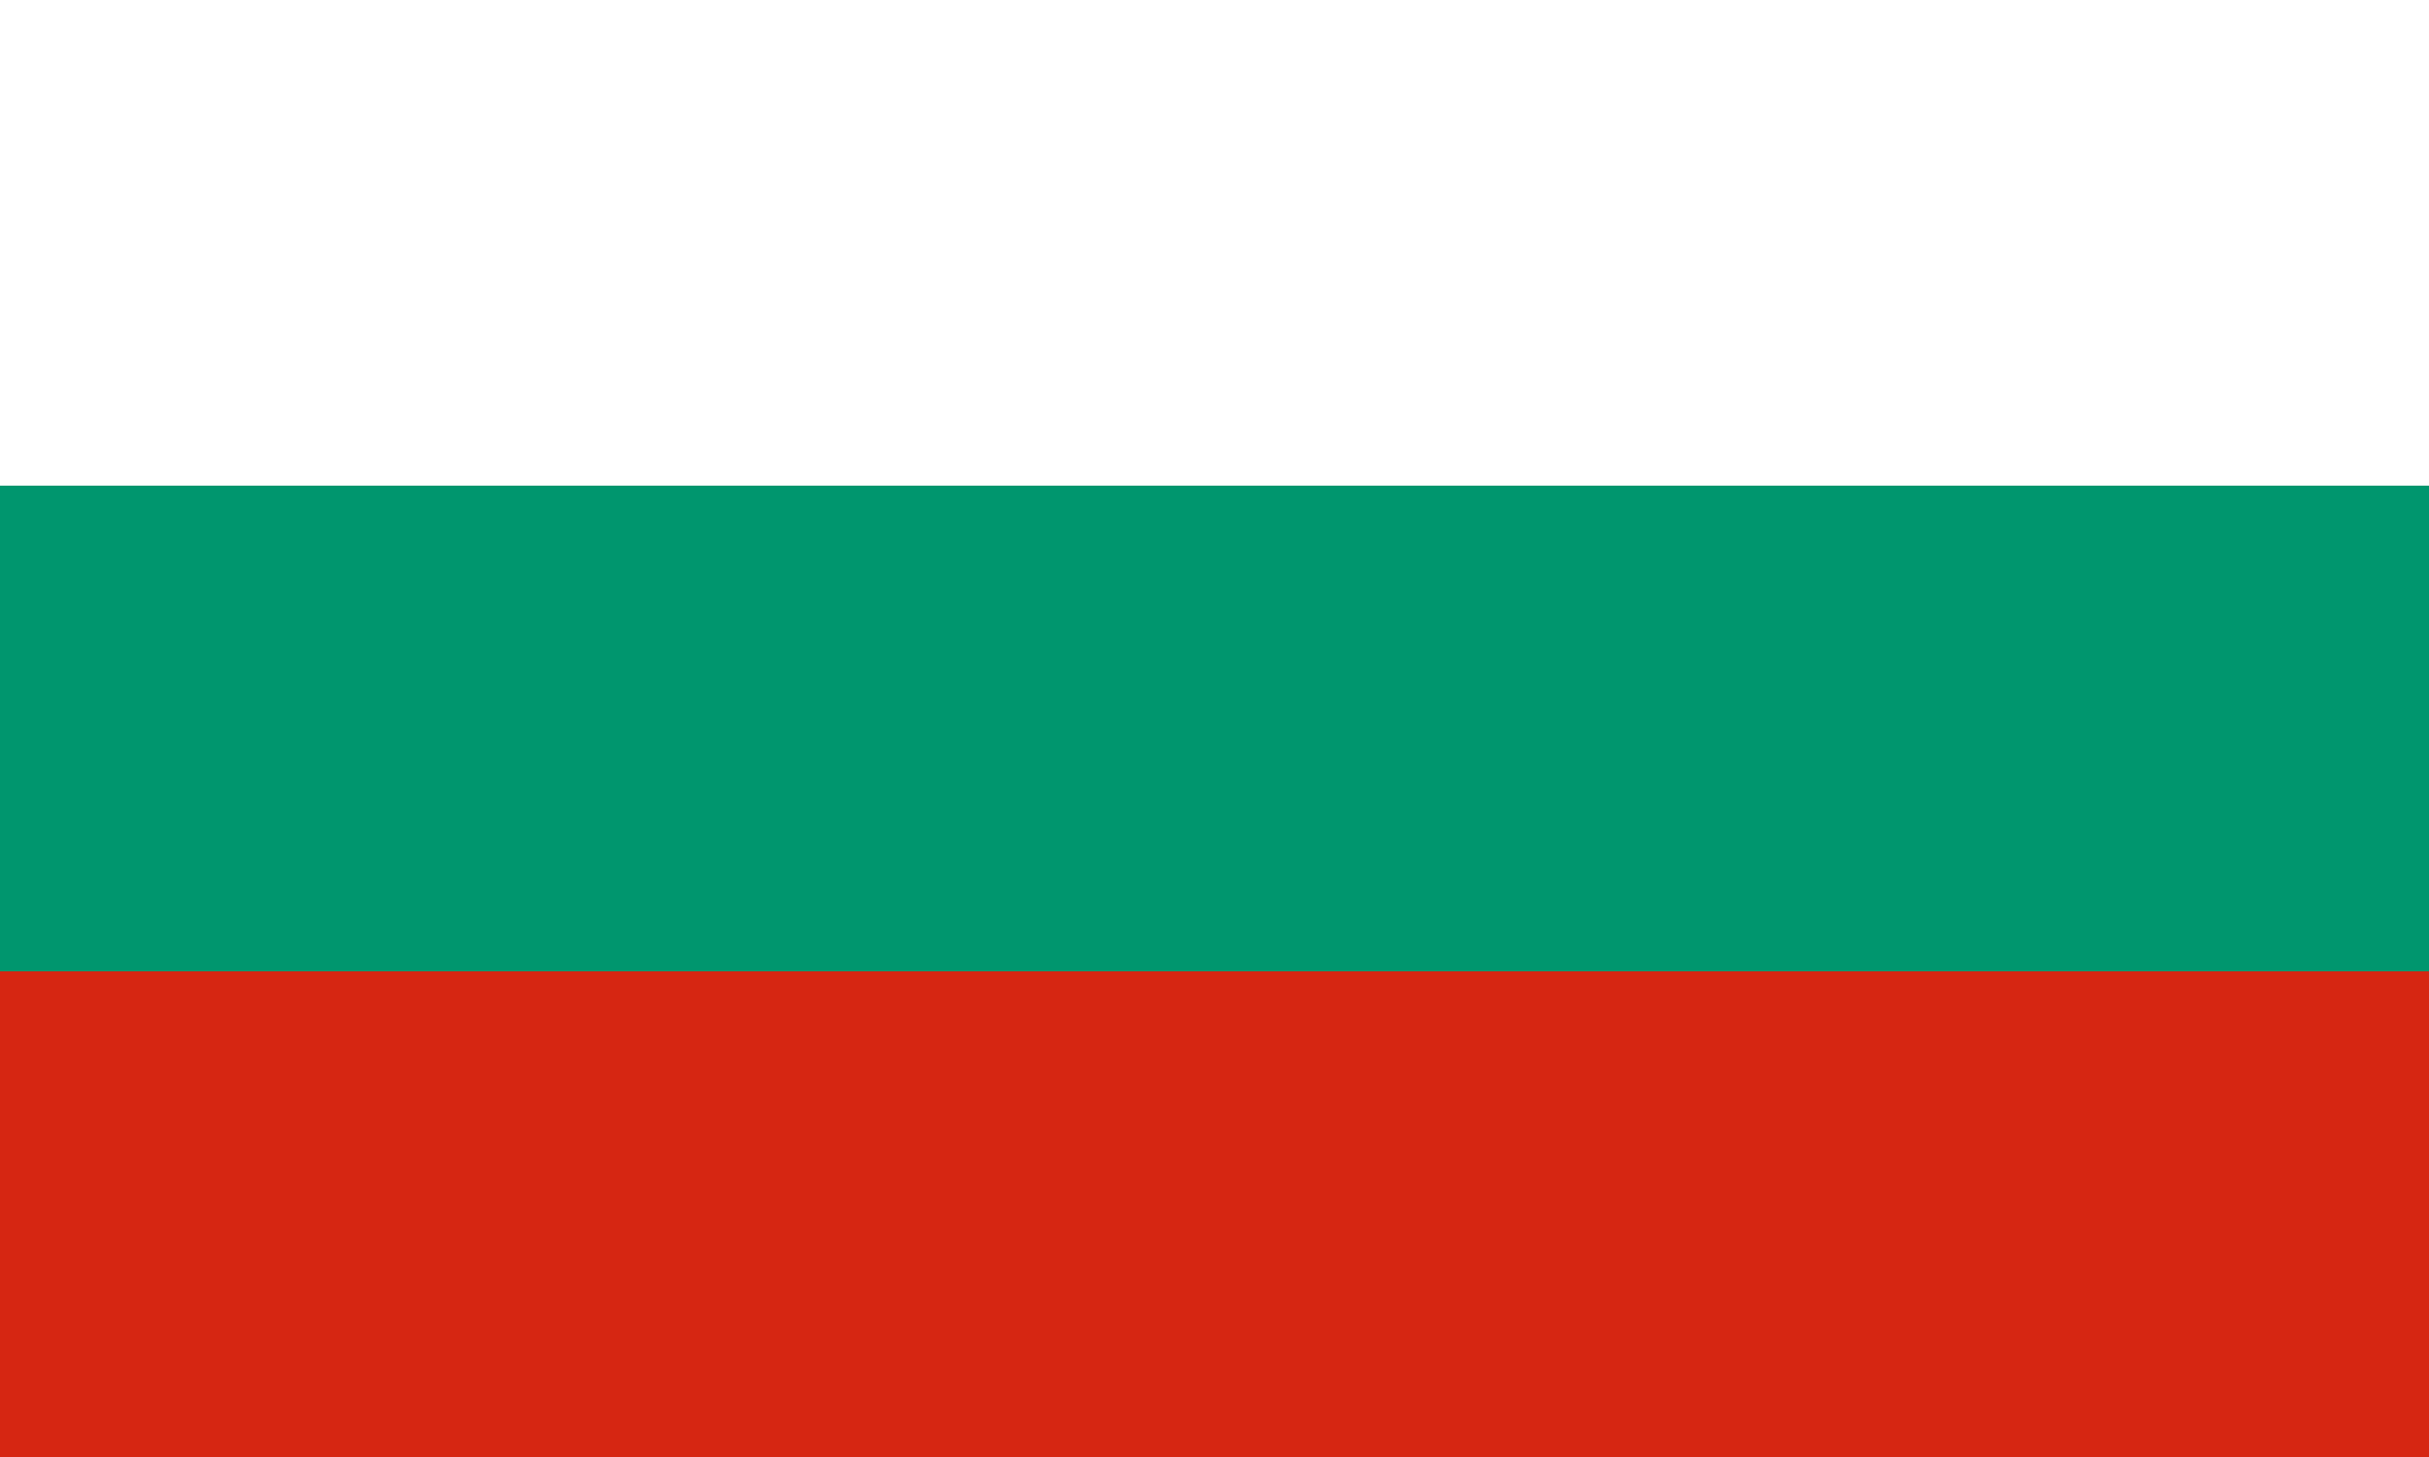
PRAYING FOR
BULGARIA

Slide 3
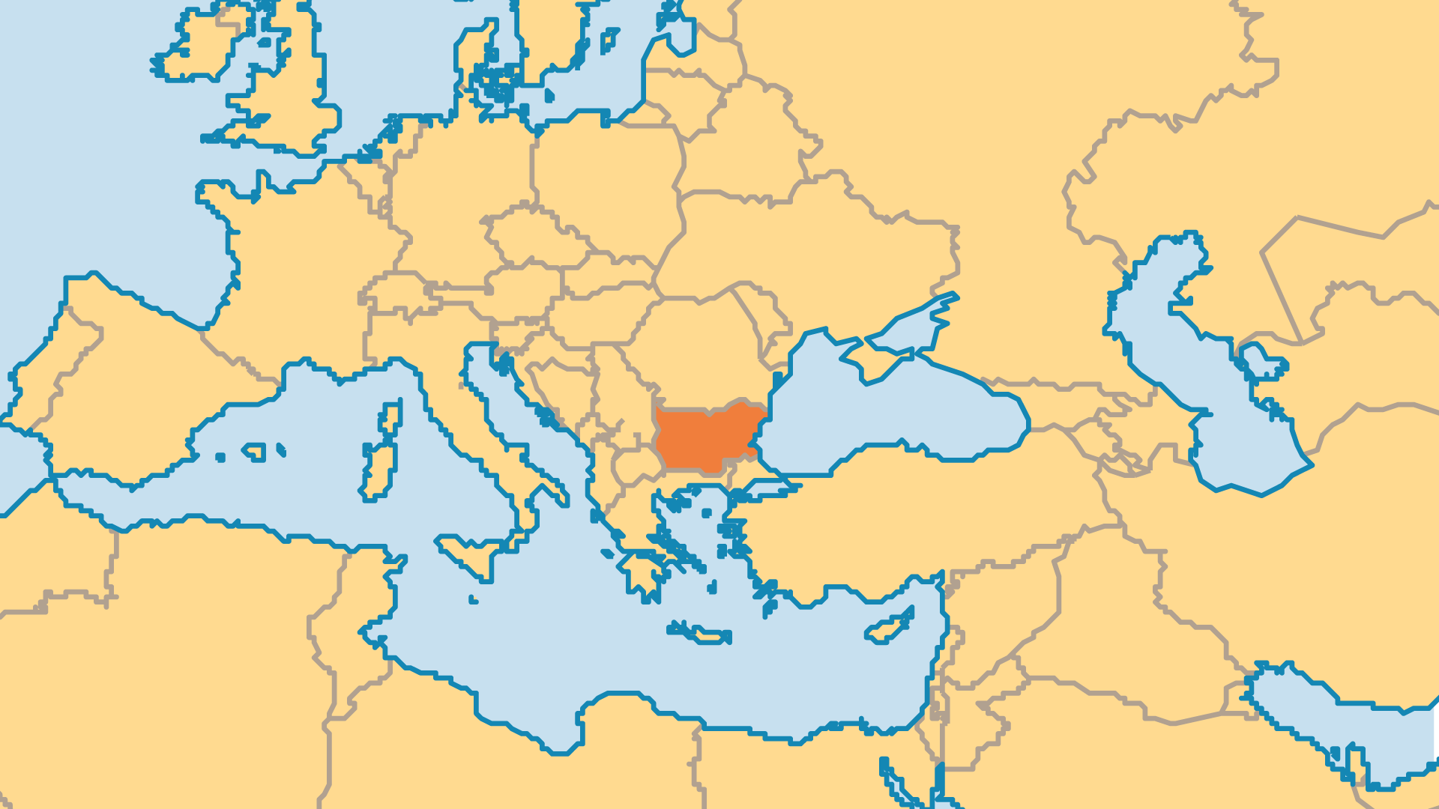
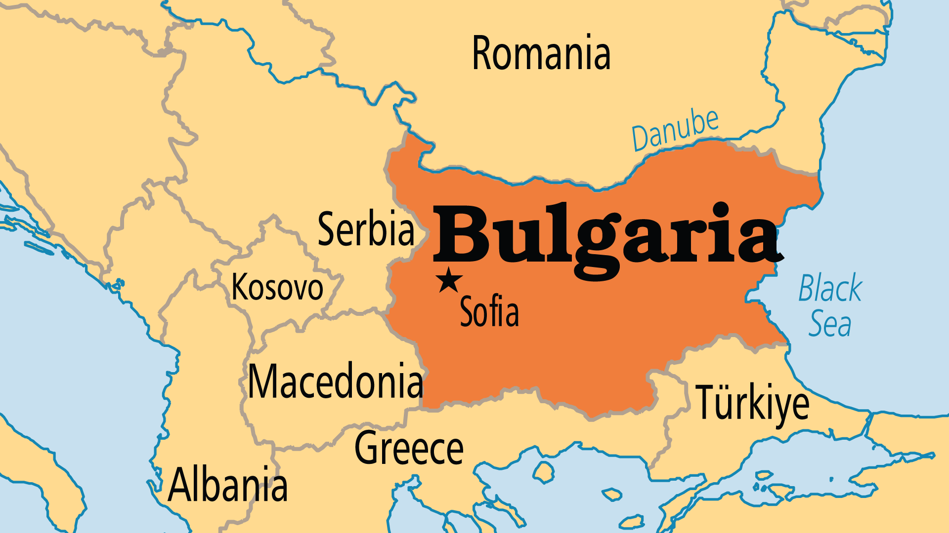
KEY STATS
Capital: | Sofia
Population: | 6,714,560
Pop Under 15 Yrs: | 14.7 %
Official Language: | Bulgarian
Languages: | 16
Literacy Rate: | 98 %
HDI Ranking: | 68/193
% Christian: | 79.9 %
% Evangelical: | 1.9 %
Largest Religion: | Christian
% Unevangelized: | 6 %

Slide 4

FOR PRAYER
Bulgaria suffered under Communist rule from 1947 to 1989, and troubles remain. Corruption, crime networks, and poverty affect many lives. Abortion, while less than in the past, is still widespread, and divorce is common. The populace continues to age even as its overall numbers have been steadily declining since 1986. Many young people leave Bulgaria (one of the poorest EU countries) to find work and opportunity in other nations. Pray for the Church to demonstrate God's love in this country where racial tensions are strong and hope is rare.
Want to know more? Go to www.operationworld.org

