Slide 1




Slide 2


PRAYING FOR
BRUNEI

Slide 3
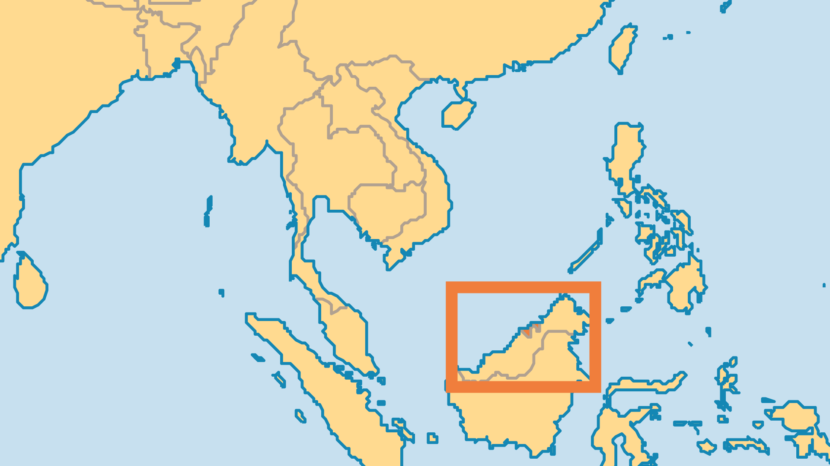
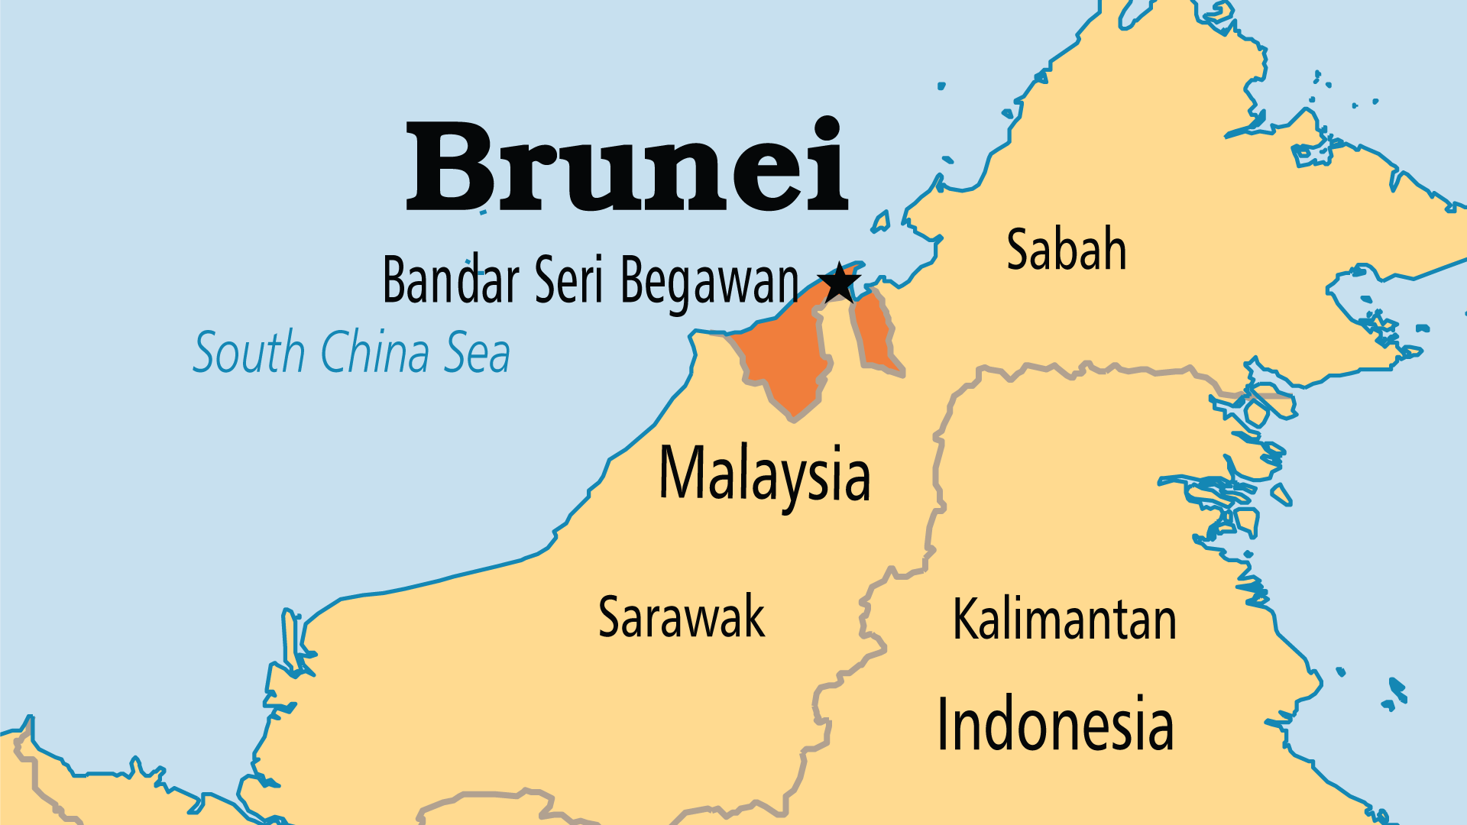
KEY STATS
Capital: | Bandar Seri Begawan
Population: | 466,331
Official Language: | Malay. English widely used
% Christian: | 11.4 %
% Evangelical: | 6.1 %
Largest Religion: | Muslim
% Largest Religion: | 65.3 %
% Unevangelized: | 52 %
Persecution Ranking: | 48/50

Slide 4

FOR PRAYER
Islam dominates life in Brunei. Bruneians practise conservative, but not radical, Islam. Pressure results in Islam converts from the tribal and Chinese minorities. Though the constitution guarantees religious freedom, it is illegal to evangelize or for a Muslim to convert to another religion. Government agents often secretly monitor other religious groups. The Sultan, considered the world's 2nd wealthiest royal, established a world-class university and aims to smoothly transfer rule to the crown prince. Pray for converts to Christ from the royal family. Pray for spiritual openness and religious freedom.
Want to know more? Go to www.operationworld.org

