Slide 1




Slide 2


PRAYING FOR
BRITISH VIRGIN ISLANDS

Slide 3
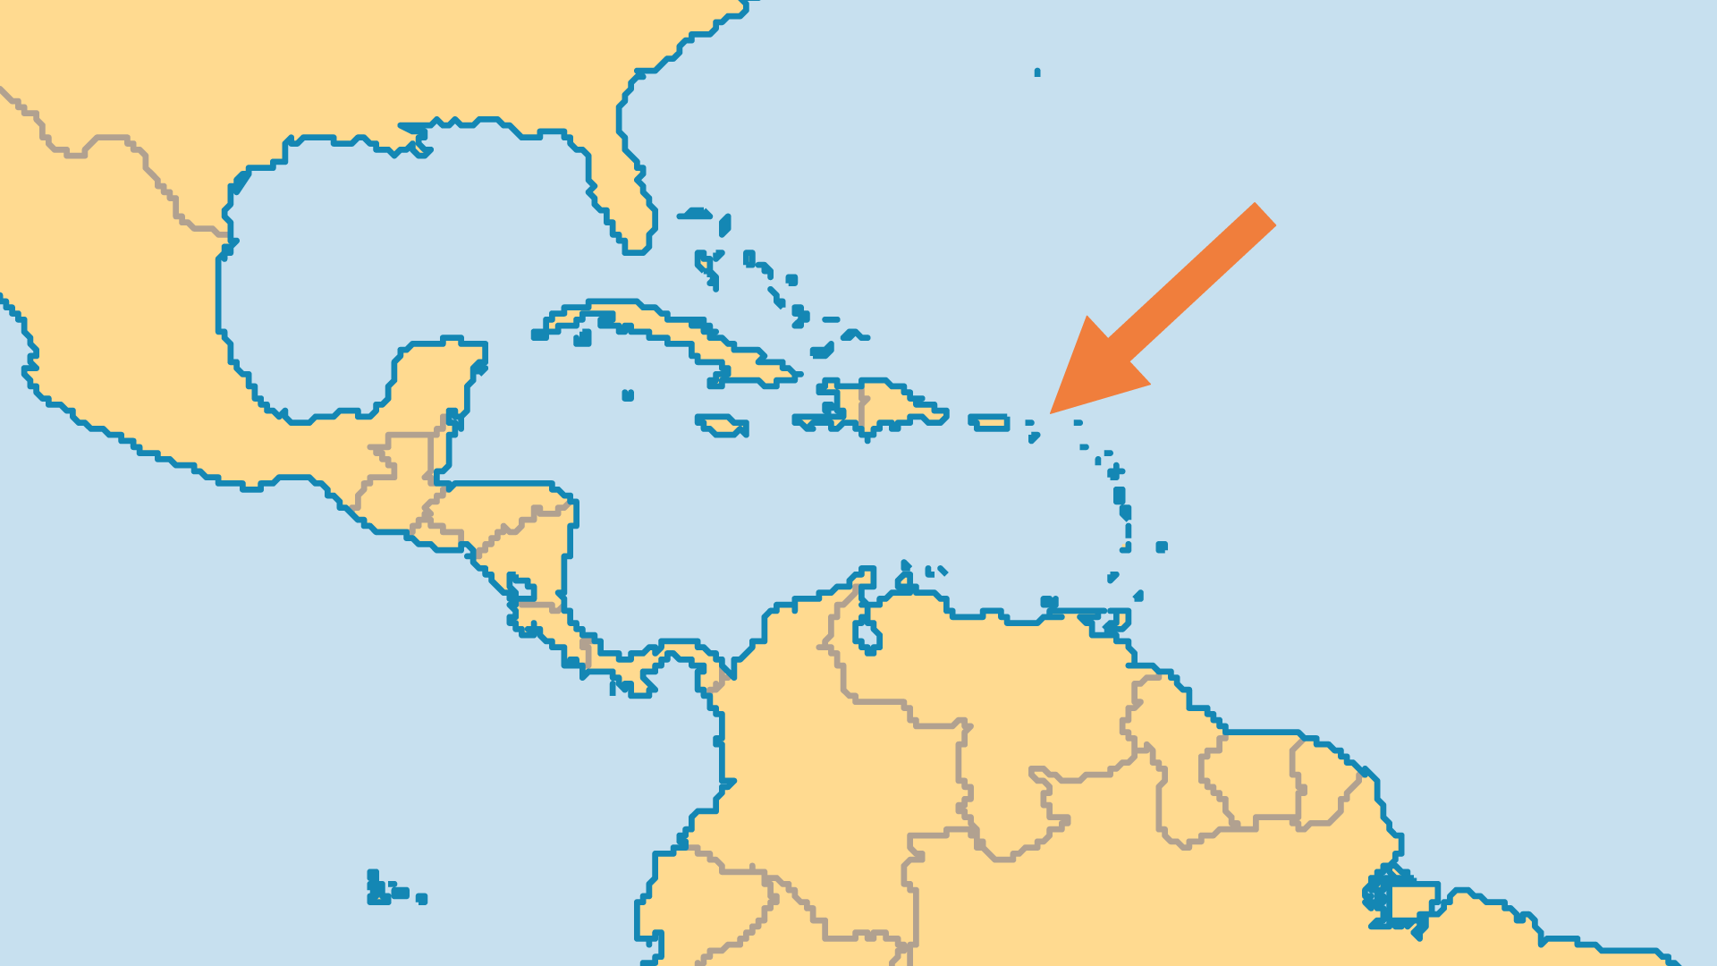
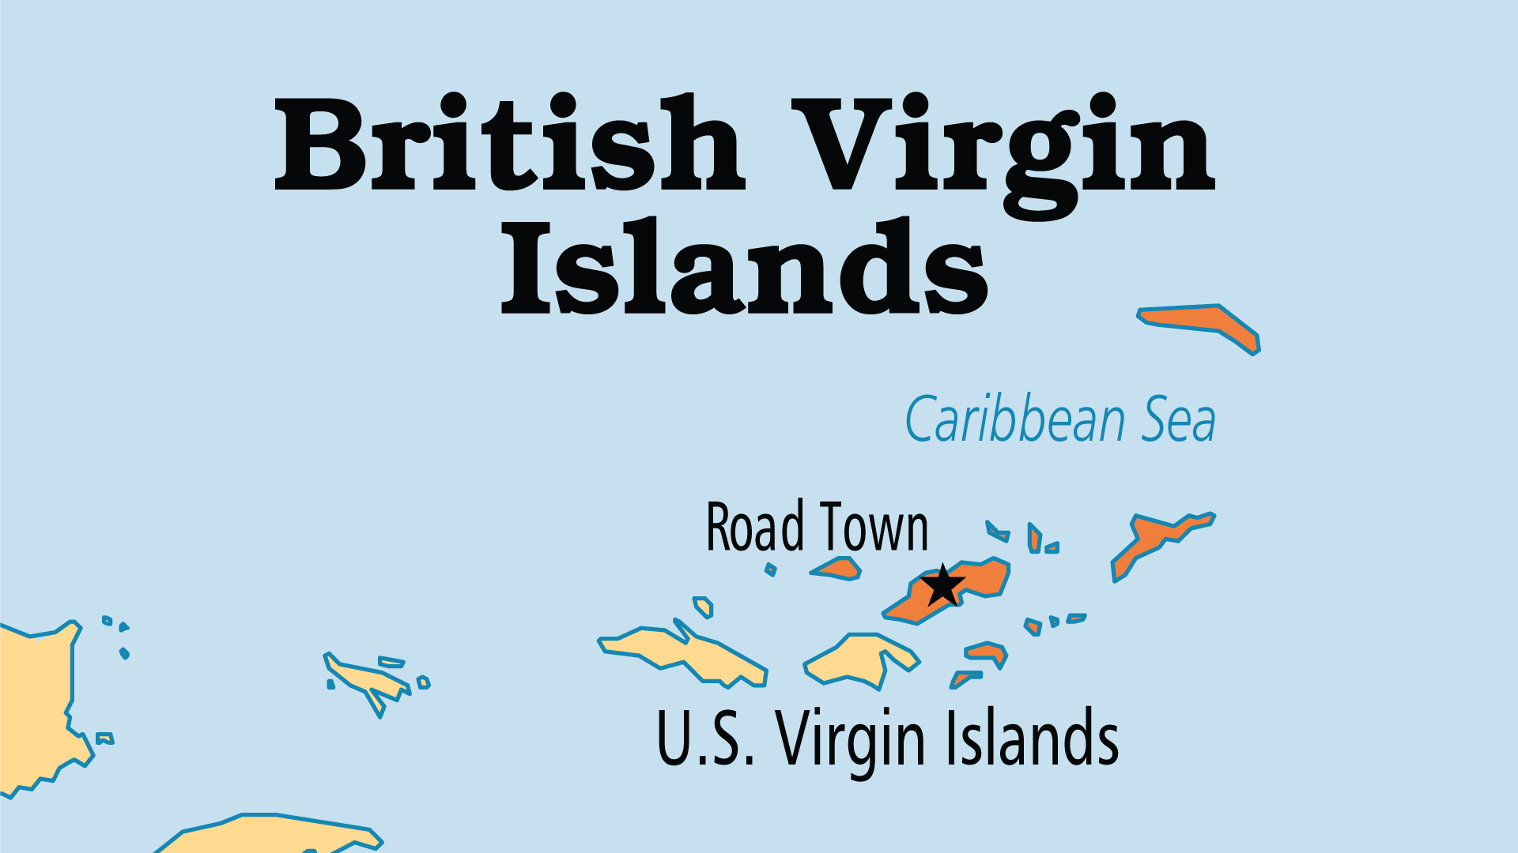
KEY STATS
Capital: | Road Town
Population: | 39,732
% Urban: | 50.6 %
Official Language: | English
Languages: | 2
Literacy Rate: | 98 %
% Christian: | 84.9 %
% Evangelical: | 27.3 %
Largest Religion: | Christian
People Groups: | 4
% Unevangelized: | 1 %

Slide 4

FOR PRAYER
Tourism combined with offshore finance bring both large numbers of wealthy pleasure-seeking visitors and illegal immigrants, with the inevitable moral impact on island life. Some of these new arrivals seek only to find legitimate employment in a relatively stable country; others have more questionable motives. Pray for local Christians and for their witness to both tourists and immigrants.
Want to know more? Go to www.operationworld.org

