Slide 1




Slide 2

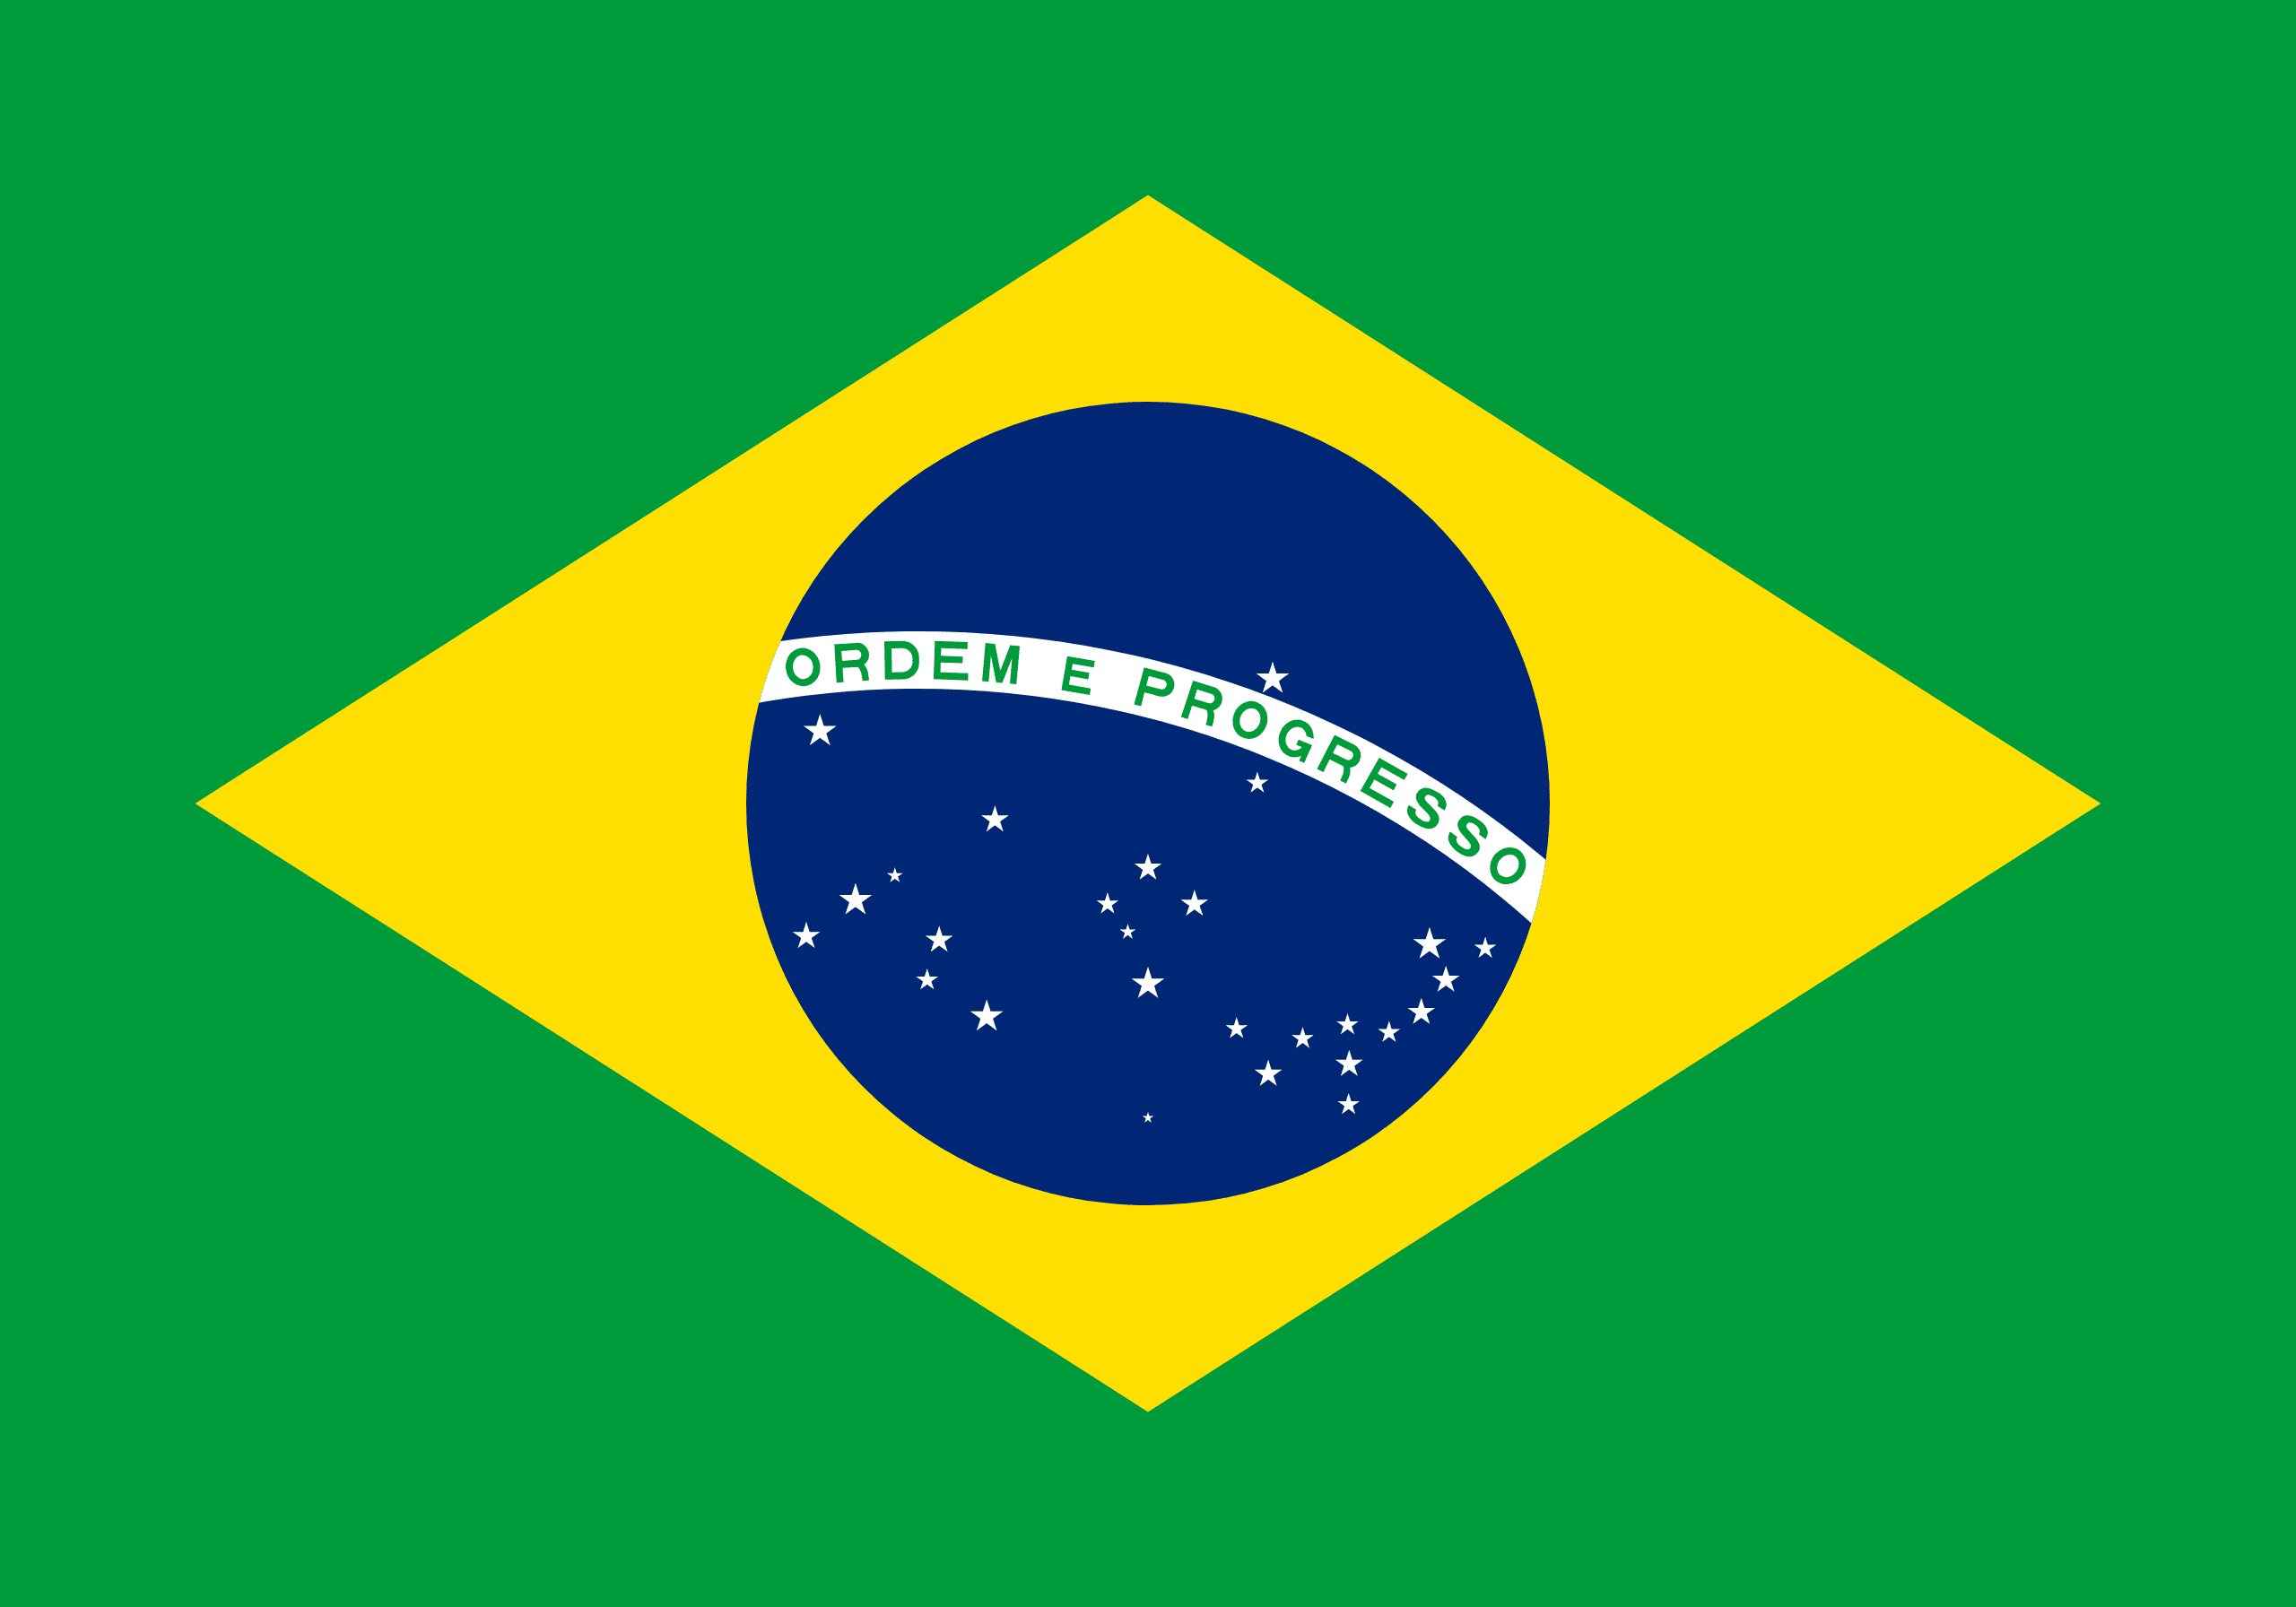
PRAYING FOR
BRAZIL

Slide 3
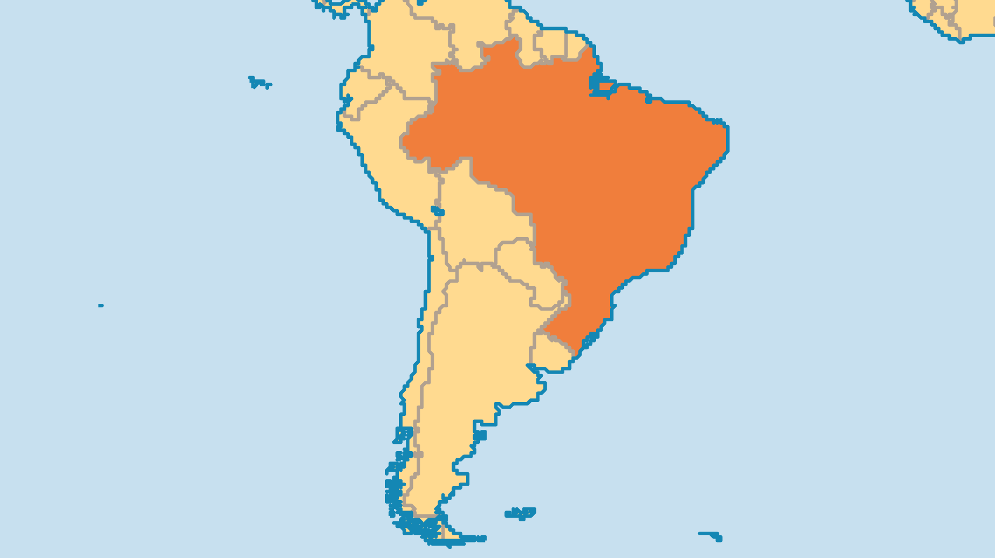
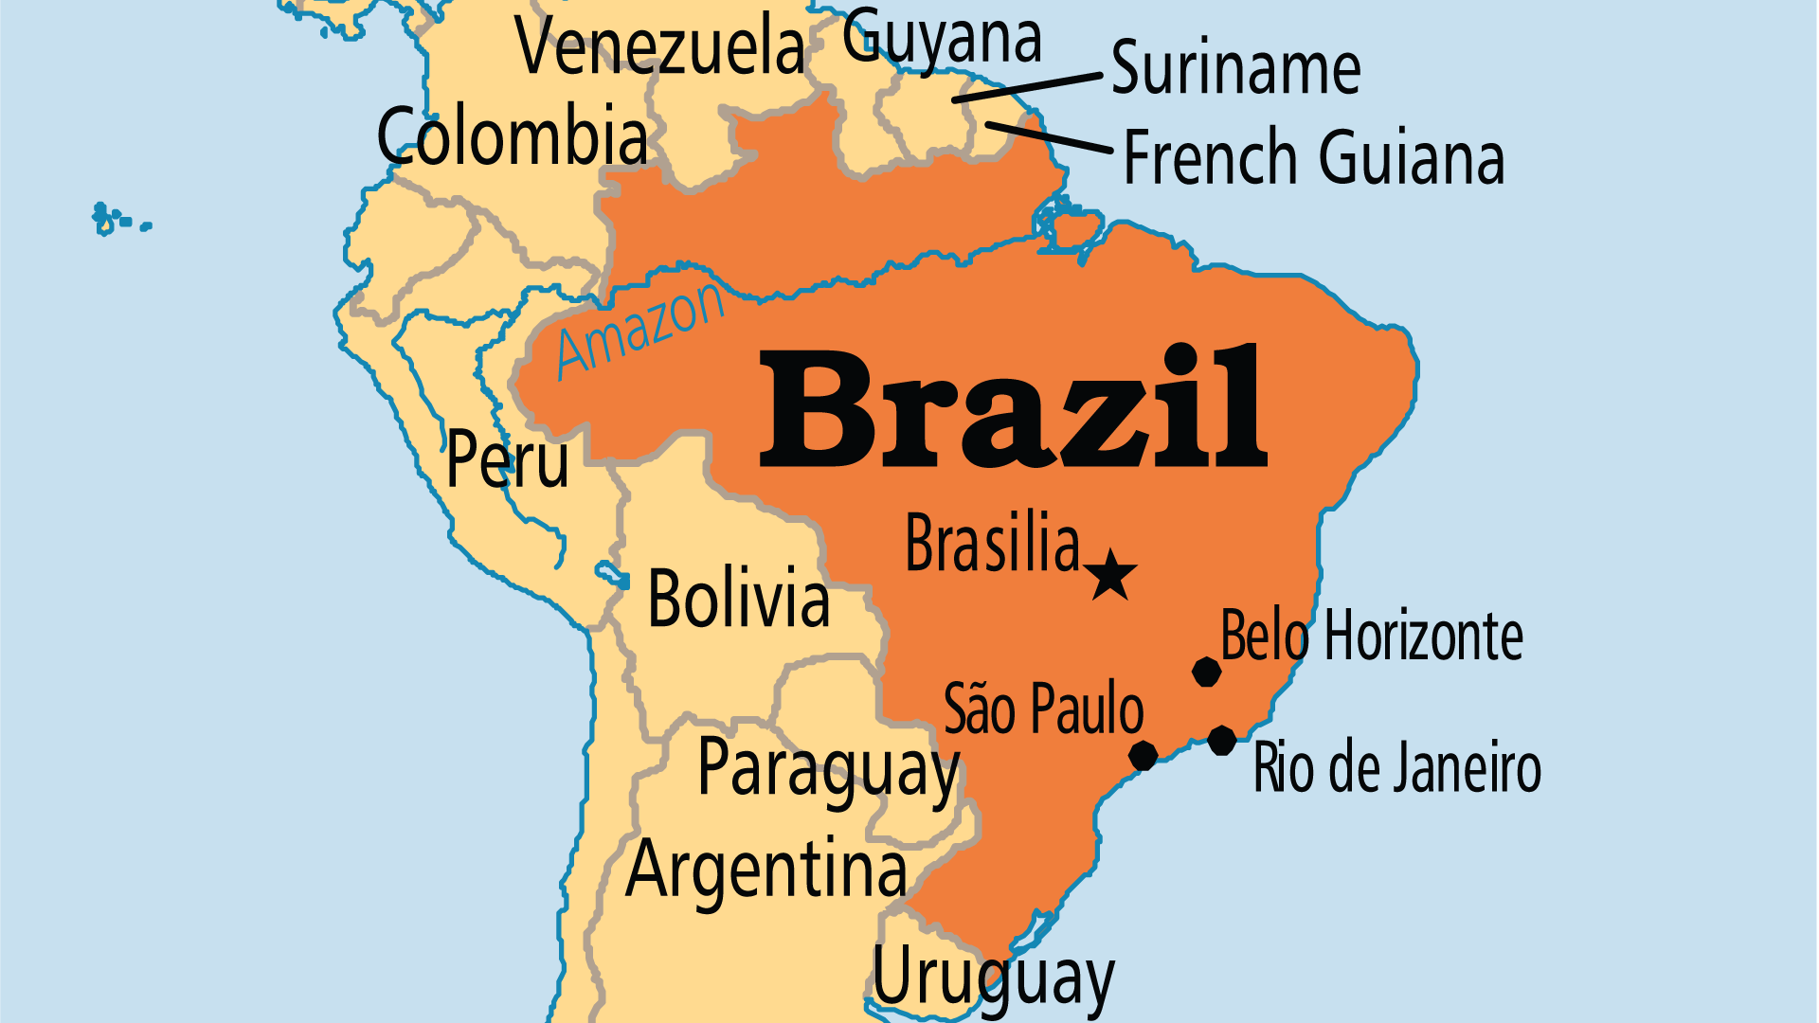
KEY STATS
Capital: | Brasilia
Population: | 212,812,405
% Urban: | 88.2 %
Official Language: | Portuguese
Languages: | 193
Literacy Rate: | 98 %
HDI Ranking: | 87/193
% Christian: | 91.4 %
% Evangelical: | 26.3 %
People Groups: | 323
Least Reached People Groups: | 50

Slide 4

FOR PRAYER
Brazil's evangélicos grew from 2 million in 1960 to an estimated 55 million in 2020. They are one of the largest evangelical populations in the world, and very strong in prayer meetings and movements. Large gatherings, women's networks, youth movements, and events like the March for Jesus, all bring masses together to pray and celebrate Jesus. Praise God for Brazilian prayer warriors!
Want to know more? Go to www.operationworld.org

Slide 5
FOR PRAYER
Brazil faces many serious challenges ahead, but none more important to address than the deep political divide between right and left, despite Brazil having a wide array of parties across the political spectrum. Economic inequality, child labour, violent crime, gangs, and the plight of the Amazon rainforest, are all too consequential to ignore. Pray that Brazil would be able to move past such divides and see their diversity as a strength. Pray that the most populous Latin American nation would be able to provide an anchor of stability, progress, and justice not just to its own 200 million-plus people but to an entire region that is greatly in need of such qualities.

Slide 6
FOR PRAYER
Many regions of Brazil still lack an evangelical presence. The poor and less-developed northeast region has the lowest percentage of evangelicals. Pray for greater response to Pentecostal outreach there. Up to one-third of the populations of Rio de Janeiro and São Paulo live in crime-filled slums. The battles between ganglords and police often make victims of the innocent. Brazil has 8 million children at risk, 7 million child labourers, and 600,000 girls in prostitution. Some churches and agencies help children through orphanages and job training ministries, but it is not enough. Pray for Christian ministry to every area of need.

Slide 7
FOR PRAYER
The Amazon Basin has 36,000 communities without a church. Church planting is difficult because of the isolation and poverty, but several organizations send missionary boats – the only way to access these communities. Pray also for sensitivity as numerous agencies minister to the Amerindian groups spread across Brazil. These indigenous peoples suffered centuries of oppression, exploitation, and worse. Rampant, illegal deforestation of the Amazon for economic development has been devastating to these indigenous groups. Pray that Christians would lead the way in advocating for sustainable development, and for justice for these threatened communities.

