Slide 1




Slide 2


PRAYING FOR
BOTSWANA

Slide 3
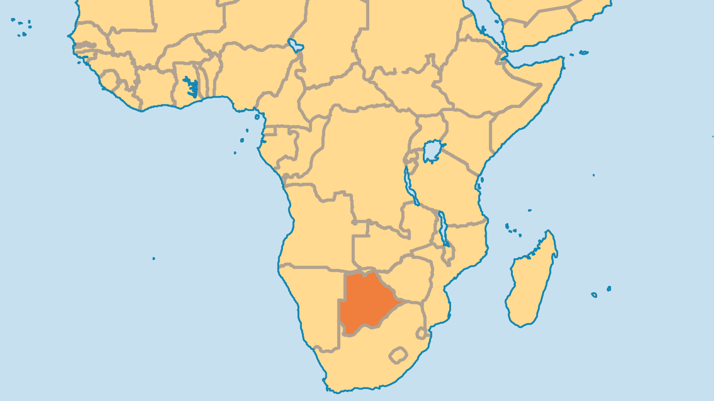
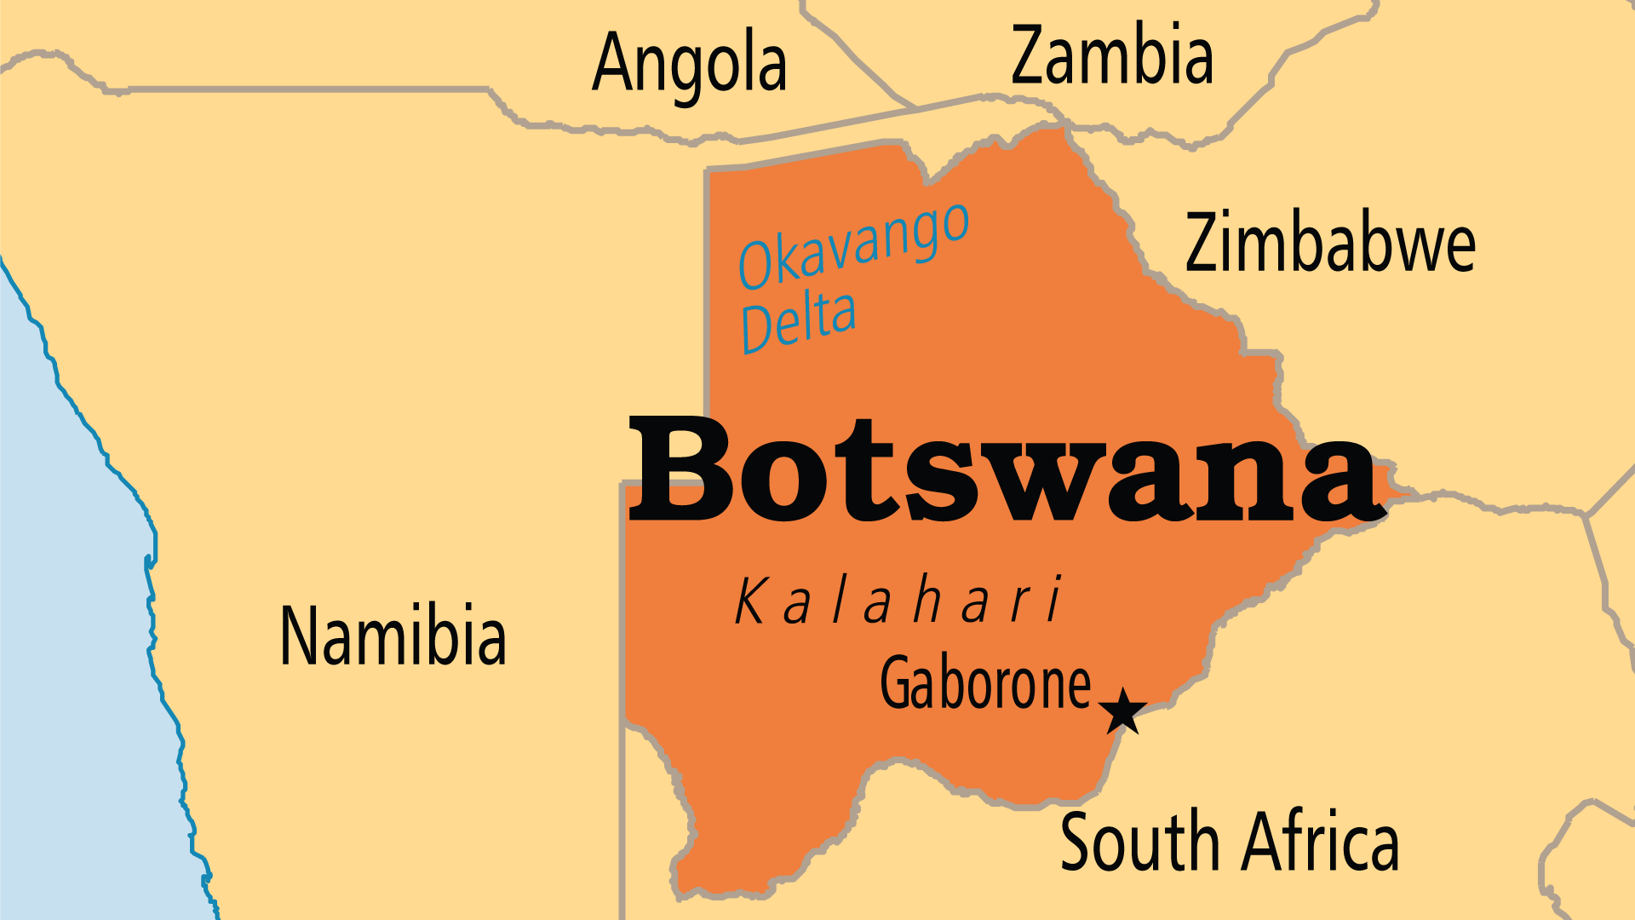
KEY STATS
Capital: | Gaborone
Population: | 2,562,122
% Urban: | 74.1 %
Pop Under 15 Yrs: | 33.8 %
Official Language: | English, Setswana
Languages: | 40
HDI Ranking: | 117/193
% Christian: | 65.6 %
% Evangelical: | 8.1 %
Largest Religion: | Christian
% Unevangelized: | 4 %

Slide 4

FOR PRAYER
Praise God for political stability, economic growth, and lower corruption in Botswana. The 2024 elections saw the ruling party of 58 years emphatically voted out. The peaceful transition to the new administration was praiseworthy and a sign of Botwana's stability and integrity. The national programme of Vision 2036 seeks "prosperity for all" and includes a sustainable environment, human and social development, good governance and peace. Pray that it might be so! After all, only under Jesus' Lordship can such a vision be truly achieved.
Want to know more? Go to www.operationworld.org

