Slide 1




Slide 2


PRAYING FOR
BOSNIA and
HERZEGOVINA

Slide 3
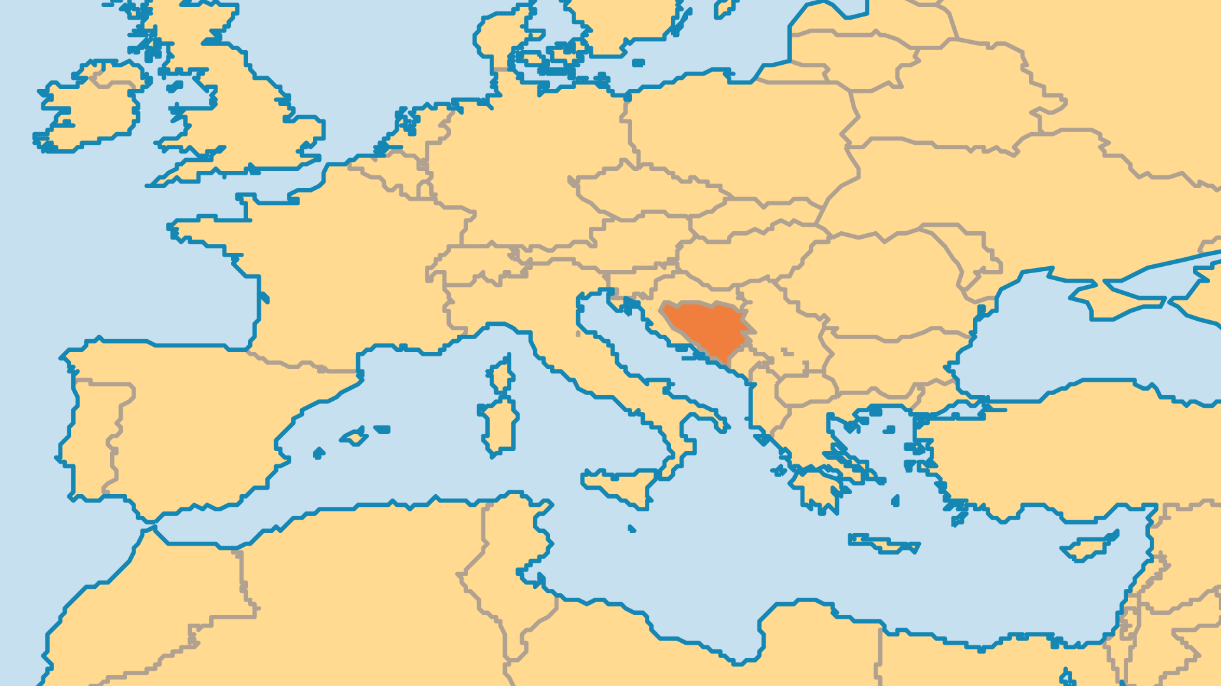
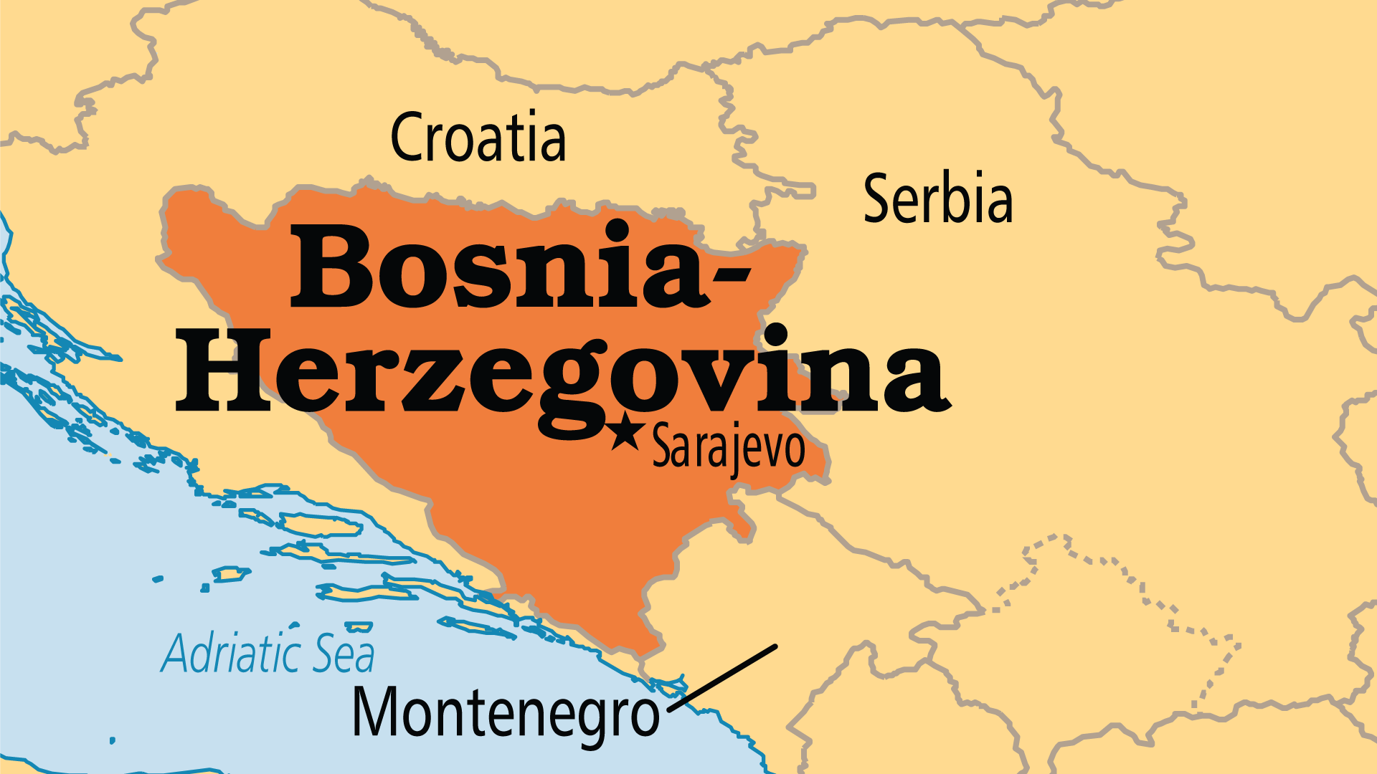
KEY STATS
Capital: | Sarajevo
Population: | 3,140,096
Official Language: | Bosnian, Serbian, Croatian
Languages: | 8
Literacy Rate: | 99 %
% Christian: | 41 %
% Evangelical: | 0.1 %
Largest Religion: | Muslim
% Largest Religion: | 54.2 %
% Unevangelized: | 23 %

Slide 4

FOR PRAYER
Bosnia has a tragic history of violence. The hatred among ethnic groups appears impossible to resolve. Recovery from the most recent conflict (1992-1995) continues even now. Many have not returned to their original homes. Roads and buildings can be rebuilt, but deep community wounds remain. Only God can bring true reconciliation and unity. Bosnia also struggles with poverty; organized crime thrives and must be stopped for Bosnia to progress. Young people feel discouraged, and more than 60% want to leave the country. Pray for a new generation of Bosnians to stay and lead their nation into a bright future!
Want to know more? Go to www.operationworld.org

