Slide 1




Slide 2

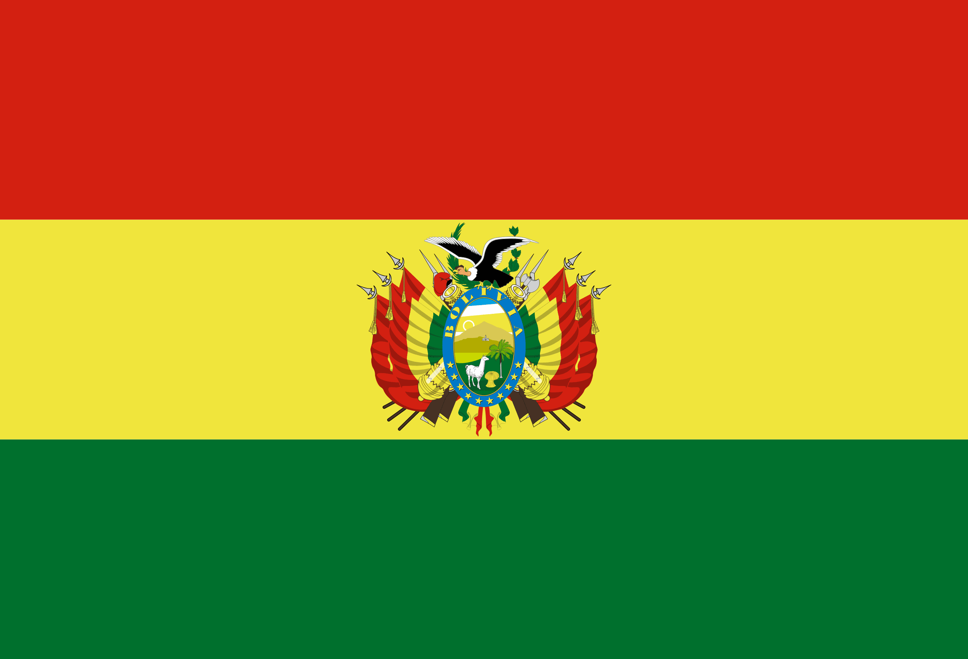
PRAYING FOR
BOLIVIA

Slide 3
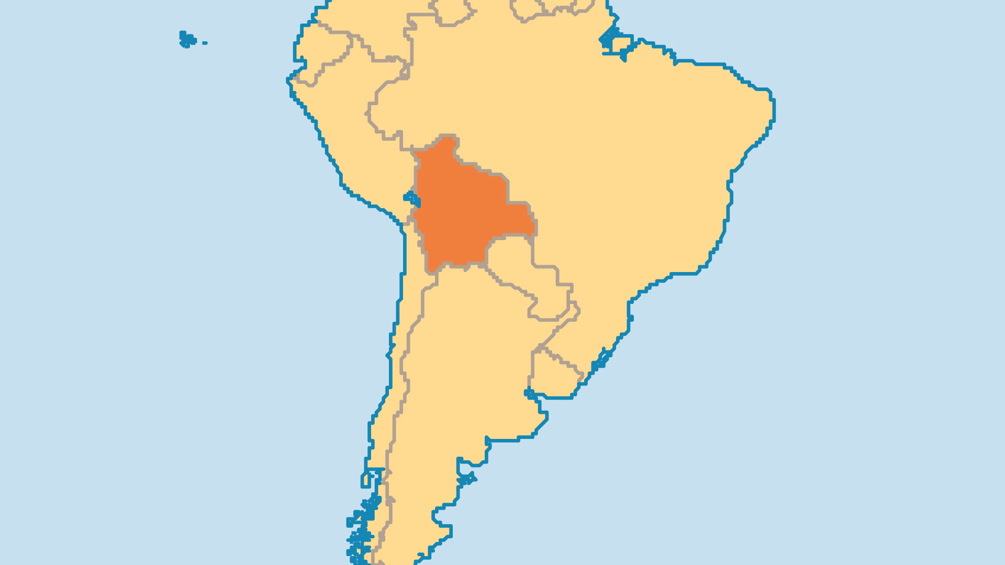
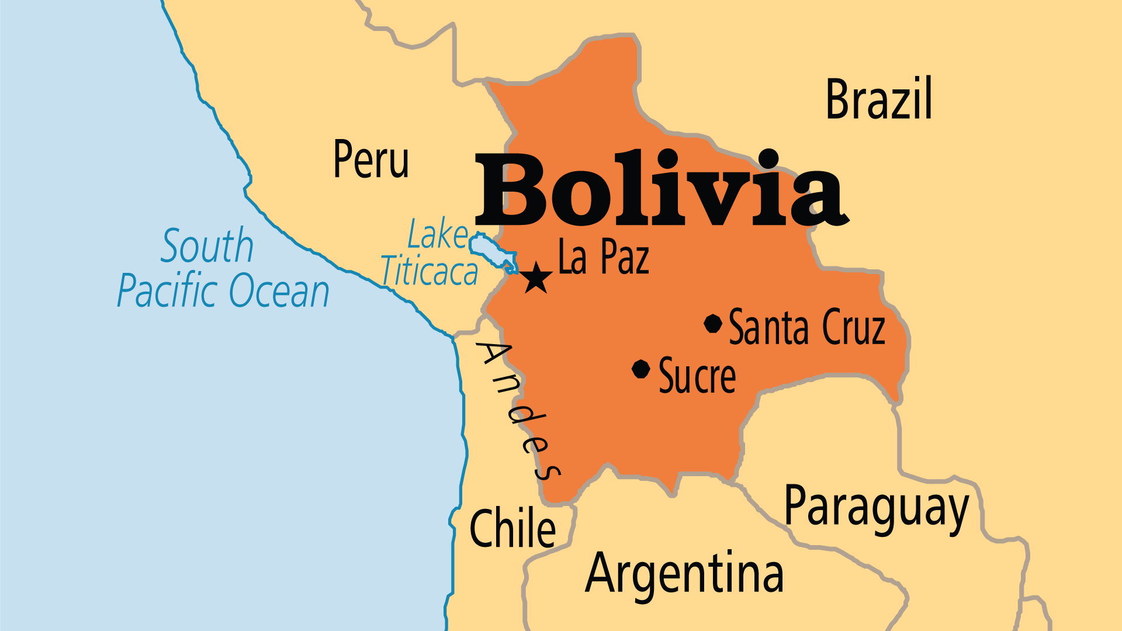
KEY STATS
Capital: | La Paz (admin); Sucre (legal)
Population: | 12,581,843
% Urban: | 71.9 %
Official Language: | Spanish; Aymara; Guarani; Quechua
Languages: | 41
% Christian: | 91 %
% Evangelical: | 16.2 %
People Groups: | 48
% Unevangelized: | 1 %

Slide 4

FOR PRAYER
Poverty and inequality continue to plague and divide Bolivia. Recent political upheaval includes the removal of President Morales in 2019 and a 2020 landslide electoral victory of his successor Luis Arce. Farmers can earn more money for the coca leaf than for other crops, but some uses for coca are illegal. Rich gas deposits in the east lead to tension among the white elite, the highland peoples of the west, and the mixed and Indian peoples of the east. Pray that individuals in power or in poverty will find courage to reject temptations and make wise decisions.
Want to know more? Go to www.operationworld.org

Slide 5
FOR PRAYER
Evangelical Christians grew greatly in number and in influence, but face challenges. Some follow false teachings or fail morally without good discipleship and Bible knowledge. Ask God to set apart thousands of new leaders for His use. Evangelicals must help lead Bolivia's battle against poverty, injustice, and evil by allowing Kingdom values to guide their words and deeds. Such believers have potential to greatly impact a nation in need of moral clarity and compassionate work among the poor.
Want to know more? Go to www.operationworld.org

