Slide 1




Slide 2

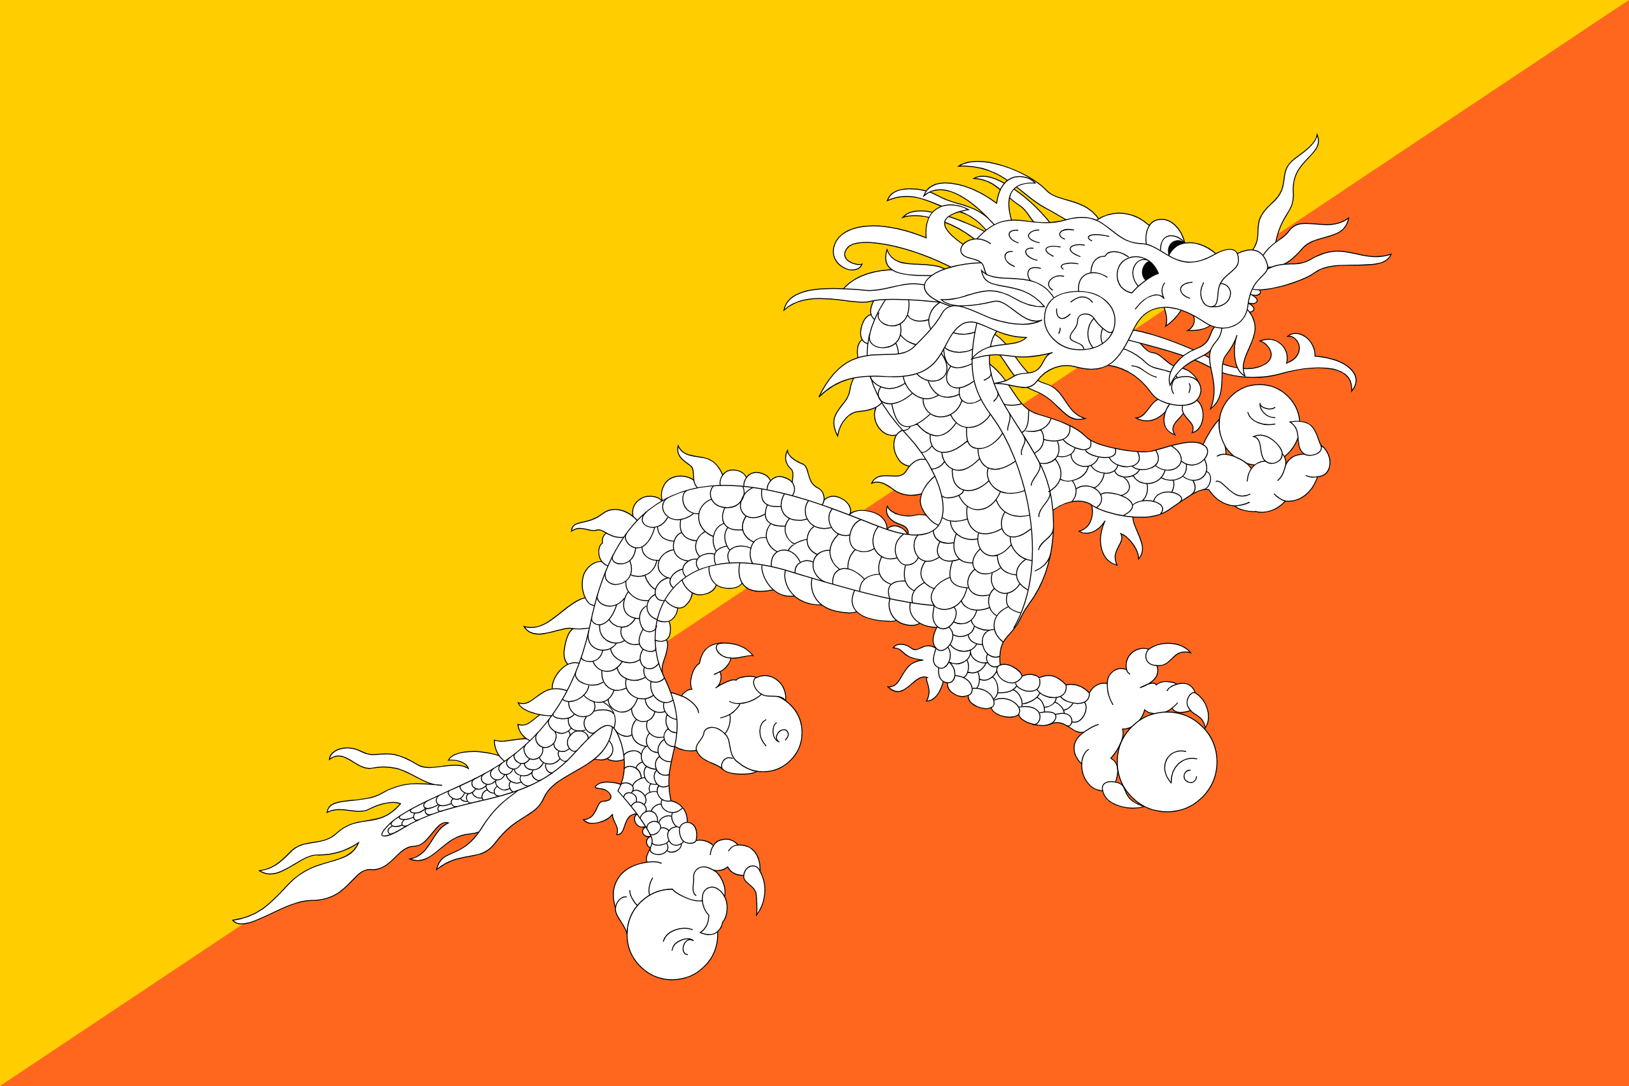
PRAYING FOR
BHUTAN

Slide 3
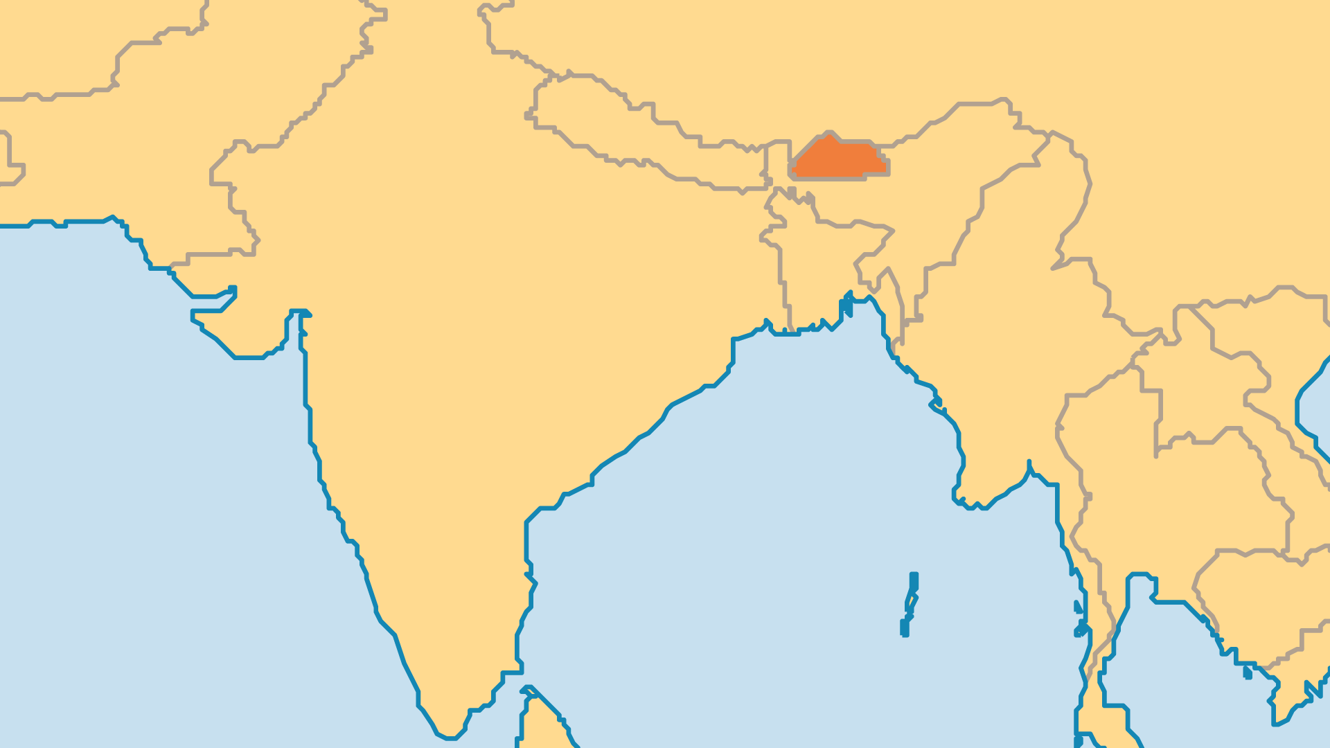
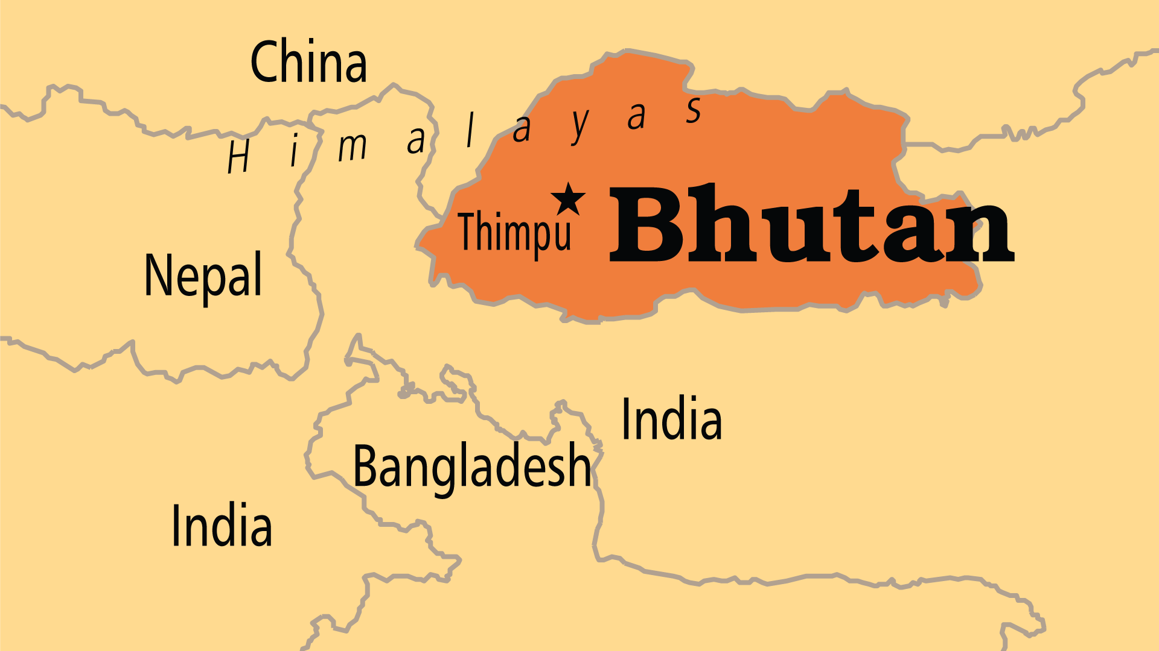
KEY STATS
Capital: | Thimpu
Population: | 796,682
Official Language: | Dzongkha. Nepali is also widely used
Languages: | 35
% Christian: | 2.1 %
% Evangelical: | 1.8 %
Largest Religion: | Buddhist
% Largest Religion: | 74.6 %
Least Reached People Groups: | 57
% Unevangelized: | 73 %

Slide 4

FOR PRAYER
Pray for true spiritual freedom in this "Land of the Dragon." The Buddhist monarchy, isolating policies and the stronghold of Vajrayana Buddhism resulted in Bhutan as one of the world's least-evangelized nations. Bon (an indigenous religion) maintains a strong occultic/ demonic influence. Pray that King Wangchuk and family may know the love and power of Jesus. Among the 5 largest Tibetan/Himalayan peoples (Dzongkha, Tshangla, Lepcha, Kheng, Gurung), only the Lepcha have a significant Christian population. Pray for believers to witness among every Bhutanese ethnic group! Dzongkha language has a New Testament, but most languages have no Scriptures.

