Slide 1




Slide 2


PRAYING FOR
BERMUDA

Slide 3
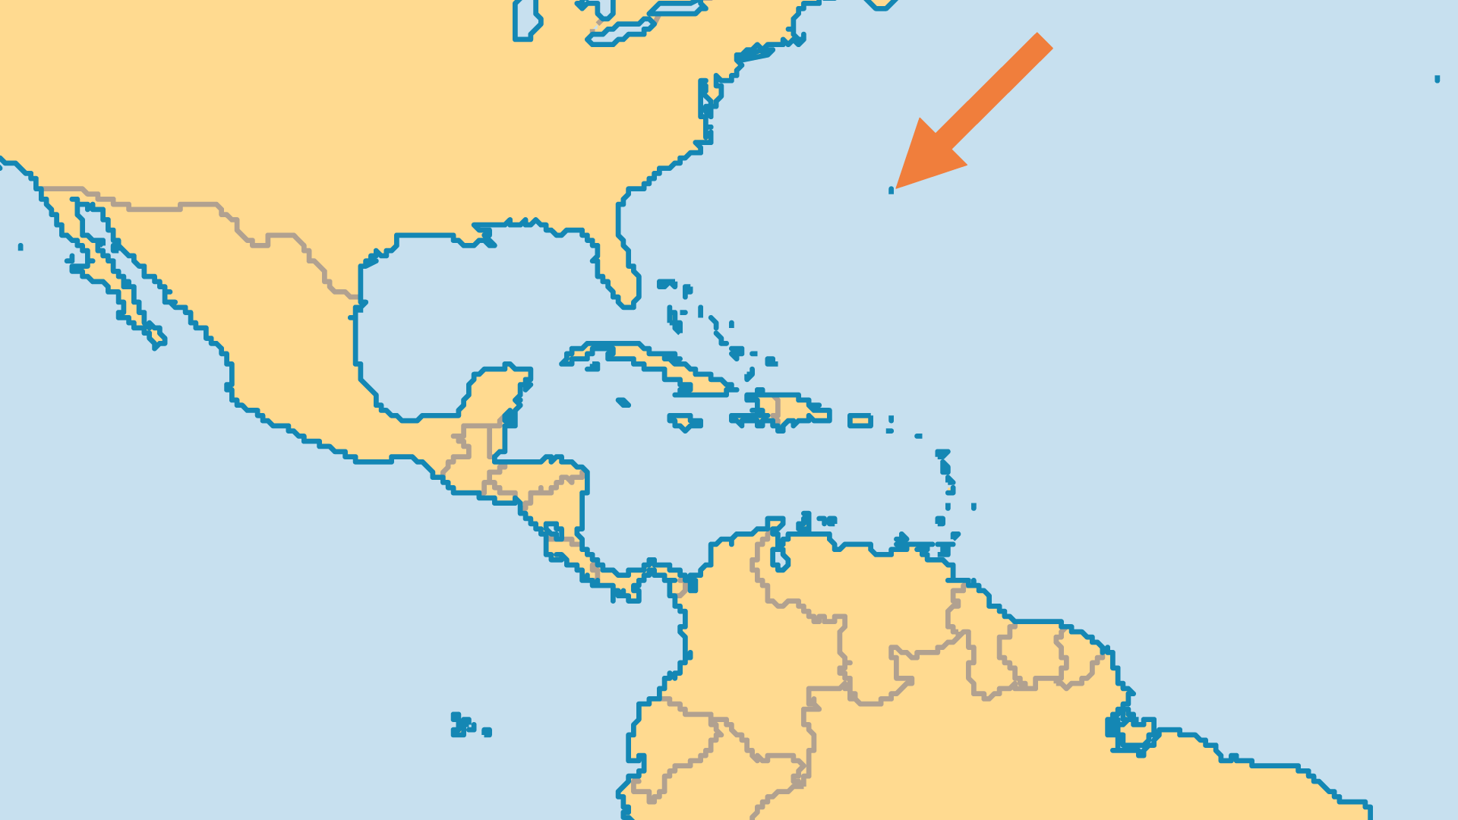
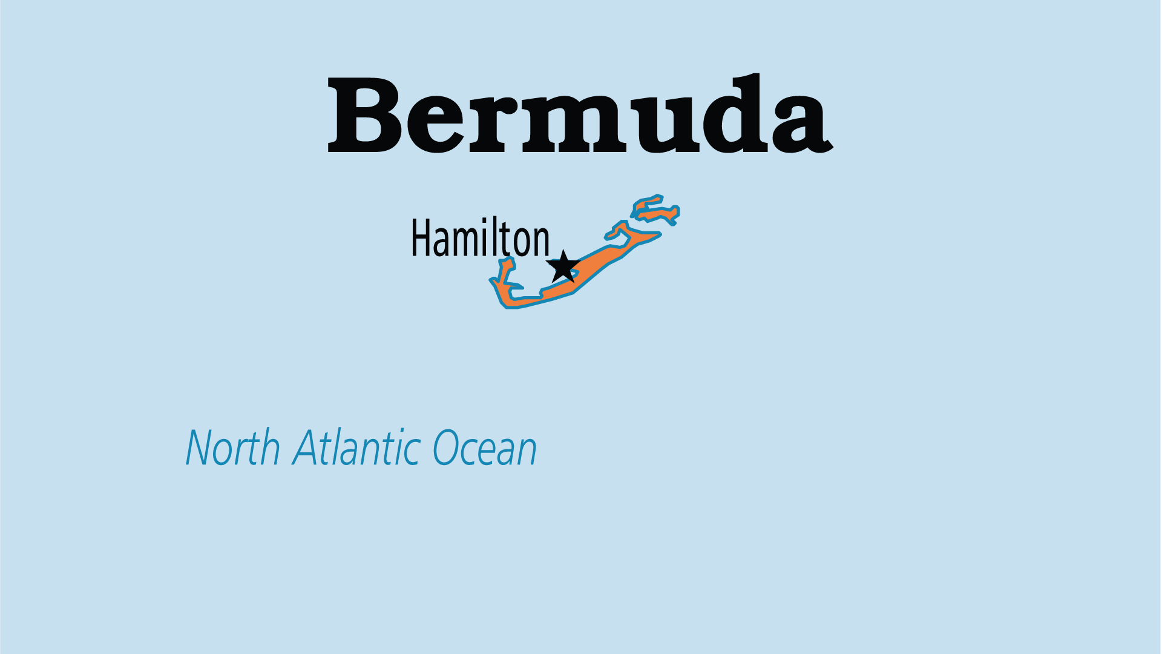
KEY STATS
Capital: | Hamilton
Population: | 64,555
% Urban: | 100 %
Official Language: | English
Literacy Rate: | 98 %
HDI Ranking: | 127/193
% Christian: | 90.5 %
% Evangelical: | 24.3 %
Largest Religion: | Christian
People Groups: | 7
% Unevangelized: | 1 %

Slide 4

FOR PRAYER
Bermuda is an earthly paradise, and Christianity is a strong part of its heritage. Sadly, the appearance of religion takes priority over genuine spirituality. Pray for revival that brings lifestyles in line with biblical knowledge.
Want to know more? Go to www.operationworld.org

