Slide 1




Slide 2

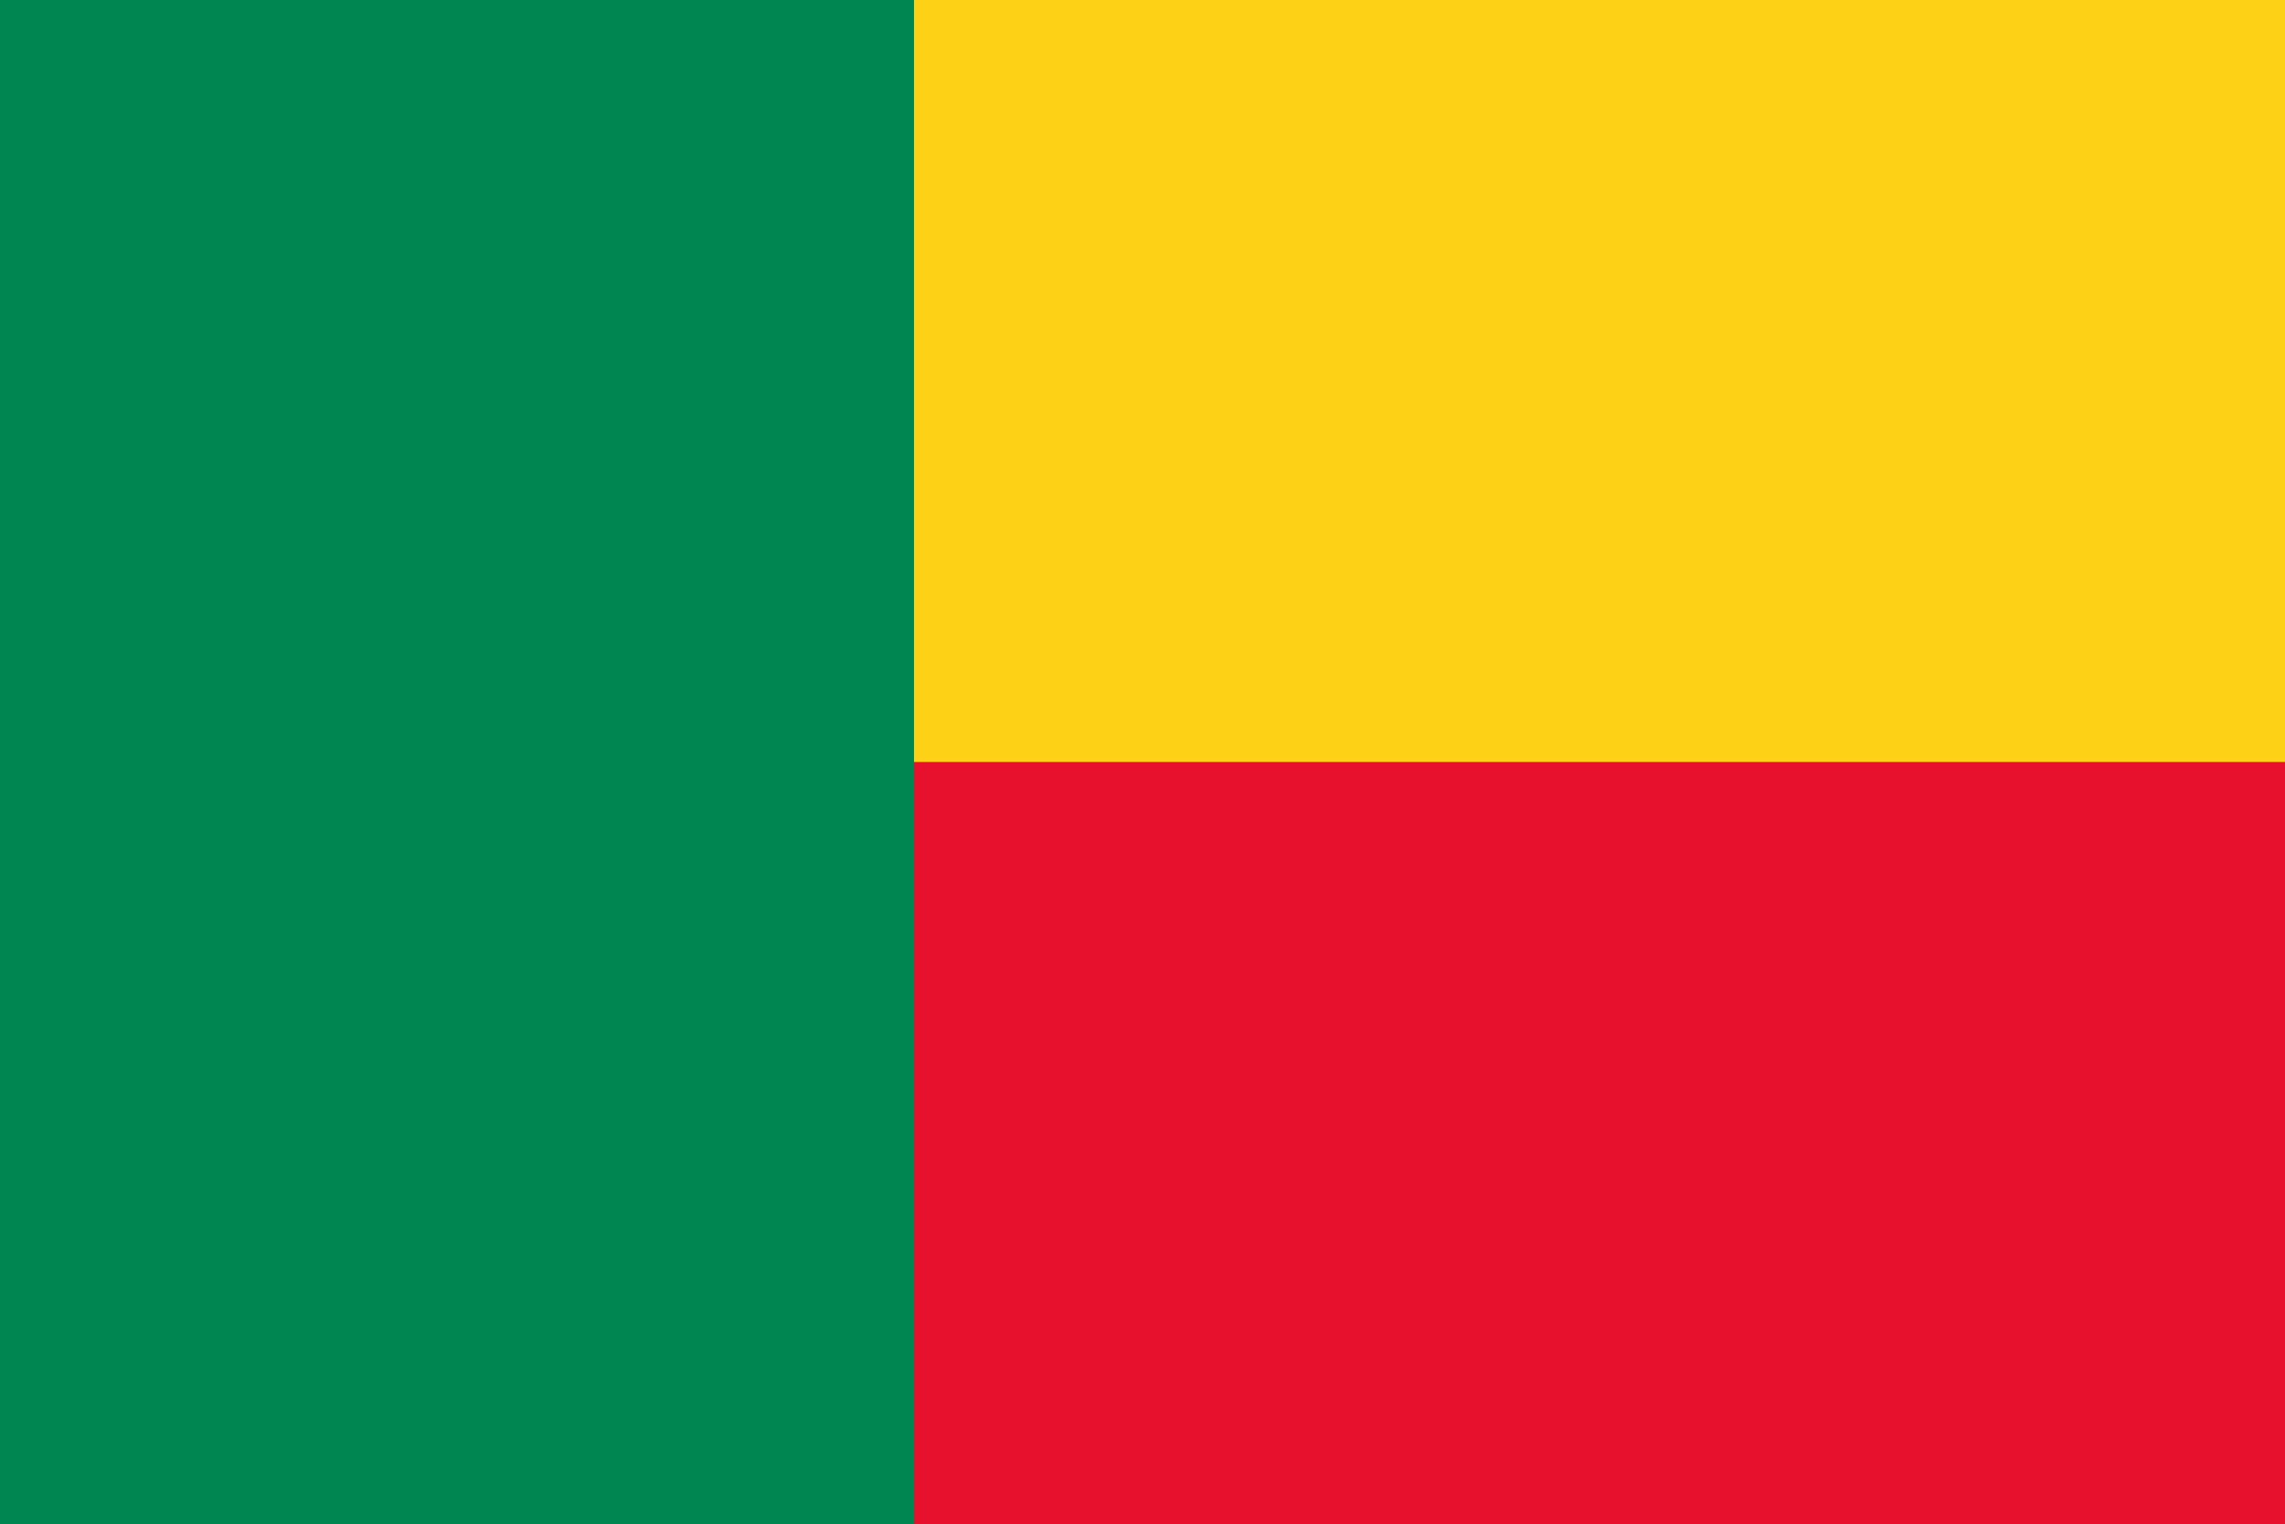
PRAYING FOR
BENIN

Slide 3
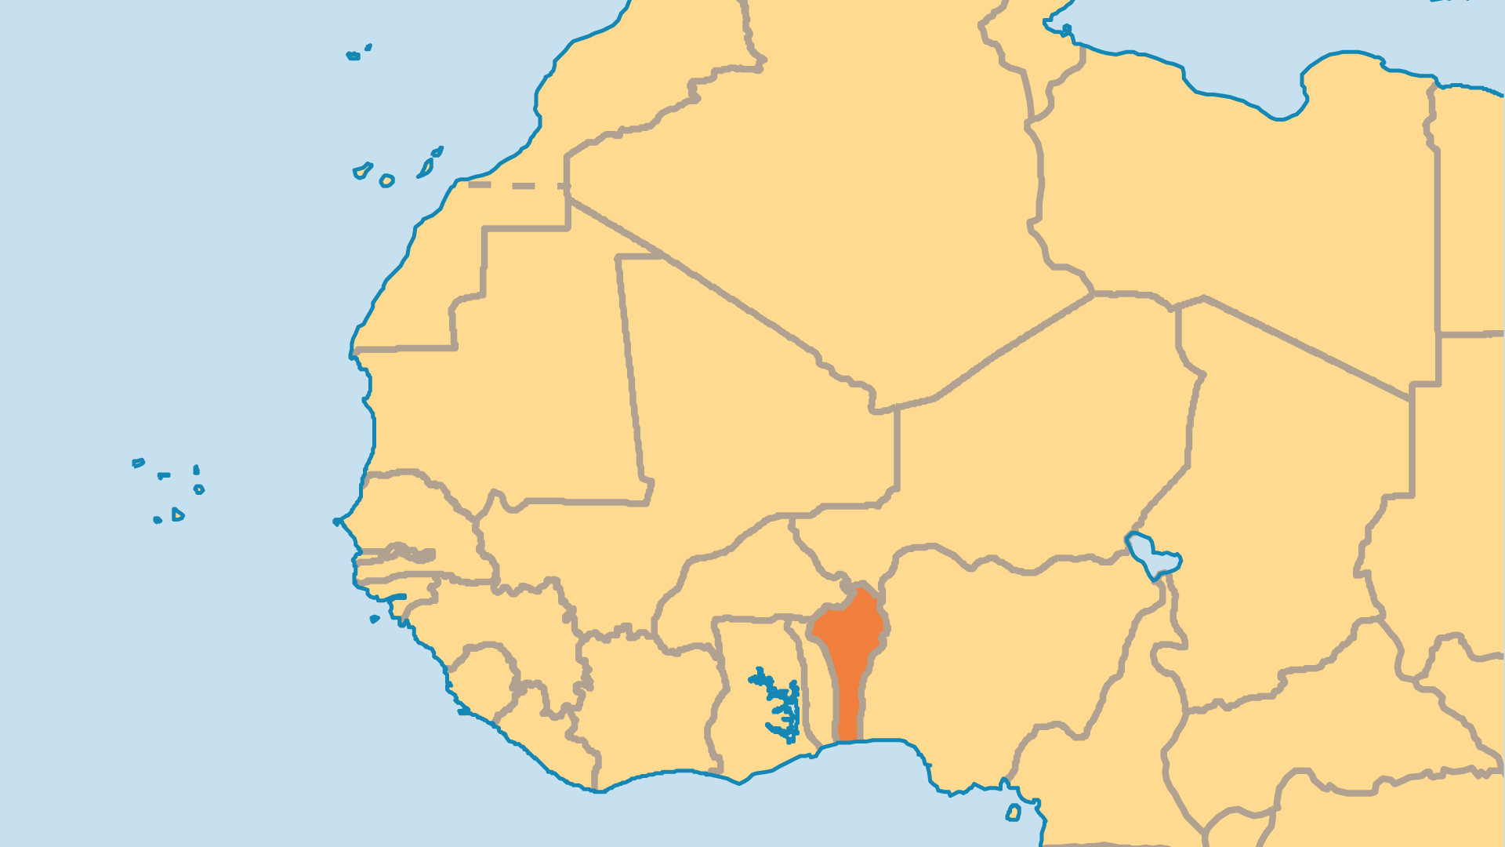
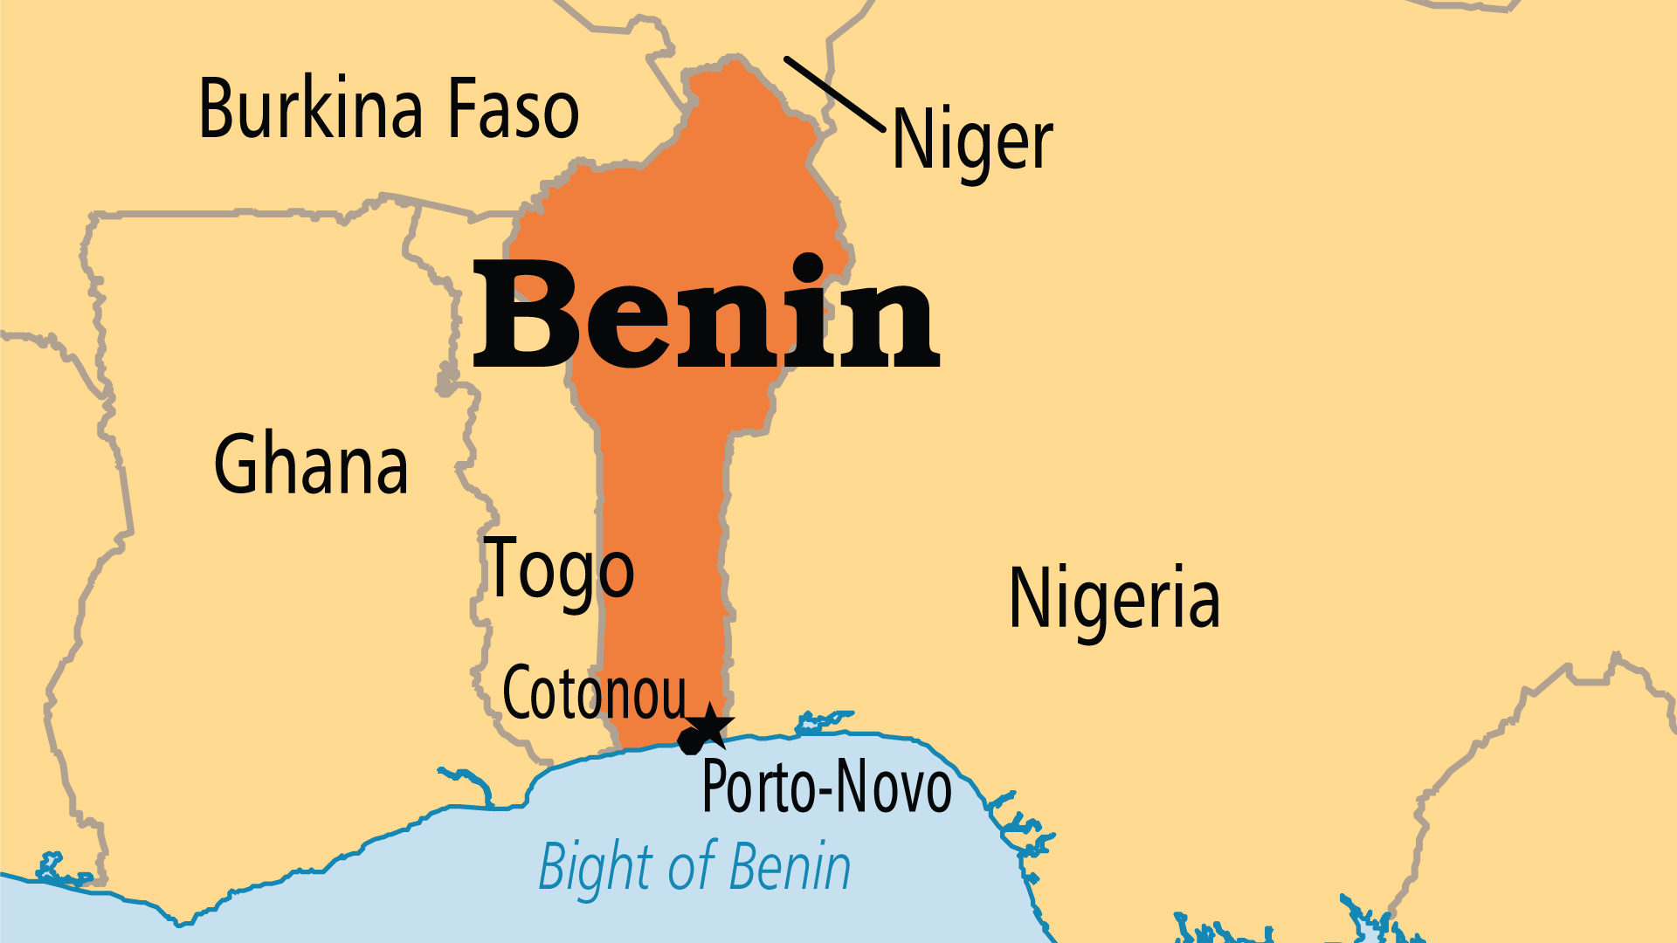
KEY STATS
Capital: | Porto-Novo
Population: | 14,814,460
Pop Under 15 Yrs: | 42.2 %
Official Language: | French
Languages: | 56
Literacy Rate: | 38 %
Life Expectancy: | 59.8 yrs (220th/236)
% Christian: | 39.9 %
% Evangelical: | 8.3 %
Largest Religion: | Christian
% Unevangelized: | 25 %

Slide 4

FOR PRAYER
Benin is one of the world's least-developed countries. Almost 75% of economic activity is illegal with ties to Nigerian interests. Some suspect that tens of thousands of children are smuggled out of Benin each year to be sold as child labourers. Pray for justice and righteousness to grow in Benin, and for Nigeria's influence to be positive and godly. Despite these challenges, Benin is one of the few places where there is freedom, receptivity, and fruitfulness in reaching Muslim peoples with the Good News.
Want to know more? Go to www.operationworld.org

