Slide 1




Slide 2

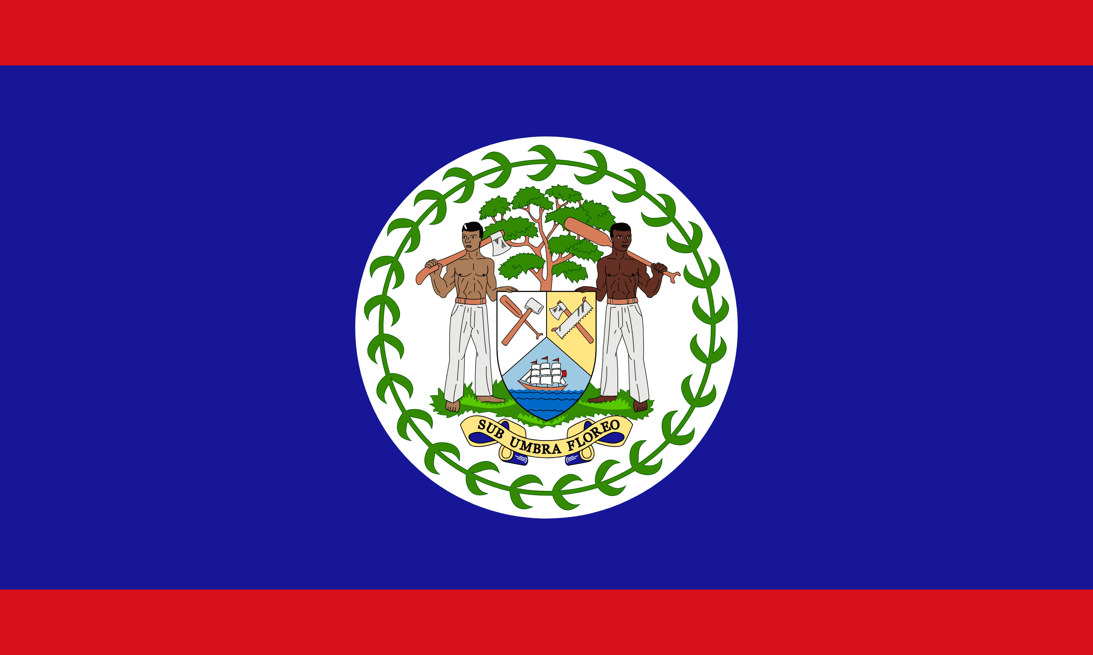
PRAYING FOR
BELIZE

Slide 3
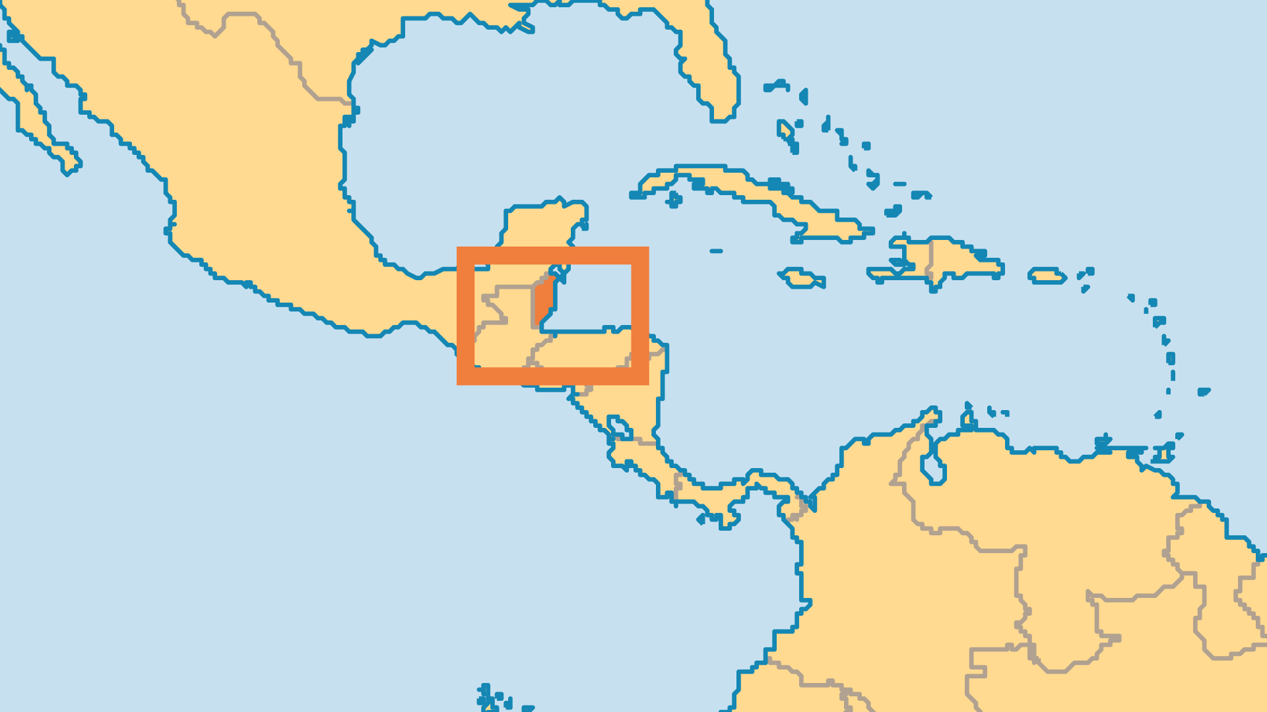
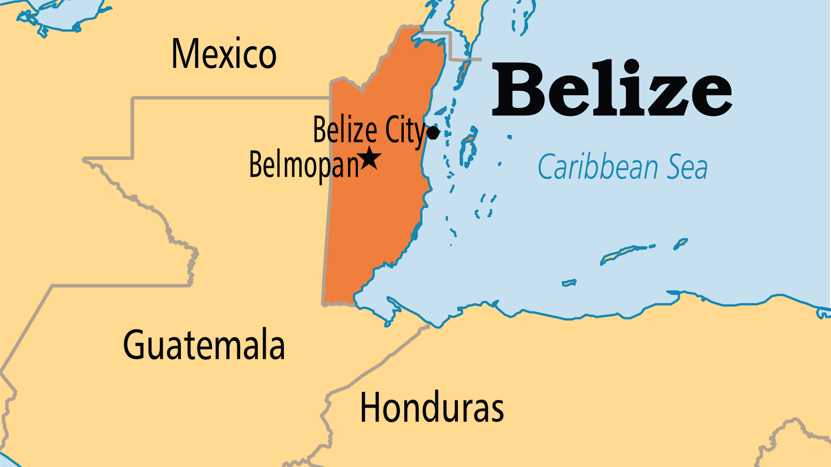
KEY STATS
Capital: | Belmopan
Population: | 422,924
Official Language: | English. Spanish spoken by the majority of the population
Languages: | 12
Literacy Rate: | 89 %
HDI Ranking: | 123/193
% Christian: | 83.9 %
% Evangelical: | 18.8 %
% Unevangelized: | 2 %

Slide 4

FOR PRAYER
Most Belizeans profess Christianity, but only 10% of the population attend church regularly. People need to encounter the true gospel in ways that are meaningful and sensitive to their culture. The Spanish-speaking immigrants sometimes mix Truth with superstitions, the Mayans with paganism, and the Garifuna with black magic. Pray for revival and spiritual conviction for any confusion in beliefs.
Want to know more? Go to www.operationworld.org

