Slide 1




Slide 2

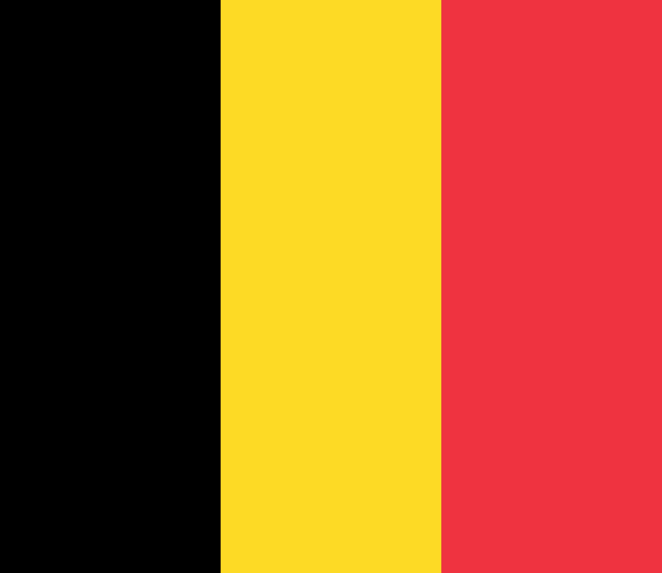
PRAYING FOR
BELGIUM

Slide 3
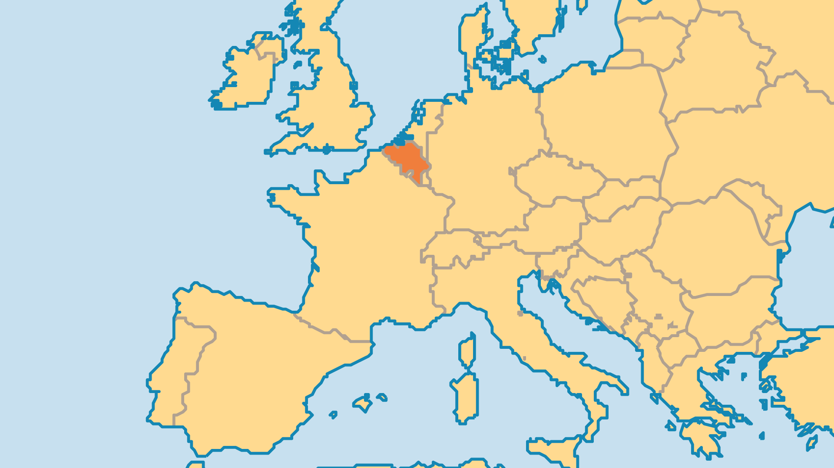
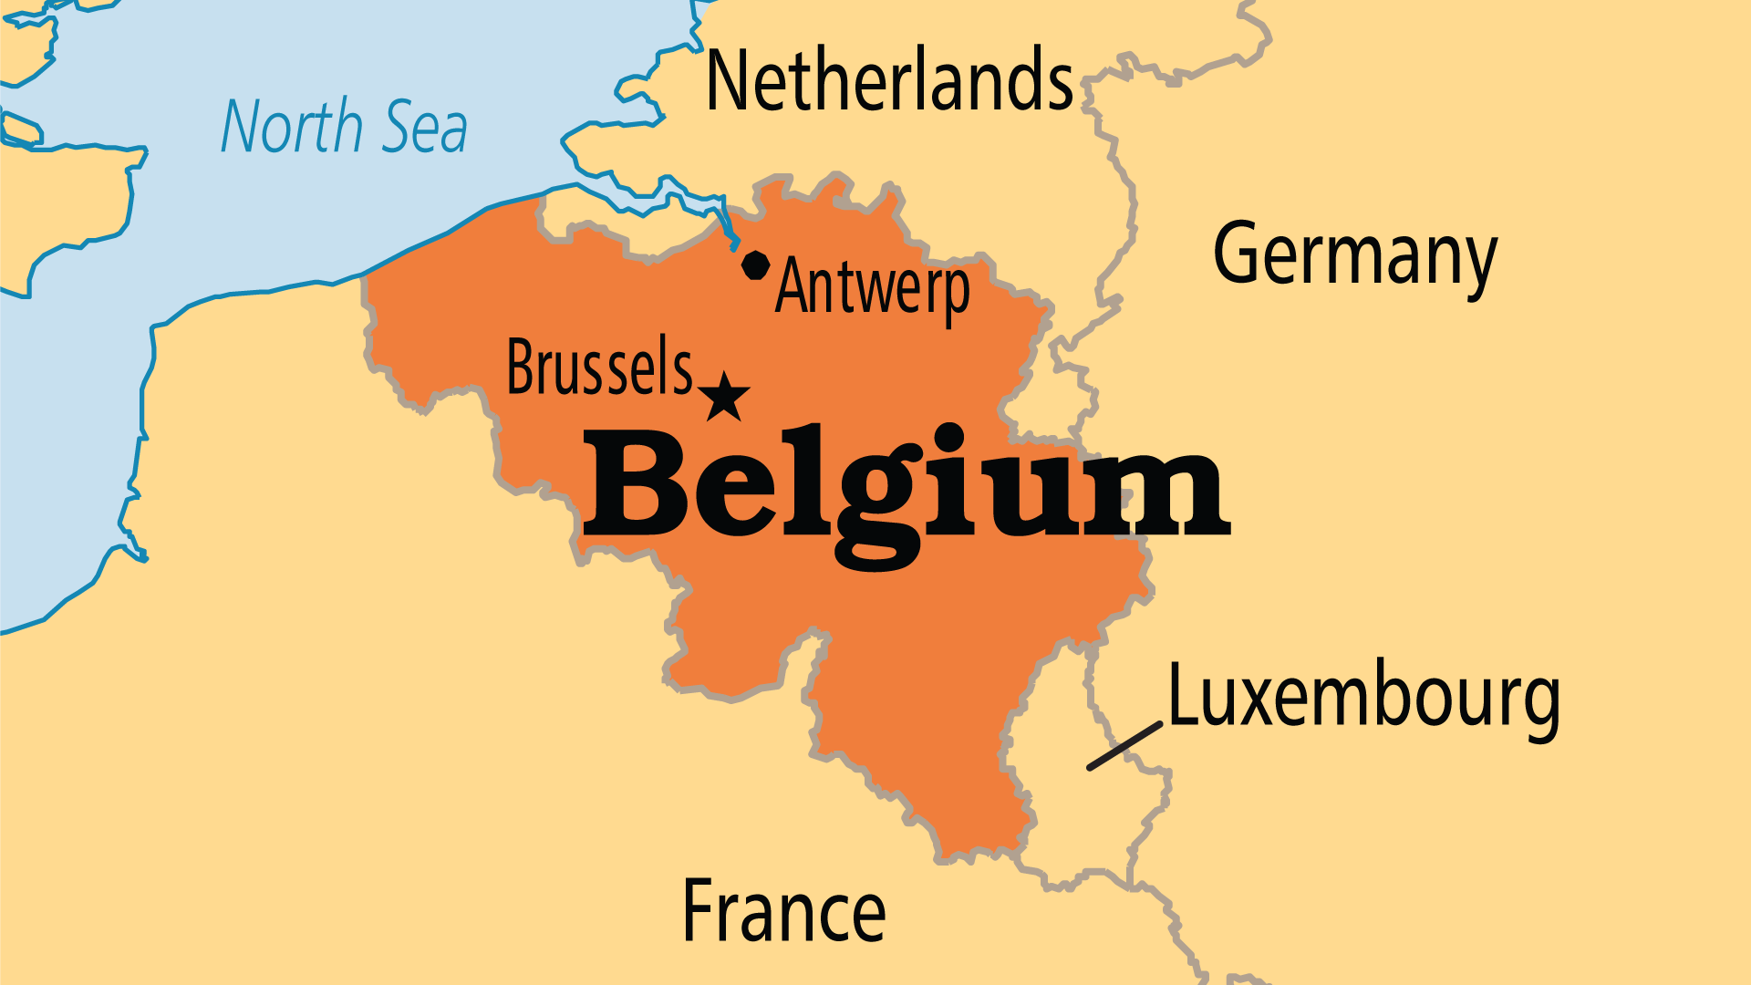
KEY STATS
Capital: | Brussels
Population: | 11,758,603
% Urban: | 98.3 %
Official Language: | Dutch, French and German
Literacy Rate: | 100 %
Life Expectancy: | 81.9 yrs (25th/236)
HDI Ranking: | 13/193
% Christian: | 62.7 %
% Evangelical: | 1.2 %
% Unevangelized: | 5 %

Slide 4

FOR PRAYER
Belgium is a deeply divided nation. For 2,000 years its land has stretched across the cultural divide between the Latin/Romance world and the Germanic world. The Walloon (south) and Flemish (north) peoples speak different languages affecting the politics, economy, religious life, and worldviews of both communities. New immigrant communities increase the complexity. Some fear the country could break apart. Pray that national leaders have wisdom to address this challenge. Pray that the Church might display unity and bring about true reconciliation and peace.
Want to know more? Go to www.operationworld.org

Slide 5
FOR PRAYER
The secular worldview seems to rule in Belgium, and godless lifestyles have become the norm in much of the country. Atheists and non-religious now number 31% of society. While almost half of the population consider themselves Catholic, only 7% attend mass. Mainline Protestant Churches also lose members. For many centuries up until 1960 the Catholic Church discouraged use of the Bible. But in 2006, after the release of a new Bible translation, French and Flemish Bible Societies worked together to share the Bible around the nation. Pray that the Word of God might take root deeply in Belgian society.

